Slide 1
Thrombosis
Dr. Nisreen Abu Shahin
Assistant Professor of Pathology
Pathology Department
University of Jordan

Slide 2
Normal blood vessel histology

Slide 3
Artery (A) vs vien (V)
The thickness of the tunica media is larger in arteries than in veins because blood pressure inside them is higher and to pump blood to down stream tissues (the tissues supplied by this artery)

Slide 4
Thrombosis
** the doc. read everything in the slides A
Some of them might result in the activation of the other and they are often found in combinations.
Pathogenesis (called Virchow's triad):
Endothelial* Injury ( Heart, Arteries)
Stasis (abnormal blood flow)
Blood Hypercoagulability
* Endothelial cells are special type of cells that cover the inside surface of blood vessels and heart (including the valves).
-They are not a type of blood cells.
-Their function (when healthy and not injured) is protection against thrombosis by secreting and controlling certain mediators that prevent the formation of blood clot and when formed they help to lyse it

Slide 5
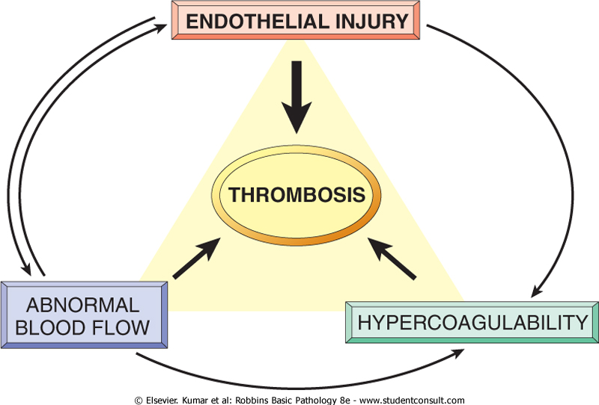

Slide 6
Contribution of Endothelial Cells to Coagulation
Intact endothelial cells maintain liquid blood flow by: 1- inhibiting platelet adherence
2- preventing coagulation factor activation
3- lysing blood clots that may form.
Endothelial cells can be stimulated by direct injury or by various cytokines that are produced during inflammation.
Endothelial injury results in:
1- expression of procoagulant proteins (tissue factor and vWF)→local thrombus formation.
2- exposure of underlying vWF and basement membrane collagen→ platelet aggregation and thrombus formation.
Endothelial = endothelial stimulation injury

Slide 7
Endothelial Cell Injury and exposure of subendothelial collagen
Adherence of platelets
Release of tissue factor

Slide 8
Response of Vascular Wall Cells to Injury
After any tissue damage inflammation and then healing will occur
Injury to the vessel wall results in a healing response, involving:
1- Intimal expansion by proliferating SMCs and newly synthesized ECM.
2- The recruitment and activation of the SMCs in which involves signals from cells (e.g., ECs, platelets, and macrophages), as well as mediators derived from coagulation and complement cascades.
Pathologic effect of vascular healing→ Excessive thickening of the intima → luminal stenosis & blockage of vascular flow

Slide 9
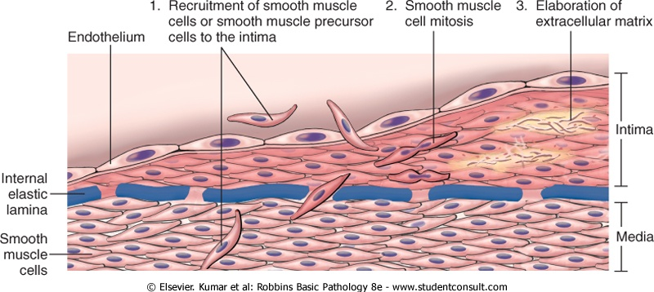
Narrowing of the lumen
Thicken-ing of the vessel wall
Normal blood vessel

Slide 10
Causes of Endothelial injury
Valvulitis (inflammation of heart valves)
MI (myocardial infarction)
Atherosclerosis
Traumatic or inflammatory conditions
Increased Blood Pressure
Endotoxins (LPS→ found in the cell wall of gram –ve bacteria)
Hypercholesterolemia (the doc. Says it acts as an antigorus body :/). Might cause atherosclerosis then thrombosis ?
Radiation
Smoking
Mainly caused by
Physical injury
Induction of inflammation
Physical injury

Slide 12
Stasis
Stasis is a major factor in venous thrombi
Normal blood flow is laminar (platelets flow centrally in the vessel lumen, separated from the
endothelium by a slower moving
clear zone of plasma)
Stasis and turbulence cause the followings:
Center
Periphery
Easier to occur in veins because of the lower musculature
Platelets - RBCS-WBCS- clear zone
In the case of stasis this arrangement is disrupted, and platelets come in contact with the endothelial cells and clot forms
Stasis and turbulence
Disrupt normal blood flow
Prevent dilution of activated clotting factors by fresh flowing blood.
Retard the inflow of clotting factor inhibitors
Promote endothelial cell injury.
Meaning that the clotting factors will work for a longer time
Stasis results in hypoxia caused by the decreased oxygen tension --> endothelial injury

Slide 13
Causes of Stasis
Atherosclerosis
Aneurysms (enlargement of an artery)
Myocardial Infarction ( Non-cotractile fibers)
Mitral valve stenosis (atrial dilation)
Hyper viscosity syndrome (PCV and Sickle Cell anemia)

Slide 14
Hypercoagulability
A. Genetic (primary):
mutations in the factor V gene and the prothrombin gene are the most common
B. Acquired (secondary):
multifactorial and is therefore more complicated
causes include: Immobilization, MI, AF, surgery, fractures, burns, Cancer, Prosthetic cardiac valves …etc
Mutations In clotting factors ( have increased activity) or clotting factors inhibitors(have decreased activity)
causes
Might be due to thrombus formation when they metastasize, Or clotting factors production (paraneoplastic syndrome)

Slide 15
Morphology of thrombi
Can develop anywhere in the CVS (e.g., in cardiac chambers, valves, arteries, veins, or capillaries).
Arterial or cardiac thrombi→ begin at sites of endothelial injury or turbulence; and are usually superimposed on an atherosclerotic plaque
Venous thrombi → occur at sites of stasis. Most commonly the veins of the lower extremities (90%)
Thrombi are focally attached to the underlying vascular surface.
The propagating portion of a thrombus is poorly attached →fragmentation and embolus formation

Slide 16
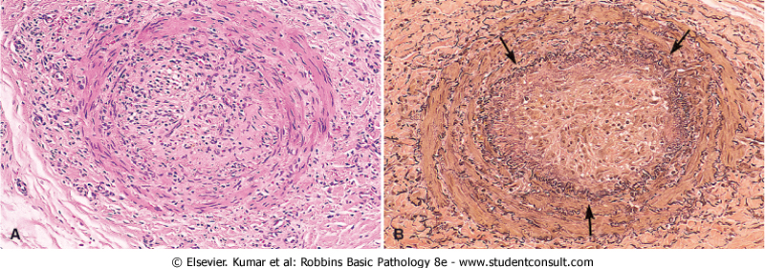
ARTERY WITH AN OLD THROMBUS. A, H&e-stain. B, Stain For Elastic Tissue. The Original Lumen Is Delineated By The Internal Elastic Lamina (Arrows) And Is Totally Filled With Organized Thrombus, Now Punctuated By A Number Of Recanalized Channels (White Spaces).
Read this after getting through organization and recanalization in slide 21

Slide 17
lines of Zahn
Thrombi can have grossly (and microscopically) apparent laminations called lines of Zahn; these represent pale platelet and fibrin layers alternating with darker erythrocyte-rich layers.
Such lines are significant in that they represent thrombosis of flowing blood (can potentially distinguish antemortem thrombosis from postmortem clots)
postmortem blood clots are bland non-laminated clots (no lines of Zahn)
They appear in antemortem blood clots, and only used to differentiae between ante- and post-mortem clots in forensics

Slide 18
lines of Zahn

Slide 19
Mural thrombi
Thrombi occurring in heart chambers or in the aortic lumen.
Causes include: Abnormal myocardial contraction (e.g. arrhythmias, dilated cardiomyopathy, or MI) or endomyocardial injury (caused by myocarditis, catheter trauma)
Vegetations
Thrombi on heart valves are called vegetations:
Types:
1- infectious (Bacterial or fungal blood-borne infections)→(e.g. infective endocarditis,).
2-Non-bacterial thrombotic endocarditis occur on sterile valves.

Slide 20
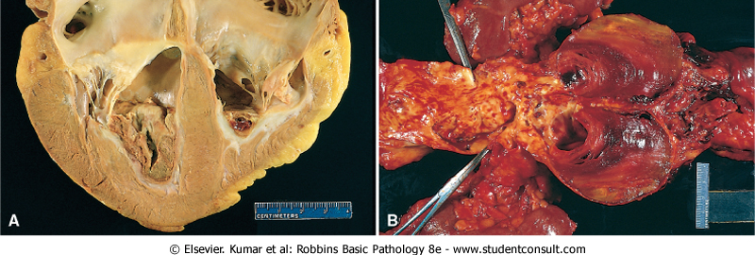
Mural thrombi

Slide 21
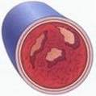
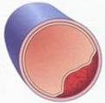
Fate of thrombi
Propagation→ accumulate additional platelets and fibrin, eventually causing vessel obstruction leading to hypoxia and necrosis
Embolization→ Thrombi dislodge or fragment and are transported elsewhere in the vasculature
Dissolution→ Thrombi are removed by fibrinolytic activity (only in recent thrombi) the ones formed in less than 5 hours
Organization* and recanalization→ Thrombi induce inflammation and fibrosis. These can recanalize (re-establishing some degree of flow),
or they can be incorporated into a thickened vessel wall
*Organization refers to the ingrowth of endothelial cells, smooth cells and fibroblasts into the fibrin rich thrombus.
5. Superimposed infection (Mycotic aneurysm)
Less compared to the other fates
1
1
2
Capillary sized channels in the thrombus
thrombus
2
Thrombus incorporated into the vessel wall

Slide 22
Venous thrombi
(veins of the legs) are most common
Superficial: e.g. Saphenous veins.
- can cause local congestion, swelling, pain, and tenderness along the course of the involved vein, but they rarely embolize
Deep: e.g. Popliteal, Femoral and iliac vein.
more serious because they may embolize
can occur with stasis or in a variety of hypercoagulable states

