Slide 1
Medical Virology
Lower Respiratory Tract Infections
Dr. Sameer Naji, MB, BCh, PhD (UK) Dean Assistant
Head of Basic Medical Sciences Dept.
Faculty of Medicine The Hashemite University

Slide 2
Viral
Lower Respiratory Tract Infections
Additions are in Italic Green

Slide 3
Structures of the Lower Respiratory System
Components of the lower respiratory system
Larynx
Trachea
Bronchi
Alveoli
Diaphragm
Various protective components
Ciliated mucous membrane, alveolar macrophages, and secretory antibodies (IgA)

Slide 4
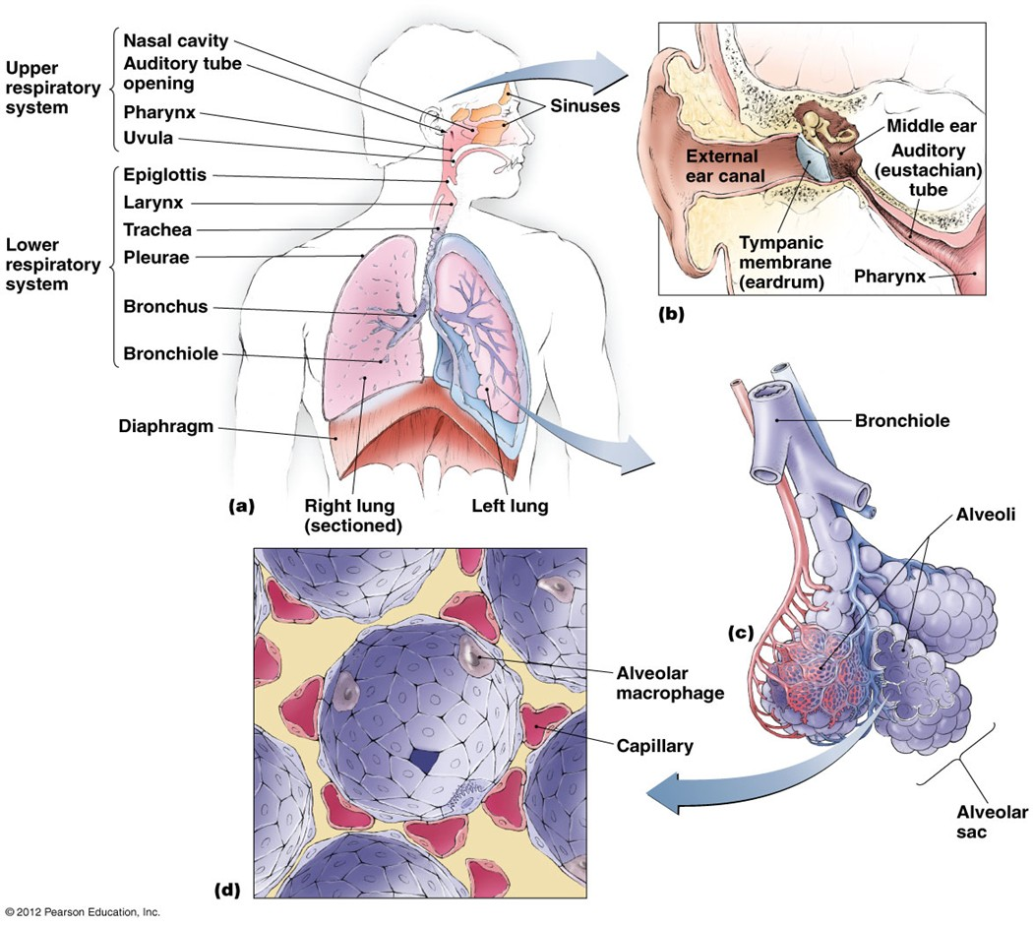
Structures of the respiratory system-overview

Slide 5
Important Viral Causes of Lower Respiratory Infections
Influenza (by dr. ashraf)
Para-influenza
Respiratory syncytial virus
SARS
MERS
Human metapneumovirus (2001) common
in comprised children and elderly persons
No etiologic agent found (33%)

Slide 6
Para influenza Viruses
It causes Croup (Acute Laryngotracheobronchitis/ Laryngotrachiaites (the lung is involved)) and pneumonia in children
Common cold – like disease in adults and children.
5 subtypes: 1, 2, 3 (most important) 4a and 4b
Surface spikes consist of H(hemagglutinin) , N(neuroaminidase) and fusion proteins. H and N on the same spike while fusion protein is on a different spike.

Slide 7
Epidemiology
Transmission: respiratory droplets, winter months. (viruses have seasonal variations)
Croup is the commonest clinical manifestation of parainfluenza virus infection, caused by subtypes 1 and 2.
It occurs in children (below 3 years).
Parainfluenza 3 is prone to produce bronchiolitis and pneumonia (so it causes infection in more lower areas of the respiratory tract) .
The majority of infections with parainfluenza viruses are subclinical.

Slide 8
Clinical Findings
Croup
Harsh cough (larynx is edematous)
Inspiratory stridor (hardly breathing)
Hoarse voice (because of edema )
SO CROUP IS AN EMERGENCY CASE – send your patient to hospital
Patients are usually afebrile.
About 80% of patients exhibit runny nose (called coriza) 1 to 3 days before the onset of the cough (it can be messed with common cold). Usually, respiratory symptoms subside within 1 or 2 days.

Slide 9
In addition to croup, parainfluenza viruses cause
common cold,
pharyngitis,
otitis media,
bronchitis
pneumonia.
Other viruses can induce croup, such as influenza viruses, RSV, measles and chickenpox.
Parainfluenza virus infections in adults are relatively uncommon, and symptoms are usually less severe in adults than children .

Slide 10
Laboratory Diagnosis
Croup is a well-defined, easily recognized clinical entity. (if you face a patient with croup outside your clinic, let him breathe a moistened air)
Cell culture isolation
Immunoflurescence (antigen-antibody reaction – needs UV microscope)
Antibody rising titre using HAI or ELISA (there should be 4x increase in titre)

Slide 11
Treatment
Hospital admission
Nursing in plastic tents supplied with cool, moistened oxygen (first step in treatment)
Severe respiratory obstruction may require endotracheal intubation followed by a tracheotomy.

Slide 12
Respiratory Syncytial Virus Infection
RSV causes Pneumonia and bronchiolitis in infants
(infant<1 year; neonate< 28 days)
(baby<7 months can have pneumonia associated with chlamydia trachomatis)
Fusion protein causes cells to fuse, forming multinucleated giant cells (syncytia)
RSV causes outbreaks of respiratory infections
every winter.
RSV is a major nosocomial pathogen in pediatric wards (because it’s a droplet infection).
The pathogen may be introduced by infected infants who are admitted from the outside and adults, especially members of staff with mild infections.

Slide 13
Transmission
Respiratory droplets and direct contact of contaminated hands with the nose or eye
The incubation period is usually 3 - 6 days (in parainfluenza 1 to 2 or 3 days)
The virus spreads along the epithelium of the respiratory tract, mostly by cell-to-cell transfer
Pathogenesis
Virus causes syncytia to form in the lungs
Immune response to RSV further damages the lungs

Slide 14
CLINICAL FINDINGS
RSV is the most common cause of severe lower respiratory disease in young infants. It is responsible for 50 - 90% of cases of bronchiolitis, 5 - 40% of pneumonias and bronchitis and less than 10% of croups in young children.
Young children
otitis media
Older children & adults
common cold like – disease
Infants
Febrile URTI
Lower respiratory tract involvement
Worsening cough
Tachypnoea (fast breathing) and dyspnoea
In bronchiolitis, the respiratory rate may be elevated, with wheezing and hyperinflation. Cyanosis may be present in severe cases (because of tachypnoea ).

Slide 15
Risk groups for fatal RSV infection
Infants with congenital heart disease
Infants with underlying pulmonary disease
especially bronchopulmonary dysplasia
Immunocompromized infants
children who are immunosuppressed or have a congenital immunodeficiency disease.
Nephrotic syndrome (kidney leaking protiens) and cystic fibrosis (a genetic disease – prone to bacterial infection with the mucoid type pseudomonas aeruginosa)

Slide 16
Complications
Apnea ((توقف التنفس
occurs in approximately 20% of cases (premature infants). The apnea is non-obstructive and develops at the onset or within the first few days of illness.
The most common complication is prolonged alterations in pulmonary function, which may lead to chronic lung disease in later life.

Slide 17
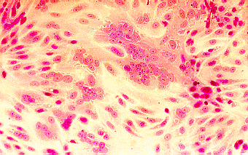
LABORATORY DIAGNOSIS
Immunoflurescence on smears of respiratory secretions
ELISA for detection of RSV antigens
Isolation in cell culture (multinucleated giant cells or syncytia)
Rise of antibody titer. (4x)

Slide 18
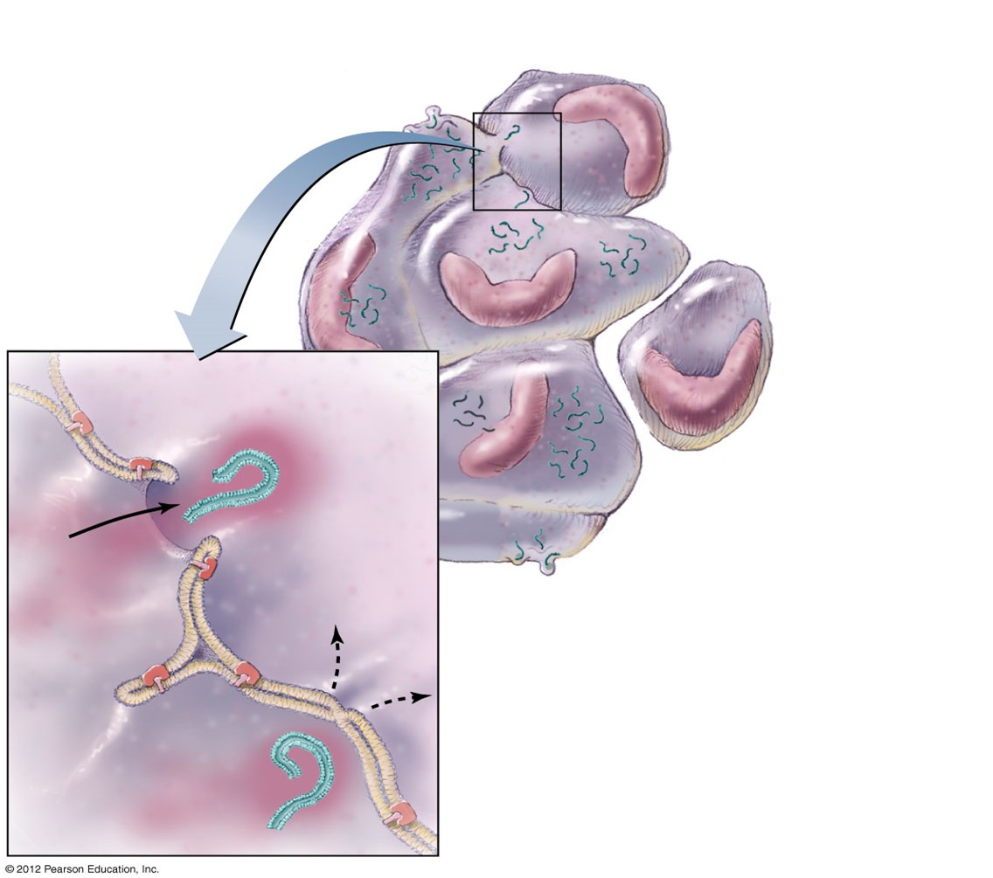
A syncytium forms when RSV triggers infected cells to fuse with uninfected cells

Slide 19
Treatment
All infants with RSV lower respiratory tract disease are hypoxemic and oxygen should be given to hospitalized infants
Aerosolized ribavirin in severely ill infants
RespiGam contains a high concentration of protective antibodies against RSV. It is given for the prevention in children under 24 months with bronchopulmonary dysplasia or a history of premature birth.

