Slide 1
VALVULAR HEART DISEASE
results in stenosis or insufficiency (regurgitation or incompetence), or both.
Stenosis : failure of a valve to open completely, obstructing forward flow.
- almost always due to a primary cuspal abnormality and is virtually always a chronic process (e.g., calcification or valve scarring).

Slide 2
Insufficiency : failure of a valve to close completely→ regurgitation (backflow) of blood.
It can result from either:
  intrinsic disease of valve cusps (e.g., endocarditis)
  disruption of supporting structures (e.g., the aorta, mitral annulus, tendinous cords, papillary muscles, or ventricular free wall) without primary cuspal injury.
  It can be either: Abrupt→ e.g. due to chordal rupture
  Insidious→ e.g. due to leaflet scarring and retraction

Slide 3
Acquired Valve disease
The mitral valve is the most common target of acquired valve diseases.
Clinical signs of valve disease:
- abnormal heart sounds called murmurs
- palpated heart sound (thrills) →severe lesions
- clinical signs according to the involved valve

Slide 4
Valvular abnormalities can be congenital or acquired.
The most common congenital valvular lesion is bicuspid aortic valve
bicuspid aortic valve:
only two functional cusps instead of the normal three
1% to 2% of all live births
associated with a number of genetic mutations
Asymptomatic in early life; however, the valve is more prone to early and progressive degenerative calcification

Slide 5
The most important causes of acquired valvular diseases are post-inflammatory scarring of the mitral valves and aortic valve due to (rheumatic fever)→ 2/3 of all valve disease.

Slide 6
Degenerative Valve Disease
Degenerative changes include
Calcifications
Alterations in the ECM
- Calcific aortic degeneration is the most common cause of aortic stenosis. it typically begins to manifest when patients reach their 70s and 80s; onset with bicuspid aortic valves is at a much earlier age (often 40 to 50 years).

Slide 7
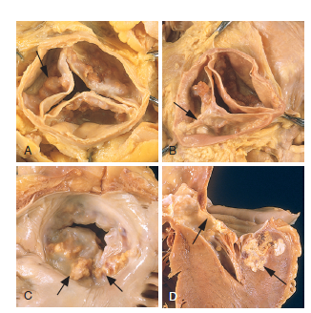
Degenerative Valve Disease

Slide 8
Rheumatic Valvular Disease
is an acute, immunologically mediated, multisystem inflammatory disease that occurs after group A β-hemolytic streptococcal infections (usually pharyngitis, rarely skin infection).
Rheumatic heart disease is the cardiac manifestation of rheumatic fever.

Slide 9
Rheumatic Valvular Disease
valvular inflammation and scarring produces the most important clinical features
PATHOGENESIS: a hypersensitivity reaction due to antibodies directed against group A streptococcal molecules that also are cross-reactive with host antigens

Slide 10
MORPHOLOGY- acute rheumatic fever
characterized by discrete inflammatory foci within a variety of tissues.
Myocardial inflammatory lesions = Aschoff bodies are pathognomonic for rheumatic fever (( collections of lymphocytes (T cells), plasma cells, and activated macrophages called Anitschkow cells with rare zones of fibrinoid necrosis))
Anitschkow cells: macrophages with abundant cytoplasm and central nuclei with chromatin condensed to form a slender, wavy ribbon (so-called caterpillar cells).

Slide 11
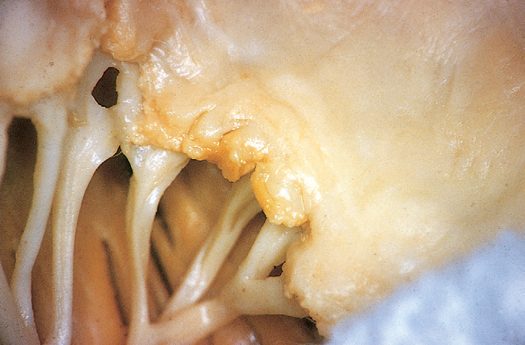
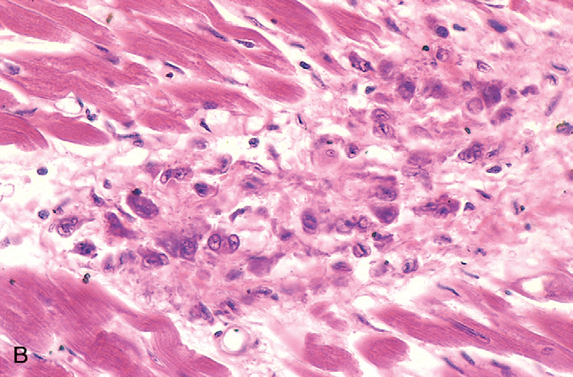
Acute rheumatic heart disease

Slide 12
MORPHOLOGY- acute rheumatic fever
acute rheumatic fever→ Aschoff bodies found in any of the three layers of the heart-pericardium, myocardium, or endocardium (including valves), or allover pancarditis.
Valve involvement →fibrin deposition along the lines of closure → regurgitation

Slide 13
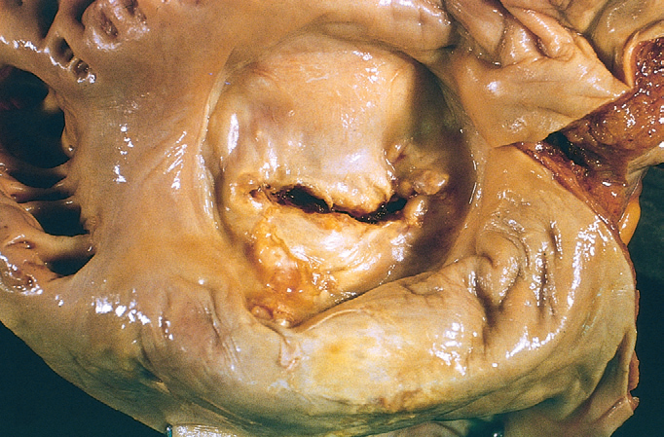
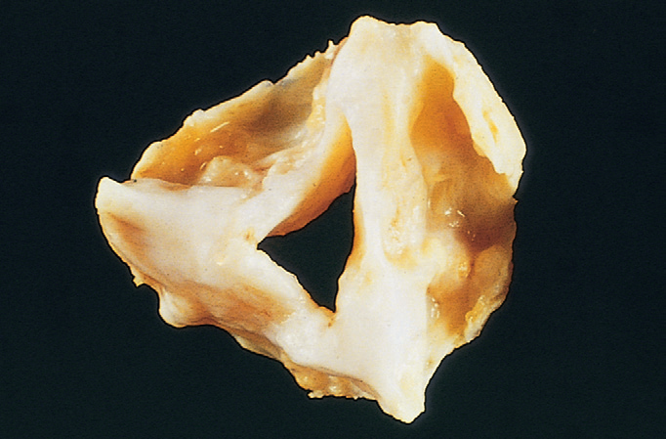
Chronic rheumatic heart disease

Slide 14
Chronic rheumatic heart disease
characterized by organization of inflammation and scarring.
Aschoff bodies are rarely seen in chronic RHD since they are replaced by fibrous scar
mitral valves is most commonly affected→ fishmouth" or "buttonhole" stenoses
Microscopic: neovascularization and diffuse fibrosis that obliterates the normal leaflet architecture

Slide 15
The most important functional consequence of chronic RHD is valvular stenosis (most common) and regurgitation (less common)
mitral valve alone: 70% of cases (most common)
combined mitral and aortic disease: 25%
tricuspid valve: less frequent, less severe
pulmonic valve: almost always escapes injury.
Complications of mitral stenosis:
- dilated left atrium - atrial fibrillation
- mural thrombi.
Complications of aortic valve disease:
left-sided heart failure
right ventricular hypertrophy and failure.

Slide 16
Acute rheumatic fever- clinical picture
occurs most often in children 80%
(20%→ adults; arthritis is the predominant feature)
principal clinical manifestation is carditis.
symptoms begin 2- 3 weeks after streptococcal infection:
fever; migratory polyarthritis (one large joint after another followed by spontaneous resolution with no residual disability).
cultures are (-) for streptococci at the time of symptom onset

Slide 17
Acute rheumatic fever- clinical picture
serum titers to streptococcal antigens (e.g., streptolysin O or DNAase) are elevated.
clinical signs of carditis→ pericardial friction rubs; arrhythmias; myocarditis; cardiac dilation; functional mitral insufficiency and CHF.
less than 1% of patients die of acute rheumatic fever.

Slide 18
The diagnosis of acute rheumatic fever
= (serologic evidence of previous streptococcal infection + two or more of the so-called Jones criteria).
Jones criteria:
Carditis
migratory polyarthritis of large joints
subcutaneous nodules
erythema marginatum skin rashes
Sydenham chorea, a neurologic disorder characterized by involuntary purposeless, rapid movements.
Minor criteria such as fever, arthralgias, ECG changes, or elevated acute phase reactants also can help support the diagnosis.

Slide 19
chronic rheumatic carditis- long-term prognosis
manifest itself clinically years or decades after initial episode of rheumatic fever.
signs and symptoms depend on which cardiac valve(s) are involved: -cardiac murmurs - cardiac hypertrophy
- CHF - arrhythmias (esp. A. fib.) - thromboembolism (mural thrombi).
scarred and deformed valves are more susceptible to infective endocarditis (IE).
prognosis is highly variable.
Management: Surgical repair or replacement of diseased valves

Slide 20
Infective endocarditis (IE)
Microbial invasion of heart valves or endocardium, with destruction of underlying cardiac tissues→ cause bulky, friable vegetations (necrotic debris+ thrombus+ organisms).
Common sites of infection: valves, endocardium, aorta, aneurysms; prosthetic devices.
The vast majority of cases→ caused by bacteria.

Slide 21
Infective endocarditis (IE)
Other cases: fungi, rickettsiae (agents of Q fever), and chlamydial species
classified into acute and subacute, based on pace and severity of clinical course
How? 1- the virulence of the responsible microbe
2- whether underlying cardiac disease is present.

Slide 22
Acute versus subacute
Acute endocarditis
a highly virulent organism (S. aureus is most common)
attack a previously normal valve
substantial morbidity and mortality even with appropriate antibiotic therapy and/or surgery.
Subacute endocarditis
organisms of low virulence (60%→ Streptococcus viridans)
a previously abnormal valve (e.g. scarred or deformed)
Insidious disease; follows a protracted course of weeks to months; most patients recover after appropriate antibiotic therapy

Slide 23
MORPHOLOGY
both acute and subacute disease→ friable, bulky, and potentially destructive vegetations (fibrin, inflammatory cells, and microorganisms) on heart valves
aortic and mitral valves are the most common sites
tricuspid valve is a frequent target in I.V. drug abusers.
Complications:
1- emboli (friable nature of the vegetations).
2- abscesses at the sites where emboli lodge
3- septic infarcts
4- mycotic aneurysms.

Slide 24
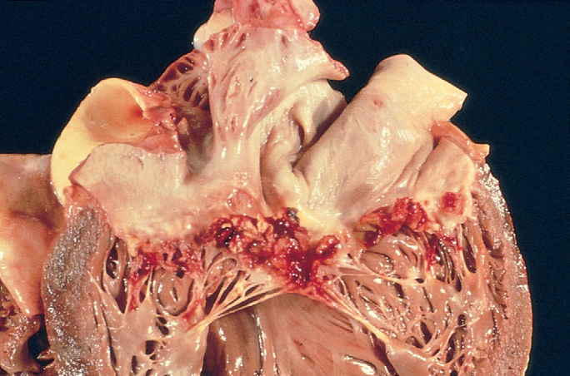
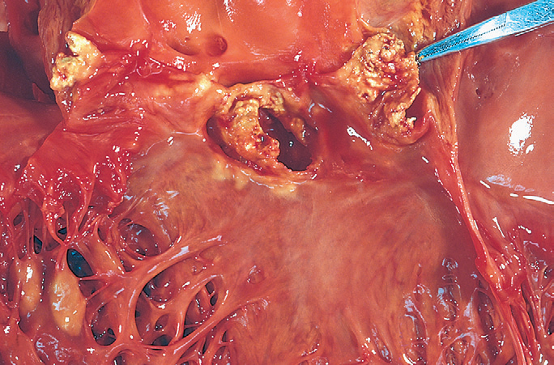
Infective endocarditis (IE)

Slide 25
Clinical Features
Acute →a stormy onset including rapidly developing fever, chills, weakness, and lassitude; murmurs
Fever is the most consistent sign of infective endocarditis (almost 100%)
microemboli in different target tissues:
Petechia (skin)
nail bed (splinter hemorrhages)
retinal hemorrhages (Roth spots)
painless palm or sole erythematous lesions (Janeway lesions)
painful fingertip nodules (Osler nodes)

Slide 26
Clinical Features
Subacute: nonspecific fatigue, weight loss, and a flulike syndrome; splenomegaly; murmurs
Diagnosis = (positive blood cultures + echocardiographic (echo) findings)

Slide 27
Prognosis
depends on the infecting organism and on whether or not complications develop.
untreated, infective endocarditis generally is fatal.
Treatment: appropriate long-term (6 weeks or more) antibiotic therapy and/or valve replacement
Mortality :
low-virulence organisms→ cure rate is 98%
enterococci and Staph. aureus→ cure rate 60% to 90%
aerobic gram-negative bacilli or fungi→ mortality 50%.
IE of prosthetic valves→ cure rate is worse than genuine valves

