Slide 1
Embolism:
An embolus is a detached intravascular solid, liquid, or gaseous mass that is carried by the blood to a site distant from its point of origin
99% due to dislodged thrombus
Types:
Thromboembolism (99%)
Fat embolism
Air embolism
Nitrogen embolism
Cholesterol embolism
Amniotic fluid embolism

Slide 2
Emboli result in partial or complete vascular occlusion.
The consequences of thromboembolism include ischemic necrosis (infarction) of downstream tissue

Slide 3
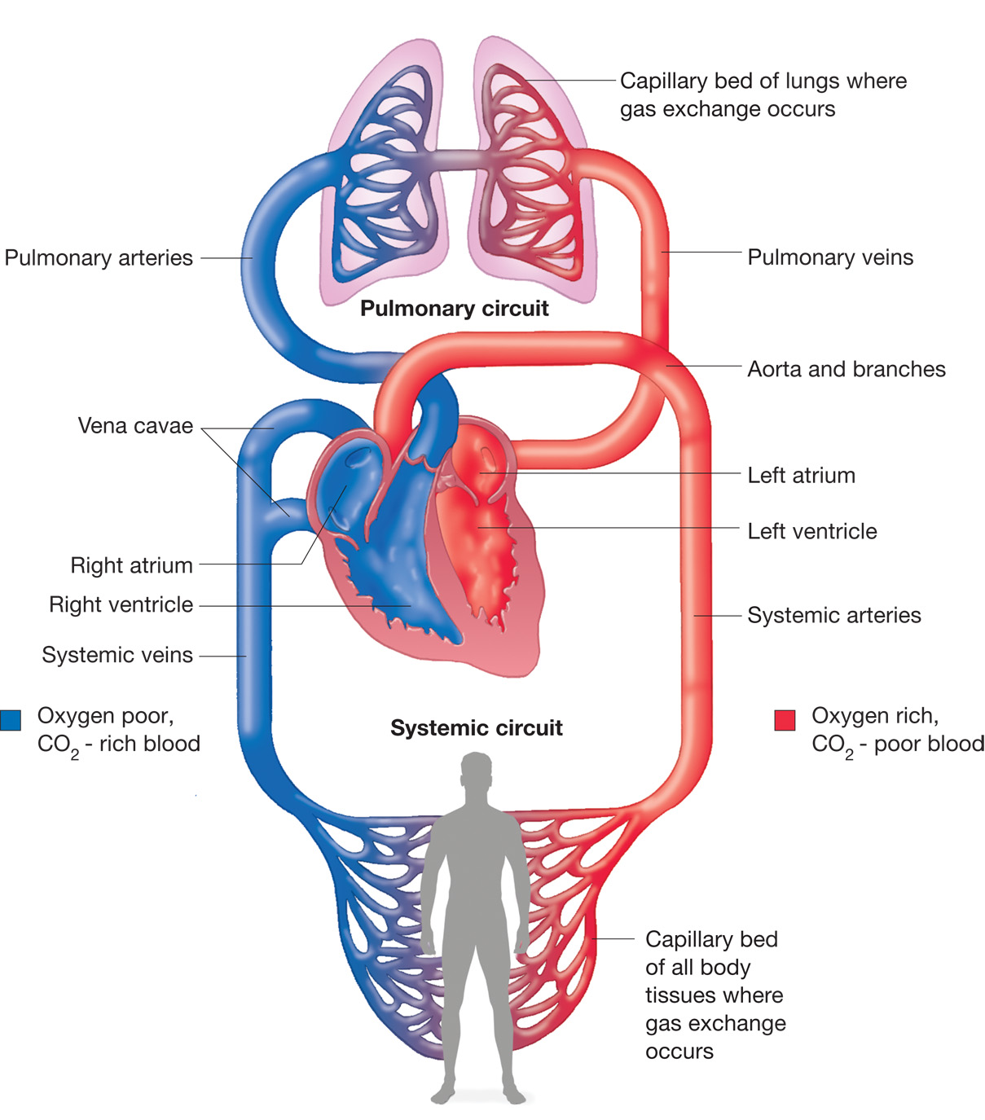

Slide 4
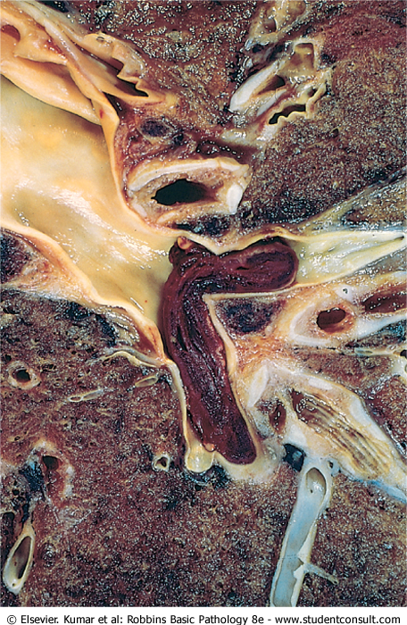
Embolus derived from a lower extremity deep venous thrombosis
and now impacted in a pulmonary artery branch

Slide 5
Pulmonary thromboembolism
95% originate from deep veins of L.L
Saddle embolus: at bifurcation of Pulmonary artery
Paradoxical embolus: Passage of an embolus from venous to systemic circulation through IAD, IVD

Slide 6
Clinical consequence of Pulmonary thromboembolism :
Most pulmonary emboli (60% to 80%) are clinically silent because they are small
Organization: 60 – 80 %
Pulmonary infarction
Sudden death, Right ventricle failure, CV collapse when more than 60 % of pulmonary vessels are obstructed.
Pumonary hemorrhage: obstruction of medium sized arteries.
Pulmonary Hypertension and right ventricular failure due to multiple emboli over a long time.

Slide 7
Systemic thromboembolism
Emboli traveling within the arterial circulation
80% due to intracardiac mural thrombi
2/3 Lt. ventricular failure
¼ Lt. atrial dilatation
Ulcerated atherosclerotic plaque,
Aortic aneurysm
valvular regetation
The major targets are:
Lower limbs 75%
Brain 10%
Intestine
Kidneys
Spleen

Slide 8
Fat embolism
Causes
Skeletal injury (fractures of long bones )
Adipose tissue Injury
Mechanical obstruction is exacerbated by free fatty acid release from the fat globules, causing local toxic injury to endothelium.
In skeletal injury, fat embolism occurs in 90% of cases, but only 10% or less have clinical findings
Fat embolism syndrome is characterized by
Pulmonary Insufficiency
Neurologic symptoms
Anemia
Thrombocytopenia
Death in 10% of the case
- Symptoms appears 1-3 days after injury
Tachypnea, Dyspnea, Tachycardia and
Neurological symptoms

Slide 9
Air Embolism
causes:
Obstetric procedures
Chest wall injury
Decompression sickness: in Scuba and deep-sea divers ((nitrogen ))
More then 100ml of air is required to produce clinical effect.
Clinical consequence
Painful joints: due to rapid formation of gas bubbles within Sk. Muscles and supporting tissues.
Focal ischemia in brain and heart
Lung edema, Hemorrhage, atelectasis, emphysema, which all lead to Respiratory distress. (chokes)
caisson disease: gas emboli in the bones leads to multiple foci of ischemic necrosis, usually the heads of the femurs, tibias, and humeri

Slide 10
Amniotic fluid embolism
Mortality Rate = 20%-40%
Uncommon complication of labor
due to infusion of amniotic fluid into maternal circulation via tears in placental membranes and rupture of uterine veins.
sudden severe dyspnea, cyanosis, and hypotensive shock, followed by seizures, DIC and coma
Finding:
Squamous cells, languo hair, fat, mucin …..etc within the pulmonary microcirculation

Slide 11
INFARCTION
An infarct is an area of ischemic necrosis caused by occlusion of either the arterial supply or the venous drainage in a particular tissue
Nearly 99% of all infarcts result from thrombotic or embolic events
other mechanisms include: local vasospasm, expansion of an atheroma, extrinsic compression of a vessel (e.g., by tumor); vessel twisting (e.g., in testicular torsion or bowel volvulus; and traumatic vessel rupture

Slide 12
Morphology of infarcts
infarcts may be either red (hemorrhagic) or white (anemic) and may be either septic or bland
All infarcts tend to be wedge shaped, with the occluded vessel at the apex and the periphery of the organ forming the base
The margins of both types of infarcts tend to become better defined with time
The dominant histologic characteristic of infarction is ischemic coagulative necrosis
most infarcts are ultimately replaced by scar. The brain is an exception, it results in liquefactive necrosis

Slide 13
Red infarcts:
occur in
venous occlusions (such as in ovarian torsion)
loose tissues (like lung) that allow blood to collect in the infarcted zone;
tissues with dual circulations (lung and small intestine),
previously congested tissues because of sluggish venous outflow
when flow is re-established to a site of previous arterial occlusion and necrosis

Slide 14
White infarcts
occur with:
arterial occlusions
solid organs (such as heart, spleen, and kidney).
Septic infarctions
occur when bacterial vegetations from a heart valve embolize or when microbes seed an area of necrotic tissue.
the infarct is converted into an abscess, with a correspondingly greater inflammatory response

Slide 15
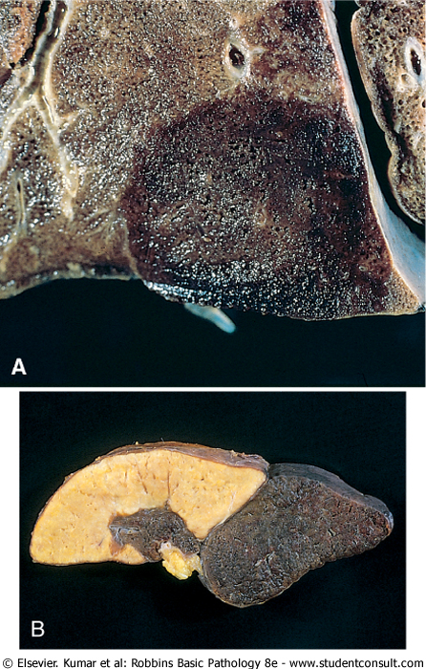
Red and white infarcts.
A→lung
B→spleen

Slide 16
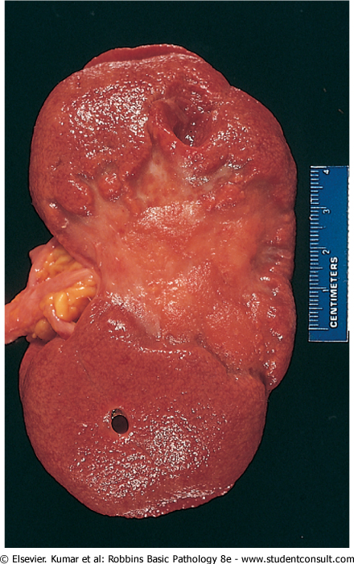
kidney infarct, now replaced by a large fibrotic scar

Slide 17
Factors That Influence Development of an Infarct
nature of the vascular supply
rate of development of the occlusion (collateral circulation )
vulnerability to hypoxia
Neurons undergo irreversible damage → 3 to 4 minutes of ischemia.
Myocardial cells die after only 20 to 30 minutes of ischemia
the oxygen content of blood

