Slide 1
Embolism:
An embolus is a detached intravascular solid, liquid, or gaseous mass that is carried by the blood to a site distant from its point of origin
99% due to dislodged thrombus
Types:
Thromboembolism
Fat embolism
Air embolism
Nitrogen embolism
Cholesterol embolism
Amniotic fluid embolism
Where it was formed
The target site is where it will be entrapped
The remaining 1%

Slide 2
Emboli result in partial or complete vascular occlusion.
The consequences of thromboembolism include ischemic necrosis (infarction) of downstream tissue
For an embolus that is formed in the veins circulation :
The most common origin is the lower limb
The most common target is the lungs (pulmonary emboli)
For an arterial emboli :
The most common origin is the heart (the left chambers in particular)
The most common target is the arteries of the lower limb, but all organs might be affected

Slide 3
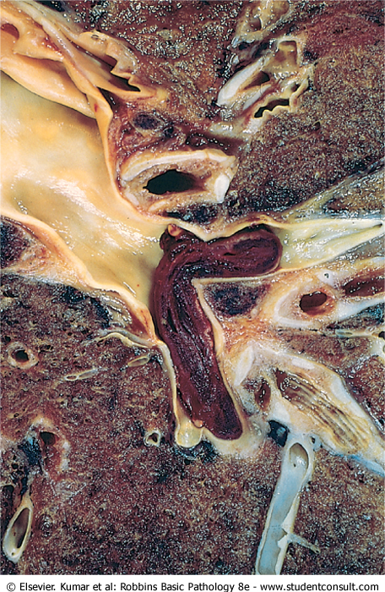
Embolus derived from a lower extremity deep venous thrombosis
and now impacted in a pulmonary artery branch
Represents a saddle embolus

Slide 4
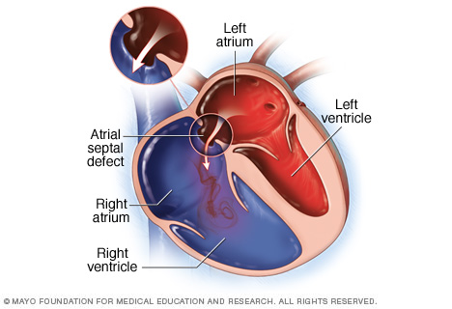
Pulmonary thromboembolism
95% originate from deep veins of L.L
Saddle embolus: at bifurcation of Pulmonary artery (will lead to cardiovascular collapse)
Paradoxical embolus: Passage of an embolus from venous to systemic circulation through IAD (inter-atrial defect), IVD(Inter-ventricular defect)
The doctor means by inter-atrial/ventricular defect : atrial/ventricular septal defect which is a congenital defect in the heart, (meaning that an embolus resulted from Deep vein thrombosis for ex. can go to the sys. Circulation through the defect)

Slide 5
Clinical consequence of Pulmonary thromboembolism :
Depend mainly on the location and size of the embolus
Most pulmonary emboli (60% to 80%) are clinically silent because they are small (they get stuck in very small vessels in the lungs that their blockage wont produce any symptoms)
Organization: 60 – 80 %
Pulmonary infarction
Sudden death, Right ventricle failure, CV collapse when more than 60 % of pulmonary vessels are obstructed.
Pumonary hemorrhage: obstruction of medium sized arteries.
Pulmonary Hypertension and right ventricular failure due to multiple emboli over a long time.
Most pulmonary emboli (60% to 80%) are small and clinically silent. With time, they undergo organization and become incorporated into the vascular wall; in some cases, organization of thromboemboli leaves behind bridging fibrous webs. ( from robbins pathology )

Slide 6
Systemic thromboembolism
Emboli traveling within the arterial circulation
80% due to intracardiac mural thrombi
2/3 Lt. ventricular failure
¼ Lt. atrial dilatation
Ulcerated atherosclerotic plaque,
Aortic aneurysm
valvular regetation
The major targets are:
Lower limbs 75%
Brain 10%
Intestine
Kidneys
Spleen

Slide 7
Fat embolism
Causes
Skeletal injury (fractures of long bones )
Adipose tissue Injury
Mechanical obstruction is exacerbated by free fatty acid release from the fat globules, causing local toxic injury to endothelium.
In skeletal injury, fat embolism occurs in 90% of cases, but only 10% or less have clinical findings
Fat embolism syndrome is characterized by
Pulmonary Insufficiency
Neurologic symptoms
Anemia
Thrombocytopenia (first to appear)
Death in 10% of the case
- Symptoms appears 1-3 days after injury
Tachypnea(rapid breathing), Dyspnea, Tachycardia and Neurological symptoms
Bone fracture
Fat in the circulation
Mechanical damage ( mass effect)
Immune RXN → affects bone marrow
Fat emboli syndrome
عشان العلم و هيك :P
** I didn’t find anything about an immune RXN in fat embolism syndrome in the internet :P, they all say it’s just the toxic (biochemical effect) of the released free fatty acid. the anemia and TCP are of unknown cause.

Slide 8
When a person dives deep, the atmospheric pressure will convert the gas into liquid ,when he goes up rapidly the liquid is converted back to gas and large amount of bubbles will be formed that resemble an embolus.
**I guess the doc. means by N2 becomes liquid is that more is dissolved in the blood as the solubility increases with pressure increment.
Air Embolism
causes:
Obstetric procedures
Chest wall injury
Decompression sickness: in Scuba and deep-sea divers ((nitrogen (80% of the air is nitrogen)))
More then 100ml of air is required to produce clinical effect.
Clinical consequence
Painful joints: due to rapid formation of gas bubbles within Sk. Muscles and supporting tissues.
Focal ischemia in brain and heart
Lung edema, Hemorrhage, atelectasis, emphysema, which all lead to Respiratory distress. (chokes)
caisson disease: gas emboli in the bones leads to multiple foci of ischemic necrosis, usually the heads of the femurs, tibias, and humeri

Slide 9
Amniotic fluid embolism
Mortality Rate = 20%-40%
Uncommon complication of labor
due to infusion of amniotic fluid into maternal circulation via tears in placental membranes and rupture of uterine veins.
sudden severe dyspnea, cyanosis, and hypotensive shock, followed by seizures, DIC and coma
Finding:
Squamous cells, languo hair, fat, mucin …..etc within the pulmonary microcirculation
As in fat emboli syndrome , the amniotic fluid will have both mechanical and immunological effects

Slide 10
INFARCTION
An infarct is an area of ischemic necrosis caused by occlusion of either the arterial supply or the venous drainage in a particular tissue
Nearly 99% of all infarcts result from thrombotic or embolic events
other mechanisms include: local vasospasm, expansion of an atheroma, extrinsic compression of a vessel (e.g., by tumor); vessel twisting (e.g., in testicular torsion or bowel volvulus; and traumatic vessel rupture

Slide 11
Morphology of infarcts
infarcts may be either red (hemorrhagic) or white (anemic) and may be either septic or bland
All infarcts tend to be wedge shaped, with the occluded vessel at the apex and the periphery of the organ forming the base
The margins of both types of infarcts tend to become better defined with time
The dominant histologic characteristic of infarction is ischemic coagulative necrosis
most infarcts are ultimately replaced by scar. The brain is an exception, it results in liquefactive necrosis

Slide 12
Red infarcts:
occur in
venous occlusions (such as in ovarian torsion)
loose tissues (like lung) that allow blood to collect in the infarcted zone;
tissues with dual circulations (lung and small intestine),
previously congested tissues because of sluggish venous outflow
when flow is re-established to a site of previous arterial occlusion and necrosis

Slide 13
White infarcts
(Anemic(without blood) infarcts)
occur with:
arterial occlusions (no blood in downstream tissues)
solid organs (such as heart, spleen, and kidney).
Septic infarctions
occur when bacterial vegetations from a heart valve embolize or when microbes seed an area of necrotic tissue.
the infarct is converted into an abscess, with a correspondingly greater inflammatory response

Slide 14
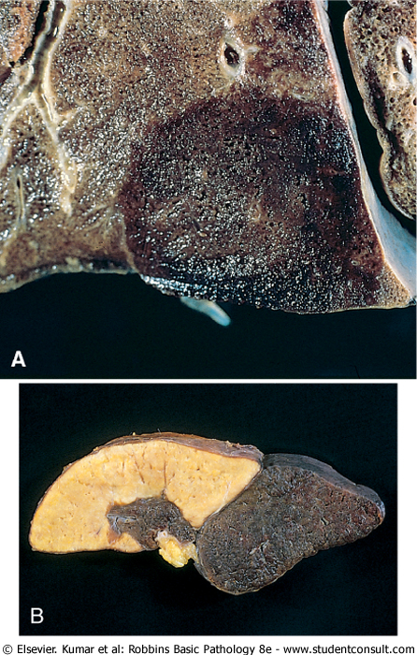
Red and white infarcts.
A→lung
B→spleen
Infarcts will appear as pyramids, the apex represents the site of occlusion and the base is the periphery.
** because of the branching it appears like this

Slide 15
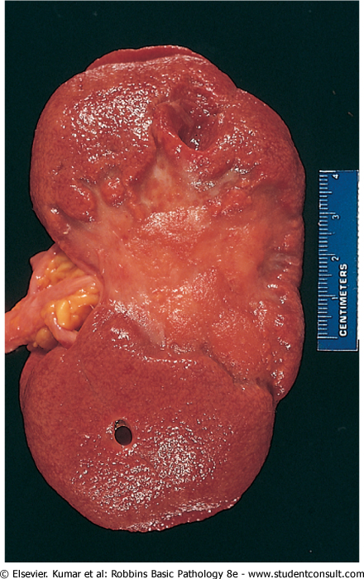
kidney infarct, now replaced by a large fibrotic scar

Slide 16
Factors That Influence Development of an Infarct
nature of the vascular supply
rate of development of the occlusion (collateral circulation )
vulnerability to hypoxia
Neurons undergo irreversible damage → 3 to 4 minutes of ischemia.
Myocardial cells die after only 20 to 30 minutes of ischemia
the oxygen content of blood

