Slide 1
Medical Virology
Lower Respiratory Tract Infections
Dr. Sameer Naji, MB, BCh, PhD (UK) Dean Assistant
Head of Basic Medical Sciences Dept.
Faculty of Medicine The Hashemite University

Slide 2
Viral
Lower Respiratory Tract Infections
Lecture 2
Additions are in Italic Green
Some points were mentioned as not important by the doctor, but it’s better if you read them

Slide 3
Severe Acute Respiratory Syndrome (SARS)
Enveloped virus, Replicates in cytoplasm of animal cells
Single-strand 30 kb RNA genome
First identified in Guangdong Province, China
Mortality 3-6% (45-63% in persons over-60)
Associated Coronavirus SARS-HCoV

Slide 4
SARS History:
November 2002: An outbreak of a mysterious respiratory illness occurs in Guangdong Province, China, making hundreds seriously ill and killing dozens.
Mid-February 2003: Virus spreads to Vietnam and Hong Kong; international travel blamed.
Mid-March: Virus spreads to Singapore and Canada.
March 15: A Singaporean doctor travels through New York on his way to Germany, becoming ill en route; he is diagnosed with SARS in Frankfurt. The World Health Organization issued an unprecedented “Worldwide Disease Alert”

Slide 5
March 17: World Health Organization facilitates the collaboration of 11 laboratories in 10 countries to identify the cause of SARS.
March 24: Centers for Disease Control and Prevention announces that a coronavirus strain causes SARS.
March 29: Dr. Carlo Urbani, a WHO officer who treated the earliest cases in Hanoi, dies of SARS.
May 1: CDC and the British Columbia Cancer Agency in Canada publish near-identical sequences of the SARS virus in Science.

Slide 6
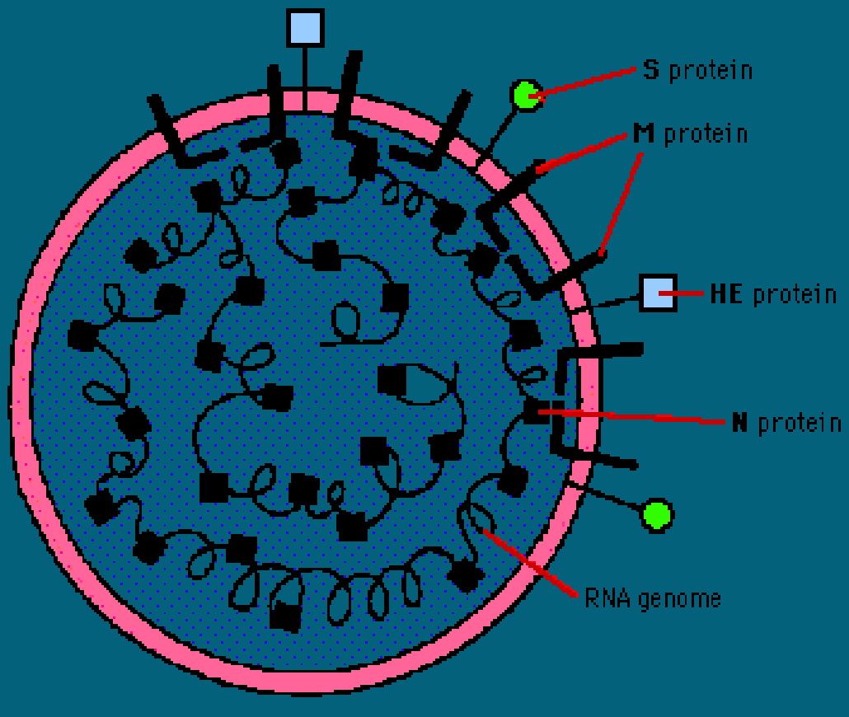
Coronavirus Pathogenesis
“Not Important’;:
The envelope carries three glycoproteins:
S - Spike protein: receptor binding, cell fusion, major antigen
E - Envelope protein: small, envelope-associated protein
M - Membrane protein: transmembrane - budding & envelope formation In a few types, there is a third glycoprotein:
HE - Haemagglutinin-esterase The genome is associated with a basic phosphoprotein, N.”
Courtesy of Dr. Alan Cann.

Slide 7
These points are not important:
enters via endocytosis & membrane fusion
• + sense genome is translated to produce viral polymerase
Viral polymerase produces full length – sense strand (poorly understood step)
- sense strand used as a template to produce mRNA (monocistronic), “nested set” of transcripts
assembled in the golgi apparatus and transport using secretory nature and released.
This point is very important:
REPLICATION OCCURS IN CYTOPLASM

Slide 8
Symptoms and Diagnostic Tests
Initial Symptoms:
High fever of 38^{о} C or higher, headaces, body aches, and malaise. (general constitutional symptoms)
Week Later:
dry cough, difficulty breathing and severe diarrhea (transmission: fecal oral, droplets, contact with the patient).
Recovery: starts after 5 to 6 days
Early Diagnosis:
patient is given antibiotics, antiviral, and steroids used for atypical pneumonia.
Patient is quarantined in specially ventilated rooms.

Slide 9
Laboratory tests:
RT-PCR (reverse transcription-polymerase chain reaction) assay
Detection of SARS-CoV RNA
It’s a molecular technique – not antigen antibody reaction
It’s the best test available
EIA (enzyme immunoassay)
Detection of serum antibody to SARS-CoV RNA
Enzyme-linked immunosorbent assays (ELISA)
Detects antibodies against the virus produced in infection

Slide 10
Treatment and Prevention
No standard treatment yet
Patients receive combination therapy
effective antiviral and steroid (Lopinavir/ritonavir plus ribavirin)
Prevention
Isolation
Sterilization of area occupied by SARS patients
Caution and extra precautionary measure taken by medical workers and doctors.
Vaccines
According to the SAVI researchers 3 vaccines are possible to be used in the future: Whole killed vaccine, adenovirus vector, and recombination spike protein.
الدكتور مش مقتنع بالتطعيمات ☺

Slide 11
Epidemiology of SARS
Animal and environmental reservoirs
Farms: raising and slaughtering of infected animals like unlucky palm civets
Might SARS-CoV recombine with other strains of the coronavirus? Yes it’s possible
Onset of illness
Incubation period: 4 to 6 days
Infectious period is very dangerous if not treated right away leads to death of infected person/animal
Transmission Important
Close contact – droplet, fomites, direct contact
Airborne
Fecal-oral

Slide 12
Middle East Respiratory Syndrome Coronavirus (MERS)
MERS is a newly described disease in human beings, first reported from Saudi Arabia in September, 2012
It is a novel positive-sense, single-stranded RNA virus of the genus Betacoronavirus.
As of July 2015, MERS-CoV cases have been reported in over 21 countries, including Saudi Arabia, Jordan, Qatar, Egypt, the United Arab Emirates, Kuwait, Turkey, Oman, Algeria,

Slide 13
Bangladesh, Indonesia, Austria,[the United Kingdom, South Korea, the United States, Mainland
China, Thailand, and the Philippines. About 3-4 out of every 10 patients reported with MERS have died.
MERS-CoV is distinct from SARS coronavirus and distinct from the common-cold coronavirus and known endemic human betacoronaviruses (HCoV-OC43 and HCoV-HKU1 Don’t memorize these two names)
It’s important to know that it’s caused by a betacoronavirus.

Slide 14
In humans, the transmission of coronaviruses between an infected individual and others can occur via
respiratory secretions. This can happen either directly through droplets from coughing or sneezing, or indirectly through touching contaminated objects or surfaces as well as close contact, such as touching or shaking hands. Camels are suspected to be the primary
source of infection for humans

Slide 15
There are currently no vaccines or specific treatments for the coronaviruses. Hence, in order to reduce the risk
and prevent the spread of infections, simple preventative measure are: good respiratory hygiene, including washing hands; avoiding touching one's eyes, mouth and nose; sanitary disposal of oral and nasal discharges as well as avoiding contact with sick people.

Slide 16
Metapneumovirus
First described in 2001 by van den Hoogen
Nasophargyngeal aspirates from 28 children over a 20 year period were examined
Children had similar symptoms to RSV
World wide distribution: Has been isolated in US, Brazil, Japan, Australia and UK

Slide 17
Virology
RNA Virus, Paramyxoviridae family
Antibodies have been isolated in samples from as far back as 1958
Epidemiology
Most of the early literature is in pediatric population
In adult population, immune compromised at highest risk
- human metapneumovirus infection could be severe in the elderly and that, during some years, metapneumovirus may account for a significant portion of the older people hospitalized with respiratory tract infections

Slide 18
Symptoms
Cough, fever, dyspnea
Can range from URTI to Respiratory failure
Significant pulmonary inflammatory changes in BAL
Increased IL-8, foamy macrophages
In temperate countries, hMPV has a seasonal distribution, overlapping with RSV with most cases reported during the winter/spring.

Slide 19
Treatment
Primarily supportive measures
Raza et al (2007) presented a case describing successful use of ribavarin in a patient with a history of double lung transplant and respiratory failure.
Ribavarin has been shown to have in vitro activity against metapneumovirus (Wyde et al 2007)

