Slide 1
Veins and lymphatics

Slide 2
Normal vein physiology
Skeletal muscles
Skeletal muscles
Prevent the backflow of blood
They “pump” the blood towards the heart and prevent backflow of blood by compressing the veins when contracted.

Slide 3
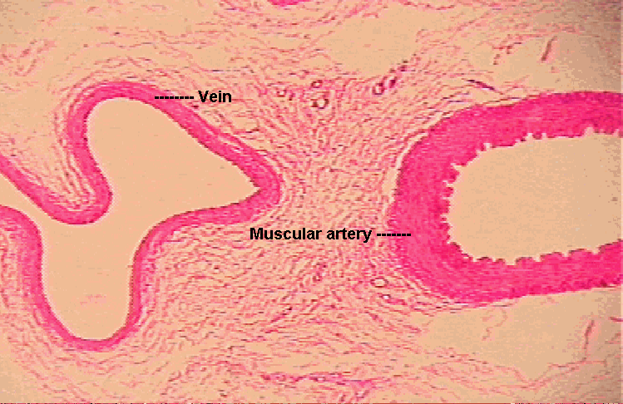
Because of the difference in tunica media between the arteries and veins, the arteries are stronger and the veins are easier to compress and dilate (the vein is weaker and tortuous)

Slide 4
Veins and lymphatics
Varicose Veins
are abnormally dilated, tortuous veins produced by prolonged increase in intra-luminal pressure, loss of vessel wall support (weakness of veins) or abnormality in pocket valves.
The superficial veins of the leg are typically involved

Slide 5
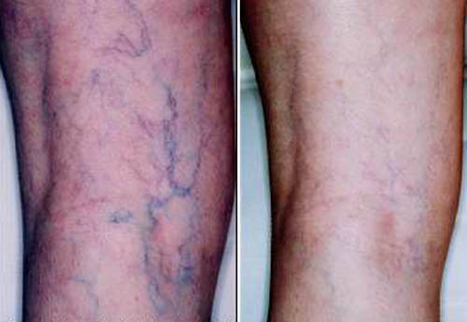
Varicose Veins
They appear because of gravity
After standing up for 2 hours
At resting state

Slide 6
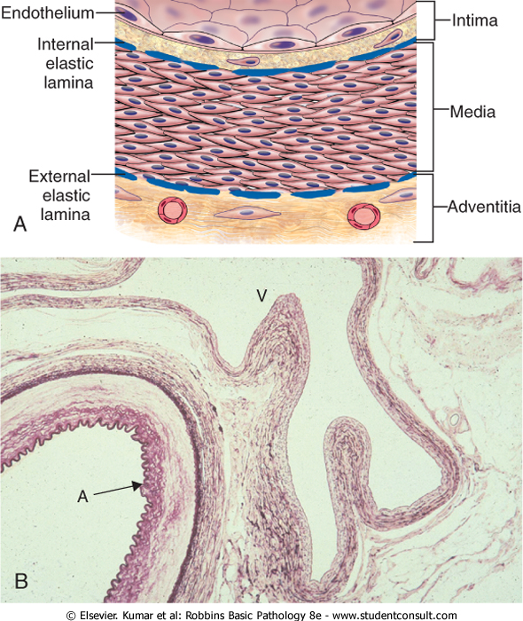

Slide 7
venous pressures in legs can be markedly elevated → venous stasis and pedal edema (simple orthostatic edema).
Some 10% to 20% of adult males and 25% to 33% of adult females develop lower extremity varicose veins
females have higher susceptibility Because of
1-pregnancy 2-weaker muscles → less “pumping”
3- estrogens by decreasing the overall muscle tone.

Slide 8
Risk factors
Obesity increases intraluminal pressure
Female gender less muscles and high estrogen
Pregnancy compressing the pelvic veins.
Familial tendency (premature varicosities results from imperfect venous wall development making the walls weaker)

Slide 9
Morphology (microscopic)
wall thinning
intimal fibrosis in adjacent segments
spotty medial calcifications (phlebosclerosis)
Focal intraluminal thrombosis
venous valve deformities (rolling and shortening)

Slide 10
complications
The problem is usually only cosmetic
stasis, congestion, edema, pain, and thrombosis
chronic varicose ulcers in the skin
embolism is very rare.
causes

Slide 11
Thrombophlebitis And Phlebothrombosis
Sometimes the inflammation occurs first and sometimes thrombosis
interchangeable terms
= (Inflammation + thrombosis) of veins
The deep leg veins account for more than 90% of cases
the most important clinical predispositions are: congestive heart failure, neoplasia, pregnancy, obesity, the postoperative state, and prolonged bed rest or immobilization
All causes stasis

Slide 12
Thrombophlebitis of upper limb veins are usually associated with local risk factors like: catheter or canula site (where inflammation sometimes occur); or in some cases can be associated with systemic hypercoagulabilities.
local manifestations: distal edema, cyanosis, superficial vein dilation, heat, tenderness, redness, swelling, and pain
Distant manifestations: emboli

Slide 13
Clinical syndromes associated with venous thrmobosis:
1- Migratory thrombophlebitis (Trousseau sign):
hypercoagulability occurs as a paraneoplastic syndrome related to tumor elaboration of pro-coagulant factors
- Most often related to GI carcinomas ( colon . Stomach and pancreatic cancers)
Migrates between veins

Slide 14
2- The superior vena caval syndrome
caused by neoplasms (most commonly lung cancer) that compress or invade the superior vena cava.
A characteristic clinical complex including marked dilation of the veins of the head, neck, and arms (upper limb) with cyanosis , edema , congestion… (all the local manifestations).

Slide 15
3- The inferior vena caval syndrome
can be caused by neoplasms that compress or invade the inferior vena cava (IVC)- particularly hepatocellular carcinoma and renal cell carcinoma, which show a striking tendency to grow within veins-
induces marked lower extremity/limb edema, distention of the superficial collateral veins of the lower abdomen, and-with renal vein involvement-massive proteinuria.

Slide 16
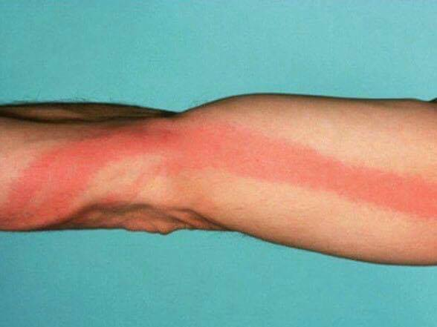
Lymphangitis
is the acute inflammation due to bacterial infections spread into the lymphatics
most common are group A β-hemolytic streptococci.
lymphatics are dilated and filled with an exudate of neutrophils and monocytes.
Presentation :red, painful subcutaneous streaks (the inflamed lymphatics),with painful enlargement of the draining lymph nodes (acute lymphadenitis) (when the infection reachs the lymph nodes) .
Its usually localized but Sometimes subsequent passage into the venous circulation can result in bacteremia or sepsis (specially in immunocompetent patients).

Slide 17
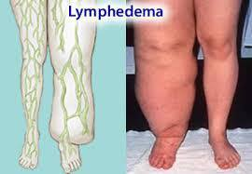
lymphedema
Edema caused by a problem in lymphatics
can occur as:
1- Primary (A congenital defect early in life), resulting from lymphatic agenesis (failure to form) or hypoplasia (less than normal).
2- Secondary or obstructive lymphedema more common
1- blockage of a previously normal lymphatic; e.g. Malignant tumors
2- Surgical procedures that remove
lymph nodes ex. Breast cancer and the
edema will occur in the upper limb
3- Post-irradiation (e.g. breast cancer)
4- Fibrosis
5- Filariasis infection by filarial parasite
that leads to blockage of lympatics
6- Post-inflammatory thrombosis and scarring

Slide 18
chylous
Accumulation of lymph outside the lymphatics
(Means milky substance)
Milky accumulations of lymph in various body cavities
caused by rupture of dilated lymphatics, typically obstructed secondary to an infiltrating tumor mass (meaning a connection between a lymphatic and a body cavity occured)
- chylous ascites (abdomen)
Chylothorax (chest)
Chylopericardium (pericardium)
Special thanks to

