Slide 1
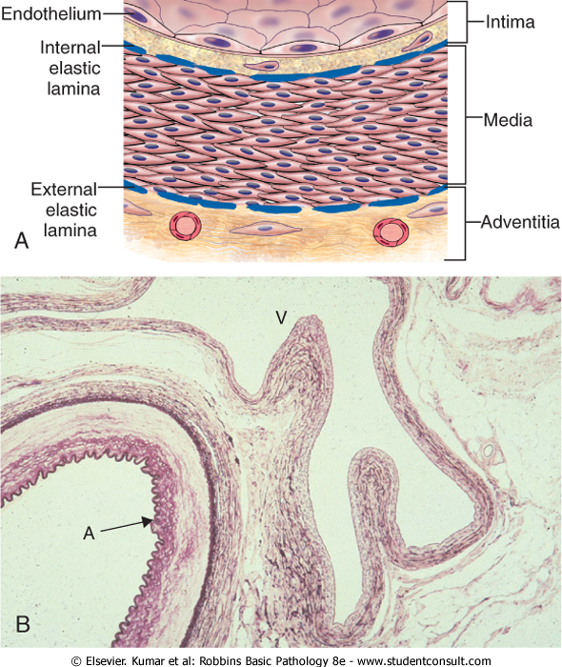
Normal
blood vessels
A= artery
V= vein

Slide 2
ARTERIOSCLEROSIS
Arteriosclerosis literally means "hardening of the arteries"
It reflects arterial wall thickening and loss of elasticity.
Three patterns are recognized, with different clinical and pathologic consequences:

Slide 3
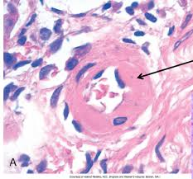
1-Arteriolosclerosis
affects small arteries and arterioles.
is most often associated with hypertension and/or diabetes mellitus

Slide 4
2-Mönckeberg medial calcific sclerosis
is characterized by calcific deposits in muscular arteries
typically in persons older than age 50.
radiographically visible
often palpable calcifications
do not encroach on the vessel lumen and are usually not clinically significant

Slide 5
2-Mönckeberg medial calcific sclerosis

Slide 6
3-Atherosclerosis
from Greek root words for "gruel" and "hardening,"
is the most frequent and clinically important pattern
characterized by intimal lesions called atheromas (also called atherosclerotic plaques), that protrude into vascular lumina.
An atheromatous plaque consists of a raised lesion with a soft, yellow, grumous core of lipid (mainly cholesterol and cholesterol esters) covered by a firm, white fibrous cap

Slide 7
Pathogenesis
The atherosclerotic process is not fully understood.
Atherosclerosis is initiated by inflammatory processes in the endothelial cells of the vessel wall associated with retained low-density lipoprotein (LDL) particles.
This retention may be a cause, an effect, or both, of the underlying inflammatory process

Slide 8
LDL particles and their content are susceptible to oxidation by free radicals
This will lead to endothelial stimulation and initiation of inflammatory process.

Slide 9
The major components of a well-developed intimal atheromatous plaque

Slide 10
Atheromatous plaque

Slide 11
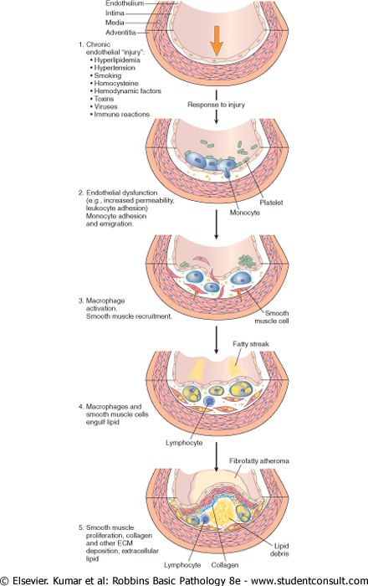
Formation of
atheromatous
plaque

Slide 12
"Endo dysfunction Athero" by Transferred from en.wikipedia to Commons.. Licensed under CC BY-SA 3.0 via Commons - https://commons.wikimedia.org/wiki/File:Endo_dysfunction_Athero.PNG#/media/File:Endo_dysfunction_Athero.PNG

Slide 13
Atherosclerosis progression

Slide 14
Epidemiology
atherosclerosis is much less prevalent in Central and South America, Africa, and Asia.
The mortality rate for IHD in the United States is among the highest in the world and is approximately five times higher than that in Japan.
Nevertheless, IHD has been increasing in Japan and is now the second leading cause of death there. Moreover, Japanese who immigrate to the United States and adopt American lifestyles and dietary customs acquire the same predisposition to atherosclerosis as the homegrown population.

Slide 15
Multiple risk factors have a multiplicative effect: 2 risk factors increase the risk 4X. E.g. if 3 risk factors are present (e.g., hyperlipidemia, hypertension, and smoking), the rate of myocardial infarction is increased 7X.

Slide 16
Risk Factors for Atherosclerosis
Major Risks | Lesser, Uncertain, or Non-quantitated Risks
Nonmodifiable | Obsesity
Increasing age | Physical inactivity
Male gender | Stress ("type A personality)
Family history | Postmenopausal estrogen deficiency
Genetic abnormalities | High carbohydrate intake
 | Lipoprotein(a)
Potentially Controllable | Hardened (trans)unsaturated fat intake
Hyperlipidemia
Hypertension | Chlamydia pneumoniae infection
Cigarette smoking
Diabetes
C-reactive protein

Slide 17
Major Constitutional Risk Factors for atherosclerosis
Major Risks (Nonmodifiable):
*Increasing age
*Male gender
*Family history
*Genetic abnormalities
Potentially Controllable/modifiable:
Hyperlipidemia
Hypertension
Cigarette smoking
Diabetes

Slide 18
1-age
Between ages 40 and 60, the incidence of myocardial infarction in men increases 5 times.
Death rates from IHD rise with each decade even into advanced age.
2-Gender
Premenopausal women are relatively protected against atherosclerosis compared with age-matched men.
MI and other complications of atherosclerosis are uncommon in premenopausal women unless they are otherwise predisposed by diabetes, hyperlipidemia, or severe hypertension.
After menopause, the incidence of atherosclerosis-related diseases increases and with greater age eventually exceeds that of men

Slide 19
3-Genetics
well-established familial predisposition to atherosclerosis and IHD is multifactorial.
In some instances it relates to:
familial clustering of other risk factors, such as hypertension or diabetes; or :
well-defined genetic derangements in lipoprotein metabolism,
- e.g. familial hypercholesterolemia that result in excessively high blood lipid levels.

Slide 20
Additional Risk Factors for atherosclerosis
20% of all cardiovascular events occur in the absence of any major risk factor
1-Inflammation as marked by C-reactive protein
2-Hyperhomocystinemia
3-Lipoprotein a
4-Factors Affecting Hemostasis
Other Risk Factors
1-lack of exercise
2-competitive, stressful lifestyle ("type A" personality)
3-obesity
4-Postmenopausal estrogen deficiency
5-High carbohydrate intake

