Slide 1
Ischemic heart disease

Slide 2
Heart disease remains the leading cause of morbidity and mortality in industrialized nations.
40% of all deaths in the U.S.A (nearly twice the number of deaths caused by all forms of cancer combined).
The yearly economic burden of ischemic heart disease (IHD) alone is in excess of $100 billion.

Slide 3
ISCHEMIC HEART DISEASE (IHD)
IHD = coronary artery disease (CAD)
IHD is a generic description for a group of related syndromes resulting from myocardial ischemia (an imbalance between cardiac blood supply (perfusion) and myocardial oxygen demand.

Slide 4
Ischemia can result from:
1- reduction in coronary blood flow caused by obstructive atherosclerotic disease → 90 % of cases
2- increased demand (e.g., tachycardia or hypertension)
3-diminished oxygen-carrying capacity (e.g., anemia, carbon monoxide poisoning)

Slide 5
There are four basic clinical syndromes of IHD:
1-Angina pectoris
ischemia causes pain but is insufficient to lead to death of myocardium
2-Acute myocardial infarction (MI)
the severity or duration of ischemia is enough to cause cardiac muscle death
3-Chronic IHD
progressive cardiac decompensation (heart failure) following MI
4-Sudden cardiac death (SCD)
can result from a lethal arrhythmia following myocardial ischemia.

Slide 6
There are four basic clinical syndromes of IHD:
1-Angina pectoris
- Angina pectoris is intermittent chest pain caused by transient, reversible myocardial ischemia (ischemia causes pain but is insufficient to lead to death of myocardium)
-pain→ a crushing or squeezing substernal sensation
- radiate down the left arm or to the left jaw (referred pain).

Slide 7
Types of angina :
1-stable angina (occur after certain levels of exertion)
2-variant angina or Prinzmetal angina ( due to vessel spasm )
3-Unstable angina
occurring with progressively less exertion or even at rest.

Slide 8
Pathogenesis of angina
atherosclerotic occlusion of coronary arteries and new superimposed thrombosis and/or vasospasm
-lesion obstructing 75% or more of a vessel lumen = critical stenosis → cause angina only in the setting of increased demand
-a fixed 90% stenosis can lead to inadequate coronary blood flow even at rest.

Slide 9
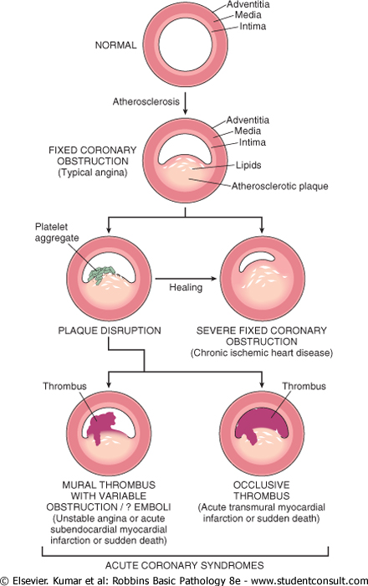
Pathogenesis

Slide 10
Acute vs chronic vascular insuffeciency
- Chronic coronary occlusion
when a coronary artery develops atherosclerotic occlusion at a sufficiently slow rate, it may be able to stimulate collateral blood flow from other major epicardial vessels → protection against MI even in the setting of a complete vascular occlusion.
Acute coronary occlusions
cannot spontaneously recruit collateral flow and will result in infarction

Slide 11
of angina & MI Clinical Features
1) Severe, crushing substernal chest pain
2) Discomfort that can radiate to the neck, jaw, epigastrium, or left arm.
angina pectoris→ pain < 20 minutes and relieved by rest or nitroglycerin
MI→ pain lasts from 20 minutes to several hours and is not relieved by nitroglycerin or rest.

Slide 12
3) MIs can be entirely asymptomatic in 10% to 15% of the cases (silent infarcts)➔ particularly common in patients with:
1- underlying diabetes mellitus (due to peripheral neuropathies)
2- in the elderly

Slide 13
4- the pulse is rapid and weak
5- patients nauseated particularly with posterior-wall MIs.
6- dyspnea is common (impaired myocardial contractility and dysfunction of the mitral valve apparatus, with resultant pulmonary congestion and edema).
7- massive MIs (>40% of the left ventricle)→ cardiogenic shock .

Slide 14
Types of angina :
1-stable angina (occur after certain levels of exertion)
2-variant angina or Prinzmetal angina ( due to vessel spasm )
3-Unstable angina
occurring with progressively less exertion or even at rest.

Slide 15
1-Typical or stable angina
-is episodic chest pain associated with exertion or some other form of increased myocardial oxygen demand (e.g., tachycardia or hypertension due to fever, anxiety, fear).

Slide 16
1-Typical or stable angina
usually associated with critical atherosclerotic narrowing (≥75%) of one or more coronary arteries.
the myocardial oxygen supply may be sufficient under basal conditions but cannot be adequately augmented to meet any increased requirements (exertion, emotional stress..etc)

Slide 17
1-Typical or stable angina
The pain is relieved by rest (reducing demand) or by administering agents such as nitroglycerin;
such drugs cause peripheral vasodilation and thus reduce venous blood delivered to the heart → reducing cardiac work.
- in larger doses, nitroglycerin also increases blood supply to the myocardium by direct coronary vasodilation

Slide 18
2-Prinzmetal, or variant angina
Is angina occurring at rest due to coronary artery spasm.
completely normal vessels can be affected.
The etiology is not clear.
Treatment: administration of vasodilators such as nitroglycerin or calcium channel blockers.

Slide 19
3-Unstable angina (crescendo angina)
characterized by increasing frequency of pain, precipitated by progressively less exertion.
the episodes also tend to be more intense and longer lasting than stable angina.
associated with plaque disruption; superimposed partial thrombosis; distal embolization; vasospasm.
an indication of more serious, potentially irreversible ischemia ( if complete luminal occlusion by thrombus)
Called pre-infarction angina

