Slide 1
acute Systemic Anaphylaxis

Slide 3
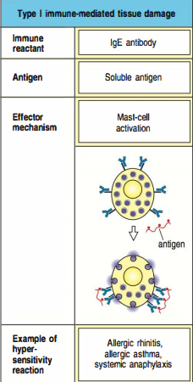
-IgE-mediated hypersensitivity.
-Rapid & life-threatening.
-First exposure: mast cells armed with specific IgE.
-Reexposure: allergic reaction.
-Histamine: increase permeability.
-Leukotrienes: bronchospasm.

Slide 4
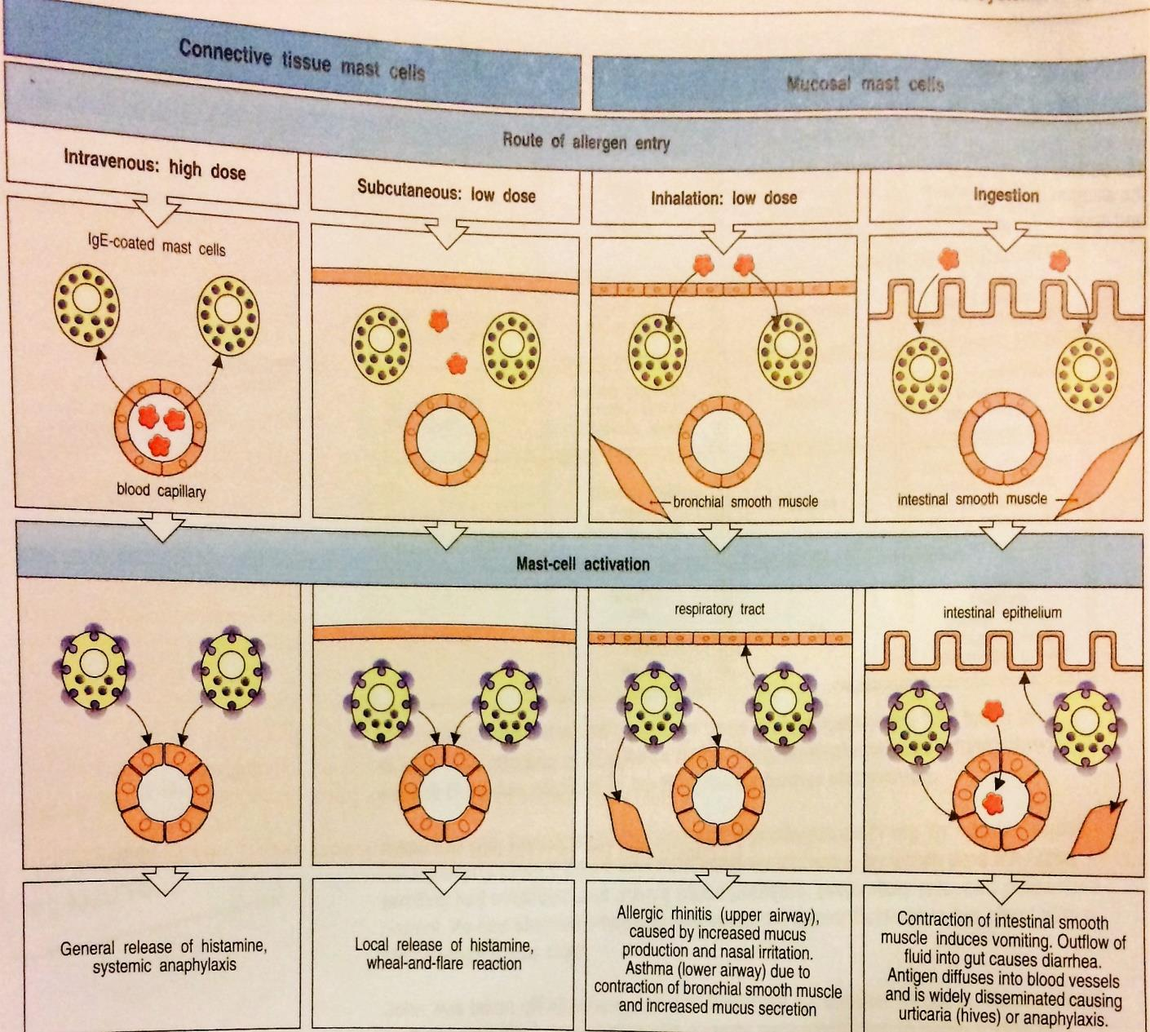
-systemic allergen cause serious anaphylactic reaction (circulation and respiratory).
-localized swelling of the throat can cause suffocation.

Slide 5
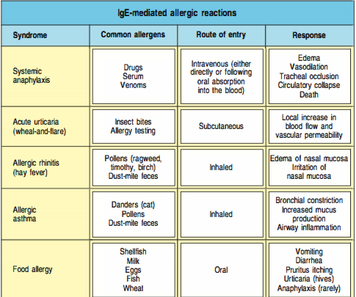
-Most common to cause acute systemic anaphylaxis are foods, antibiotics (penicillin) and insect venoms.
-Act as haptens (small molecules bind to proteins and form antibodies against them)

Slide 6
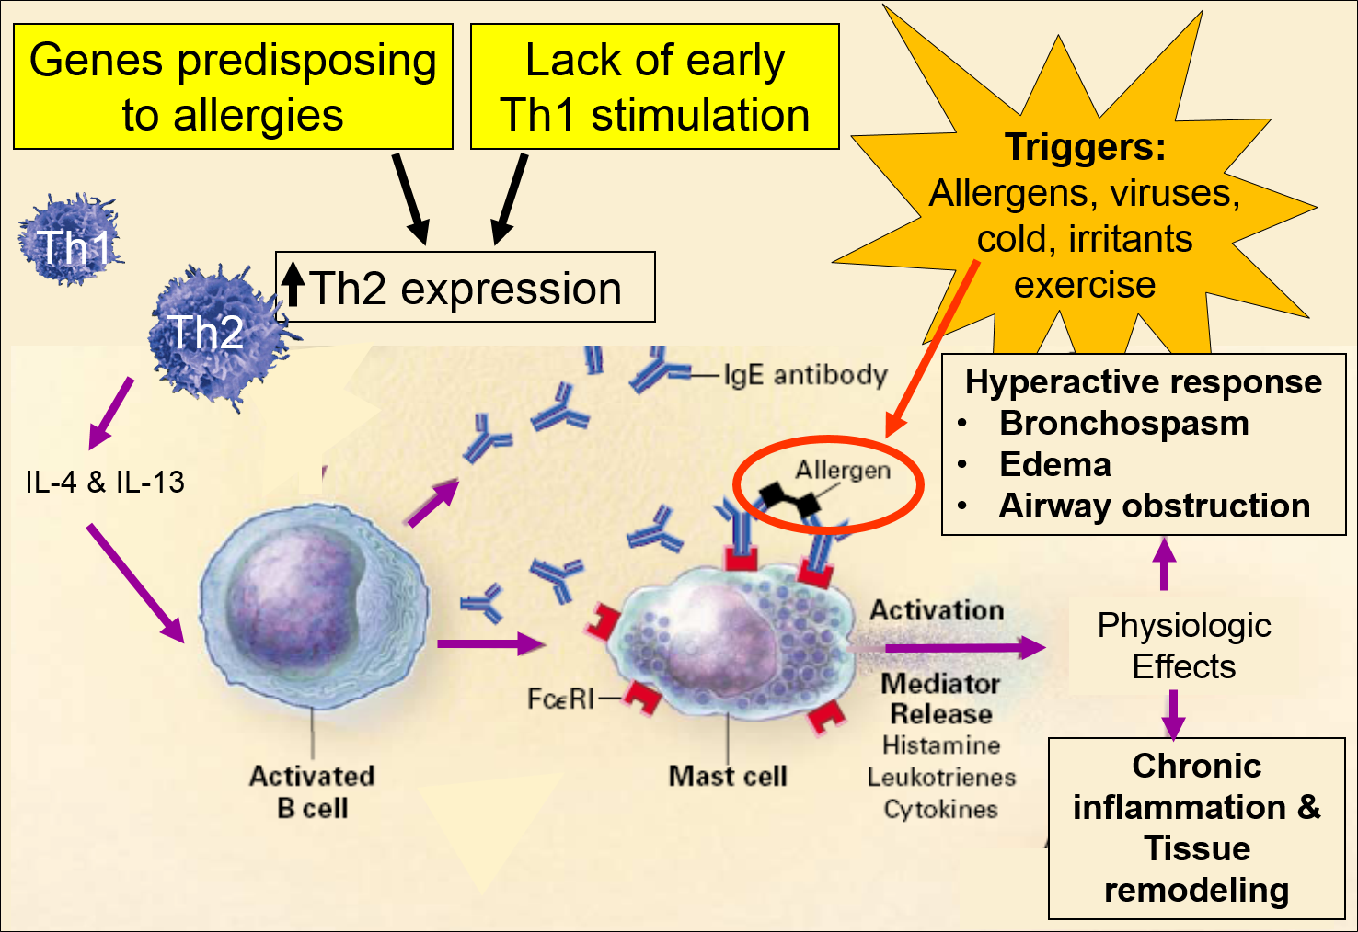

Slide 7
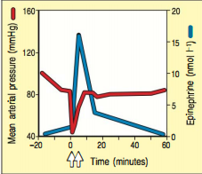
Insect-sting:
At time zero: onset of the anaphylactic reaction.
Anti-histamine and epinephrine.

Slide 8
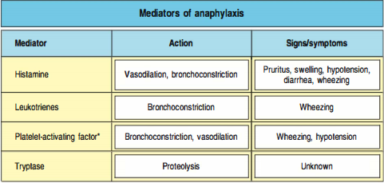
*Platelet-activating factor is not released by mast cells but by neutrophils, basophils, platelets and endothelial cells.

Slide 9
The case of john mason: a life-threatening immune reaction
22-month-old child , swollen lips after eating cookies containing peanut butter.
Symptoms disappeared in about an hour.
A Month later, after eating the same type of cookies, he started to vomit, became hoarse, had great difficulty in breathing, started to wheeze and developed a swollen face.
Unconscious.

Slide 10
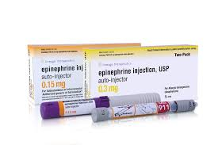
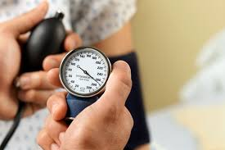
On arrival at hospital,
Blood pressure 40/0 mmHg (normal 80/60)
Pulse 185 beats/min (normal 80-90)
Respiratory rate 76/min (normal 20)
-Give epinephrine immediately.
-(saline, anti-histamine, corticosteroid) IV.
A blood sample was taken to test for histamine and tryptase.

Slide 11
Within minutes,
John’s hoarseness improved, wheezing diminished and his breathing became less labored.
Blood pressure rose to 50/30 mmHg (normal 80/60)
Pulse decreased to 145 beats/min (normal 80-90)
Respiratory rate 61/min (normal 20)

Slide 12
Thirty minutes later,
The hoarseness and wheezing got worse again.
Blood pressure dropped to 40/20 mmHg (normal 80/60)
Pulse increased to 170 beats/min (normal 80-90)
Respiratory rate 70/min (normal 20)
-John was given another injection of epinephrine and inhaled albuterol. (this treatment was repeated after 30 mins)

Slide 13
One hour later,
The child was fully responsive
Blood pressure rose to 70/50 mmHg (normal 80/60)
Pulse decreased to 116 beats/min (normal 80-90)
Respiratory rate 46/min (normal 20)
-An injection of Susphrine (long acting epinephrine) was administered .
-treatment with benadryl and methylprednisolone IV every 6 hours was continued for 24 hours, by wich time the facial swelling has subsided, BP, RR, P were normal.
-NO MORE PEANUTS

Slide 14
summary
-requires immediate therapy.
Difficulty in breathing due to constriction of bronchial smooth muscle.
Catastrophic loss of blood pressure due to leakage of fluid from the blood vessels.
An antigen administered by subcutaneous, IM or IV injection is more likely to induce a clinical anaphylactic reaction than one that enters by the oral or respiratory route.

