Slide 1
Endocrine Physiology
Hashim A. Mohammad
2nd year medical student- University of Jordan
July, 2016

Slide 2
Adrenal Glands

Slide 3
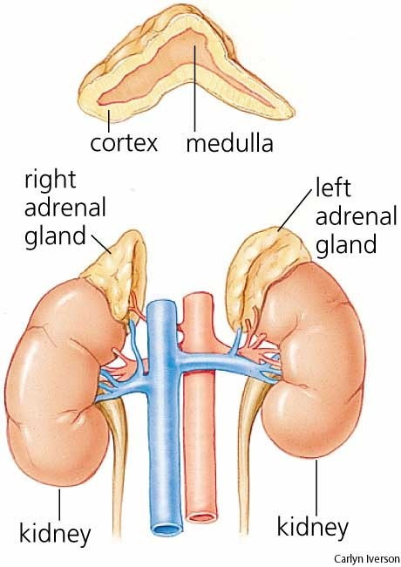
Adrenal Glands
AKA suprarenal glands
Two Parts:
Medulla → Catecholamines
Cortex → Corticosteroids
Corticosteroids:
Synthesized from cholesterol
Similar chemical structure
Different functions
Essential for life

Slide 4
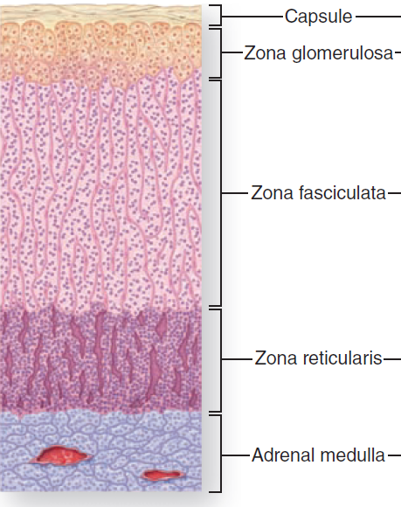
Histology of the Adrenal Cortex
Three layers, each with major hormone product.
Zone Glomerulosa 15%
Zona Fasciculata 75%
Zona reticularis

Slide 5
Main Effects of Adrenocortical Hormones
Mineralocorticoids (Aldosterone):
Reabsorption of sodium and excretion of potassium and hydrogen ions.
Glucocorticoids:
Regulation of Metabolism
Anti-inflammatory effects and immunosuppression
Stress hormone and a counter-regulatory hormone

Slide 6
Adrenocortical Hormones
Steroids (have similar structure but different functions).
Synthesized from cholesterol.
20% de novo synthesis+ 80% from circulating LDL
All synthesis steps occur either in the mitochondria or the ER.
Bound to plasma proteins.
Cortisol-binding globulin (transcortin).
Albumin
Cortisol: 90-95% is protein-bound / Aldosterone: 60%.
Half-life: Cortisol 60-90 min / Aldosterone 20 min.

Slide 7
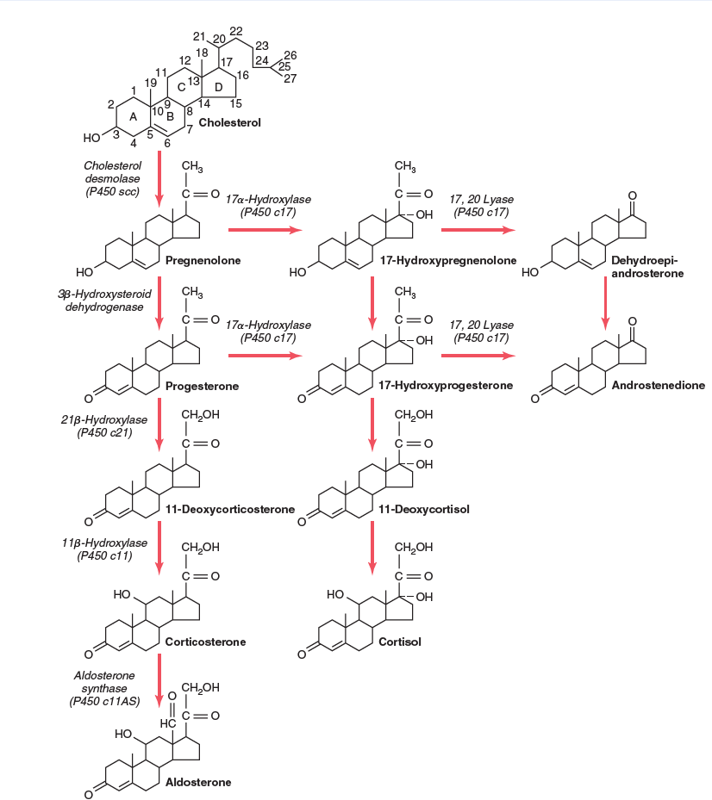
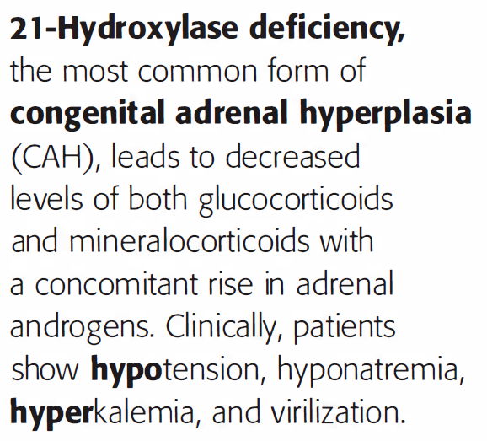
Synthesis of Adrenocortical Hormones

Slide 8
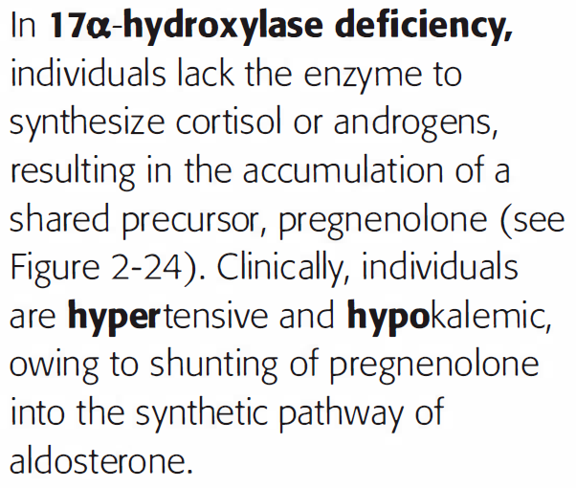
Synthesis of Adrenocortical Hormones

Slide 10
Physiological Anatomy of the Kidney
The functional unit of the kidney is the nephron.
The nephron is composed of a renal corpuscle and tubules.
The renal corpuscle is composed of the glomerulus and Bowman’s capsule. -------------------------------------------------------------------------
Functions of nephrons:
1- Removal of waste products and formation of urine.
2- Regulation of blood volume and pressure.
3- Regulation of water and electrolytes levels in the blood.
4- Regulation of blood pH.

Slide 11
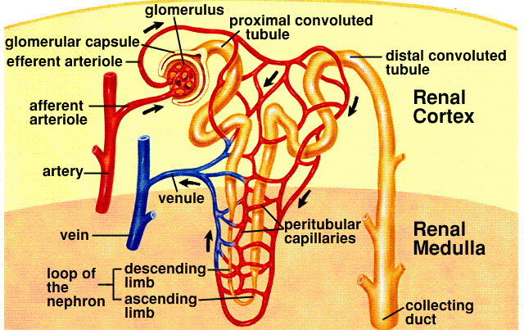
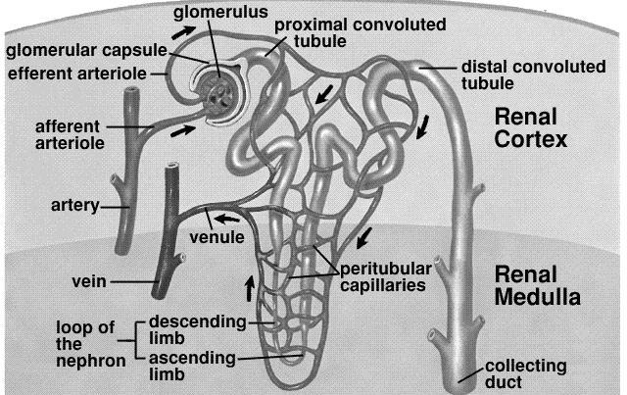
Nephron Structure

Slide 12
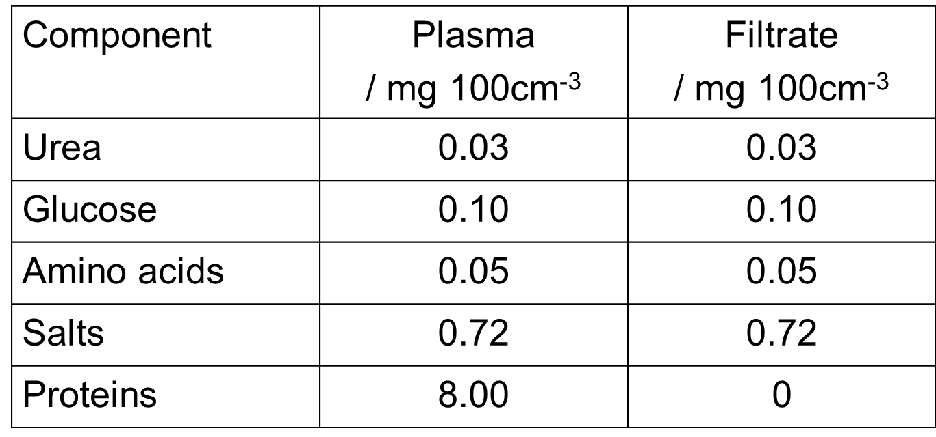
Plasma v.s Filtrate
The filtrate has the same concentration of plasma of everything except for proteins, which cannot pass through capillaries.

Slide 13
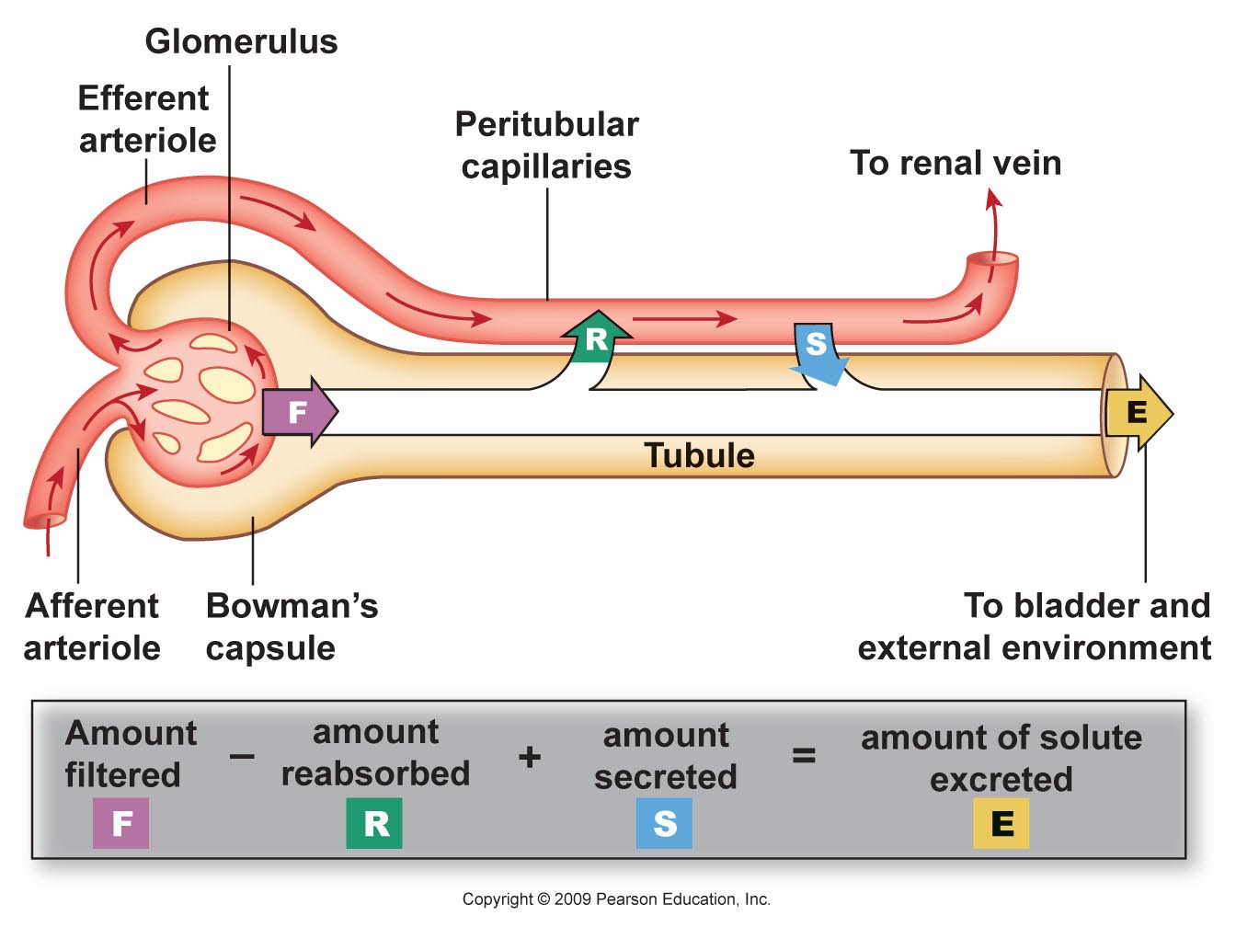
Functions of the Nephron
The nephron has vascular components (afferent and efferent arterioles) and tubular components (PCTs, Loop of Henle, and DCTs).
Tubular reabsorption and secretion is made to meet blood needs.

Slide 14
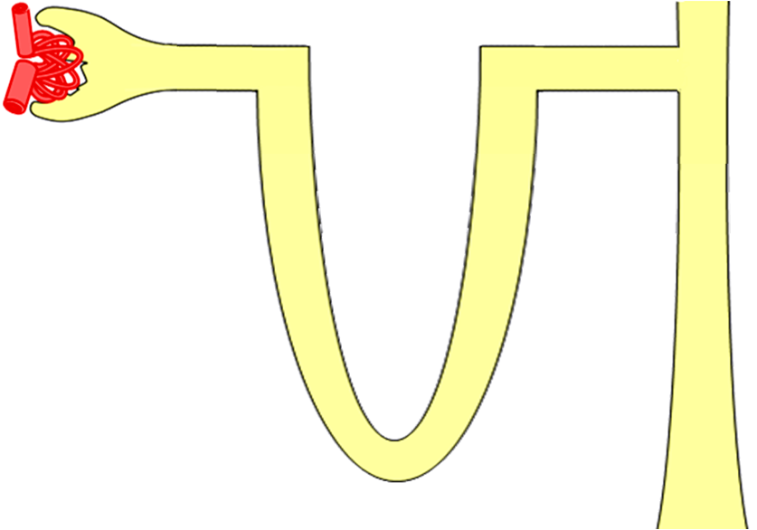
Protein free : water + solutes : same concentration as plasma : Na, K, Ca, chloride,
sulphate, phosphate, glucose, AAs, urea, creatinine………
125
ml/min
PCT Loop DCT
1250
ml/min
Collecting duct
1 – 1.5ml/min
1.5-2 L/day

Slide 15
In the nephrons, water and electrolytes are absorbed passively through the proximal convoluted tubules.
Hormones acts on the distal convoluted tubules and collecting ducts to renormalize water amount and electrolyte concentrations in the plasma by either increasing or decreasing the rate of reabsorption.
Maintenance of normal levels of water and electrolytes is very important. Why?
Water content affects blood pressure.
Electrolytes are important for many physiological functions in the body.

Slide 16
Adrenal Glands
Mineralocorticoids

Slide 17
Mineralocorticoids (Aldosterone)
Mineralocorticoids are the acute life-saving portion of the adrenocortical hormones.
The main site of action of mineralocorticoids is the kidney. However, it acts also on the salivary glands, sweat glands and intestinal epithelial cells.
Wherever aldosterone works, it acts to increase sodium levels, and decrease potassium and hydrogen levels in the blood.
Aldosterone has a short half-life (20 minutes).
Its level in the blood is 2000 times less than that of cortisol (Aldosterone: 6 ng/dl), Cortisol: 12 microgram/dl).

Slide 18
Mineralocorticoids (Aldosterone)
Overall Effects of Aldosterone:
Increases sodium reabsorption
Increases excretion of: K+, H+
If aldosterone is secreted in excessive amounts, this results in:
Hypokalemia
Increased water retention → Increased blood pressure
Alkalosis

Slide 19
Effect of Aldosterone on Kidneys
Aldosterone increases exchange transport of sodium and potassium (i.e. increases sodium reabsorption and potassium excretion) in the DCT, collecting tubules and collecting ducts.
Normal sodium level: 140-150 mg/dl.
Normal potassium level: 4-5 mg/dl.

Slide 20
Effect of Aldosterone on the Circulatory System
Aldosterone increase sodium reabsorption and potassium excretion.
Under the effect of aldosterone, Na+ plasma concentration rises only slightly, because its absorption is accompanied with passive water retention (i.e. aldosterone expands the ECFV in an isotonic manner).
There’s little increase in plasma sodium concentration due to:
Simultaneous reabsorption of water.
Stimulation of thirst center and increased water intake.

Slide 21
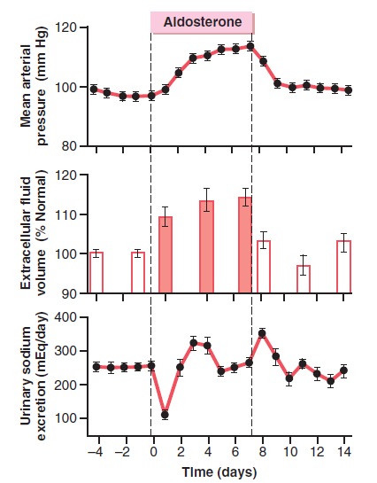
Effect of Aldosterone on the BP
The increase in ECF volume increases the blood pressure.
But, when BP increases 15-25 mm Hg above normal, the arterial pressure increases GFR (Pressure Natriuresis & Pressure Diuresis).

Slide 22
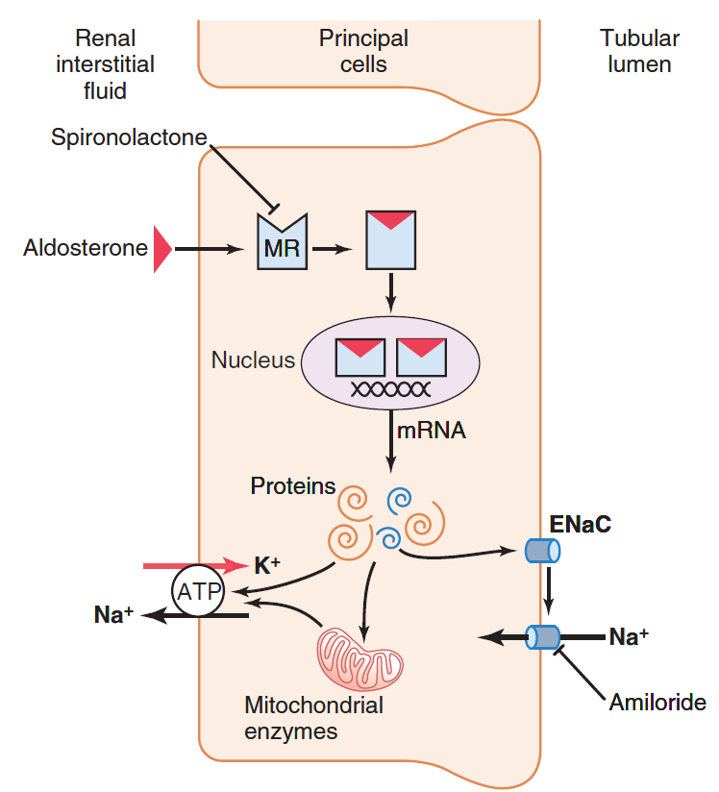
Cellular Mechanism of Aldosterone
Steps of aldosterone action:
1- Diffusion
2- Binding to MR receptor
3- H-R complex diffuses into the nucleus.
4- Activation of certain genes.

Slide 23
Luminal membrane
Basal membrane
Ald
Na⁺
mRNA
K⁺
Na⁺
K⁺
3Na⁺
Na⁺
ATP
2K⁺

Slide 24
What Are the Genes Expressed?
Sodium-potassium pump: to pump sodium from the tubular cells into the blood, and potassium from the blood into cells.
Sodium channel proteins: to transport sodium into the cells and potassium into the tubules.
Mitochondrial enzymes: to provide the cell with the needed energy for the transport work.

Slide 25
Cortisol as a Mineralocorticoid
Cortisol plasma level is 2000 times that of aldosterone.
It can bind to mineralocorticoid receptor.
But cortisol is converted to cortisone that doesn’t have mineralocorticoid activity.
Cortisol Cortisone
If this enzyme is deficient or inhibited, cortisol will not be converted to cortisone and it will have mineralocorticoid activity.
Licorice inhibits this enzyme, that’s why it has mineralocorticoid activity.
11beta-hydroxysteroid dehydrogenase type 2

Slide 26
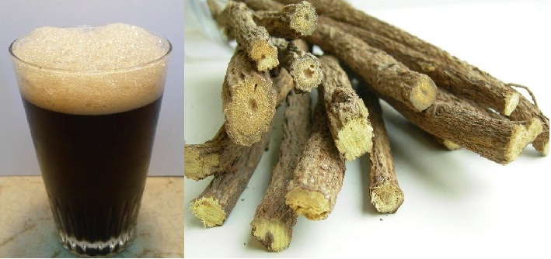
Licorice Effect on Water Retention
Licorice contains glycyrrhetinic acid that inhibits 11beta-hydroxysteroid dehydrogenase type 2
Cortisol will act as a mineralocorticoid
Increased sodium and water retention
Less thirst
A preferable drink in Ramadan.

Slide 27
Regulation of Aldosterone Secretion
Plasma level of potassium:
1- A slight increase of K+ level stimulates aldosterone secretion.
Eating a meal rich in potassium increases aldosterone secretion.
2- K+ stimulates the conversion of cholesterol into aldosterone.
3- Increased K+ causes depolarization in the membranes of the adrenal cortex cells. This increases intracellular calcium levels and stimulates aldosterone release.

Slide 28
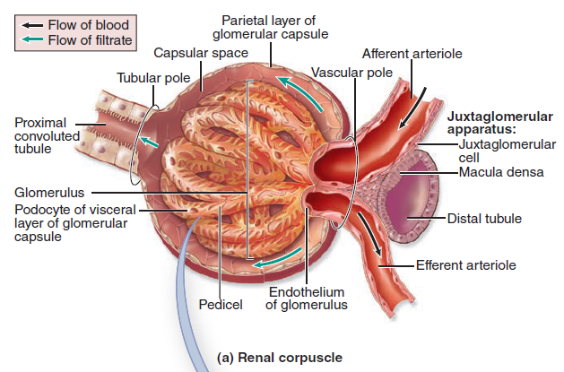
Regulation of Aldosterone Secretion
Renin-Angiotensin System:
Juxtaglomerular apparatus.
Macula densa

Slide 29
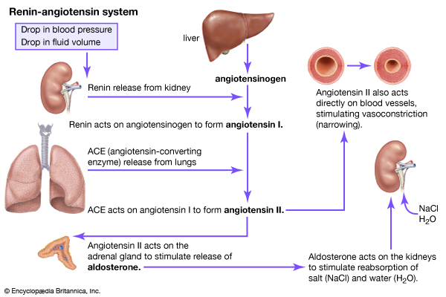

Slide 30
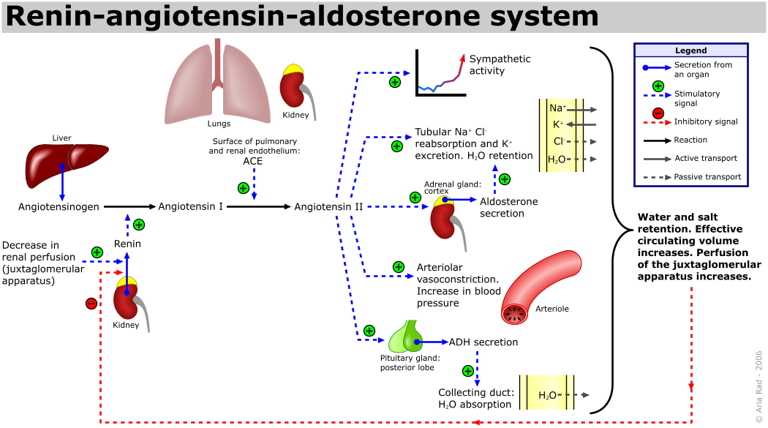

Slide 31
Regulation of Aldosterone Secretion
Plasma level of Sodium:
1- A normal increase or decrease in Na+ levels doesn’t affect aldosterone secretion significantly.
2- Acute decline in plasma Na+: about 20 mEq/L stimulates aldosterone secretion.
3- Dietary restriction of Na+ (mild & slow decline) increases aldosterone secretion. WHY?
Decreased Na+ levels within the tubular fluid in the kidney → this will increase renin secretion.
Decreased ECF volume activates the renin-angiotensin system.

Slide 32
Regulation of Aldosterone Secretion
ACTH: has a tonic function (i.e. when ACTH is deficient, the responsiveness of zona glomerulosa is decreased).
ANP:
ANP opposes the actions of both ADH and aldosterone.
When blood volume increases, atrial stretch increases and this results in higher ANP secretion. ANP decreases aldosterone levels.

Slide 33
Minerals Homeostasis is Regulated by Many Other Mechanisms
Sympathetic stimulation

Slide 34
Adrenal Glands
Glucocorticoids

