Slide 1
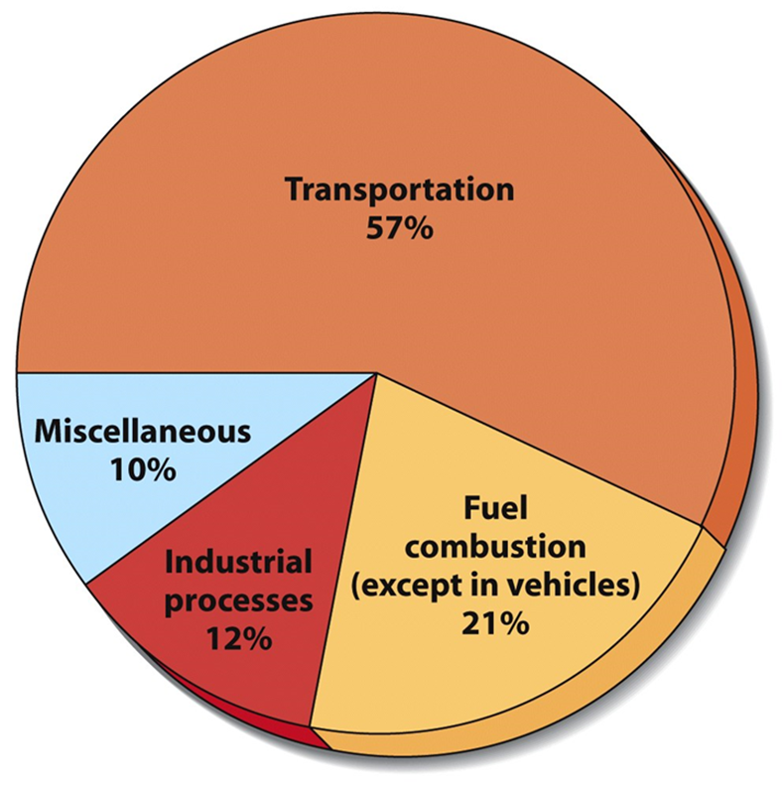
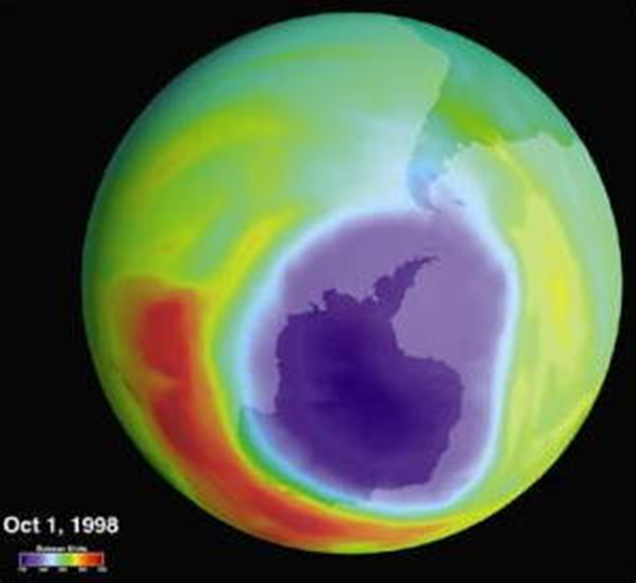
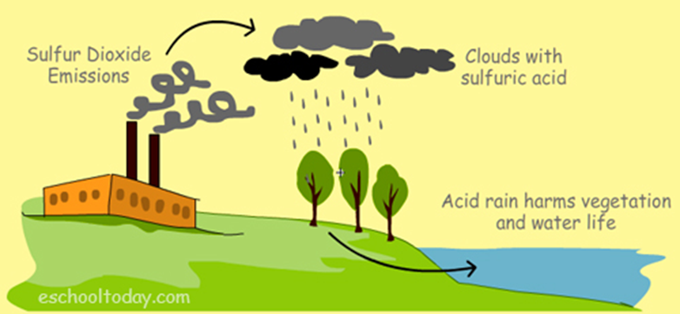
Air Pollution
Dr. Sireen Alkhaldi, DrPh
Community Medicine, First semester 2015/ 2016
Faculty of Medicine/ The University of Jordan

Slide 2
Learning Objectives
Identify the classes of air pollutants and their sources.
Review the various effects of exposure to air pollutants.
Evaluate different solutions to air quality control.

Slide 3
What is the Atmosphere?
The Earth is surrounded by a blanket of air (made up of various gases) called the atmosphere.
The atmosphere helps protect the Earth and allow life to exist. Without it, we would be burned by the intense heat of the sun during the day or frozen by the very low temperatures at night.

Slide 4
What is the Atmosphere?
Atmospheric Composition:
  Nitrogen 78.08%, Oxygen 20.95%, Argon 0.93%, Carbon dioxide 0.04%.
Ecosystem benefits:
  Blocks UV radiation
  Moderates the climate
  Redistributes water in the hydrologic cycle

Slide 5
What is Air Pollution?
Air pollution occurs when gases, dust particles, fumes (or smoke) or odors are introduced into the atmosphere in a way that makes it harmful to humans, animals and plants.

Slide 6
Significance of the Problem
Ambient (outdoor air pollution) in both cities and rural areas was estimated to cause 3.7 million premature deaths worldwide in 2012. (WHO).
88% of those premature deaths occurred in low- and middle-income countries, and the greatest number in the WHO Western Pacific and South-East Asia regions.

Slide 7
Significance of the Problem
WHO estimates that some 80% of these deaths were due to ischemic heart disease and strokes, while 14% of deaths were due to chronic obstructive pulmonary disease or acute lower respiratory infections; and 6% of deaths were due to lung cancer.
In addition to outdoor air pollution, indoor smoke is a serious health risk for some 3 billion people who cook and heat their homes with biomass fuels and coal.

Slide 8
Definitions
Air pollutants are airborne gases, particles, and aerosols that are added to the atmosphere by natural events or human activities in concentrations that threaten the well-being of organisms or disrupt the orderly functioning of the environment.
Primary air pollutants pollute the air when emitted directly into the atmosphere.
Secondary air Pollutants are created by chemical reactions between primary air pollutants in the atmosphere. May involve sunlight or a catalyst.

Slide 9
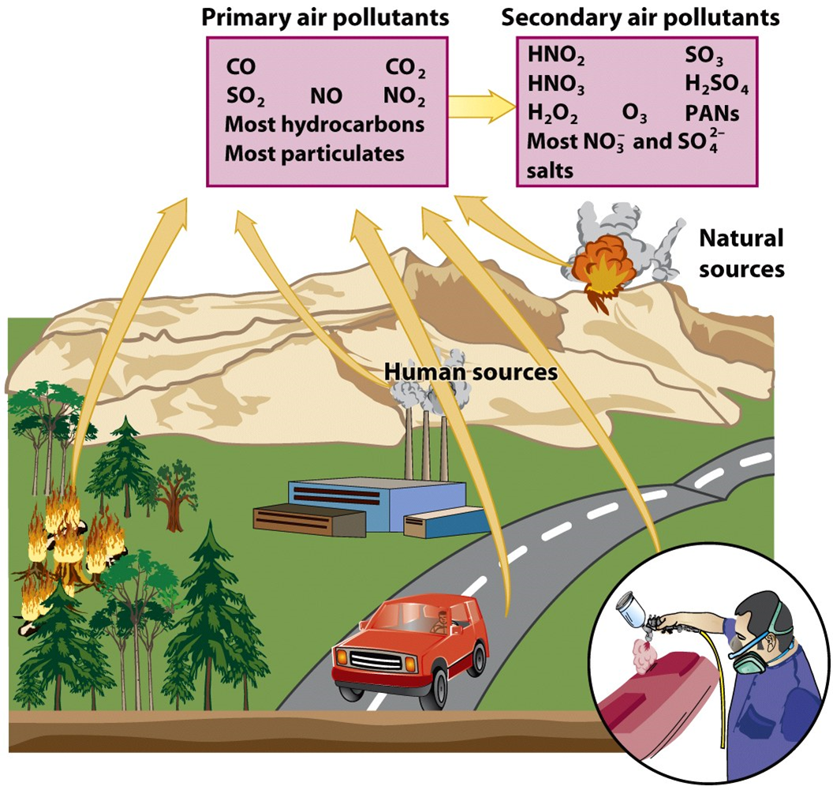

Slide 10

The most common air pollutants
Oxides of Carbon
Volatile Hydrocarbons (VOC’s)
Oxides of Nitrogen
Sulfur Compounds
Photochemical Smog
Suspended Particulates (aerosols)

Slide 11
1. Oxides of Carbon
Oxides of Carbon: odorless, colorless
1. Carbon dioxide (CO2):
fourth most common atmospheric gas
produced from oxidation of hydrocarbons
asphixiant
greenhouse gas
2. Carbon monoxide (CO):
toxic in low concentrations
produced by incomplete combustion of fossil fuels.

Slide 12
2. Volatile Hydrocarbons: (VOC’s)
Volatile Hydrocarbons
1. Methane, terpenes: Mostly natural sources (marshes, ruminants, rice paddies, trees).
2. Benzene, tetrachloroethylene, gasoline, formaldehyde, many others: products of chemical industry used as solvents, paints, cleaning agents.
All may form secondary pollutants that irritate eyes and damage respiratory system (photochemical smog).

Slide 13
3. Oxides of Nitrogen
1. Nitric Oxide (NO)
Produced by soil microbes
Forms NO2 in combination with oxygen in atmosphere
2. Nitrous Oxide (N2O)
Natural and man made sources
Anesthetic
Greenhouse gas
3. Nitrogen Dioxide (NO2)
Formed in auto engines and electrical generating plants.
Contributes to heart, lung, liver and kidney diseases at high concentration
Responsible for brownish haze (smog)
Forms nitric acid in rainwater

Slide 14
4. Compounds of Sulfur
Compounds of Sulfur:
1. Sulfur Oxides (SO2, SO3, SO4):
volcanoes, sea spray, combustion of fossil fuels (coal)
irritate respiratory passages (SO2)
form acidic aerosols, acid rain (SO3, SO4)
damage lakes, forests, steel and masonry structures.
2. Hydrogen Sulfide
produced in anaerobic environment
bad odor, toxic asphixiant, explosive

Slide 15
5. Photochemical Smog
Forms in bright sunlight from:
nitrogen oxides
Hydrocarbons (VOCs)
oxygen
Interact chemically to produce powerful oxidants like ozone (O3) and peroxyacetyl nitrate (PAN).
These secondary pollutants are damaging to plant life and lead to the formation of photochemical smog.
PAN and ozone are primarily responsible for the eye irritation so characteristic of this type of smog.

Slide 16
Ozone
Tropospheric Ozone
Man- made pollutant in the lower atmosphere
Secondary air pollutant
Component of photochemical smog
Stratospheric Ozone
Essential component that screens out UV radiation in the upper atmosphere
Man- made pollutants (ex: CFCs*) can destroy it.
*CFC’s are gases used in refrigeration and in pressured spray cans.

Slide 17
6. Suspended Particles
Particulate mater (PM): Thousands of different solid or liquid particles suspended in air. It includes dust, fungal spores, ammonia, sodium chloride, lead, asbestos, black carbon (soot), soil particles, and sulfuric acid droplets.
PM affects more people than any other pollutant.
The most health-damaging particles are those with a diameter of 10 microns or less, (≤ PM₁₀), which can penetrate and lodge deep inside the lungs.
Greatest threat to health among air pollutants.
Chronic exposure to particles contributes to the risk of developing cardiovascular and respiratory diseases, as well as of lung cancer.

Slide 18

What are the sources of air pollution?
Three main sources:
  Transportation
  Power plants
  Industry

Slide 19
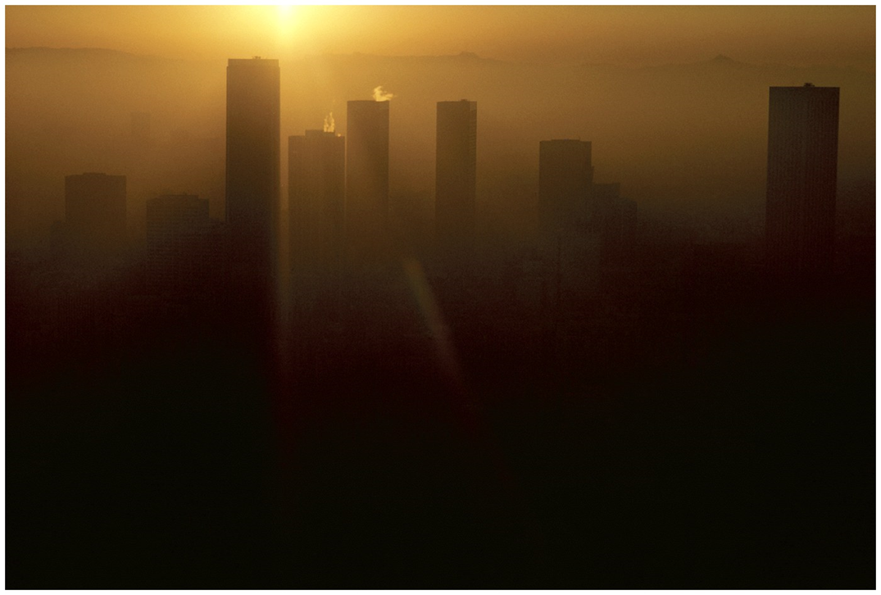
Urban Outdoor Air Pollution
Photochemical Smog (ex: Los Angeles below)
  Brownish-orange haze formed by chemical reactions involving sunlight, nitrogen oxide, and hydrocarbons

Slide 20
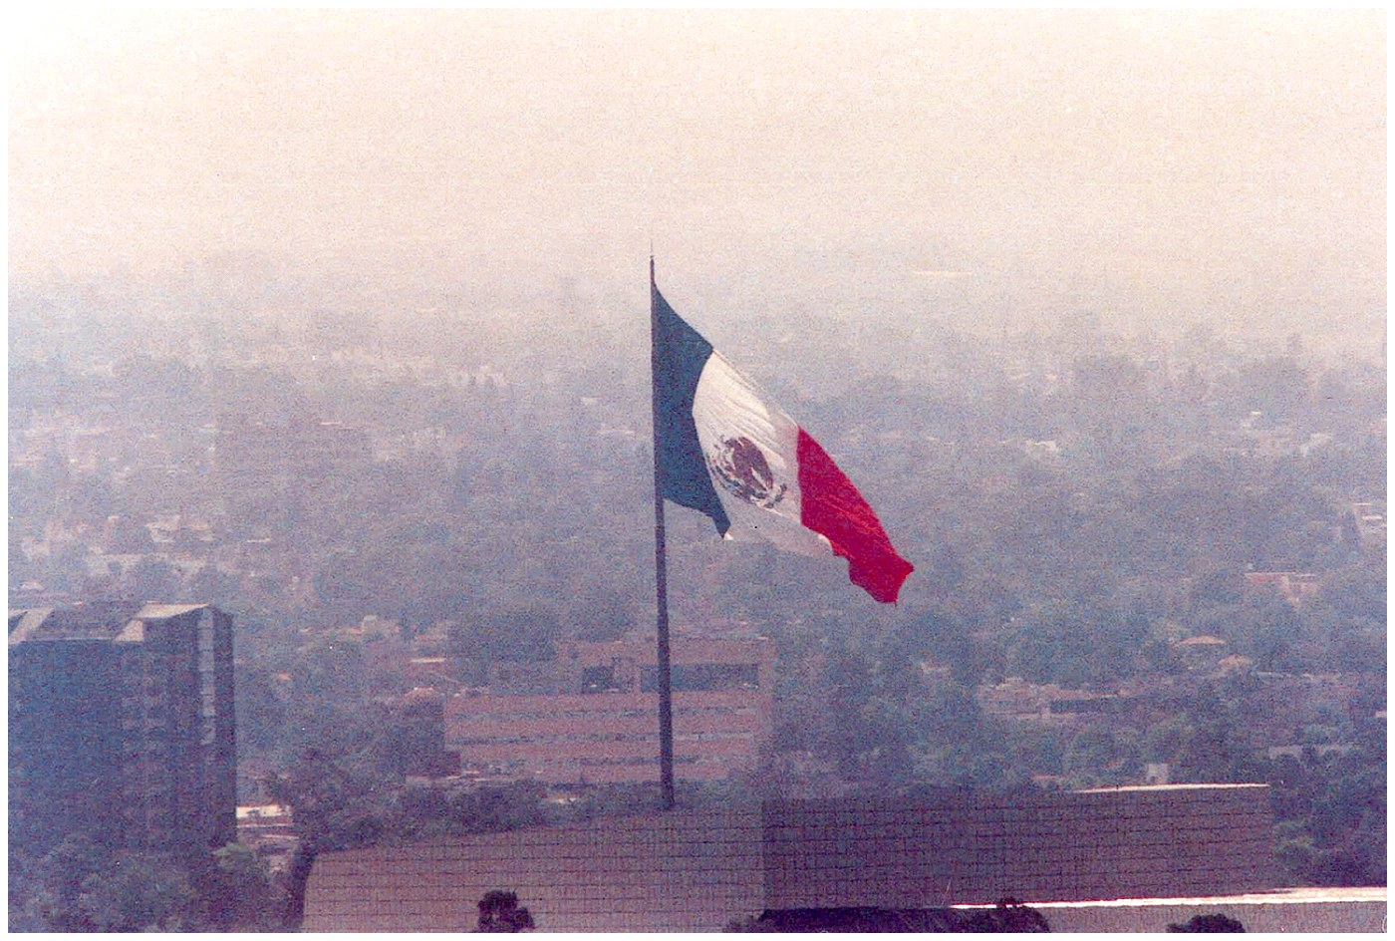
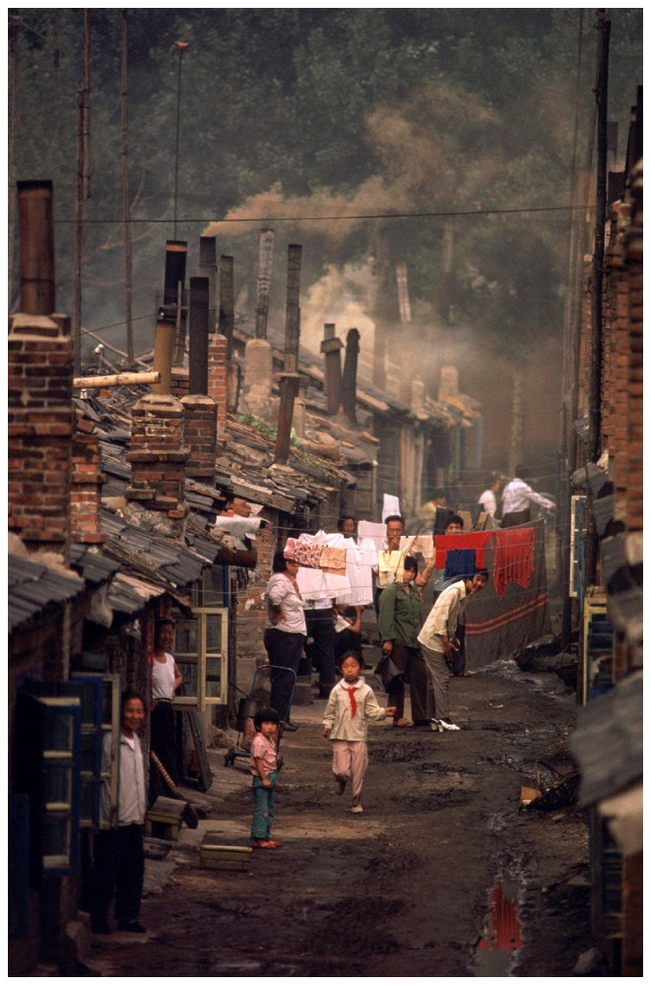
Air Pollution in Beijing and Mexico City
Beijing (left)
Mexico City (above)

Slide 21
Health Effects of Air Pollution
Sulfur Dioxide and Particulate material
  Irritate respiratory tract and impair ability of lungs to exchange gases
Nitrogen Dioxides
  Causes airway restriction
Carbon monoxide
  Binds with iron in blood hemoglobin
  Causes headache, fatigue, drowsiness, death
Ozone
  Causes burning eyes, coughing, and chest discomfort

Slide 22
Children and Air Pollution
Greater health threat to children than adults
  Air pollution can restrict lung development
  Children breath more often than adults
Children who live in high ozone areas are more likely to develop asthma

Slide 23

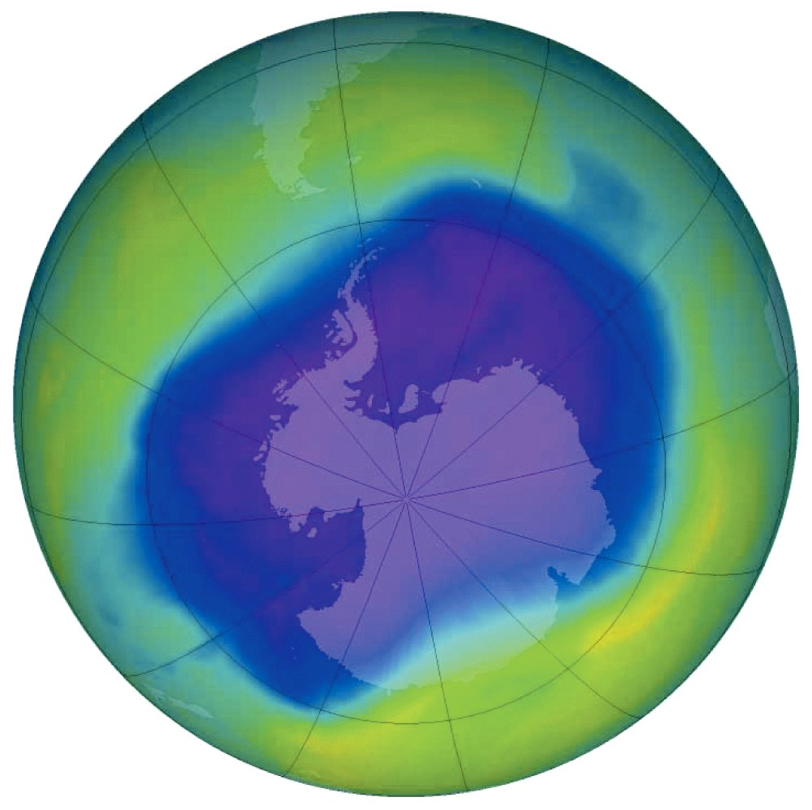
Ozone Depletion in Stratosphere
Ozone thinning/hole
  First identified in 1985 over Antarctica
Caused by
  human-produced bromine and chlorine containing chemicals
  Ex: CFCs

Slide 24
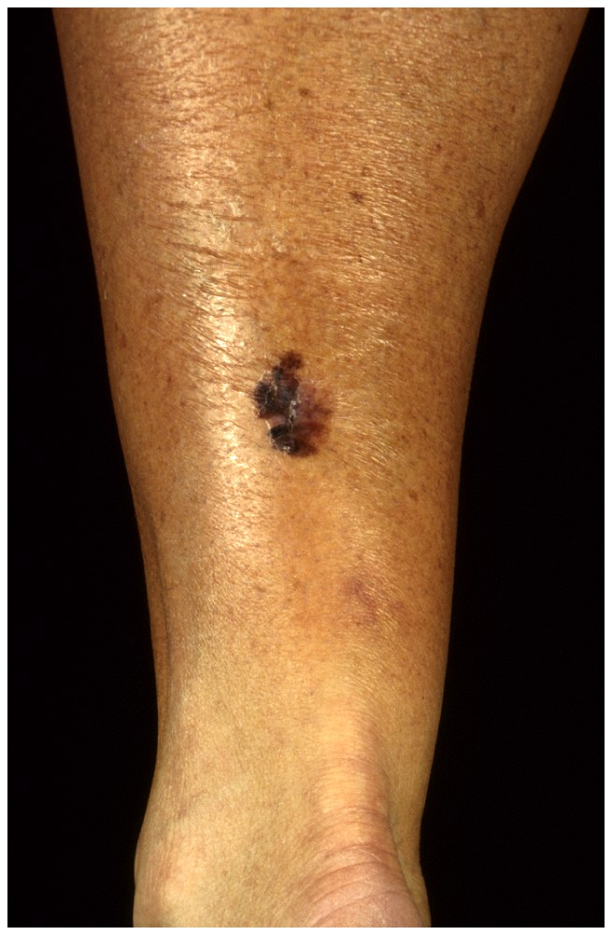
Effects of Ozone Depletion
Higher levels of UV-radiation hitting the earth
  Eye cataracts
  Skin cancer (right)
  Weakened immunity
May disrupt ecosystems
May damage crops and forests

Slide 25
Recovery of Ozone Layer
Montreal Protocol (1987)
  Reduction of CFCs
Phase out of all ozone destroying chemicals is underway globally
Satellite pictures in 2000 indicated that ozone layer was recovering
Full recovery will not occur until 2050

Slide 26
Acid Deposition
Sulfur dioxide and nitrogen dioxide emissions react with water vapor in the atmosphere and form acids that return to the surface as either dry or wet deposition.

Slide 27
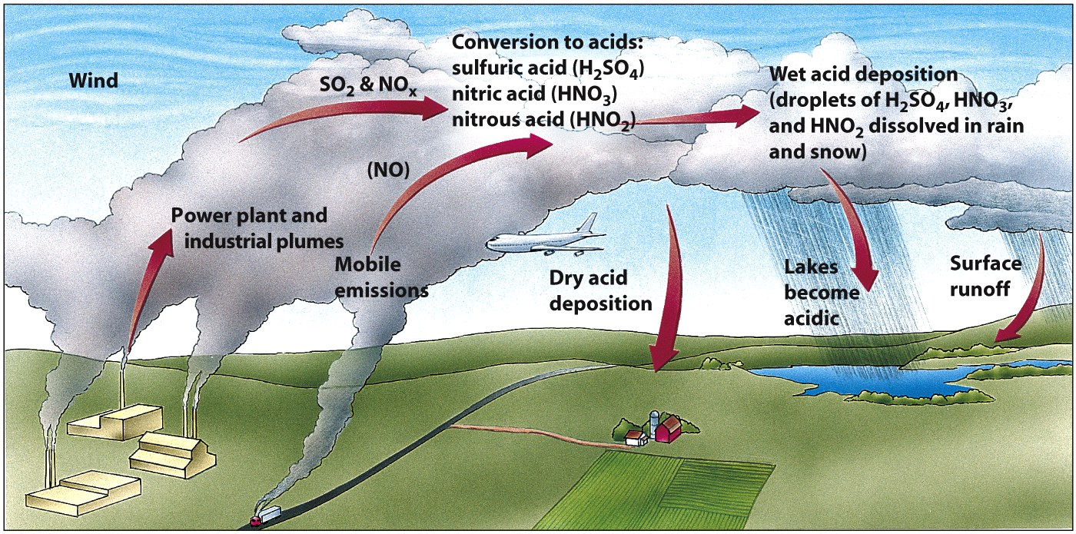
How Acid Deposition Develops

Slide 28
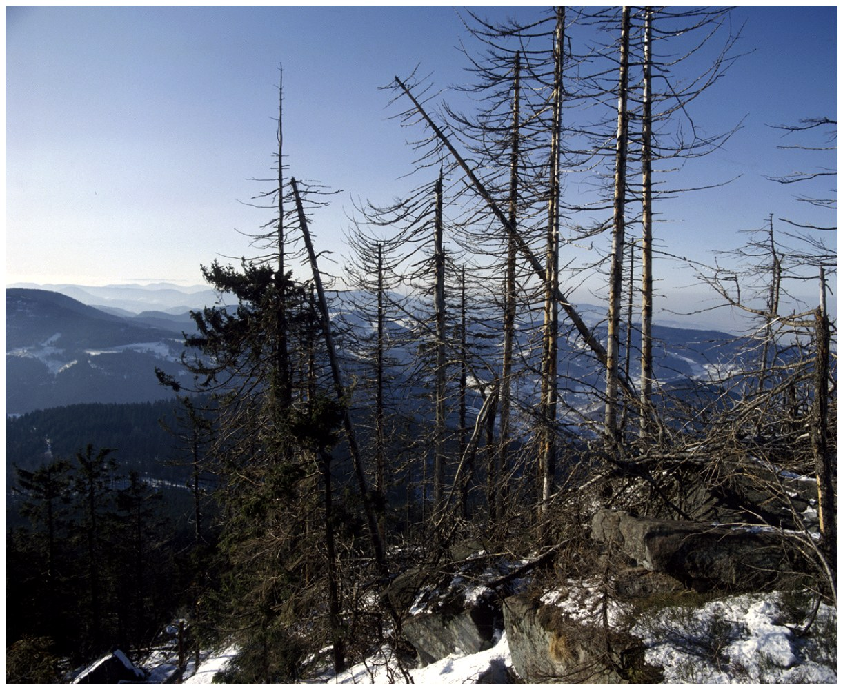
Effects of Acid Deposition
Declining Aquatic Animal Populations
Thin-shelled eggs prevent bird reproduction
Forest decline
  Ex: Black forest in Germany (50% is destroyed)

Slide 29
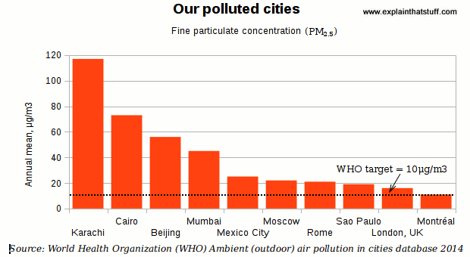

Slide 30
Agricultural Effects of Air pollution
Air pollution can seriously affect the growth of plants.
It is easy to find chemical residues in plants that grow alongside highways.
Also, the huge increase in atmospheric carbon dioxide now causing global warming, and climate change is expected to have a major impact on the world's agriculture (reducing crop yields in some places but potentially increasing yields elsewhere).

Slide 31
Other Effects of Air Pollution
The buildings look dirty and stained in black. Exhaust fumes from traffic are generally to blame.
Apart from blackening buildings with soot, they also contribute to acid rain (see below) that can wear away stonework in a matter of years or decades.

Slide 32
Air Pollution Around the World
Air quality is deteriorating rapidly in developing countries
Shenyang, China
  Residents only see sunlight a few weeks each year
Developing countries have older cars
Still use leaded gasoline

Slide 33
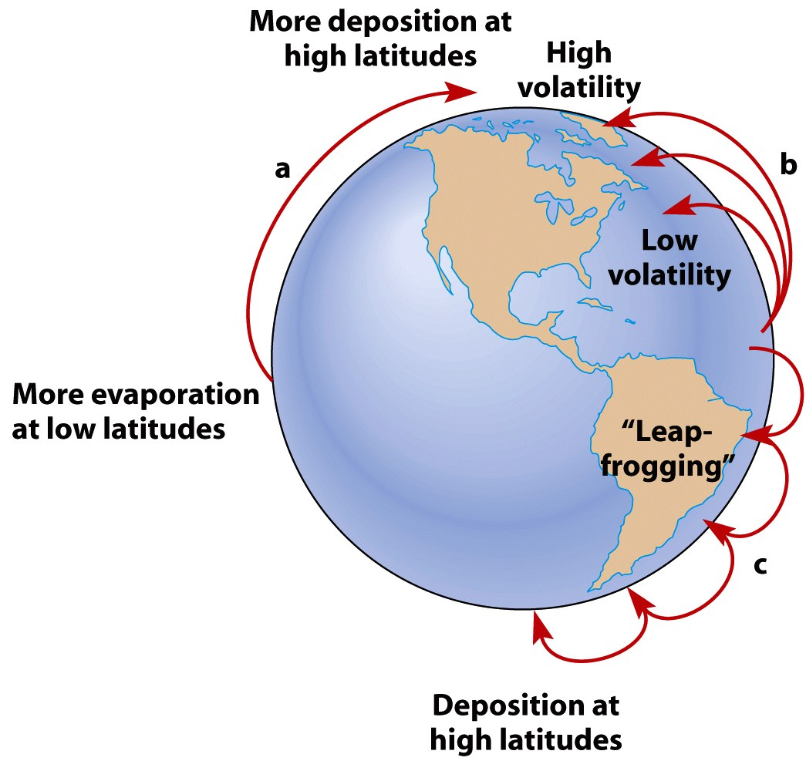
Long Distance Transport of Air Pollutants

Slide 34
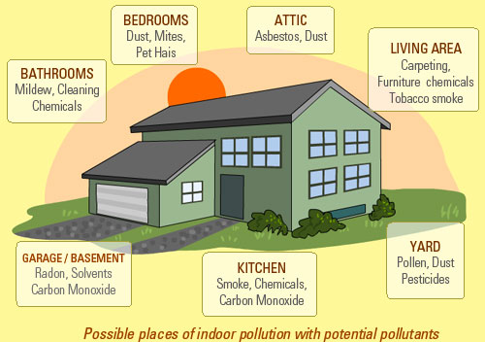
Indoor
Air Pollution

Slide 35
Indoor Air Pollution
Around 3 billion people cook and heat their homes using open fires and leaky stoves, and burning biomass (wood, animal dung and crop waste) and coal.
Nearly 2 million people die prematurely from illness attributable to indoor air pollution from household solid fuel use (e.g. chronic obstructive respiratory disease).
Nearly 50% of pneumonia deaths among children under five are due to particulate matter inhaled from indoor air pollution.
Both women and men exposed to heavy indoor smoke are 2-3 times more likely to develop COPD
Source: WHO: http://www.who.int/mediacentre/factsheets/fs292/en/

Slide 36
Indoor Air Pollution
Common indoor air pollutants include:
Tobacco smoke: This is smoke burning cigarettes or exhaled smoke by people smoking.
Biological Pollutants: These include allergens such as pollen from plants, hair from pets, fungi and some bacteria.
Radon: This is a gas that is naturally emitted from the ground. Radon can be trapped in basements of building and homes. The gas is known to cause cancer after exposure over a period.
Carbon Monoxide: This is a poisonous gas with no color or smell. Carbon monoxide is produced when fuels such as gas, oil, coal or wood do not burn fully

Slide 37
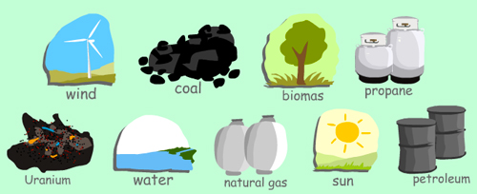
How can we solve the problem of air pollution?
Technological Solutions: cars and factories with less pollution, and using renewable energy.
Laws and Regulations
Raising awareness and changing behavior

Slide 38
