Slide 1
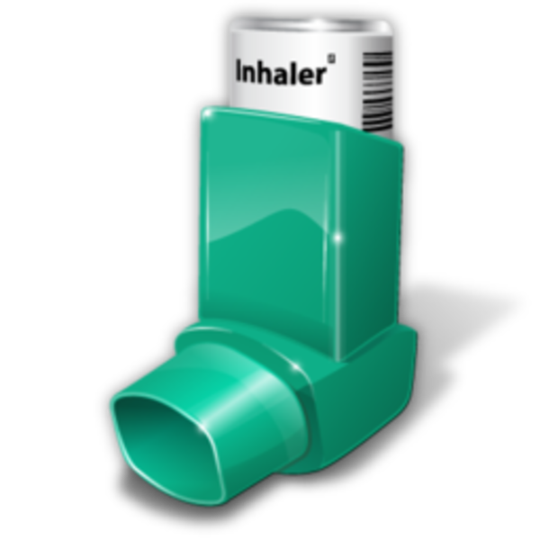
Allergic asthma
Done by : Mohammad Da’as
p.s. please read the notes under the slides

Slide 2
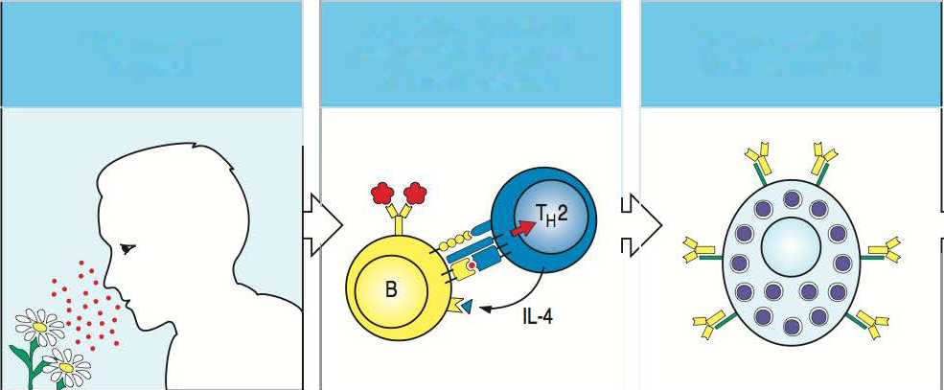
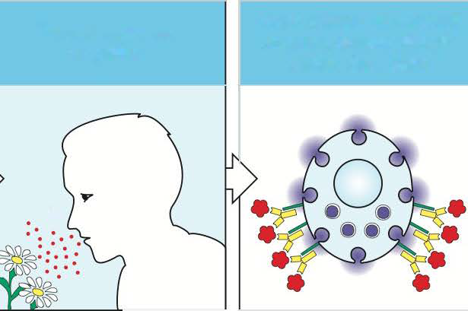
و جرّنا الحرام لحرام فحرام
IL-4 drives B cells to
produce lgE in response
to pollen antigens
Pollen-specific lgE
binds to mast cell
First exposure to pollen
Second exposure
to pollen
Acute release of mast-cell
contents causes allergic
rhinitis (hay fever)
Notes:
Allergic reaction :
** first exposure to the allergen
1- allergic response → Type 1 hypersensitivity reaction involve in :
A) Activation of Helper CD4 TH2 Cells B) IgE antibody formation C) Mast-cell sensitization D) Recruitment of eosinophils
2- IgE Abs bind to Fcε receptor on the surface of a mast cell and basophils “armed OR resting OR sensitized” .
** Already sensitized individual is re-exposed to the same allergen “pre-sensitization to the allergen” .
1- The allergen antigen “multivalent” will cross-links these bound IgE → immediate release of mast-cell granule content “histamine” 2- Histamine + various enzymes (tryptase) → increase blood flow & vascular permeability “early phase an immediate allergic reaction”
3-the allergic reaction becomes worse with each subsequent exposure “ by increasing the level of Abs + T-cells”.
4- several exposures might be needed before the allergic reaction is initiated “or a strong exposure”.

Slide 3
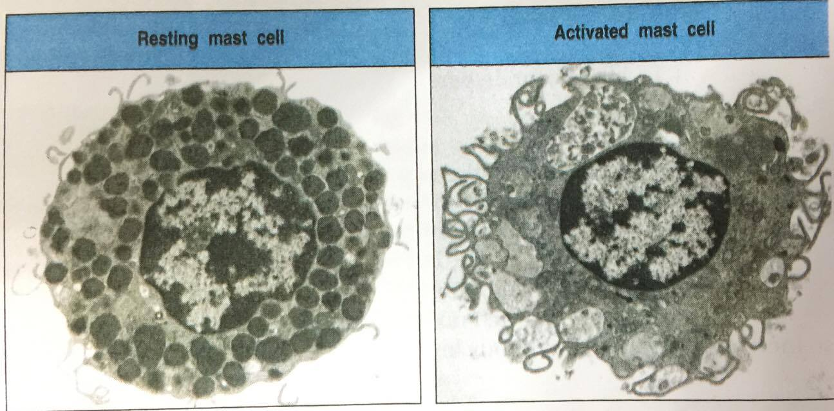
Notes:
** Degranulation of mast cells

Slide 4
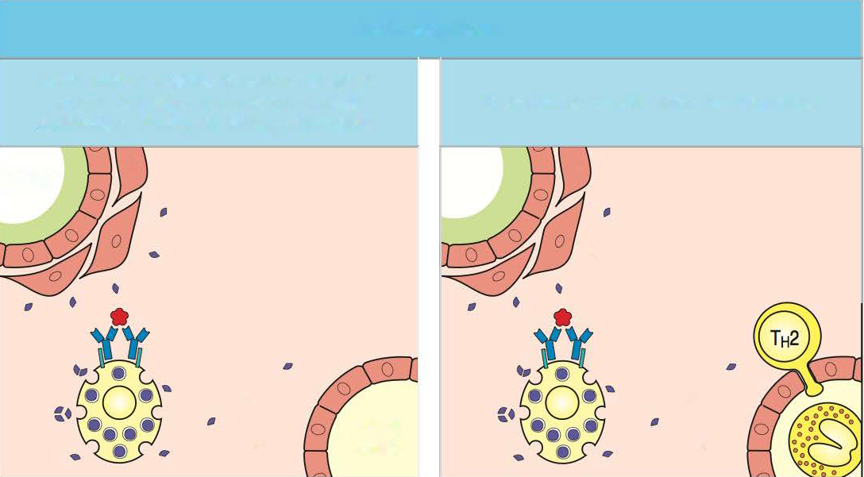
Acute responses
Inflammatory mediators cause increased
mucus secretion & smooth muscle
contraction leading to airway obstruction
Recruitment of cells from the circulation
airway
airway
blood
vessel
Notes:
After 12 hours of contact with antigen: (Late-phase reaction) → Cellular infiltrate.
1- Arachidonic acid metabolism in mast-cells produce (PGs & leukotrienes) →increase blood flow & vascular permeability & bronchial smooth muscle contraction.
2-Activated mast-cell & TH2 cells → cytokines (IL-3, IL-4,IL-5, TNF-α) + mediators (histamine) → influx of monocytes + more TH2 lymphocytes+
eosinophils into the site of allergen entry.
** all of these products will cause tissue damage and overproduction of mucus which will lead to

Slide 5
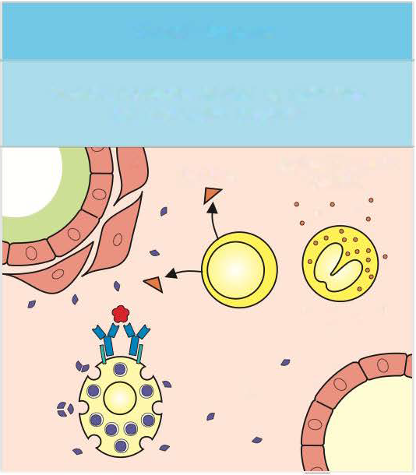
Chronic response
Chronic response caused by cytokines
and eosinophil products
cytokines
eosinophil granule
proteins
Notes:
** Further tissue damage and influx of inflammatory cells → “Chronic allergic reactions” ** mast-cell are also reactivated and thus the inflammatory reaction is perpetuated (immortal).
** Chronic inflammation might cause irreversible damage to the airways

Slide 6
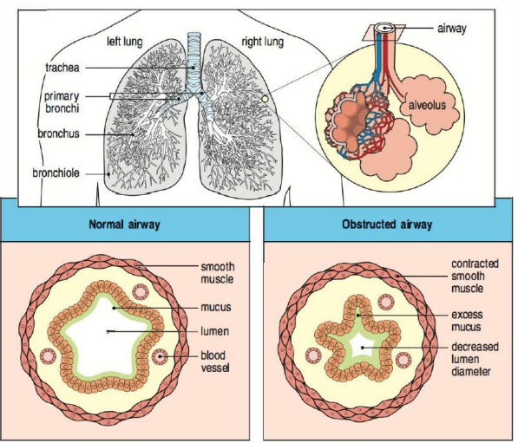
Obstruction of Airways in Chronic Asthma
Notes:
- asthma attack can be triggered not only by the allergen but by viral infection, cold air, exercise, or pollutants. This is due
to a general hyperirritability or hyperresponsiveness of the airways,
-leading to constriction in response to nonspecific stimuli, thus reducing the air flow.

Slide 7
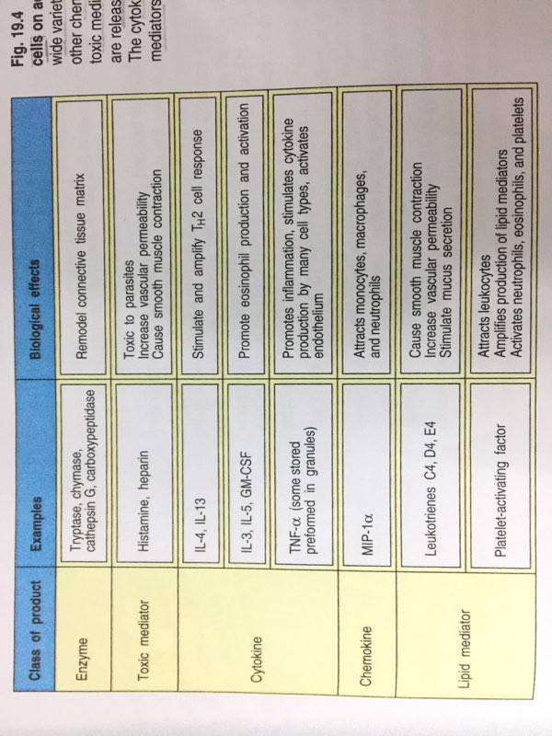
Notes:
Molecules Released by Mast Cell on Activation

Slide 8
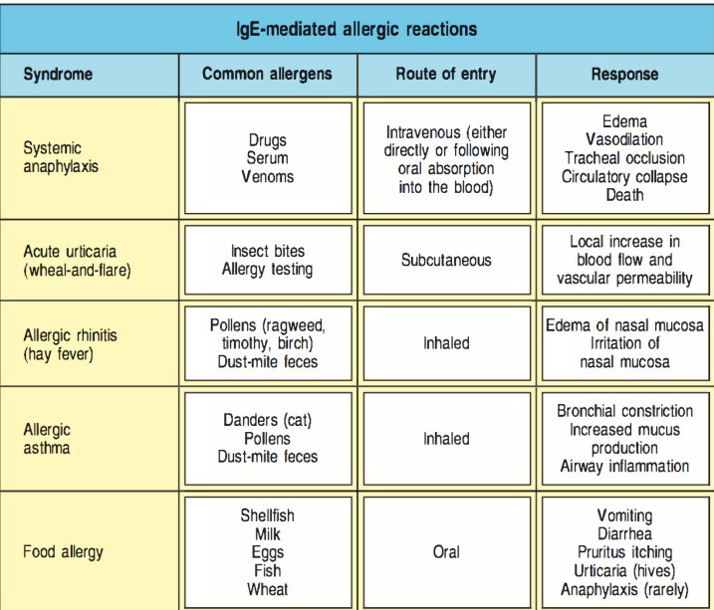
Notes:
- 15% of the population suffer from IgE-mediated allergic diseases !! ☺ ☺

Slide 9
هلأ جدّ بدنا نحكي عن ال Asthma
- One of the most common allergies
- Caused by inhaled particles containing foreign proteins “allergen” → Allergic rhinitis & allergic asthma.
- The allergic inflammatory response → increase hypersensitivity of the airways not only to re-exposure to allergen but also to non-specific agents. A) Intrinsic asthma “without allergies” B) Extrinsic asthma “ Allergic asthma”

Slide 10
The case of Frank Morgan
A 14 year old boy
Persistent wheezing for 2 weeks
No response to frequent inhalation treatment.
History of Chronic asthma & rhinitis.
Notes:
- Bronchodilator → β2-adrenergic agent albuterol !!

Slide 11
When he was 3 years old
First attack of wheezing.
Similar attack of varying severity on subsequent visits

Slide 12
History (1)
4 years old
5 years old
Attacks of coughing and wheezing .
every spring & end of the summer
Sweat test to rule out cystic fibrosis .
It was within normal range.
During the past 10 years → admitted 3 times to hospital for the treating of asthma “Bronchodilators and intravenous steroids”
-Many emergency visits with SEVERE ASTHMA ATTACKS
Maxillary sinusitis X3 “showed on radiograph” associated with exacerbation of his asthma & green nasal discharge
Notes:
Cystic fibrosis → possible cause of chronic respiratory problems.
-Coughing & sometimes wheezing :
Exercises (Gym classes, Basketball, Soccer games)
Going out during cold winter months.
He was able to avoid wheezing by inhaling Albuterol (15-30 min) before exercise .
-Night cough , wheezing during having a cold.
-Chest symptom were treated by Bronchodilators.

Slide 13
History (2)
As a baby
4 years old
Eczema.
Cleared up by age 5
Intermittent sneezing, nasal discharge & nasal congestion (rhinitis).
Worsen upon exposure to Cats & dogs.
Nasal symptoms → oral Anti histamine “moderate success”

Slide 14
Family History Genetic predisposition→ “Atopy”
Asthma
Allergic rhinitis
Notes:
a syndrome characterized by a tendency to be “hyperallergic”. A person with atopy typically presents with one or more of the following : eczema (atopic dermatitis), allergic rhinitis (hay fever), or allergic asthma.

Slide 15
Arrival
Thin & unable to breath easily.
No fever.
Nasal mucosa → severely congested
Wheezing heard all over the lung fields.
Normal CBC but “high # eosinophils & high serum IgE”
Lung function tests → obstructive lung disease + reduced peak flow rate PFR + reduced expiratory volume in the first second of expiration FEV1.

Slide 16
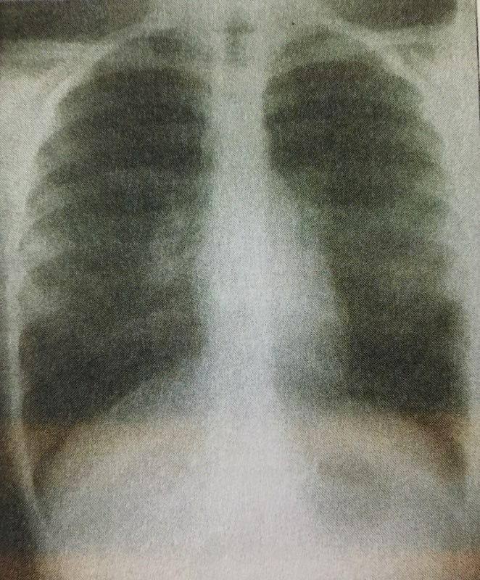
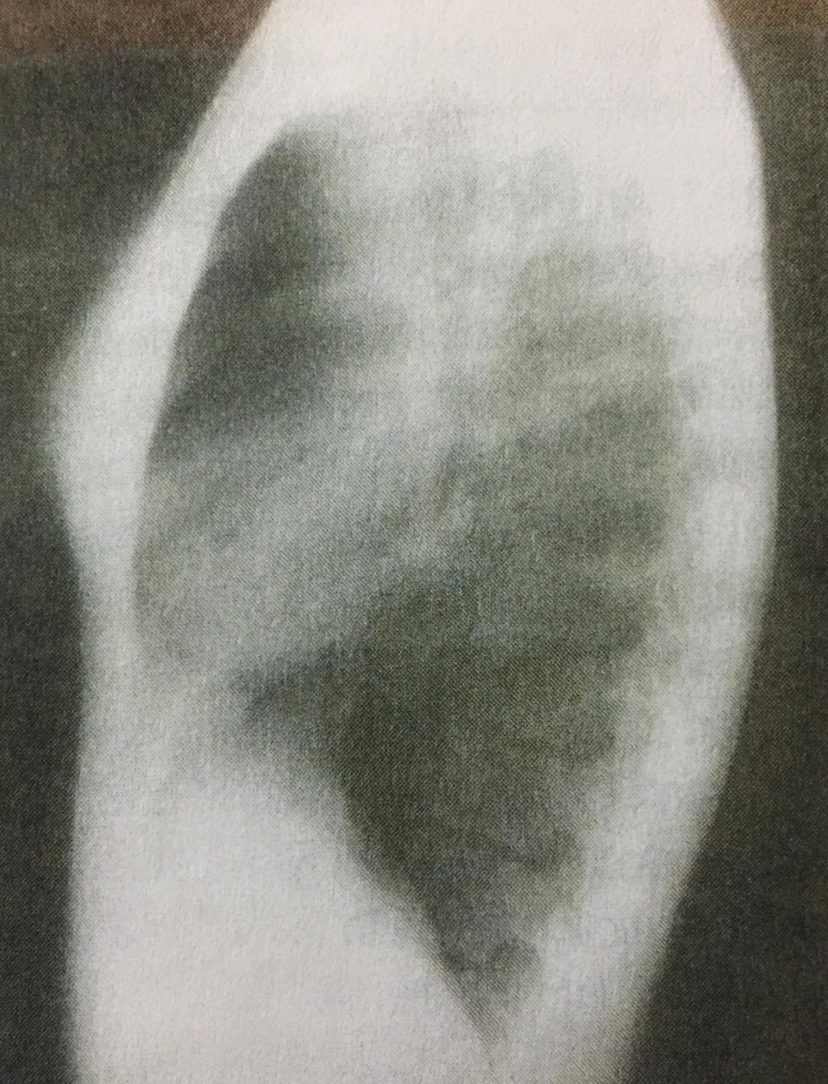
Hyperinflation
Notes:
A-P view → volume “8-9 ribs instead of 7” - Lateral view → increased A-P dimension
- bronchial markings are accentuated and can be seen → inflammation of airways

Slide 17
More & more tests
Don’t press
RAST “ antigen specific IgE”
Histological examination of frank’s nasal fluid → presence of Eosinophils. “أكيد لازم يطلع هيك”

Slide 18
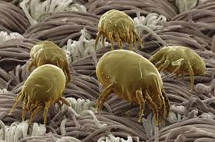
Notes:
1- dog’s denders
2- cat’s denders
3- Dust mites
4- Tree & grass
5- Rag weed

Slide 19
Treatment
Immediate inhalation of bronchodilator ventolin “albuterol sulfate” at the clinic → felt better & PFR rose ♥
Sent home on 1-week course of corticosteroid prednisone “orally”
Inhale albuterol 3 times a day , with extra dose if needed but not more than every 4 hours.
Inhaled Disodium cromoglycate
Oral antihistamine + beclomethasone “inhaled” → to relieve his nasal congestion

Slide 20
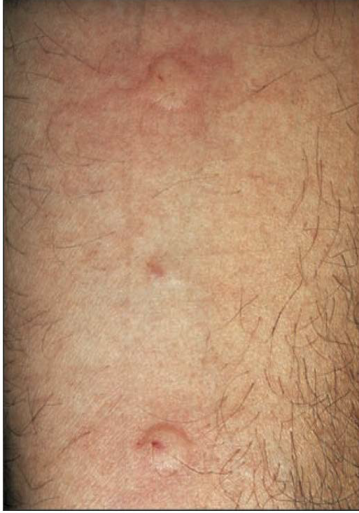
Hypersensitivity skin tests “skin prick test”
Ragweed
-This test was done After 2 weeks.
- Type 1 hyper sensitivity positive.
- He was advised to avoid contact with allergens.
- Started immunotherapy with injection of (grass, trees , ragweed pollen, dust mite antigens)
- A year and a half later his asthma is stable , Rhinitis require much less medication
Saline
control
Histamine
control

Slide 21
AND HE LIVES ♥♥
Thank you ☺
Hala madrid

