Slide 1
ANTENATAL HYDRONEPHROSIS,
Dr Hashem Al-Momani
Pediatric Surgeon
JORDAN UNIVERSITY HOSPITAL

Slide 2
Definitions
Hydronephrosis: is dilatation of the pelvicalyceal system
Hydronephrosis is not synonymous with obstruction.

Slide 3
obstruction
obstruction is defined as ‘‘a restriction to urinary outflow that, if untreated, leads to renal deterioration’’

Slide 4
Clinical Presentation
Symptomatic : with infection or pain for which surgical indications are straightforward.
asymptomatic prenatally detected hydronephrosis for which surgical indications are controversial

Slide 5
incidence
The incidence of prenatal hydronephrosis is 1 to 3 % of pregnancies
17–30% are bilateral.

Slide 6
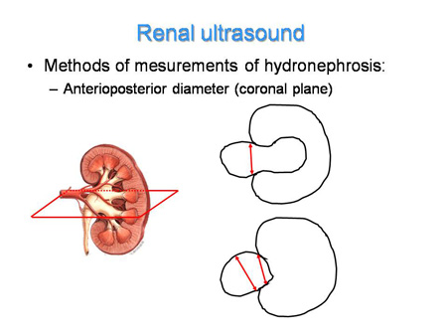

Slide 7
Causes of antenatal hydronephrosis
Intermittent hydronephrosis
obstruction
  Ureteropelvic junction obstruction
  Ureterovesical junction obstruction (megaureter)
  Posterior urethral valves
Vesicorenal reflux

Slide 8
CLINICAL PRESENTATION
INFANTS
OLDER CHILDREN

Slide 9
INFANTS
ANTENATAL ULTRASOUND
ABDOMINAL MASS
HEMATURIA
U.T.I.
GASTROINTESTINAL DISTURBANCES

Slide 10
OLDER CHILDREN
PAIN: ABDOMINAL OR FLANK
HEMATURIA FOLLOWING MILD TRAUMA
U.T.I.

Slide 11
Postnatal investigation of hydronephrosis

Slide 12
Postnatal imaging of prenatally detected hydronephrosis shows
resolution on postnatal ultrasound in 48% of patients,
a non-obstructed hydronephrosis in 15%,
ureteropelvic junction obstruction in 11%,
vesicoureteral reflux in 9%,
megaureter in 4%,
multicystic dysplastic kidney in 2%
ureterocele in 2%
renal cyst in 2%
posterior urethral valves in 1%

Slide 13
postnatal ultrasound
Timing of the first postnatal ultrasound
On day 3 to 7
At Birth: false negatives because of dehydration and a low glomerular filtration rate immediately after birth.

Slide 14
VCUG
VUR
Neurogenic bladder
PUV

Slide 15
renogram
A renogram is usually obtained at 8–12 weeks to allow for maturation of kidney function
in suspected PUJ obstruction a renogram estimates baseline differential function and rapidity of radiotracer washout.

Slide 16
Renogram
MAG-3 (mercaptoacetyl-triglycine) is used to evaluate differential function and drainage as in PUJ obstruction
DMSA (Dimercapto-succinic acid ), deposits tracer in proximal tubular cells and is superior to MAG-3 in assessing cortical scars and function in the setting of reflux but is inferior in assessing drainage

Slide 17
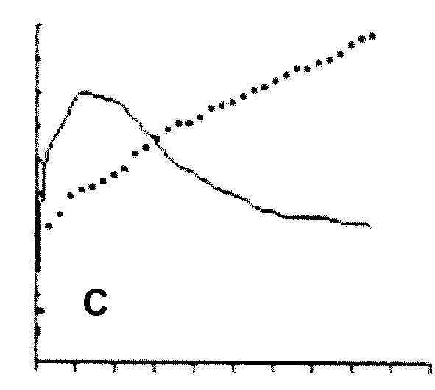
renogram

Slide 18
Newer studies
MR- Urography
3D-Ultrasound

Slide 19
MR- Urography
does not use ionizing radiation.
high-resolution anatomic images of the entire urinary tract,
functional information about the concentration and excretion of the individual kidneys includes:
  differential renal function (DRF)
  renal transit time : If less than 245 seconds R/O Obstruction
  estimation of individual kidney glomerular filtration rate (GFR)

Slide 20
MCD

Slide 21
Lt PUJ

Slide 22
MIDURETERIC OBSTRUCTION

Slide 23
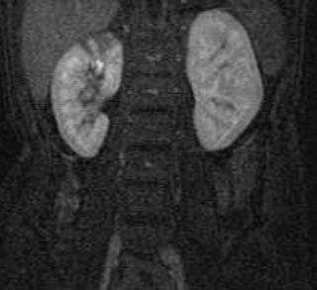
SCAR

Slide 24
Management of unilateral hydronephrosis
Surgery versus conservative
prior to the 1990s immediate surgery was the usual trend
recent studies into the natural history of hydronephrosis suggest that the majority will resolve spontaneously without adversely affecting renal function.

Slide 25
Surgery versus conservative
Only 23% of patients required surgery because of
  worsening renal function,
  worsening hydronephrosis
  UTI

Slide 26
Observation
Prophylactic antibiotics
Renal ultrasound every 2-12 months
Repeat MAG-3 for worsening ultrasound or symptoms

Slide 27
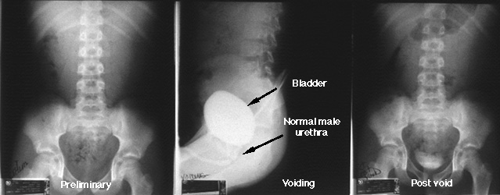
Normal Voiding Cystourethrogram (VCUG)

Slide 28
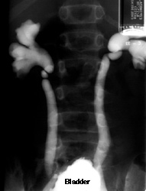
Reflux Seen on Voiding Cystourethrogram (VCUG)

Slide 29
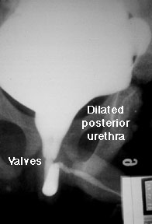
Posterior Urethral Valves Seen on Voiding Cystourethrogram

Slide 30
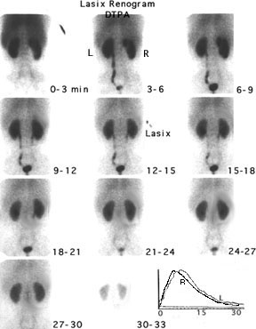
Normal Nuclear Renogram
Notes:
Normal Nuclear Renogram
After the venous injection of radioisotope, images are collected over three minute intervals. DTPA is one of four types of radionuclide agents used in imaging of the kidney. It is filtered through the glomerulus so it is useful in detecting perfusion of the kidney and glomerular filtration. It does not demonstrate function of the renal tubules. The images are read from left to right and from top to bottom. Note that, unlike x-rays, nuclear renograms show the left kidney on the left side (as you face the scan). The data collected by the camera is analyzed by a computer and plotted on a time graph. Counts (how much isotope is in the kidneys) is shown on the Y axis and time from injection is shown on the X axis. The response of each kidney is plotted separately.Notice that both kidneys take up the isotope rapidly (the curves are steeply rising between 1 and 3 minutes). The concentration of the isotope peaks at 4-6 minutes and then starts to fall. Normally at least half of the isotope is excreted and drained from the kidneys within 20 minutes. When obstruction is suspected, a diuretic is given 15 minutes after injection of the isotope to increase urine production. This will wash the isotope out of an enlarged kidney pelvis as long as there is no obstruction to urine flow into the bladder. See a scan showing obstruction.

Slide 31

Nuclear Renogram of Kidney with Hydronephrosis(PUJ)
Notes:
Nuclear Renogram of Kidney with Hydronephrosis
After the venous injection, both kidney take up the radioisotope, DTPA. Notice that although the kidneys are the same size, the center of the right kidney has areas of decreased radioactivity (photopenia); the hilum of the right kidney is lighter grey. This indicates that the kidney has hydronephrosis; the pelvis is so large that the renal parenchyma is stretched over it.Notice that the left kidneys show peak concentration (computer generated curve in the lower right-hand corner of the image) at about 5-7 minutes. The left kidney promptly drains (the computer curve drops rapidly). The computer curve of the right kidney shows a much more gradual rise and it continues to rise almost to the end of the study. This shows that the right kidney doesn't drain; it is obstructed. Additional studies demonstrated that the obstruction occurred at the ureteropelvic junction.

Slide 32
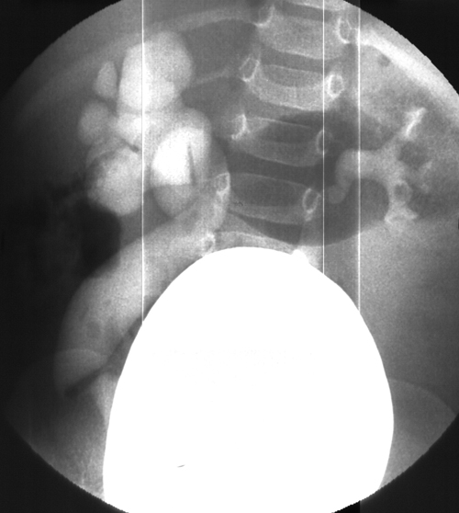
Primary Megaureter Coexisting With Reflux

Slide 33
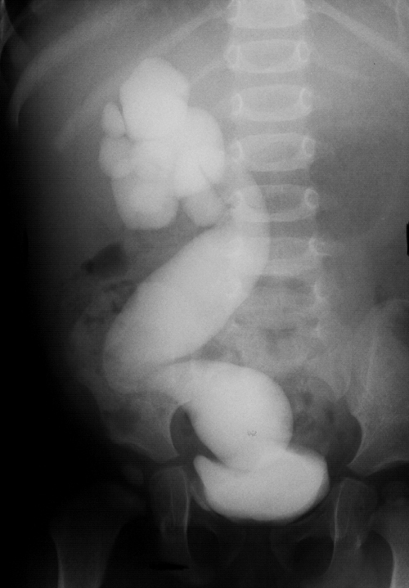
right primary megaureter plus reflux
Notes:
A late drainage film showed prompt drainage of the left reflux, but on the right, there was obstruction at the end of the ureter

Slide 34
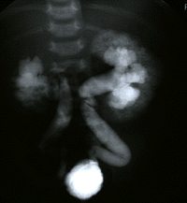
REFLUX AND INTRARENAL REFLUX

Slide 35
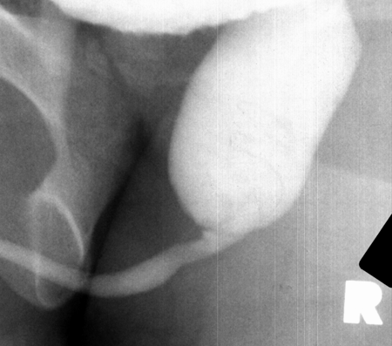
Posterior Urethral Valves

Slide 36
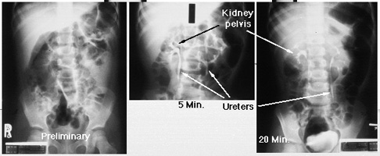
Normal Intravenous Pyelogram (IVP)

Slide 37
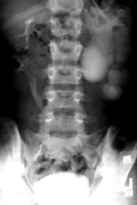
Intravenous Pyelogram Showing Hydronephrosis

Slide 38
THANK YOU

