Slide 1
Anti-inflammatory Drugs & Gout
Dr. Alia Shatanawi

Slide 2
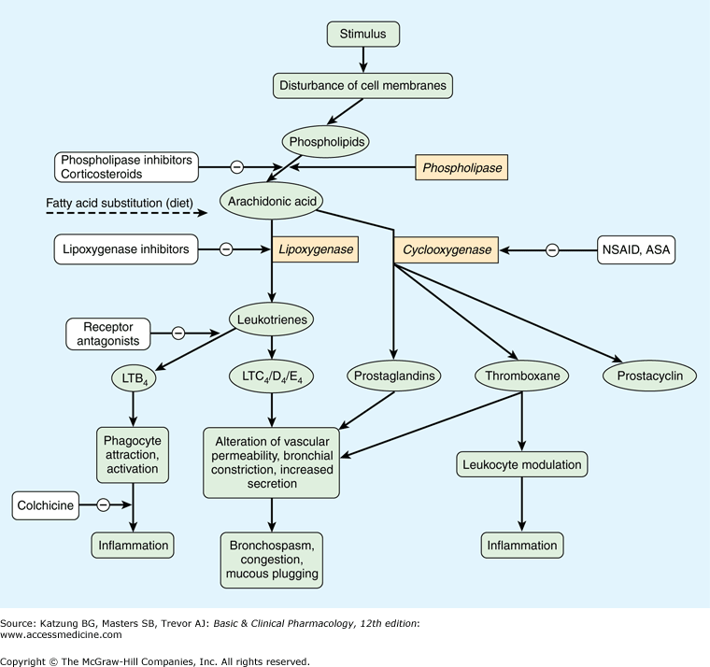
Notes:
Zileuton

Slide 3
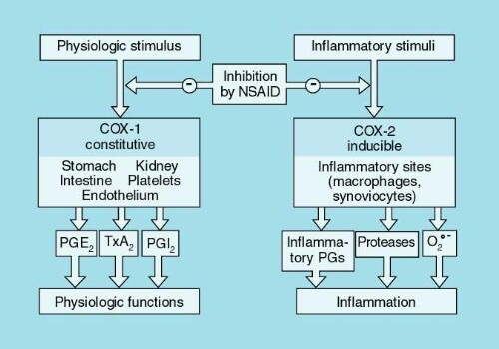

Slide 4
Propionic acid derivatives Ibuprofen , naproxen
their GI effects are generally less intense than those of aspirin.
These drugs are reversible inhibitors of the cyclooxygenases
All are well absorbed after oral administration and are almost totally bound to serum albumin.
They undergo hepatic metabolism and are excreted by the kidney.
The most common adverse effects are GI, ranging from dyspepsia to bleeding.
Side effects involving the central nervous system (CNS), such as headache, tinnitus, and dizziness, have also been reported. (less frequent)

Slide 5
Naproxen and Ibuprofen
Pregnancy : FDA pregnancy category: C
Naproxen should be avoided in late pregnancy because it may cause premature closure of the ductus arteriosus.
Ibuprofen has been assigned by the FDA to pregnancy category C prior to 30 weeks gestation and pregnancy category D at greater than or equal to 30 weeks gestation.
Ibuprofen not exceed 3200mg/day., and take with food or with water to avoid GI effect.
Notes:
强直性脊柱炎，急性肌腱炎，痛经

Slide 6
Acetic acid derivatives
Indomethacin , Sulindac , Etodolac
Indomethacin, cause lithium retention by reducing its excretion by the kidneys. Thus indomethacin users have an elevated risk of lithium toxicity.
For patients taking lithium (e.g. for treatment of depression or bipolar disorder), less toxic NSAIDs such as sulindac or aspirin are preferred.
Indomethacin also increases plasma renin activity and aldosterone levels, and increases sodium and potassium retention. It also enhances the effects of vasopressin. Together these may lead to:
edema (swelling due to fluid retention)
hyperkalemia (high potassium levels)
hypernatremia (high sodium levels)
hypertension

Slide 7
Oxicam derivatives
Piroxicam and Meloxicam
are used to treat RA, ankylosing spondylitis, and osteoarthritis.
They have long half-lives, which permit once-daily administration, and the parent drug as well as its metabolites are renally excreted in the urine.
Meloxicam inhibits both COX-1 and COX-2, with preferential binding for COX-2, and at low to moderate doses shows less GI irritation than piroxicam.

Slide 8
Fenamates
Mefenamic
have no advantages over other NSAIDs as anti-inflammatory agents.
Their side effects, such as diarrhea, can be severe, and they are associated with inflammation of the bowel.
Cases of hemolytic anemia have been reported

Slide 9
Heteroaryl acetic acids
Diclofenac, Tolmetin , Ketorlac
are approved for long-term use in the treatment of RA, osteoarthritis.
Diclofenac is more potent than indomethacin or naproxen.
Diclofenac accumulates in synovial fluid, and the primary route of excretion for the drug and its metabolites is the kidney.

Slide 10
Diclofenac sodium
Used PO 50mg after food, I.M. inj 75mg
Diclofenac potassium is prompt release and has quicker onset where as the Diclofenac sodium is delayed release.
Pregnancy: category C
Toxicity similar to others

Slide 11
Acetaminophen
Acetaminophen inhibits prostaglandin synthesis in the CNS.
This explains its antipyretic and analgesic properties.
Acetaminophen has less effect on cyclooxygenase in peripheral tissues, which accounts for its weak anti-inflammatory activity.
Acetaminophen does not affect platelet function or increase blood clotting time.

Slide 12
Therapeutic uses
Acetaminophen is a suitable substitute for the analgesic and antipyretic effects of aspirin for those patients with gastric complaints, those in whom prolongation of bleeding time would be a disadvantage, or those who do not require the anti-inflammatory action of aspirin.
Acetaminophen is the analgesic/antipyretic of choice for children with viral infections or chickenpox (recall that aspirin increases the risk of Reye's syndrome).

Slide 13
Adverse effects
With normal therapeutic doses, acetaminophen is virtually free of any significant adverse effects.
Renal tubular necrosis and hypoglycemic coma are rare complications of prolonged, large-dose therapy.
large doses Hepatic necrosis, a very serious and potentially life-threatening condition can result.
Renal tubular necrosis may also occur.
Periodic monitoring of liver enzymes tests is recommended for those on high-dose acetaminophen.

Slide 14
Pharmacokinetics
Acetaminophen is rapidly absorbed from the GI tract. A significant first-pass metabolism occurs in the luminal cells of the intestine and in the hepatocytes.
Under normal circumstances, acetaminophen is conjugated in the liver to form inactive metabolites.
A portion of acetaminophen is hydroxylated to form N-acetylbenzoiminoquinone a highly reactive and potentially dangerous metabolite .

Slide 15
At normal doses of acetaminophen, the N-acetylbenzoiminoquinone reacts with the sulfhydryl group of glutathione, forming a nontoxic substance
The antidote acetylcysteine acts as a precursor for glutathione, helping the body regenerate enough to prevent damage to the liver (in the first 24hours).
Acetaminophen and its metabolites are excreted in the urine.

Slide 16
Cyclooxygenase II Inhibitors
Do not affect platelet function.
May increase the incidence of edema and hypertension.
Less gastro irritant (half of COX2-non selective drugs).
Higher incidence of cardiovascular thrombotic events.

Slide 17
Cyclooxygenase II Inhibitors
Meloxicam
Rofecoxib
Celocoxib

Slide 18
Drugs for RA
Nonsteroidal anti-inflammatory drugs (NSAIDs)
Disease-modifying anti-rheumatic drugs (DMARDs)
Synthetic
Biologic
Glucocorticoids

Slide 19
DMARDs
Disease Modifying Anti-Rheumatic Drugs
Reduce swelling & inflammation
Improve pain
Improve function
Have been shown to reduce radiographic progression (erosions)

Slide 20
DMARDs
Synthetic
Biologic

Slide 21
Synthetic DMARDs
Methotrexate
Sulphasalazine
Chloroquine
Hydroxychloroquine
Leflunomide

Slide 22
Synthetic DMARDs
Methotrexate
Sulphasalazine
Chloroquine
Hydroxychloroquine
Leflunomide

Slide 23
Methotrexate (MTX)
Dihydrofolate reductase inhibitor
↓ thymidine & purine nucleotide synthesis
“Gold standard” for DMARD therapy
7.5 – 30 mg weekly
Absorption variable
Elimination mainly renal

Slide 24
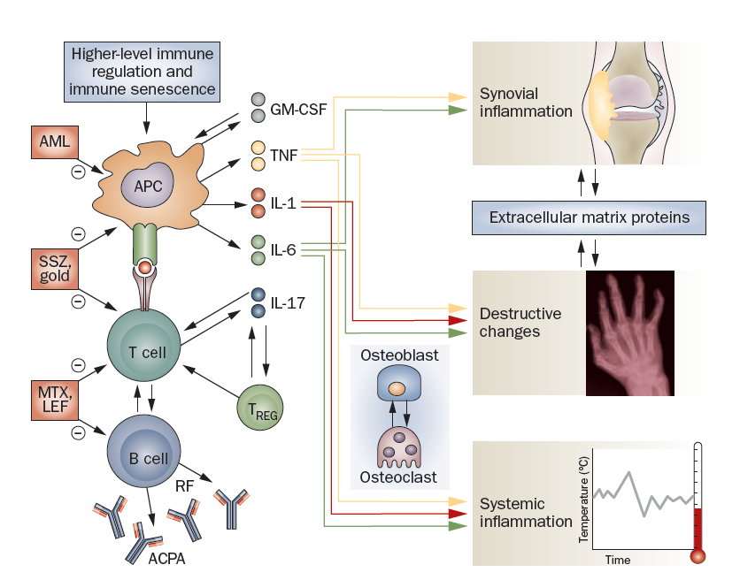

Slide 25
MTX adverse effects
Hepatotoxicity
Bone marrow suppression
Dyspepsia, oral ulcers
Pneumonitis
Teratogenicity
Folic acid reduces GI & BM effects
Monitoring
FBC, ALT, Creatinine

Slide 26
Synthetic DMARDs
Methotrexate
Sulphasalazine
Chloroquine
Hydroxychloroquine
Leflunomide

Slide 27
Sulphasalazine
Sulphapyridine + 5-aminosalicylic acid
Remove toxic free radicals
Remission in 3-6 month

Slide 28
Elimination hepatic
Dyspepsia, rashes, BM suppression

Slide 29
Synthetic DMARDs
Methotrexate
Sulphasalazine
Chloroquine /Hydroxychloroquine
Leflunomide

Slide 30
Chloroquine, Hydroxychloroquine
Mechanism unknown
Interference with antigen processing ?
Anti- inflammatory and immunomodulatory
For mild disease

Slide 31
Chloroquine cont
Take a month to see the effect

Slide 32
Chloroquine cont
Side effects
Irreversible Retinal toxicity, corneal deposits
Ophthalmologic evaluation every 6 months

Slide 34
Synthetic DMARDs
Methotrexate
Sulphasalazine
Chloroquine
Hydroxychloroquine
Leflunomide

Slide 35
Leflunomide
Competitive inhibitor of dihydroorotate dehydrogenase (rate-limiting enzyme in de novo synthesis of pyrimidines)
Reduce lymphocyte proliferation

Slide 36
Leflunomide cont
Oral
T ½ - 4 – 28 days due to EHC
Elimination hepatic
Action in one month
Avoid pregnancy for 2 years

Slide 37
Side effects of leflunomide
Hepatotoxicity
BM suppression
Diarrhoea
rashes

Slide 38
Combination therapy (using 2 to 3) DMARDs at a time works better than using a single DMARD

Slide 39
Common DMARD Combinations
Triple Therapy
Methotrexate, Sulfasalazine, Hydroxychloroquine
Double Therapy
Methotrexate & Leflunomide
Methotrexate & Sulfasalazine
Methotrexate & Hydroxychloroquine

Slide 40
DMARDs
Synthetic
Biologic

Slide 41
BIOLOGIC THERAPY
Complex protein molecules
Created using molecular biology methods
Produced in prokaryotic or eukaryotic cell cultures

Slide 42
Biologics
Monoclonal Antibodies to TNF
Infliximab
Adalimumab
Soluble Receptor Decoy for TNF
Etanercept
Receptor Antagonist to IL-1
Anakinra
Monoclonal Antibody to CD-20
Rituximab

Slide 43
Tumour Necrosis Factor (TNF)
TNF is a potent inflammatory cytokine
TNF is produced mainly by macrophages and monocytes
TNF is a major contributor to the inflammatory and destructive changes that occur in RA
Blockade of TNF results in a reduction in a number of other pro-inflammatory cytokines (IL-1, IL-6, & IL-8)

Slide 44
How Does TNF Exert Its Effect?
TNF Receptor
Any Cell
Trans-Membrane Bound TNF
Macrophage
Soluble TNF

Slide 45
Notes:
Destructive effects of TNF
TNF triggers multiple destructive effects in RA. In part, it stimulates osteoclasts to resorb bone, ultimately resulting in bone erosions visible on x-ray.¹ TNF also induces the proliferation of synoviocytes, which in turn produces inflammation due to the release of inflammatory mediators.^{2,3} As depicted here, inflammation not only causes pain and swelling but also has been shown to precede joint damage.^{2,4} Chondrocytes are a third target of TNF activation, producing collegenase that degrades cartilage and eventually causes joint space narrowing.^{1,5}
In addition to these effects, TNF plays an early role in the inflammatory process by stimulating activation of T cells by foreign antigens.^{2,3} TNF also induces expression of adhesion molecules, thereby promoting the migration of macrophages and lymphocytes into the synovium.⁵
References: 1. Goronzy JJ, Weyand CM. Rheumatoid arthritis: epidemiology, pathology, and pathogenesis. In: Klippel JH, ed. Primer on the Rheumatic Diseases. 11th ed. Atlanta, Ga: Arthritis Foundation; 1997:155-174. 2. Carpenter AB. Immunology and inflammation. In: Wegener ST, ed. Clinical Care in the Rheumatic Diseases. Atlanta, Ga: American College of Rheumatology; 1996:9-14. 3. Albani S, Carson DA. Etiology and pathogenesis of rheumatoid arthritis. In: Koopman WJ, ed. Arthritis and Allied Conditions: A Textbook of Rheumatology. Vol 1. 13th ed. Baltimore, Md: Williams & Wilkins; 1997:979-992. 4. McGonagle D, Conaghan PG, O'Connor P, et al. The relationship between synovitis and bone changes in early untreated rheumatoid arthritis: a controlled magnetic resonance imaging study. Arthritis Rheum. 1999;42:1706-1711. 5. Rosenberg AE. Skeletal system and soft tissue tumors. In: Cotran RS, ed. Robbins Pathologic Basis of Disease. 5th ed. Philadelphia, Pa: W.B. Saunders Company; 1994:1213-1271.

Slide 46
Strategies for Reducing Effects of TNF
Monoclonal Antibody (Infliximab & Adalimumab)
Trans-Membrane Bound TNF
Macrophage
Soluble TNF

Slide 47
Side Effects
Infection
Common (Bacterial)
Opportunistic (Tb)
Demyelinating Disorders
Malignancy
Worsening CHF

Slide 48
GOUT

Slide 50
GOUT

Slide 51
TREATMENT GOALS
Rapidly end acute flares
Protect against future flares

Slide 52
Acute Flare
NSAIDS
Colchicine
Corticosteroids

Slide 53
Colchicine
Colchicine- reduces pain, swelling, and inflammation; pain subsides within 12 hrs and relief occurs after 48 hrs
Prevent migration of neutrophils to joints

Slide 54
Side effects
Nausea
Vomiting
Diarrhea
Rahes

Slide 55
TREATMENT GOALS
Rapidly end acute flares
Protect against future flares

Slide 57
URICOSURIC AGENTS
Probenecid
Increased secretion of urate into urine
Reverses most common physiologic abnormality in gout ( 90% pt.s are underexcretors)

Slide 59
Hypoxanthine
Xanthine
Uric acid
XO

Slide 60
Hypoxanthine
Xanthine
Uric acid
XO
ALLOPURINOL

Slide 61
XANTHINE OXIDASE INHIBITOR
Allopurinol
Effective in overproducers
May be effective in underexcretors
Can work in pt.s with renal insufficiency

Slide 62
Summary

Slide 63
Drugs for RA
Nonsteroidal anti-inflammatory drugs (NSAIDs)
Disease-modifying anti-rheumatic drugs (DMARDs)
Synthetic
Biologic
Glucocorticoids

Slide 64
RA

Slide 65
TREATMENT OF GOUT
Colchicine, NSAID, steroids – acute attack
Allopurinol- decreases the production of uric acid
Probenecid - prevent absorption of uric acid in the tubules of kidney

