Slide 1
The head of a pin can hold five hundred million rhinoviruses (cause of the common cold). One sneeze can generate an aerosol of enough cold viruses to infect thousands of people!

Slide 2
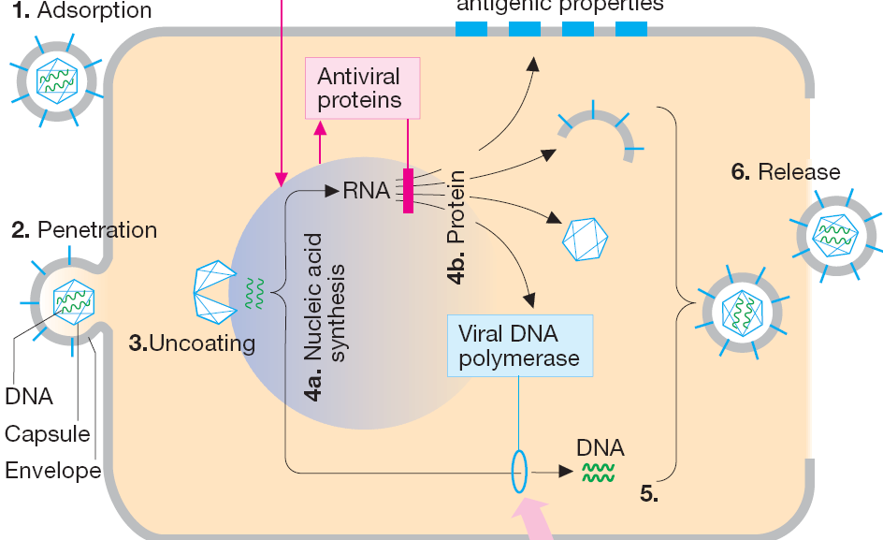

Slide 3
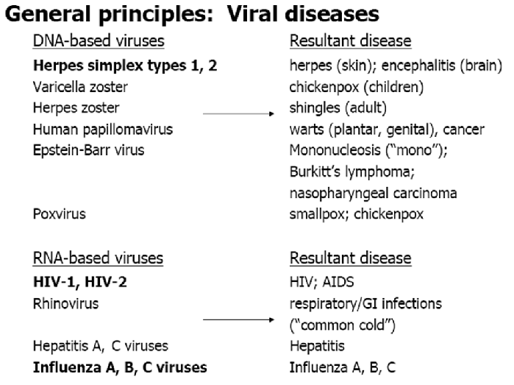

Slide 4
Treatment of Herpesviruses Varicella-zoster, Cytomegalavirus, Herpes simplex

Slide 5
Anti-metabolites
“False” DNA building blocks or nucleosides. A nucleoside consists of a nucleobase and the sugar deoxyribose.
In antimetabolites, one of the components is defective. In the body, the abnormal nucleosides undergo bioactivation by attachment of three phosphate residues
Acyclovir has both specificity of the highest degree and optimal tolerability, because it undergoes bioactivation only in infected cells, where it preferentially inhibits viral DNA synthesis.

Slide 6
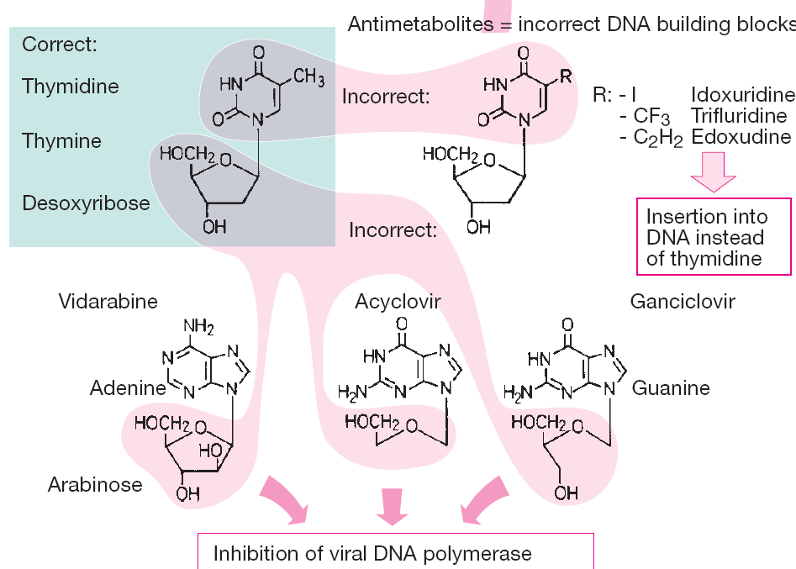

Slide 7
Acyclovir
A virally coded thymidine kinase (specific to H.simplex and varicella-zoster virus) performs the initial phosphorylation step; the remaining two phosphate residues are attached by cellular kinases.
Acyclovir triphosphate inhibits viral DNA polymerase resulting in chain termination.
It is 30-fold more potent against the virus enzyme than the host enzyme.
Acyclovir is active against herpes simplex and varicellar-zoster virus.
It is rapidly broken down in cells, is orally active and is relatively non-toxic systemically.

Slide 8
Acyclovir and Valacyclovir (pro-drug, better availability)
A Guanine analogue with antiviral for Herpes group only
Acyclovir
AcycloGMP
AcycloGTP
Thymidine kinase
Cellular kinases
Viral 200x affinity
of mammalian
Inhibits viral DNA polymerase selectively
Incorporated into DNA and terminates synthesis
Resistance:
1. ↓ activity of thymidine kinase
2. altered DNA polymerase

Slide 9
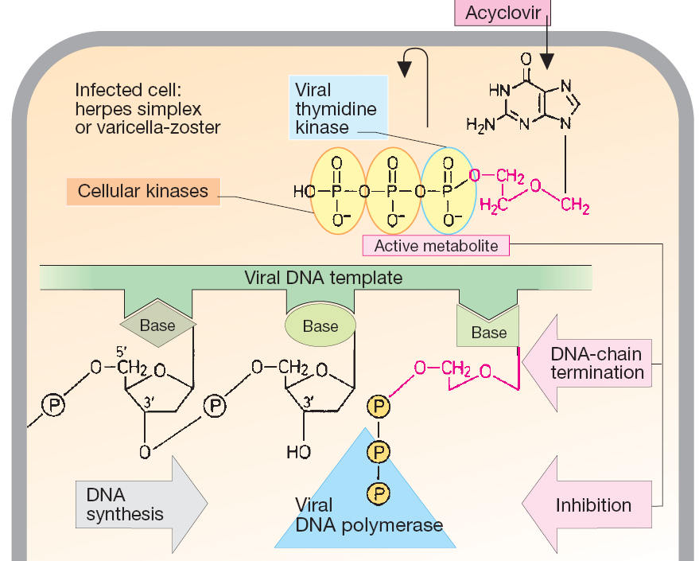

Slide 10
Acyclovir
Acyclovir is used to treat:
Herpes simplex infections (genital herpes, and herpes encephalitis).
Chickenpox in immuno-compromised patients.
Prophylactically in patients treated with immunosuppressant drugs or radiotherapy who are in danger of infection by reactivation of latent virus.
Prophylactically in patients with frequent recurrences of genital herpes.

Slide 11
Oral acyclovir has multiple uses. In first episodes of genital herpes, oral acyclovir shortens the duration of symptoms by approximately 2 days, the time to lesion healing by 4 days, and the duration of viral shedding by 7 days. In recurrent genital herpes, the time course is shortened by 1–2 days.
Oral acyclovir is only modestly beneficial in recurrent herpes labialis.
Topical acyclovir cream is substantially less effective than oral therapy for primary HSV infection. It is of no benefit in treating recurrent genital herpes.

Slide 12
Acyclovir
Common adverse drug reactions are nausea, vomiting, diarrhea and headache.
Additional common adverse effects, when acyclovir is administered IV, include :
Renal insufficiency and neurologic toxicity
However, incommon with adequate hydration and
avoidance of rapid infusion rate.

Slide 13
Ganciclovir
Mechanism like Acyclovir
Active against all Herpes viruses including CMV (100 time than acyclovir)
Low oral bioavailability given I.V.
Most common adverse effect: bone marrow suppression (leukopenia 40%, thrombocytopenia 20%) and CNS effects (headache, behavioral, psychosis, coma, cnvulsions).
1/3 of patients have to stop because of adverse effects
Drug of choice for CMV infections: retinitis, pneumonia, colitis.

Slide 14
Foscarnet
An inorganic pyrophosphate analog
Active against Herpes (I, II, Varicella , CMV), including those resistant to Acyclovir and Ganciclovir.
Direct inhibition of DNA polymerase and Reverse Transcriptase
Nephrotoxicity (25%) most common side effect
Use: (1) CMV retinitis and other CMV infections instead of ganciclovir or …………..
(2) H. simplex resistant to Acyclovir.
(3) HIV.

Slide 15
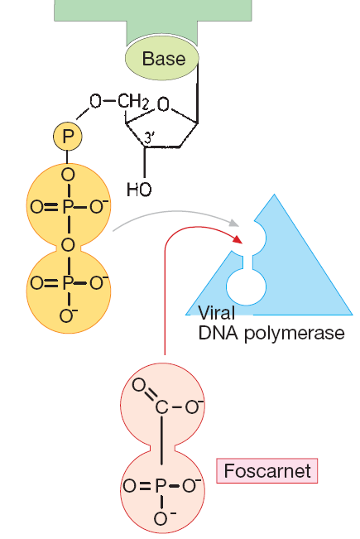

Slide 16
Treatment of respiratory virus infection
Influenza A & B
Respiratory suncytial virus (RSV)

Slide 17
Attachment Inhibitors
The primary antiviral mechanism of Amantadine and Rimantadine is to block the viral membrane matrix protein, which function as an ion channel that is required for the fusion of the viral membrane with the cell membrane.
Their clinical use is limited to Influenza A infection.
They are very effective in preventing infection if the treatment is begun at the time of-or prior to- exposure to the virus.

Slide 18
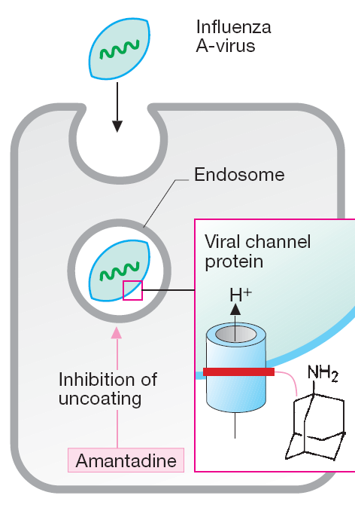

Slide 19
Attachment Inhibitors
Side effects of Amantadine are mainly associated with the CNS, such as ataxia and dizziness.
While Rimantadine produce little CNS effect because it does not penetrate the blood brain barrier.
Both should be used with caution in pregnant and nursing women.

Slide 20
Neuroaminidase inhibitors
Oseltamivir and Zanamavir
Mechanism of action
Viral neuraminidase catalyzes cleavage of terminal sialic acid residues attached to glycoproteins and glycolipids, a process necessary for release of virus from host cell surfaces.
Neuraminidase inhibitors thus prevent release of virions from infected cell

Slide 21
Neuroaminidase inhibitors
Administration of neuraminidase inhibitors is a treatment that limits the severity and spread of viral infections.
Neuraminidase inhibitors are useful for combating influenza infection:
zanamivir, administered by inhalation;
oseltamivir, administered orally.
Toxicities
– Exacerbation of reactive airway disease by zanamavir
– Nausea and vomiting for oseltamivir

Slide 22
oseltamivir
Early administration is crucial because replication of influenza virus peaks at 24–72 hours after the onset of illness.
When a 5-day course of therapy is initiated within 36–48 hours after the onset of symptoms, the duration of illness is decreased by 1–2 days compared with those on placebo,
severity is diminished, and the incidence of secondary complications in children and adults decreases.
Once-daily prophylaxis is 70–90% effective in preventing disease after exposure.

Slide 23
Peramivir IV

Slide 24
Antiretroviral agents

Slide 25
HIV Life Cycle
Step 1: Fusion
Step 3:
Integration
reverse
transcriptase
HIV
Step 5: Packaging
and Budding
Step 2: Transcription
Step 4: Cleavage

Slide 26
Azidothymidine (Zidovudin(AZT))
It is a potent antagonist of reverse transcriptase, It is a chain terminator.
Cellular enzyme phosphorylate AZT to the triphosphate form which inhibits RT and causes chain termination
It is widely use in the treatment of AIDS (The only clinical use).
AZT is toxic to bone marrow, for example, it cause severe anaemia and leukopenia In patient receiving high dose. Headache is also common

Slide 27
In pregnancy , a regimen of oral zidovudine beginning between 14 and 34 weeks of gestation, intravenous zidovudine during labor, and zidovudine syrup to the neonate from birth through 6 weeks of age has been shown to reduce the rate of vertical (mother-to-newborn) transmission of HIV by up to 23%.

Slide 28
Non-nucleoside Non-competitive RT inhibitors
(1) bind to viral RT, inducing conformational changes that result in enzyme inhibition
(2) Combination therapy with AZT (resistant mutants rapidly emerge, little use in monotherapy)
(3) Resistance mutations will be at different sites

Slide 29
Non-nucleoside Non-competitive RT inhibitors
Nevirapine Approved for AIDS patients, Good blocker of mother to child transmission (perinatal - breast feeding)
Single dose at delivery reduced HIV transmission by 50%
Single dose to baby by 72 hours
NNRTI’s: Adverse Effects
RASH!!
CNS effects (e.g. sedation, insomnia, vivid dreams, dizziness, confusion, feeling of “disengagement”)

Slide 30
Rash
Rash, usually a maculopapular eruption that spares the palms and soles, occurs in up to 20% of patients, usually in the first 4–6 weeks of therapy.
Although typically mild and self-limited, rash is dose-limiting in about 7% of patients. Women appear to have an increased incidence of rash.
When initiating therapy, gradual dose escalation over 14 days is recommended to decrease the incidence of rash.

Slide 31
Protease Inhibitors
HIV Protease Inhibitors; have significantly alter the course of the HIV disease.
All are reversible inhibitors of HIV Protease-the viral enzyme responsible for cleavage of viral polyprotein into number of essential enzymes (reverse transcription, polymerase).
Examples are : Saquinavir, and Ritonavir.
They are orally active, side effects include GI disturbances and hyperglycemia, interact with cytochrome P450. buffalo hump

Slide 32
Anti-Viral Chemotherapy
GAG/POL polyprotein
GAG
Integrase
Polymerase
Protease
Retrovirus --- HIV

Slide 33
Anti-Viral Chemotherapy
GAG
Integrase
Polymerase
Protease folds and cuts itself free

Slide 34
Anti-Viral Chemotherapy
GAG
Integrase
Polymerase
Protease cuts at a site between the integrase and polymerase

Slide 35
Anti-Viral Chemotherapy
GAG
Integrase
polymerase

Slide 36
New targets
Agents that block fusion of HIV with the host cell by interacting with gp41
Enfuvirtide is Peptides derived from gp41 can inhibit infection, probably by blocking the interaction of gp41 with cell membrane proteins during fusion.
Raltegravir (Integrase Inhibitor) targets integrase, an HIV enzyme that integrates the viral genetic material into human chromosomes, a critical step in the pathogenesis of HIV.
Maraviroc It blocks the interaction between chemokine receptor CCR5 and HIV gp120.

Slide 37
(HAART)
Highly active anti-retroviral therapies
Combination therapies (triple drug cocktail, HAART) are very effective and can reduce viral load in the patient below detectable levels implying that HIV replication has ceased.
examples (1) NNRTI–Based Regimens (1-NNRTI + 2NRTIs)
(2) PI-Based Regimens (1 or 2 PIs + 2 NRTIs)
The trouble with all of these complicated drug regimens is compliance. The components of HAART must be taken at different times.
Non-compliance with protease inhibitor therapy is of serious concern as the new virus that emerges is resistant to the inhibitor being taken and also resistant to other protease inhibitors.

Slide 38
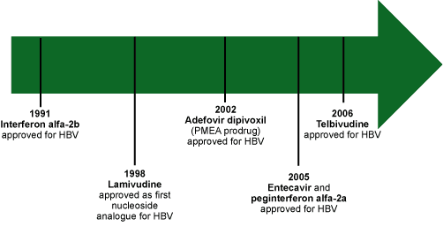
Anti-Hepatitis B Virus Agents
Figure 2. Timeline of evolution of HBV therapies, United States.

Slide 39
Interferons
Interferon Alfa
Endogenous proteins induce host cell enzymes that inhibit viral RNA translation and cause degradation of viral mRNA and tRNA .
Bind to membrane receptors on cell surface , May also inhibit viral penetration, uncoating, mRNA synthesis, and translation, and virion assembly and release.
Pegylated interferon Alfa
A linear or branced polyethylene gylcol (PEG) moiety is attached covalently to interferon
Increased half-life and steady drug concentrations

Slide 40
Interferon, mechanism of action:
1) binds to cell surface receptors
2) induces expression of translation inhibitory protein (TIP)
3) TIP binds to ribosome, inhibits host expression of viral proteins

Slide 41
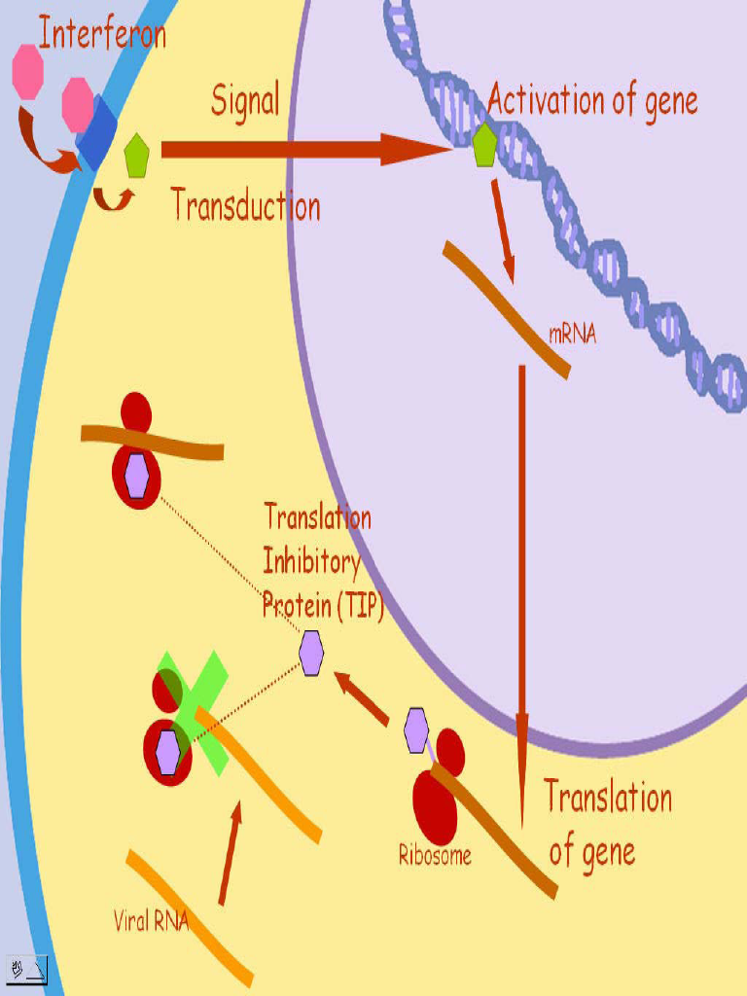

Slide 42
Interferons
a limited treatment course (ie, only 1 year of therapy),
lack of resistance development.
Disadvantages include a high rate of treatment-related adverse events. flu-like symptoms: increased body temperature, feeling ill, fatigue, headache, muscle pain.

Slide 43
Anti-Hepatitis B Virus Agents
…….
Entecavir and tenofovir have very strong resistance profiles in treatment-naive patients.
Disadvantages include the need to continue therapy indefinitely and the potential for resistance development.

Slide 44
Anti-Hepatitis C Virus Agents
• Approved
– Interferon-alpha (pegylated)
– Ribavirin
• In development
– Protease inhibitors
– Polymerase inhibitors

Slide 45
Ribavirin
It is an antimetabolite that inhibits influenza RNA polymerase non-competitively in vitro but poorly in vivo.
An aerosol form is used against RSV (respiratory syncytial virus) and the drug is used intravenously against Lassa fever.
Adverse reactions includes: Anemia due to hemolysis and bone marrow suppression

