Slide 1
Basic Communication Skills
Dr Ruba M Jaber
Family Medicine consultant
Women and child’s health specialist

Slide 2
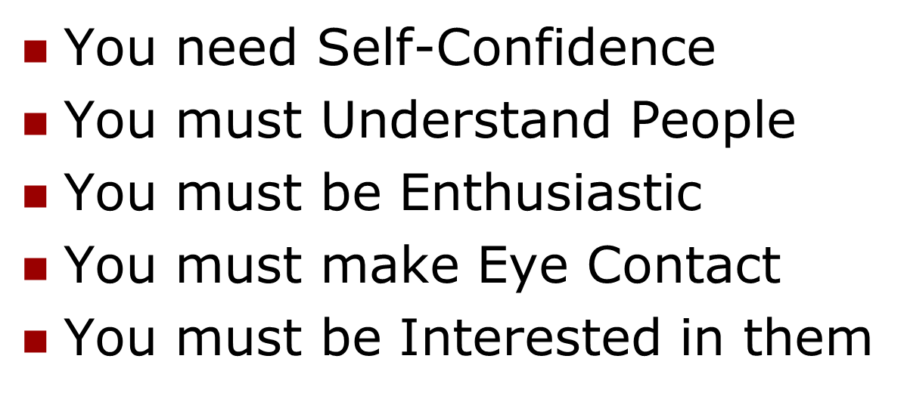
ESTABLISHING RAPPORT
How do you go about Establishing Rapport?

Slide 3
Communication - Meaning
Communication is a dynamic process…
Through this process we convey a thought or feeling to someone else.
How it is received depends on a set of events, stimuli, that person is exposed to.
How you say what you say plays an important role in communication

Slide 4
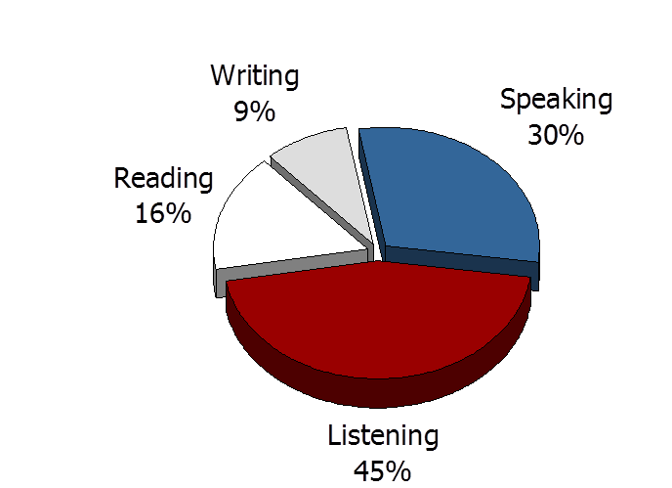
TOTAL COMMUNICATION PROCESS

Slide 5
LEVELS OF COMMUNICATION
VERBAL
Intra verbal: intonation of word and sound
Extra verbal verbal: implication of words and phrases, semantics
NON-VERBAL
Gestures
Postures
Movements
SYMBOLIC

Slide 6
Barriers in Communication (that have to do with the COMMUNICATOR)
Unwillingness to say things differently
Unwillingness to relate to others differently
Unwillingness to learn new approaches
Lack of Self-Confidence
Lack of Enthusiasm
Voice quality
Prejudice

Slide 7
Barriers in Communication (that have to do with the COMMUNICATOR)
Disagreement between verbal and non-verbal messages
Negative Self Image
Lack of Feedback
Lack of Motivation and Training
Language and Vocabulary Level
Lack of Self Awareness

Slide 8
Barriers in Communication (that have to do with the RECEIVER)
Selective Perception
Unwillingness to Change
Lack of Interest in the Topic/Subject
Prejudice & Belief System
Rebuttal Instincts
Personal Value System
Here-and-Now internal & external factors

Slide 9
External Barriers in Communication
Environment
The venue
The effect of noise
Temperature in the room
Other People – Status, Education
Time

Slide 10
5 Basic reasons we Do Not Listen
Listening is Hard Work
Competition
The Rush for Action
Speed differences (120 wpm v/s 360 wpm)
Lack of Training

Slide 11
4 Levels of Listening
The Non-Listener
The Marginal Listener
The Evaluative Listener
The Active Listener

Slide 12
Improving Listening Skills
By not being Preoccupied
Being Open Minded & Non Defensive
Minimizing Interruptions
Effective Listening is: Hearing, interpreting when necessary, understanding the message and relating to it.
By Asking Questions

Slide 13
COMMUNICATION
7% WORDS
Words are only labels and the listeners put their own interpretation on speakers words
38% PARALINGUISTIC
The way in which something is said - the accent, tone and voice modulation is important to the listener.
55% BODY LANGUAGE
What a speaker looks like while delivering a message affects the listener’s understanding most.

Slide 14
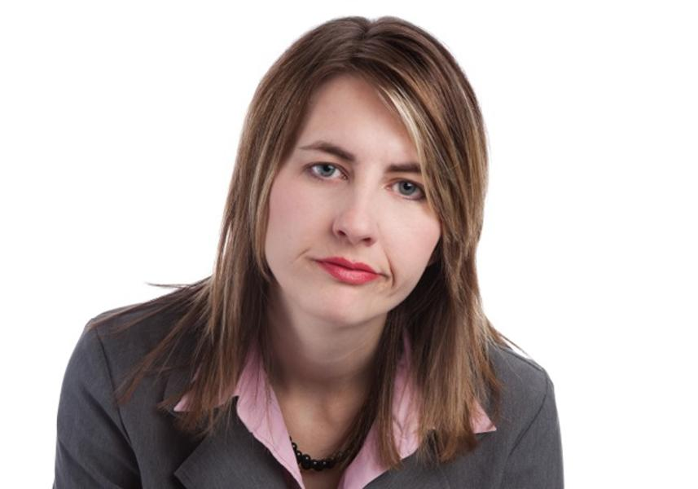

Slide 15
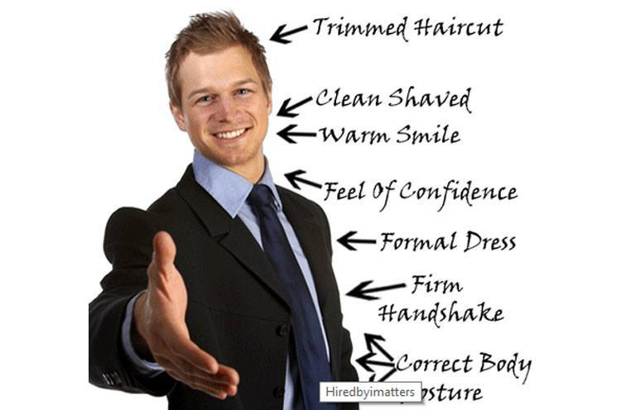

Slide 16
TYPES OF BODY LANGUAGE Remember that you are dealing with “PEOPLE”
(P)OSTURES & GESTURES
How do you use hand gestures? Stance?
(E)YE CONTACT
How’s your “Lighthouse”?
(O)RIENTATION
How do you position yourself?
(P)RESENTATION
How do you deliver your message?
(L)OOKS
Are your looks, appearance, dress important?
(E)XPRESSIONS OF EMOTION
Are you using facial expressions to express emotion?

Slide 18
Thank you
for listening ;)

