Slide 1
Endocrine Physiology
Mohammad Qussay Al-Sabbagh
2nd year medical student- University of Jordan
June,2016

Slide 2
Endocrine Physiology
لجان الدفعات- كلية الطب دفعة 2014
Adrenal cortex- glucocorticoids

Slide 3
Introduction

Slide 4
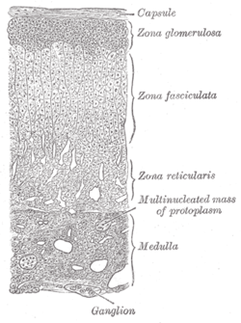
Adrenal cortex histology
3 layers according to parenchymal cells arrangement around capillaries
Glucocorticoids are produced from Z. F & Z. R

Slide 5
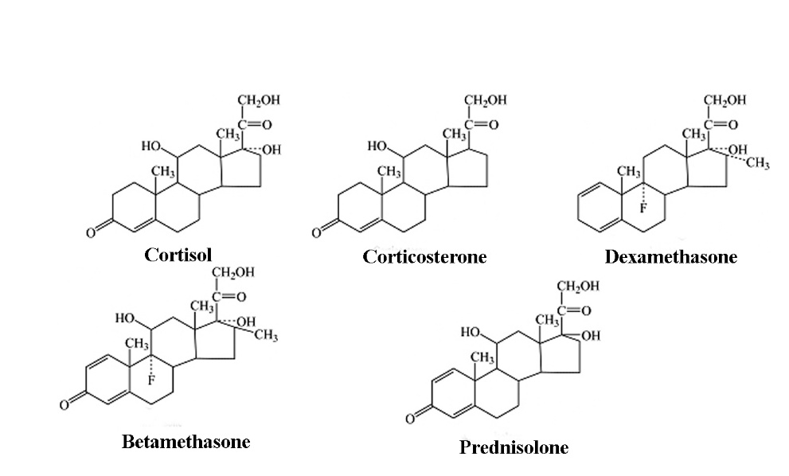
Glucocorticoids (cortisol)
have gained their name because they exhibit important effects that increase blood glucose concentration.
Are Steroids Derived From Cholesterol.
95% of the glucocorticoid activity of the adrenocortical secretions results from the secretion of cortisol.

Slide 6
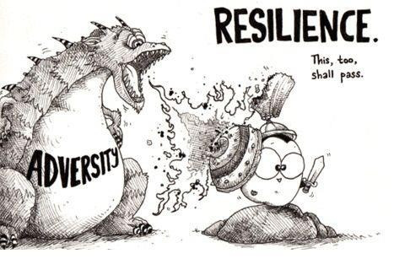
Cortisol (general description)
The major glucocorticoid.
adrenal cortex responds to daily stress, delayed responses by secreting glucocorticosteroids, by:
Inc. Carbs content.
Inc. Synthetic activity of the lever.
immunosuppression

Slide 7
Regulation of cortisol secretion

Slide 8
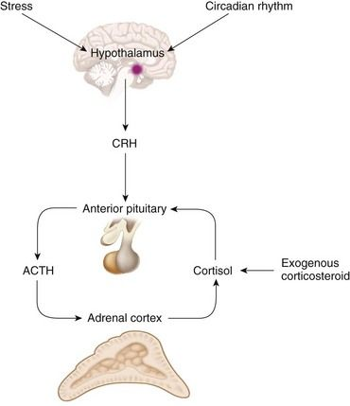
Regulation of cortisol secretion
Cortisol secretion has a Circadian rhythm.
Typical regulation cascade.
- CRH → ACTH → cortisol.

Slide 9
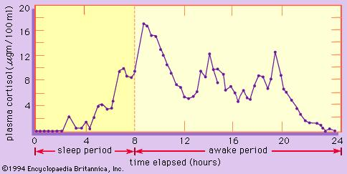
Circadian rhythm.

Slide 10
Regulation of cortisol secretion
Corticotropin-Releasing Factor (CRF)
-hypothalamic releasing hormone.
-uses cAMP as a 2nd messenger.
- Stress →The limbic system → hypothalamus → CRF

Slide 11
Regulation of cortisol secretion
ACTH
Corticotropin / adrenocorticotropin
released by ant. Pituitary.
uses cAMP as a 2nd messenger.
ACTH is normally necessary for any adrenocortical hormones to be formed

Slide 12
Regulation of cortisol secretion
Physiological Stress Increases ACTH and Adrenocortical Secretion
Cortisol has direct negative feedback effects on
-hypothalamus to dec. the formation of CRF - anterior pituitary gland to dec. the formation of ACTH.

Slide 13
Cortisol functions

Slide 14
General functions of cortisol
Cortisol affects
glucocorticoids are essential for the response to stress.
Affects metabolic activites → inc. Blood glucose levels
Suppress the immune system.
Embryo development
Embryo
development
response to stress
Metabolic effects
immunosuppression

Slide 15
General functions of cortisol
Cortisol affects
Metabolic effects
inc. Blood glucose levels, by affecting:
carbs. Metabolism
Protenis metabolism.
Fat metabolism.
Embryo
development
response to stress
Metabolic effects
immunosuppression

Slide 16
General functions of cortisol
Cortisol affects
Carbs. metabolism
- stimulation of gluconeogenesis.
decrease glucose utilization
Provide belding blocks.
Embryo
development
response to stress
Metabolic effects
immunosuppression
Adrenal diabetes ??

Slide 17
General functions of cortisol
Cortisol affects
Proteins metabolism
Reduction in cellular proteins .
Increase liver and plasma proreins.
Increase blood amino acids conc.
Fat metabolism
Increase blood FFA conc.
Embryo
development
response to stress
Metabolic effects
immunosuppression
Immunosupression due to proteins catabolism ??

Slide 18
General functions of cortisol
Cortisol affects
Immunosuppression.
induce the synthesis of an inhibitor of phospholipase A2.
Inhibits leukocyte recruitment.
Dec. Cappillaries permb.
Inhibits lymphocytes prolifiration.
Reduce fever.
Resolution of inflammation
Embryo
development
response to stress
Metabolic effects
immunosuppression

Slide 19
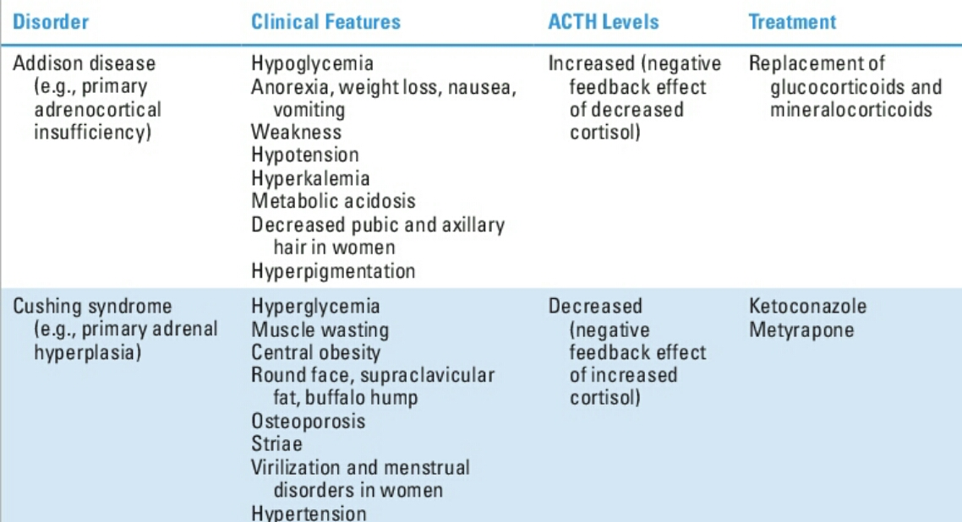
Abnormalities in cortisol Levels

Slide 20
Thank you
لجان الدفعات- كلية الطب دفعة 2014
Mohammad qussay Al-Sabbagh

