Slide 1
Context
The context of people’s lives influance their health, and so blaming individuals for having poor health or crediting them for good health is inappropriate. Individuals are unlikely to be able to directly control many of the determinants of health.

Slide 2
Determinants of health
Many factors combine together to affect the health of individuals and communities.
Whether people are healthy or not, is determined by their circumstances and environment.
To a large extent, factors such as where we live, the state of our environment, genetics, our income and education level, and our relationships with friends and family all have considerable impacts on health.
Access and use of health care services often have less of an impact.

Slide 3
Determinants of health
The social and economic environment,
The physical environment
The person’s individual characteristics and behaviours.
Access to quality health care

Slide 4
Determinants of health
Poverty, Income and social status - higher income and social status are linked to better health. The greater the gap between the richest and poorest people, the greater the differences in health.
Social support networks – greater support from families, friends and communities is linked to better health.
Education – low education levels are linked with poor health, more stress and lower self-confidence.
Gender - Men and women suffer from different types of diseases at different ages.
Culture, customs and traditions, and the beliefs of the family and community all affect health.

Slide 5
Determinants of health
Genetics - inheritance plays a part in determining lifespan, healthiness and the likelihood of developing certain illnesses.
Personal behaviour and coping skills – balanced eating, keeping active, smoking, drinking, and how we deal with life’s stresses and challenges all affect health.
Health services - access and use of services that prevent and treat disease influences health

Slide 6
Determinants of health
Physical environment
- Safe water and clean air, healthy workplaces, safe houses, communities and roads all contribute to good health.
- Employment and working conditions – people in employment are healthier, particularly those who have more control over their working conditions

Slide 7
Determinants of Health
Plus many more factors such as
Political stability, wars and conflicts
Natural disasters
Human and civil rights
Population growth and economic development in the country
Urbanization

Slide 8
Examples
Malnutrition –
more susceptible to disease and less likely to recover
Cooking with wood and coal –
lung diseases
Poor sanitation –
more intestinal infections
Poverty
commercial sex work and STIs, HIV/AIDS
Advertising tobacco and alcohol –
addiction and related diseases
Untrained drivers on unsafe roads-
road traffic accidents

Slide 9
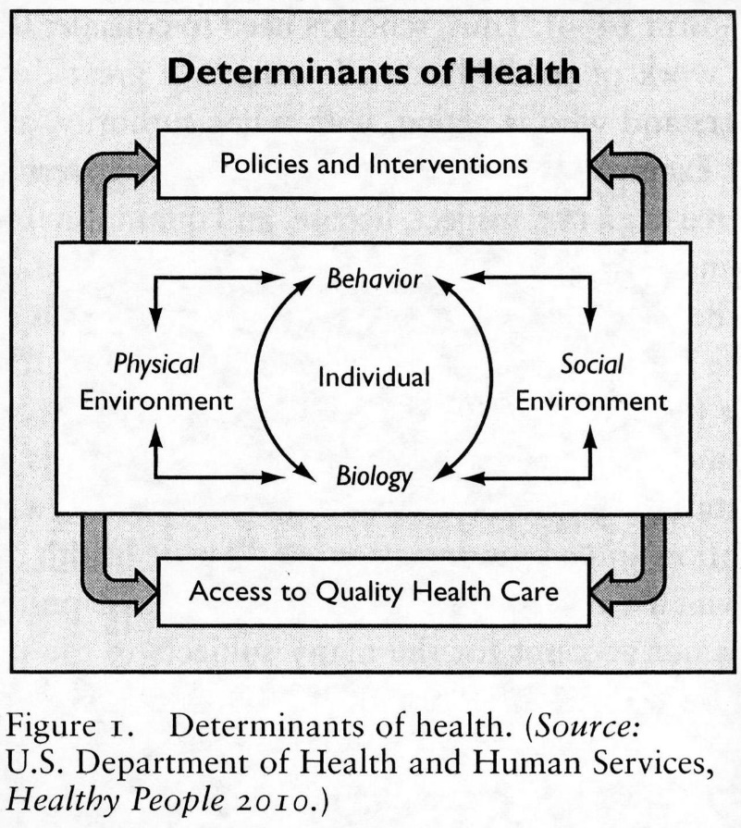

Slide 10
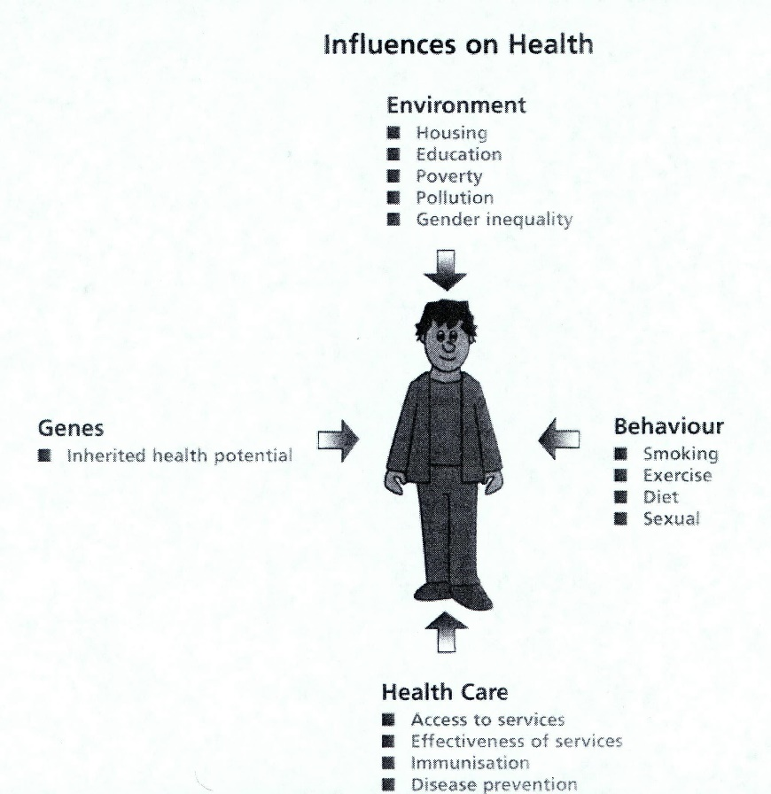

Slide 11
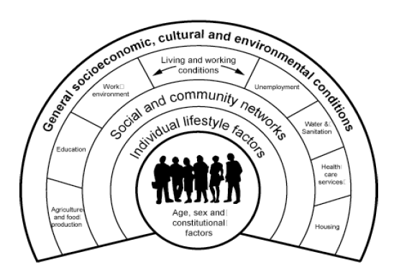
Determinants of Health
Genetic make up
Age
Gender
Lifestyle choices
Community influences
Income status
Geographical location
Culture
Environmental factors
Work conditions
Education
Access to health
services
Source: Dahlgren G. and Whitehead M. 1991

