Slide 1
Diseases of the respiratory system lecture 3
Dr Heyam Awad
FRCPath

Slide 2
CHRONIC BRONCHITIS/ definition
The presence of a persistent productive cough for at least 3 consecutive months in at least 2 consecutive years.
so: diagnosis is based on clinical criteria ( remember that emphysema diagnosis is based on morphological features)

Slide 3
etiology
Smoking.
Air pollution

Slide 4
pathogenesis
Smoking causes:
1. inflammation and fibrosis of trachea and bronchi. This inflammation is mediated by neutrophils, macrophages and lymphocytes.
2. hypertrophy of sub mucosal mucous secreting glands as well as goblet cell hyperplasia of smaller bronchi and bronchioles

Slide 5
Changes in Point 2 in the previous slide result in increased mucous secretion…. Manifests clinically as productive cough

Slide 6
Note
-In the early stages of the disease, the productive cough raises mucoid sputum, but airflow is not obstructed ( because large airways are affected and even narrowed, they are large enough for the inhalation and exhalation to remain within normal limits)

Slide 7
Obstructive features in chronic bronchitis are the result of:
1. Small airway disease –(chronic bronchiolitis) which is induced by:
a. Goblet cell metaplasia with mucous plugging of the bronchiolar lumen,
b. Inflammation,
c. Bronchiolar wall fibrosis,
2. Coexistent emphysema

Slide 8
Note
- Small airway disease ( chronic bronchiolitis) is an important component of early and relatively mild airflow obstruction,
- Significant airflow obstruction is almost always caused by coexistent emphysema

Slide 9
MORPHOLOGY
Gross:
- Hyperemia and swelling of the mucosal lining of the large airways.
- The mucosa of bronchi is covered by a layer of mucinous or mucopurulent secretions

Slide 10
Morphology/ microscopic features
- Enlargement of the mucus-secreting glands in trachea and large bronchi.
- The magnitude of the increase in size is assessed by the ratio of the thickness of the submucosal gland layer to that of the bronchial wall (the Reid index-normally 0.4).

Slide 11
Clinical Features
- In patients with chronic bronchitis, a prominent cough and the production of sputum may persist indefinitely without ventilatory dysfunction
- Some patients develop significant COPD with outflow obstruction.

Slide 12
Patients have :hypercapnia, hypoxemia, and (in severe cases) cyanosis (hence the term "blue bloaters").
Hypercapnea: due to expiratory obstruction causing CO2 retention
Hypoxemia: due to ventilation/perfusion mismatch that happens due to increased cardiac output.

Slide 13
Complications of COPD ( emphysema and chronic bronchitis)
Pneumonia and recurrent respiratory infections
Respiratory fiailure
Right sided cardiac failure: cor pulmonale = cardiac failure secondary to lung disease
Bronchiectasis.

Slide 14
Bronchiectasis
- permanent dilation of bronchi and bronchioles caused by destruction of the muscle and the elastic tissue, resulting from or associated with chronic necrotizing infections.
- It is not a primary disease but secondary to persisting infection or obstruction caused by a variety of conditions.

Slide 15
The Predisposing conditions include:
1. Bronchial obstruction and common causes are :
a- Tumors, foreign bodies, and impaction of mucus.
- With these conditions, the bronchiectasis is localized to the obstructed lung segment.
b- Bronchiectasis can also complicate atopic asthma and chronic bronchitis.

Slide 16
3.Necrotizing, or suppurative, pneumonia, particularly with Staphylococcus aureus or Klebsiella spp., may predispose affected patients to development of bronchiectasis.
Note: Posttuberculosis bronchiectasis continues to be a significant cause of morbidity in endemic areas.

Slide 17
PATHOGENESIS of bronchiectasis:
- Two processes are crucial in pathogenesis : obstruction and chronic infection and either of these may come first.
- Normal clearance mechanisms are hampered by obstruction, so secondary infection soon follows conversely, chronic infection over time causes damage to ; bronchial walls, leading to weakening and dilation.

Slide 18
1- For example, obstruction caused by a primary lung cancer or a foreign body impairs clearance of secretions, providing substrate for superimposed infection and the resultant inflammatory damage to the bronchial wall and the accumulating exudate further distend the airways, leading to irreversible dilation.

Slide 19
2- Conversely, a persistent necrotizing inflammation in the bronchi or bronchioles may cause obstructive secretions, inflammation in the wall (with peribronchial fibrosis and traction on the walls), and eventually the train of events .

Slide 20
MORPHOLOGY
- Bronchiectasis usually affects the lower lobes bilaterally,
- When caused by tumors or foreign bodies the involvement may be localized to a single segment and the most severe involvement is in the more distal bronchi and bronchioles.

Slide 21
Gross:
- The airways may be dilated to as much as four times their usual diameter and on gross examination of the lung can be followed almost to the pleural surfaces
- By contrast, in normal lungs, the bronchioles cannot be followed by ordinary gross examination beyond a point 2 to 3 cm from the pleural surfaces

Slide 22
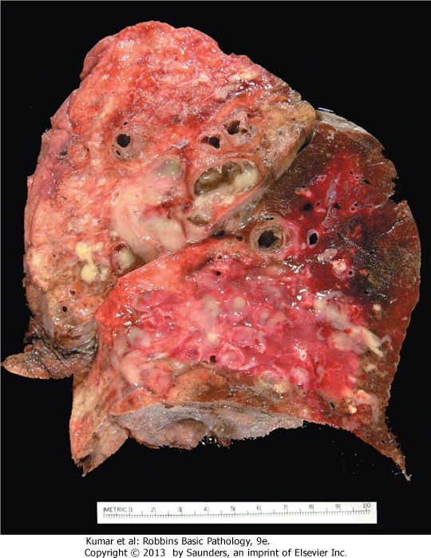
Bronchiectasis

Slide 23
Clinical Features
- severe, persistent cough with expectoration of mucopurulent sputum.
- The sputum may contain flecks of blood; frank hemoptysis can occur.
.

Slide 24
- Symptoms often are episodic and are precipitated by upper respiratory tract infections or the introduction of new pathogenic agents.
- Clubbing of the fingers may develop

