Slide 1
بسم الله الرحمن الرحيم
الحمد لله رب العالمين والصلاة والسلام على سيدنا محمد الصادق الوعد الأمين اما بعد..

Slide 2
Dr. Samar AL-Sharif
Senior Lecturer in Community and Family Medicine Department.
Primary Health Care and Health Promotion (MD. MPHC)

Slide 3
References:
1- Primary Health Care Systems and
Services.
WHO 1997.
2- Primary Care The Future
NHS. June 2005
3- Health in Jordan WHO 2005
4- Population and Family Health Survey
Jordan. 2007
5- Population and Family Health Survey
Jordan. 2012

Slide 4


Slide 5


Slide 6
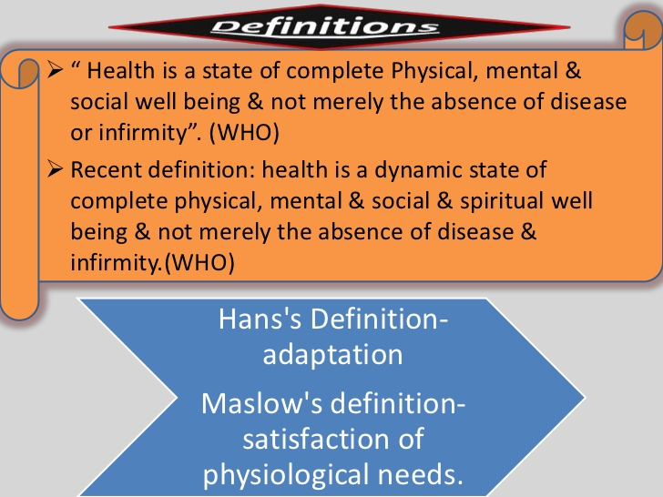

Slide 7


Slide 8


Slide 9
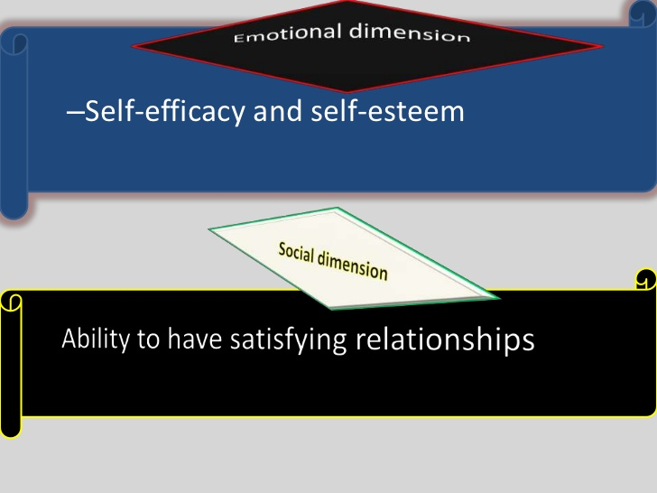

Slide 10


Slide 11


Slide 12
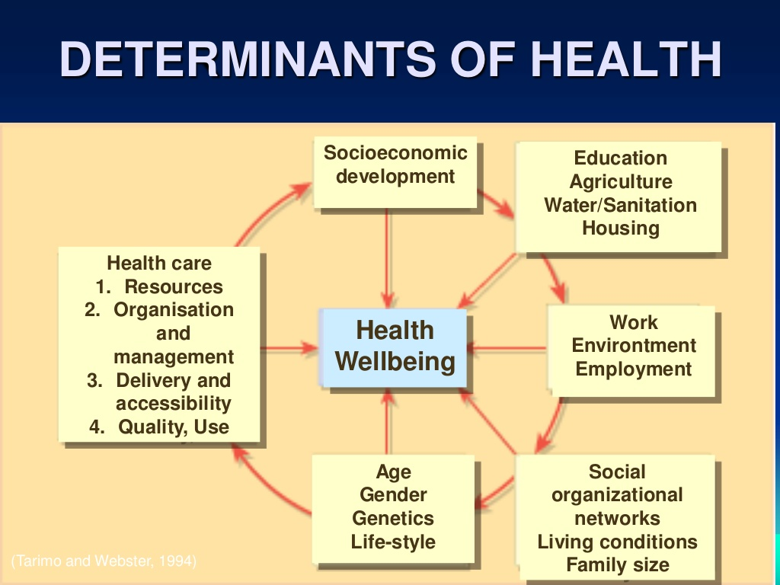

Slide 13


Slide 14


Slide 15
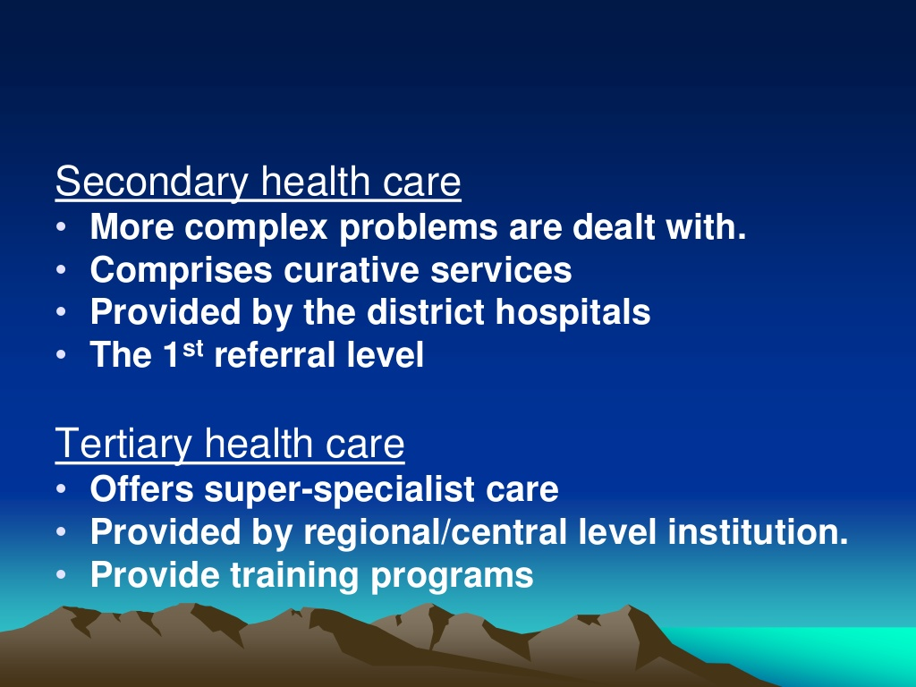

Slide 16

What is Primary Health Care ?
Notes:
16

Slide 17


Slide 18


Slide 19


Slide 20


Slide 21


Slide 22


Slide 23


Slide 24


Slide 25


Slide 26


Slide 27


Slide 28


Slide 29


Slide 30


Slide 31


Slide 32


Slide 33


Slide 34
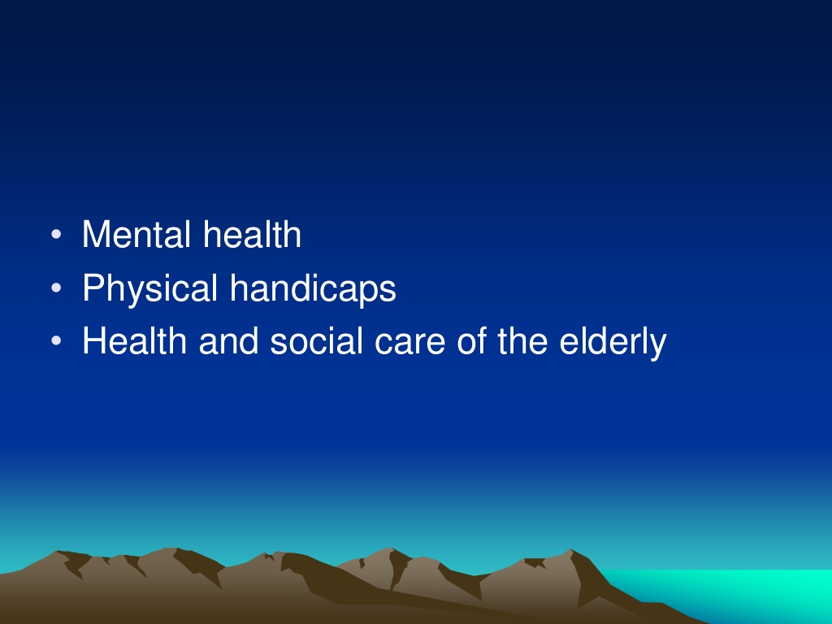

Slide 35
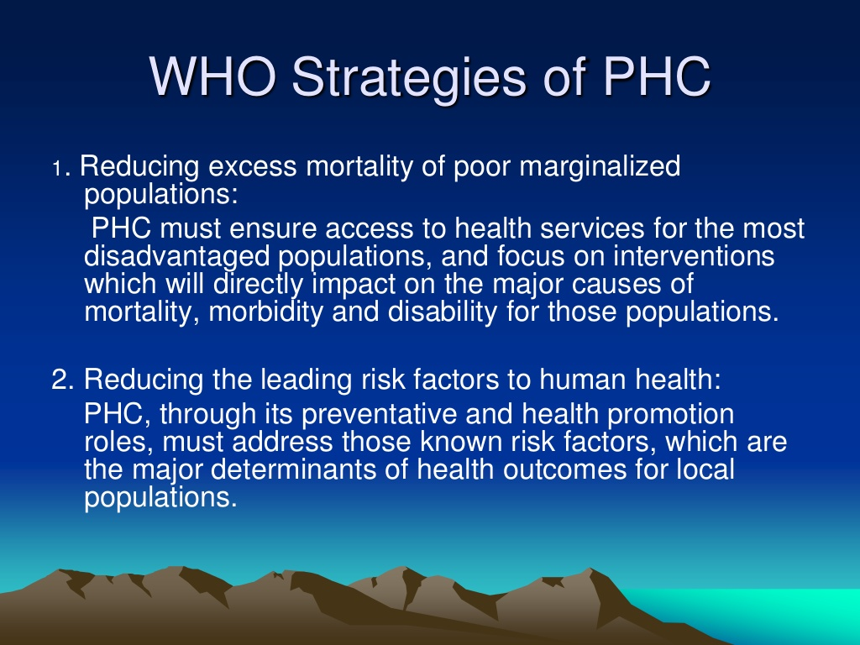

Slide 36


Slide 37


Slide 38


Slide 39
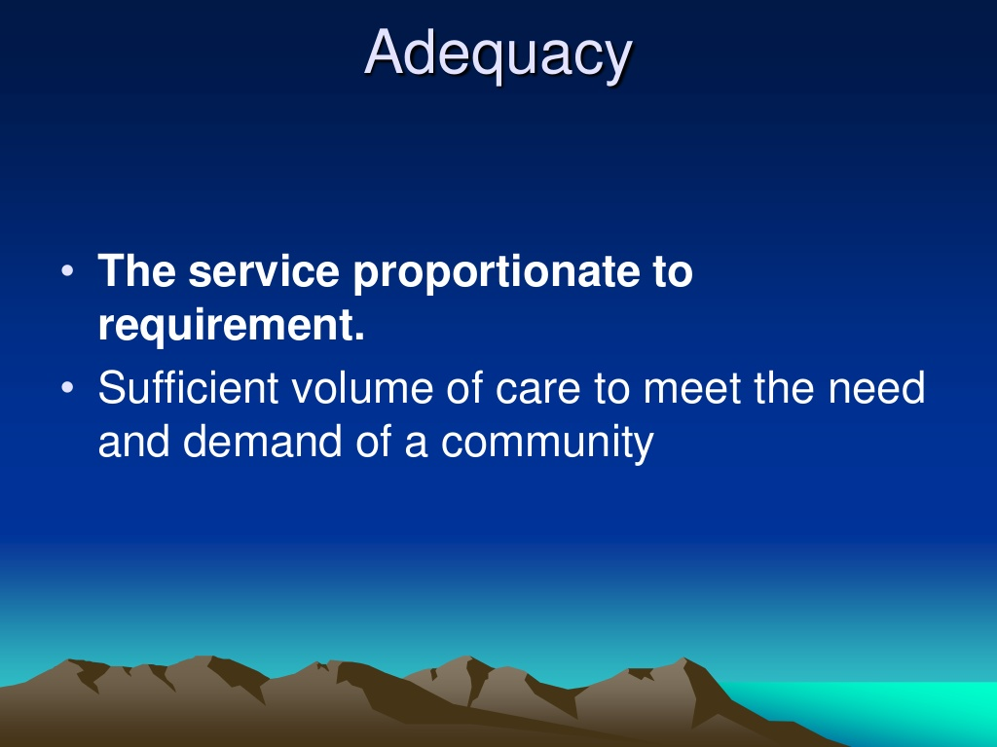

Slide 40


Slide 41


Slide 42


Slide 43


Slide 44


Slide 45


Slide 46
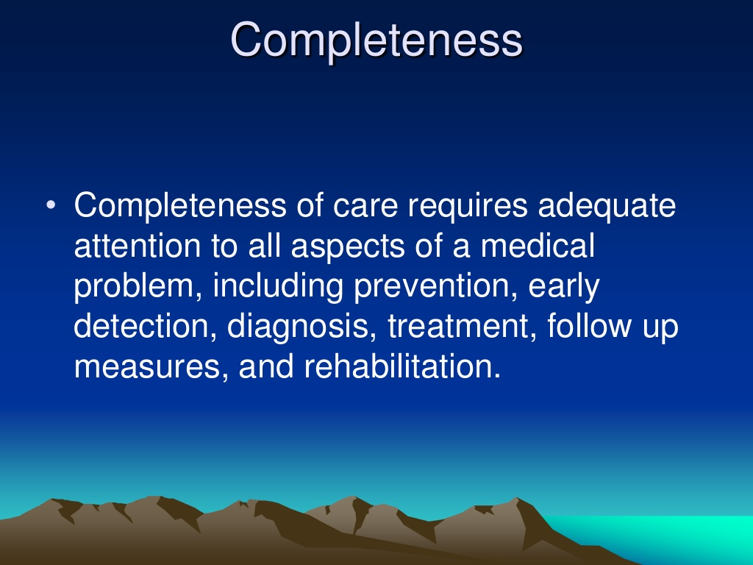

Slide 47


Slide 48
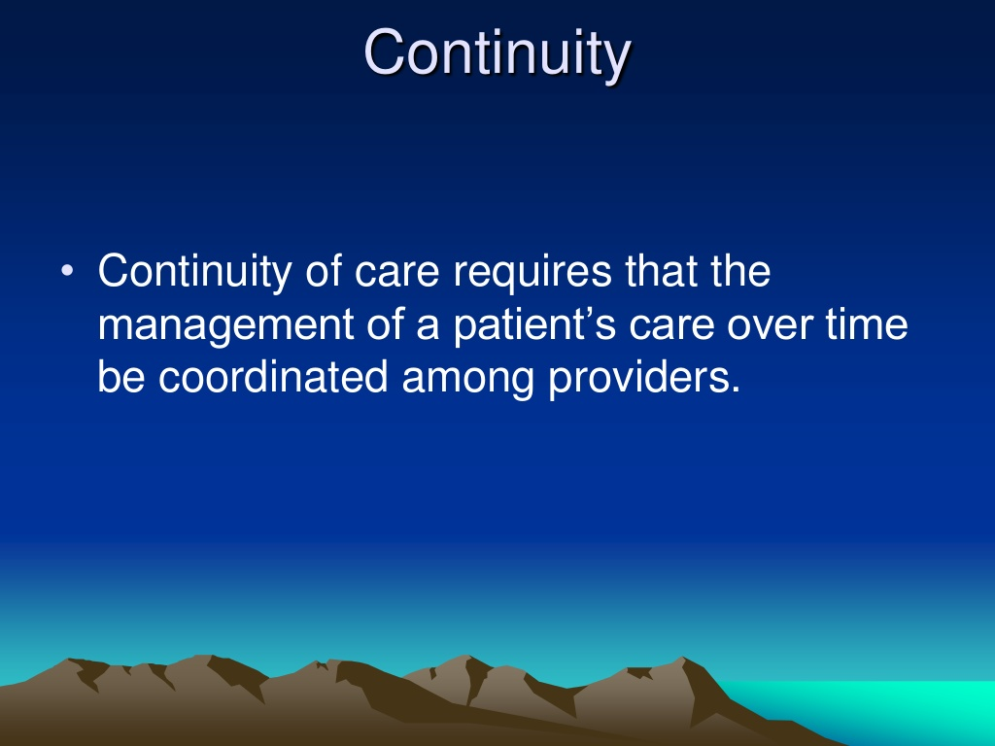

Slide 49


Slide 50


Slide 51
Primary Health Care Reform
Medical model Primary Health Care
• Treatment • Health promotion
• Illness • Health
• Cure • Prevention, care, cure
• Episodic care • Continuous care
• Specific problems • Comprehensive care
• Individual practitioners • Teams of practitioners
• Health sector alone • Intersectoral collaboration
• Professional dominance • Community participation
• Passive reception • Joint responsibility
Barbara Starfield, Johns Hopkins University

Slide 52
Conclusion
Primary Health Care:
Working Together for Better Health

Slide 53
PHC team?
A team : A group of people who make different contribution towards the achievement of common goal.
Family health services, which are administered by FHSAs, and include the four practitioner services
  GPs
  Dental practitioners
  Pharmacists
  Opticians

Slide 54
Community health services, which include:
  Community doctors
  Dentists
  Nurses, midwives, and health visitors
  Other allied professions such as chiropody and physiotherapy

Slide 55
- Counseling social workers, psychologists, and psycho-therapists.
Administrative
- Reception of clients/ making appointments
- Secretarial / clerical work

Slide 56
Essential characteristics of team work :
- The members of a team share a common purpose which binds them together and guides their actions.
- Each member of the team has a clear understanding of his own functions and recognizes common interests.
- The team works by pooling knowledge skills, and resources: and all members share the responsibility for outcome.

Slide 57
Current health status and health care in Jordan
1- Health status has improved significantly during the past quarter century. Some important indexes to go with that are:
a. Life expectancy at birth increased from 49 in 1965 to 66 years in 1990 to 72 in 2004 to 73 (71.6 males and 74.4 females) in 2012
Ranging from 57 in developing countries to 76 years in developed countries).
.

Slide 58
b. Infant mortality decreased from 130 in 1960 to 35 per 1000 live births in 1992
to 22 in 2002 to 19 in 2007 to 17 in 2012.

Slide 59
C. Total fertility rate dropped from 7 to 5.6 to 3.7 to 3.6 to 3.5 on 1994 and 1988 and 2002,2007,2012 respectively
d. Small – Pox was eradicated on 1979
Measles, polio prevalence rates were decreased a lot other rates will be mentioned later

Slide 60
Selected Indicators 2012
2.2 Population Growth Rate(%)
31.5 Population Doubling Time (years)
37.3 Population Less Than 15 Year of Age (%)
3.2 Population Age 65+years(%)
82.6 Urban Population (%)
73.0 Life Expectancy at Birth ( year) 71.6Male 74.4Female

Slide 61
Primary Health Care Provision in Jordan: Summary and Update

Slide 62
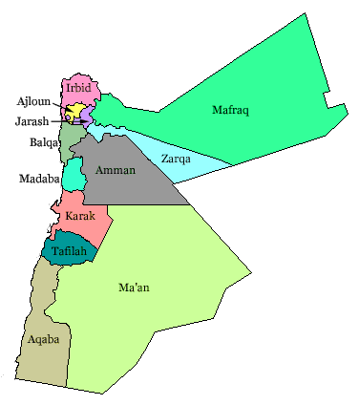
Jordan Governorates
Syria
Iraq
West Bank
Saudi Arabia

Slide 63
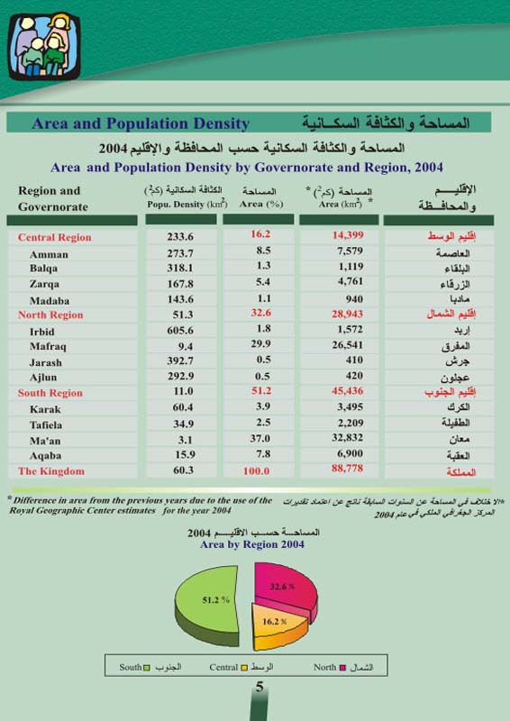

Slide 64
A country in demographic and fertility transition
Over the next 50 years, Jordan’s demographics will change dramatically – This will pose great challenges for the country (resources and services).
The country’s population is growing rapidly, doubling over the last 20 years and likely to double again by 2029. However, it is undergoing a demographic transition : moves from high fertility and mortality, to low fertility and mortality (David Bloom, “Demographic Transition and Economic Opportunity: The Case of Jordan,” April 2001).

Slide 65
Fertility declines in Jordan have contributed to slowing the population growth rate down to 3.2 percent in the second half of the 1990s, and to 2.8 percent in 2002.(JPFHS, 2002) to 2.2 % in 2012.

Slide 66
The urban population increased by 14 percent between 1980 and 1994, increasing from 70 to 79 percent. (JPFHS, 2002) to 82.6 % 2012)
Results of the 1994 census indicate that the age structure of the population has changed considerably since 1979 – the result of changes in fertility, mortality, and migration dynamics.

Slide 67
The proportion of the population under 15 years of age declined from 51 percent in 1979 to 39 percent by 2002 to 37.3% by 2012, while the proportion of those age 65 and over has been rising. (JPFHS, 2002) to 3.2 % by the year 2012 .

Slide 68
The Ministry of Health (MOH), through its Maternal and Child Health Centers (MCH), provided optional and predominantly free family planning services as an unofficial and indirect intervention in the population policy. The efforts made by the Jordan Association of Family Planning and Protection (JAFPP), as well as by some voluntary nongovernmental organizations, were invaluable in this regard.

Slide 69
Challenges
While low infant mortality rates and high life expectancy - are among the best in the region, the population growth rate continues to be a major development constraint - especially when analyzed in light of the quantity and quality of services to be provided to accommodate this rapid increase in population.
.

Slide 70
The landmark passage of the National Population Strategy (NPS) in March 1996 and the passage of the Reproductive Health Action Plan, a sub-strategy of the NPS, in April 2004 make it clear that Jordan is serious about family planning.

Slide 71
Less than fully functional public health systems,
An unmet demand for high quality maternal - child health care services and information,
A significant increase in the prevalence of chronic diseases

Slide 72
Primary Health Care Initiatives Project
380 PHC clinics
Renovation and provision of furniture and specialized medical equipment
Clinical training of service providers,
Establishment of performance improvement review systems
Improvement of the management information system

Slide 73
Primary Health Care in Jordan
- It follows that for a community like JORDAN were
- The population is small and highly urbanized .
- Highly qualified medical personnel are abundant.
- Intermediately qualified paramedical staff are scarce .
-Piped water and safe waste disposal are almost universal
Notes:
73

Slide 74
Three main reasons for PHC in Jordan 1986 MOH study visits are :
a. 33% respiratory diseases
b. 14% infectious and parasitic diseases
c. 10% digestive diseases
Notes:
74

Slide 75
مديرية الرعاية الصحية الاساسية
قسم النهوض بالصحة العامة | قسم صحة البيئة | قسم مكافحة الامراض السارية | قسم العيادات ومراكز الرعاية الصحية الاولية
الصحة المدرسية | الهندسة الصحية | الملاريا والبلهارسيا
رعاية الامومة والطفولة | رقابة البيئة | الامراض الصدرية | قسم التدرن
التغذية | الصحة الصناعية | التطعيم
التثقيف الصحي |  | الاستقصاء الوبائي والصحة العامة
تمريض الصحة العامة |  | شعبة الاسهالات والكوليرا
شعبة الطب الرياضي |  | برنامج الايدز الوطني

Slide 76
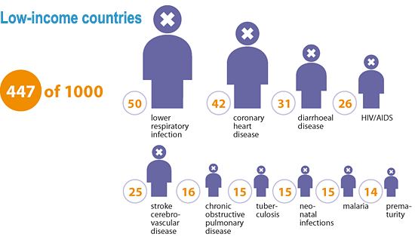
What would be the top 10 causes of their deaths?
Notes:
76

Slide 77
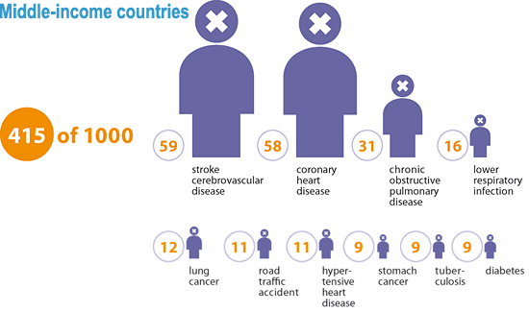
Notes:
77

Slide 78
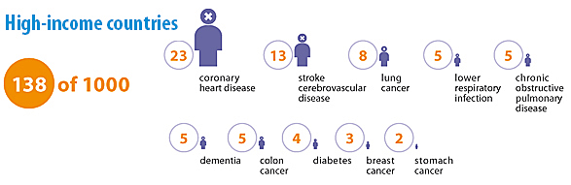
9
Notes:
78

Slide 79
الاسباب الرئيسية للوفاة في الاردن
اما الاسباب الرئيسية للوفاة في الاردن لجميع الاعمار فقد كانت عام 1979 كما يلي :-
النسبة المئوية % | المرض
23 | امراض القلب والدورة الدموية
20 | امراض الجهاز التنفسي
16 | الاسهالات
9 | الحوادث
6 | تعقيدات الحمل والولادة
5 | السرطان
3 | سوء التغذية
19 | اخرى
100 | المجموع

Slide 80
جدول رقم (54)
اسباب الوفاة الرئيسية للبالغين موزعة
بنسب مئوية حسب الجنس خلال عام 1991م
النسب | المجموع | النسبة | اناث | النسبة | ذكور | اسباب الوفاة
39.7 | 4470 | 34.5 | 1555 | 43.1 | 2915 | امراض القلب والشرايين وضغط الدم
8.9 | 1009 | 6.7 | 303 | 15.4 | 706 | الحوادث بانواعها
3 | 339 | 3 | 137 | 3 | 202 | الاورام الخبيثة
4.6 | 518 | 4 | 180 | 5 | 338 | الالتهابات الرئوية
2.3 | 275 | 3.3 | 148 | 1.9 | 127 | امراض الكلى
1.5 | 164 | 1.4 | 63 | 1.5 | 101 | امراض الكبد
.3 | 33 | .3 | 16 | .3 | 17 | امراض سارية
39.6 | 4460 | 46.7 | 2108 | 34.8 | 2352 | اسباب غير محددة
100% | 11268 | 100% | 4510 | 100% | 6758 | المجموع

Slide 81
Proportionate Mortality Ratio by order of magnitude
Disease of circulatory system | 41.97
Neoplasm's | 13
Accidents and adverse effects | 10.5
Conditions origniating in the perinatal period | 7.39
Disease of respiratory system | 6.24
Congenital malformations, deformities and chromosomal abnormalities | 4
Cause could not be determined | 4.02
Cause of urinary system | 3
Diseases of digestive system | 3
III-defined and unknown causes | 3
Infectious disease | 2.4
Endocrine and metabolic disorders, diabetes | 1.5
Diseases of the nervous system | 0.6
Diseases of the blood and forming elements | 0.2
Pregnancy , childbirth, and the puerperium | 0.11

Slide 82
Top 10 Causes of Death in Jordan center for disease control and prevention (CDC 2010)
)
Ischemic Heart Disease 18% | 6. Chronic Kidney Disease 4%
Cancer 15% | 7. Road injuries 4%
Stroke 12% | 8. Lower-Respiratory infection 3%
Diabetes 7% | 9. Pre-Term Birth Complications 2%
Congenital Abnormalities 4% | 10. Chronic Obstructive Pulmonary Disease 2%

Slide 83
Thank you for your attention!

