Slide 1
Association & Causation in epidemiological studies
Dr. Sireen Alkhaldi
Community Medicine, 2015/ 2016 The University of Jordan

Slide 2
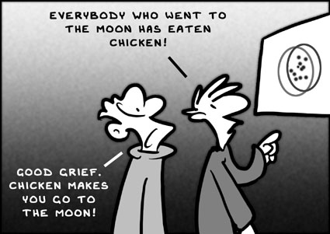
Association and Causation

Slide 3
Which of these foods will stop cancer? (Not so fast)
Cancer patients always ask what to eat to reduce their chances of dying from the disease.
Diet messages are everywhere:
NCI: Eat 5 to 9 fruits and vegetables a Day for Better Health
Prostate Cancer Foundation has anticancer diet
Will dietary changes make a difference.
It is more difficult than expected to discover if diet affects cancer risk.
Hypotheses are abundant, but convincing evidence remains elusive (hard to prove).
September 27, 2005 – New York Times - By GINA KOLATA

Slide 4
What is the question?
Does the exposure lead to an increase (or decreased) risk of disease?
Is the exposure causal (or protective)?
Some problems:
We observe associations
We infer (guess, speculate, reach to a conclusion) causes.

Slide 5
Descriptive studies
Identify disease problem in community
Relate to environment & host factor
Analytical & experimental studies
Test the hypothesis derived for observed RELATIONSHIP b/w suspected cause & disease
Suggest an etiological hypothesis

Slide 6
ASSOCIATION
Definition: the concurrence of two variables more often than would be expected by chance.
Types of Associations:
Spurious Association
Indirect Association
Direct (causal) Association
One to one causal association
Multi-factorial causation.

Slide 7
Association or not?
A researcher in his observational study found that the average serum homocysteine among patients of IHD was 15 mcg/dl (Normal=10-12 mcg/dl)!

Slide 8
Implication
Can we say that
Hyperhomocystenemia causes IHD?
Hypothesize that
Hyperhomocystenemia may have a role in etiology of IHD.
For final proof there has to be a ‘comparison’.
Comparison would generate another summary measure which shows the extent of ‘Association’ or ‘Effect’ or ‘risk’ (RR, OR, P-value, AR)

Slide 9
Cause
Cause defined as “anything producing an effect or a result”. [Webster]
Cause in medical textbooks discussed under headings like- “etiology”, “Pathogenesis”, “Mechanisms”, “Risk factors”.
Important to physician because it guides their approach to three clinical tasks- Prevention, Diagnosis & Treatment.

Slide 10
Etiology of a disease
The sum of all factors contribute to the occurrence of a disease
Agent factors +Host factors +Environmental factors = Etiology of a disease
The factor which can be modified, interrupted or nullified is most important.

Slide 11
Factors for disease causation
Sufficient factors: one that inevitably produces disease (the presence of the factor always result in disease).
Example: Rabies virus for rabies
Necessary factors: without which disease does not occur, but by itself, it is not sufficient to cause disease (the disease will not occur without the presence of the factor)
Example: Mycobacterium TB for TB

Slide 12
Types of Causal Relationships
Four types possible:
Necessary & sufficient
Necessary, but not sufficient
Sufficient, but not Necessary
Neither Sufficient nor Necessary

Slide 13
I. Necessary & Sufficient
Without that factor, the disease never develops (factor is necessary)
and in presence of that factor, the disease always develops (factor is sufficient).
Rare situation.
Factor A
Disease

Slide 14
II. Necessary, but not Sufficient
Multiple factors are required, often in specific temporal sequence (cancer, initiator then promoter)
Factor A
Factor C
Factor B
Disease

Slide 15
III. Sufficient, but not Necessary
Factors independently can produce the disease.
Either radiation or benzene exposure can each produce leukemia without the presence of the other.
Factor A
Factor C
Factor B
Disease
OR
OR

Slide 16
IV. Neither sufficient nor Necessary
More complex model.
Probably most accurately represents causal relationships that operate in most chronic diseases
Factor A
Factor B
Disease
Factor C
Factor D
Factor E
Factor F
OR
OR

Slide 17
Necessary / Sufficient
Disease Not Present
Disease Present
Disease Present
“A” is necessary – it appears in each sufficient causal complex
“A” is not sufficient –
Notes:
Necessary and sufficient
a factor is both necessary and sufficient for producing disease – and the disease never develops without the factor

Slide 18
Alternate Sufficient Sets for Breast Cancer
No Breast Cancer
Breast Cancer Present – Hereditary Set
Breast Cancer Present – Non Hereditary Set
Only women with “A” and “F” causal components develop breast cancer
“A” could be an environmental component that unless is present with “F”, a host susceptibility component, does not cause disease
In the Hereditary Set, components such as BRCA1 and/or BRCA2 mutations are present
In the Non Hereditary Set, other environmental or host factors are present.

Slide 19
Example….
A researcher in his observational study found the presence of Helicobacter pylori in patients of duodenal ulcer!
Can we say that
H.pylori causes duodenal ulcers?
Hypothesize that
H.pylori may have a role in etiology of duodenal ulcers.
For final proof there has to be a ‘comparison’.
Comparison would generate another summary measure which shows the extent of ‘Association’ or ‘Effect’ or ‘risk’

Slide 20
Process of establishing a “Cause & Effect” or “Exposure & Outcome” relationship
Needs a research on the lines of ‘hypothesis testing’
final establishment of an “exposure - outcome” relationship consists of a sequence of steps as follows :
Step 1: ensure that the results of the study are accurate and not “spurious”.
Correct methods?
Validity, reliability preserved?
Bias?

Slide 21
Process of establishing a “Cause & Effect” or “Exposure & Outcome” relationship
Step 2a: do statistical results indicate association?-p value/ 95% CI.
Step 2b: if not significant p value, may be b/c of low power of the study (smaller sample size)-
The investigator should suggest additional studies using large sample (or else, a ‘meta - analysis’ type of study), rather than straightaway dismissing the ‘exposure - outcome’ association as non - causal.

Slide 22
Process of establishing a “Cause & Effect” or “Exposure & Outcome” relationship
Step 3: if statistically significant –evaluate as to whether this relationship is due to ‘indirect relationship’ with a third variable (confounder).

Slide 23
Process of establishing a “Cause & Effect” or “Exposure & Outcome” relationship
Step 4: if confounder excluded- now test this postulated “causal” relationship on the following criteria of “causal association”

Slide 24
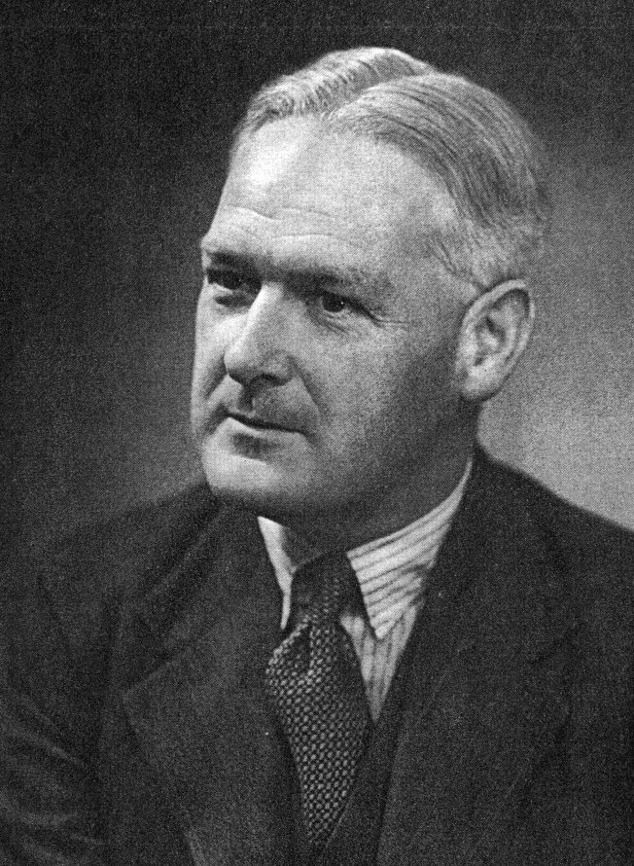
Sir Austin Bradford Hill, 1965
In what circumstances can we pass from [an] observed association to a verdict of causation? Upon what basis should we proceed to do so?

Slide 25
Guidelines for judging whether an association is causal
Sir Austin Bradford Hill criteria
Most Important criteria
Temporality: cause precedes effect
Strength of association: large relative risk
Consistency: repeatedly observed by different persons, in different places, circumstances, and times
Notes:
Red : most important criteria
Green: give additional support to causal reasoning

Slide 26
Guidelines for judging whether an association is causal
Additional supportive criteria
Biological gradient (dose response): larger exposures to cause associated with higher rates of disease. And reduction in exposure is followed by lower rates of disease (reversibility).
Biological plausibility: makes sense, according to biologic knowledge of the time.
Experimental evidence.
Other criteria: Analogy (cause & effect relationship already established for a similar exposure or disease), specificity (one cause lead to one effect) and coherence.

Slide 27
1. Strength of association
Definition:
The larger the magnitude of association the more likely the exposure affects the risk of developing the disease.
Why Important?:
Quantify how much the exposure increases the risk of disease. The larger the risk – the less chance of errors
Epidemiologic Measures:
Risk ratios, risk differences
Example:
RR of lung cancer in smokers vs. non-smokers = 9
RR of lung cancer in heavy vs. light smokers = 20
Mortality from scrotal caner among chimney sweeps compared to others = 200

Slide 28
2. Consistency
Definition: The association is observed repeatedly in different persons, places, times, and circumstances.
Why Important? If association is observed under different circumstances, with different samples and study designs, the more likely it is to be causal.
Smoking associated with lung cancer in 29 retrospective and 7 prospective studies
(Hill, 1965)

Slide 29
3. Specificity
Definition: The extent to which one exposure is associated with one outcome or disease.
Why important?: Be certain that you identify the particular agent, or cause, that results in a particular outcome.

Slide 30
3. Specificity
A single factor can cause several diseases (e.g., smoking associated with increased risk of lung cancer, small birth weight babies, etc.).
Also, a single disease can be caused by many factors (e.g., heart disease).
Bradford-Hill: Specificity should be used as evidence in favor of causality, not as refutation against it.
Example:
Smoking associated with lung cancer, as well as other conditions (lack of specificity)
Lung cancer results from smoking, as well as other exposures.

Slide 31
4. Temporality
Definition: The factor that is hypothesized to cause the disease must precede it in time.
Why important?: A factor can co-occur with a disease and not cause it. In some cases, a factor might actually result from a disease.
R.E. Epidemiology: Study design: Prospective cohort studies designed so that we know the exposure precedes the outcome.

Slide 32
5. Biological Gradient
Definition: A “Dose Response” association. Persons who are exposed to greater amounts of a risk factor show increasingly higher “rates” of disease.
A dose-response relationship provides support for causality, but the lack of this relationship does not mean lack of causality.
Example:
Lung cancer death rates rise with the number of cigarettes/day smoked.
The 16 year risk of colon cancer was similar among women in each of the 5 levels of dietary fiber intake, from lowest to highest (Fuchs et al.,1999).

Slide 33
6. Biological Plausibility
Definition: Knowledge of biological (or social) model or mechanism that explains the cause-effect association.
Epidemiologic studies often identify cause-effect relationships before a biological mechanism is identified
E.g. In the mid 19th century when a clinician recommended hand washing by medical students & teachers before attending obstetric units, his recommendations were dismissed by medical fraternity as “doesn’t stand to reasoning”
E.g., John Snow and cholera; thalidomide and limb reduction defects).
Bradford-Hill noted that biological plausibility cannot be “demanded”.

Slide 34
7. Coherence
Coherence - On the other hand, the cause-and-effect interpretation of our data should not seriously conflict with the generally known facts of the natural history and biology of the disease.

Slide 35
8. Experiment
Definition: Investigator-initiated intervention that tests whether modifying the exposure through prevention, treatment, or removal, results in less disease.
Why Important?: Most epidemiologic studies are observational.
RE. Epidemiology: Randomized clinical trials are closest to experiments in epidemiology.

Slide 36
9. Analogy
Definition: Has a similar cause-effect association been observed with another exposure and/or disease?
Why Important?: Important for generating hypotheses for the cause of newly-observed syndromes.

Slide 37
From Association to Causation
Association
Likely
Unlikely
No
Yes
Yes
No
Cause
Bias in selection or measurement
Chance
Confounding
Cause

