Slide 1
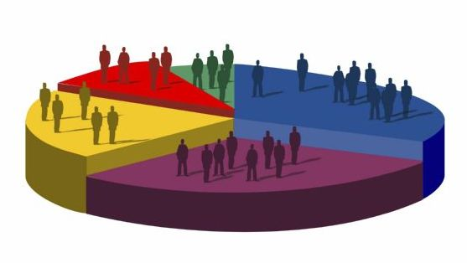
Demography
Dr. Sireen M. Alkhaldi
Department of Family and Community Medicine
Community Medicine Course
Faculty of Medicine/ The University of Jordan

Slide 2

Lecture Objectives
Present the need for population studies ( demography)
Introduce the components of population dynamics ( births, deaths, migration)
Introduce the basics of fertility and mortality and their measures
Discuss determinants of fertility
Describe population composition
Describe types of population profiles
Introduce basics of population change
Introduce basics of population transition

Slide 3

Resources:
Population Handbook, 6th International Edition, 2011.
Jordan Population and Family Health Surveys for the years 1997, 2002,2007, 2012.
Empowering women , developing society: female education in the MENA
Population trends and challenges in the MENA region

Slide 4
Demography
Demography ( population studies):
is the study of human populations: their size, composition, and distribution as well as the causes and consequences of changes in these characteristics.

Slide 5
Demography
Everyone of us is a member of a population.
Population factors have an impact on many facets of life—from where we live to the prices we pay for goods and services.
The need for health care preoccupies the political leaders of the industrialized countries whose populations are “aging,” while the need for classrooms, employment opportunities, and housing preoccupies the leaders of countries that are still growing rapidly.

Slide 6
Demography
Demography is the scientific study of population.
Demographers seek to know the levels and trends in population size and its components. They search for explanations of demographic change and their implications for societies.
They use censuses, birth and death records, surveys, visa records, even motor vehicle and school registrations. They shape these data into manageable forms such as simple counts, rates, or ratios.
Most of the principal measures used in demography (counts, rates, ratios, and proportions) will be defined in these lectures, together with recent examples of their use.

Slide 7
The Tools of Demography
COUNT: The absolute number of a population or any demographic event occurring in a specified area in a specified time period. (For example, 2,027,000 live births occurred in Egypt in 2010.).
RATE: The frequency of demographic events in a population during a specified time period (usually a year) divided by the population “at risk” of the event occurring during that time period. Rates tell how common it is for a given event to occur. (For example, in 2008 in Zambia the death rate was 16 per 1,000 population.) Most rates are expressed per 1,000 population.
Crude rates are rates computed for an entire population and Specific rates are computed for a subgroup, usually the population more nearly approximating the population “at risk” of the event (age-specific, sex-specific, race-specific, occupation-specific)

Slide 8
The Tools of Demography
RATIO: The relation of one population subgroup to or to another subgroup; that is, one subgroup divided by another. (For example, the sex ratio in France in 2010 was 94 males per 100 females.)
PROPORTION: The relation of a population subgroup to the entire population; that is, a population subgroup divided by the entire population. (For example, the proportion of Vietnam’s population in 2008 classified as urban was 29 percent.)

Slide 9
Demography:
Population Dynamics
Three major factors determine the dynamics of a population:
Births ( fertility)
Deaths ( mortality)
Migration
If some groups within a population grow or decline faster than others, the composition of the whole is altered. These three factors determine the most basic characteristics of a population, as well as its demographic future.

Slide 10
Fertility
Fertility is the number of live births women have.
Total Fertility Rate (TFR): is the average number of children that would be born to a woman by the time she ends childbearing.
The TFR is one of the most useful indicators of fertility because it gives the best picture of how many children women are currently having.
The average for the world it is 2.9
In Jordan total fertility rate is 3.5 (JPHS, 2012).

Slide 11

Fecundity
The physiological ability of women to reproduce.
Some are infecund due to disease or genetic dysfunction.
Mothers could be infecund when they breastfeed.
For individuals, fecundity ranges between 0-30 children.

Slide 12
Factors Affecting fertility
What are the factors that may influence fertility?
Cultural, social, economic, and health factors interfere with the process of human reproduction.
These factors operate in different societies in different ways. The relative importance of these factors varies by society.

Slide 13
Factors Affecting fertility
(general factors):
Cultural values e.g. ( Does the society value large or small families?)
Social roles: ( Is the wife primarily a child bearer or a child rearer ?)
Economic ( Do parents rely on children to look after them in old age?)
Health ( what is the prevalence of gonorrehea in a population ), that will impair fecundity.

Slide 14
Proximate determinants of fertility
Fertility is affected by cultural, social, economic, and health factors. Most of these factors operate (indirectly) through 4 other factors which explain nearly all variation in fertility levels among populations and have a direct biological effect on fertility:
The proportion of women in sexual union.
The percentage of women using contraception
The proportion of women who are not currently fecund (primarily because of breastfeeding).
The level of induced abortion.

Slide 15
Proximate determinants of fertility
In US. and most developed countries contraceptive use and abortion are the most important proximate determinants. The US, Brazil, Australia, and few East and South East Asia countries have contraceptive use rates of >= 75%.
The latest figure in Jordan is 42% for modern methods use( DHS report, 2012).

Slide 16
Proximate determinants of fertility
Spain recorded the lowest fertility rate in a nation 1.15 births per woman of reproductive age. Basically due to 72% using contraceptives.
Russia achieved low fertility rates due to having easier access to abortion.

Slide 17
Proximate determinants
When contraceptive and abortion prevalence rates are low, the postpartum infecundity and marriage determinants are more important.
African countries:
women marry early and bring more children, but they breast feed for 2-3 years, thus prolonging the period of infecundity following childbirth.

Slide 18
Proximate determinants of fertility
Others abstain as long as women are breast feeding.
Polygamy and being away form home
Sexually transmitted diseases affect fecundity.

Slide 19
Fertility Measurement
Birth Rate (Crude Birth Rate)
The birth rate (also called the crude birth rate) indicates the number of live births per 1,000 population in a given year
It is the most easily obtained and most common reported fertility measure

Slide 20
Fertility Measurement
Crude Birth Rate
There were 24 births per 1,000 population in Kuwait in 1994 :
Number of births (38,868) divided by the Total population (1,620,086 ) x K (1,000 )= 24.0
In Jordan, Crude Birth Rate= 28.1 (DHS 2012).

Slide 21
Fertility Measurement
General Fertility Rate
The general fertility rate GFR, (also called the fertility rate) ,is the number of live births per 1,000 women ages 15-49 in a given year.
The GFR is a somewhat more refined measure than the birth rate because it relates births to the age-sex group at risk of giving birth (usually defined as women ages 15-49).

Slide 22
General Fertility Rate
Yemen’s general fertility rate in the early 1990s was 238 live births per 1,000 women ages 15-49—one of the highest in the world.
The Czech Republic’s, it was very low at a rate of 34 per 1,000 women aged 15-49 in 1996.

Slide 23
Replacement level fertility
The level of fertility at which a couple has only enough children to replace themselves, or about two children per couple.
This pop will eventually stop growing.
It needs a TFR slightly higher than 2
In US it is 2.1 because death rate is not too high
In Sierra Leone , Repl. Level Fert. would be greater than 3 because death rate is too high.

Slide 24
Mortality
Death Rate
The death rate (also called the crude death rate) is the number of deaths per 1,000 population in a given year.
In the early 1990s, the death rate in Turkey was 6.6 per 1,000 population.
Number of deaths (405,000 )/ Total population (61,644,000) x K (1,000) = 6.6
In the early 1990s, Guinea’s death rate was 20 per 1,000 population, while Singapore’s was 5 per 1,000.

Slide 25
Death rates:
Age-Specific death rate
Cause-specific death rate
Sex-specific death rate

Slide 27
Infant Mortality Rate (IMR)
The infant mortality rate is the number of deaths of infants under age 1 per 1,000 live births in a given year.
The infant mortality rate is considered a good indicator of the health status of a population.
Latest figure about IMR in Jordan is 17/1000 live births ( DHS /2012)

Slide 28
Maternal Mortality Ratio
The maternal mortality ratio is the number of women who die as a result of complications of pregnancy or childbearing in a given year per 100,000 live births in that year.
Deaths due to complications of spontaneous or induced abortions are included.
a maternal death is defined as the death of a woman while pregnant or within 42 days of termination of pregnancy from any cause related to or aggravated by the pregnancy or its management but not from accidental or incidental causes.

Slide 29
Maternal Mortality Ratio
This measure is sometimes referred to as the maternal mortality rate
Number of maternal deaths (185 )x Total live births (1,408,159 )x K (100,000 )= 13.1
In Jordan MMR 19.1 (Maternal Mortality Study – Jordan 2007-2008- Higher Population Council, 2009)

Slide 30
Morbidity
Morbidity refers to disease and illness, injury and disability, in a population.
Data about the frequency and distribution of a disease can aid in controlling its spread, and in some cases, may lead to identification of it causes.

Slide 31
Morbidity : Incidence Rate
Incidence: The incidence rate is the number of people contracting a disease during a given time period per 1,000 population at risk. The incidence rate and other morbidity rates vary so widely in magnitude that any constant may be used that expresses the rate in a clear manner (from “per 100” or “percent” to “per 100,000”).
Number of people developing tuberculosis
during a given time period x K = 252,316 x 100,000 = 372
Population at risk 67,827,000
The incidence of tuberculosis in the Democratic Republic of the Congo in 2009 was 372 per 100,000 population

Slide 32
Morbidity (Prevalence)
Prevalence: The prevalence rate is the number of people who have a particular disease at a given point in time per 1,000 population. This rate includes all known cases that have not resulted in death, cure, or remission, as well as new cases developing during the specified period.
Number of people ages 15-49 with HIV/AIDS x K = 892,750 x 100 = 14.3
Total population ages 15-49 6,243,000
The prevalence of HIV/AIDS in Zimbabwe among adults (ages 15-49) in 2009 was 14.3 per 100 population.
In 2009, the prevalence rate of HIV/AIDS for males ages 15-49 in Botswana was 20.6 percent and for females, 29.2. Corresponding rates in Argentina were 0.6 and 0.3, respectively.

Slide 33
Morbidity
Case Fatality Rate The case fatality rate is the proportion of people contracting a disease who die of that disease during a specified time period.
Number of persons dying from the disease x K = 12,270 x 100,000 = 20.5 Number of persons contracting the disease 60,000,000
during a period
From April 2009 to March 2010, the U.S. Centers for Disease Control and Prevention estimates that there were 12,270 deaths from H1N1 flu in the United States, or 21 deaths for every 100,000 cases

Slide 34
Life Expectancy
Life expectancy is an estimate of the average number of additional years a person could expect to live if the age-specific death rates for a given year prevailed for the rest of his or her life.
Life expectancy is a hypothetical measure because it is based on current death rates and actual death rates change over the course of a person’s lifetime.
Each person’s life expectancy changes as he or she grows older and as mortality trends change.

Slide 35
Life Expectancy
If the age-specific death rates for 1996 remain unchanged, males in Brazil born in
Life expectancy for Jordanians 73 years (DHS, 2012).

Slide 36
Population Composition
Age and Sex Composition
Age and sex are the most basic characteristics of a population.
Every population has a different age and sex composition— the number and proportion of males and females in each age group—
This structure can have considerable impact on the population’s social and economic situation, both present and future.

Slide 37
Population Composition
Age and Sex Composition
Populations could be relatively young / developing countries, About 40 % <15 years e.g. Africa.. Jordan . Less than 4% are older groups.
Relatively old populations ( aging), developed countries, more than 10% over 65 years e.g. Europe/ Less than 25% of pop <15 years.

Slide 38
Age and Sex Composition
Young and old populations have markedly different age compositions; as a consequence, they also have different proportions of the population in the labor force or in school, as well as different medical needs, consumer preferences, and even crime patterns.

Slide 39
Median Age
A population’s age structure has a great deal to do with how that population lives.
The median age is the age at which exactly half the population is older and half is younger.
Examples:
The median age of the Costa Rican population in
1995 was 23 years. While that in Sweden was 38, signifying an older population.
In 1995, the median age in Jordan, with a young population, was 18. In 2012, median age in Jordan was 20,3 years (2012).

Slide 40
Sex Ratio
The sex ratio is the ratio of males to females in a given population,
usually expressed as the number of males for every 100 females.
The sex ratio at birth in most countries is about 105 or 106 males per 100 females.
After birth, sex ratios vary because of different patterns of mortality and migration for males and females within the population.

Slide 41
Population Pyramid
A population pyramid graphically displays a population’s age and sex composition.
Horizontal bars present the numbers or proportions of males and females in each age group.
The sum of all the age-sex groups in the population pyramid equals 100 percent of the population.

Slide 42
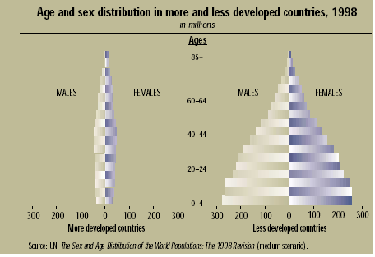

Slide 43
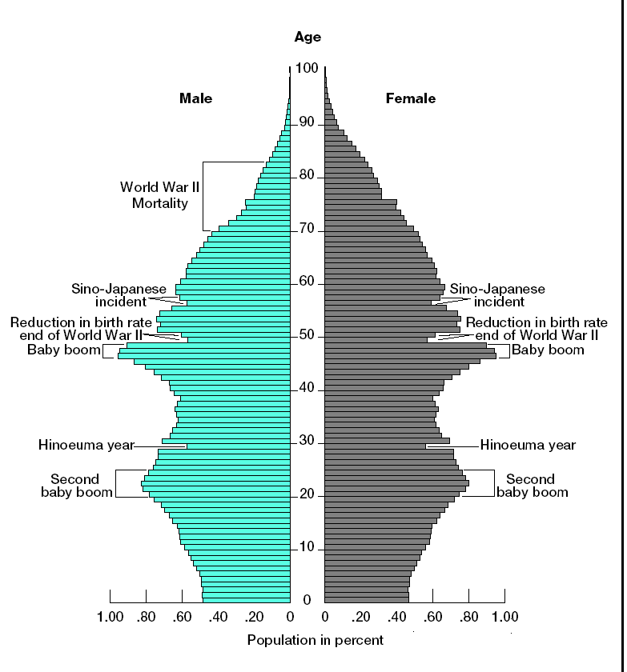
Japan’s population pyramid, 2006

Slide 44
Population profiles
Populations of countries can differ markedly as a result of past and current patterns of fertility, mortality, and migration. However, they all tend to fall into three general profiles of age-sex composition.
1. Rapid growth is indicated by a pyramid with a large percentage of people in the younger ages.
2. Slow growth is reflected by a pyramid with a smaller proportion of the population in the younger ages.
3. Zero growth or decreasing populations are shown by roughly equal numbers of people in all age ranges, tapering off gradually at the older ages.

Slide 45
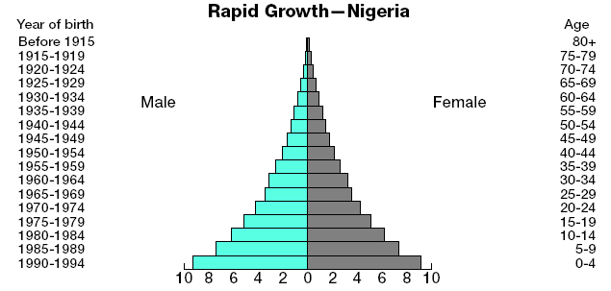
Age pattern of Senegal population, 2010

Slide 46
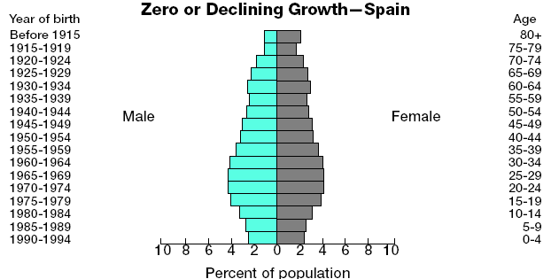
Age pattern of Italy’s population, 2010

Slide 47
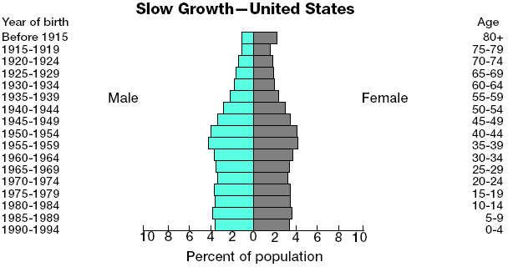
Age pattern of US population, 2009

Slide 48
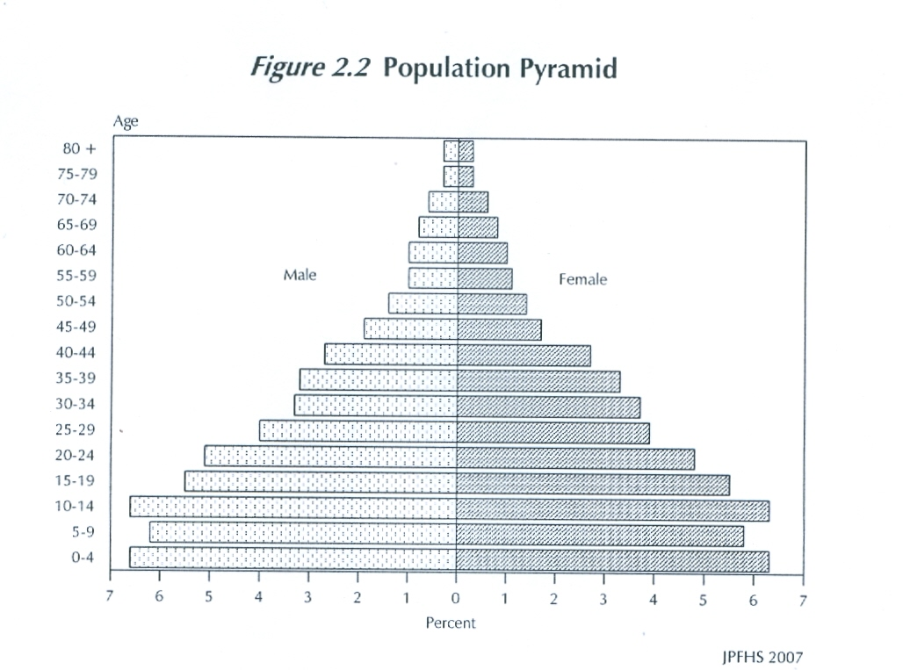
JPFHS 2007
Notes:
48

Slide 49
Population change
Population change has three components: births, deaths, and migration.
As people are born, die, or move, their total numbers in an area change.
During most of history, world population increased very slowly, but during the 20th century, this growth has accelerated.

Slide 50
How do populations change?
A change in population size over a given period of time equals the number of people in the population at the beginning of the period plus any births that occur during the period, minus any deaths, plus net migration during the period.

Slide 51
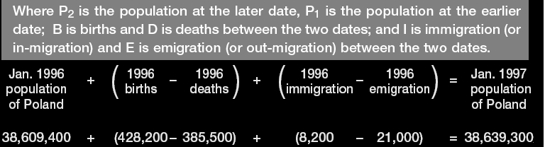
Calculating population change over time
P1+(B-D)+(I-E)= P2

Slide 52
Population change
The change in population size accounted for by more births in the population than deaths is referred to as "natural increase."
The term "natural decrease" refers to population decline resulting from more deaths than births.
Jordan :
        Growth rate 2.2
        Natural growth: 2.1 ( DHS, 2012)

Slide 53
Rate of Natural Increase
The rate of natural increase is the rate at which a population is increasing (or decreasing) in a given year due to a surplus (or deficit) of births over deaths, expressed as a percentage of the base population.
Net migration is the number of immigrants minus emigrants.

Slide 54
Growth Rate
The growth rate is the rate at which a population is increasing (or decreasing) in a given year due to natural increase and net migration, expressed as a percentage of the base population.
The growth rate takes into account all components of population growth: births, deaths, and migration.
It equals ( births – deaths )+_ net migration/ total population X K ( 100).
It should never be confused with the birth rate, but it sometimes is.

Slide 55
The Demographic Transition
The demographic transition refers to the change that populations undergo from high rates of births and deaths to low rates of births and deaths.
High levels of births and deaths kept most populations from growing rapidly throughout most of time.

Slide 56
The Demographic Transition
The decline in mortality usually precedes the decline in fertility, resulting in population growth during the transition period.

Slide 57
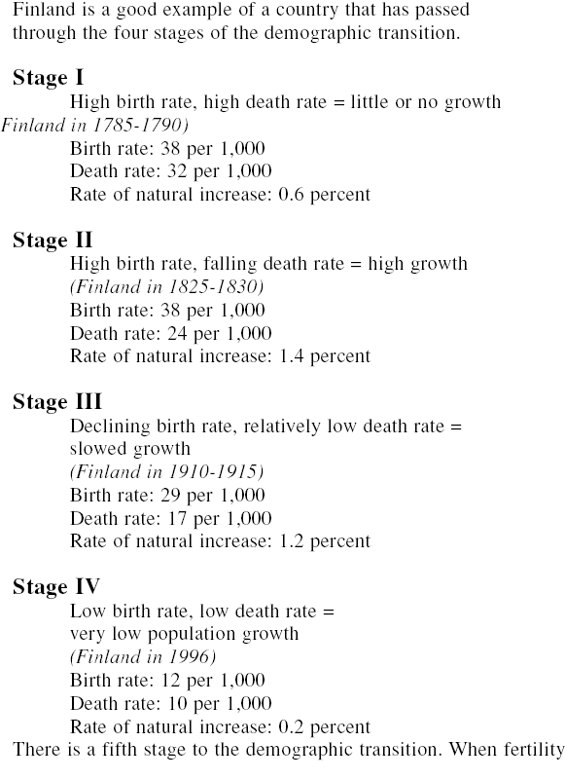

Slide 58
Population policies
National population commissions were formed in different countries
They formulated national population policies and action plans
One major component of the action plan deals with reproductive health
Reproductive health in the context of population includes reproductive rights, sexuality, family planning, reproductive morbidity, violence against women, gender based differences, male involvement in reproductive health.

Slide 59
Selected Indicators of Jordan
Jordan Population and Family Health Survey (JPFHS), 2012
Total population (000) * 6.388.0
Population Growth Rate (%) 2.2
Rate of natural increase (%) 2.1
Population Doubling time (year ) 31.5
Population less than 15 years (%) 37.3
* Excluding Syrian Refugees

Slide 60
Population Age 15-65 years (%) 59.5
Population Age 65+ years(% ) 3.2
Dependency ratio 68.2
Urban population (%) 82.6
Rural population (%) 17.4
Life Expectancy at birth (year) 73.0
Male 71.6
Female 74.4

Slide 61
Total fertility rate (Women 15-49 years ) 3.5
Urban 3.4
Rural 3.9
Sex ratio 106.3
Crude marriage rate (per 1000 population ) 11.1
Crude divorce rate (per 1000 population ) 2.8

Slide 62
Singulate mean age at first marriage (year) 28.1
Male 30.0
Female 25.9
Married of total population (Jordanians 15 +years) (%) 55.2
Male 53.9
Female 56.6

Slide 63
Population median age (year) 20.3
Crude birth rate (per1000 Population ) 28.1
Crude death rate (per 1000 population ) 7.0
Infant mortality rate (per 1000 live births ) 17.0
Under five mortality rate (per 1000 live births) 21.0

Slide 64
Life Expectancy at birth (year) 73.0
Male 71.6
Female 74.4

