Slide 1
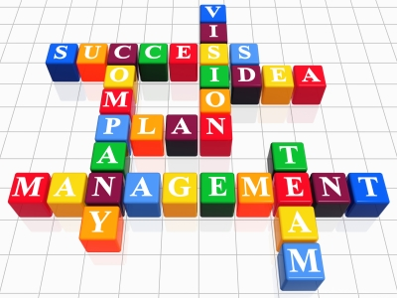
Health Management
Dr. Sireen Alkhaldi, DrPH
Community Medicine
Faculty of Medicine, The University of Jordan
First Semester 2015 / 2016

Slide 2
Why Study Management?
Healthcare organizations are very complex and dynamic
Healthcare management is the profession that provides leadership and direction to organizations that deliver personal health services, and to divisions, departments, units or services within those organizations.
Organizations were created to achieve goals that were beyond the capacity of any single individual.
The scope and complexity of tasks in healthcare organizations require that managers coordinate highly specialized disciplines that must work together seamlessly.
Healthcare managers take decisions to make sure that patients receive the most appropriate, timely, and effective services possible. And at the same time to achieve performance targets.

Slide 3
The
Specific Health Care Environment

Slide 4
What Is Management?
  Management is what managers do.
  Management is getting work done through people.
  Management is the attainment of organizational goals in an effective and efficient manner through: planning, organizing, leading, and controlling organizational resources.

Slide 5
What Is Management?
Managerial Concerns:
  Efficiency
    “Doing things right”
      Getting the most output for the least inputs (people, money, …)
  Effectiveness
    “Doing the right things”
      Attaining organizational goals

Slide 6
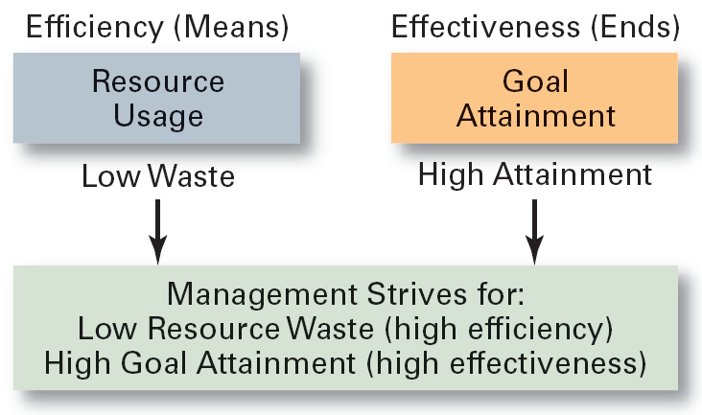
Effectiveness and Efficiency in Management

Slide 7
What Is An Organization?
An Organization Defined:
  A deliberate arrangement of people to accomplish some specific purpose, that individuals independently could not accomplish alone.
Common Characteristics of Organizations
  Have a distinct purpose (goal)
  Composed of people
  Have a deliberate structure

Slide 8
What Is An Organization?
In health care, organizations can take a variety of forms:
  Small non-profit clinics
  Large private hospitals
  Private physicians’ offices
  Networks of health care specialists
  Community health center

Slide 9
The Purpose of An Organization?
The PURPOSE of an organization is to produce goods and/ or services that satisfy the needs of the customers.
All organizations exist because they contribute something useful to the society.

Slide 10
Who Are Managers?
A manager is:
  Someone who coordinates and oversees the work of other people so that organizational goals can be accomplished.

Slide 11
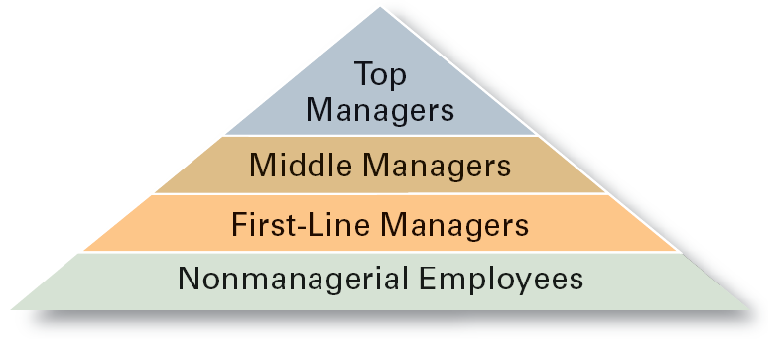
Managerial Levels

Slide 12
Levels of Managers
First-line Managers
  Individuals who manage the work of non-managerial employees (e.g. team leaders, supervisors of units).
Middle Managers
  Individuals who manage the work of first-line managers. They are in charge of large departments or divisions consisting of several smaller work units (e.g. Head of department in hospitals and regional managers).
Top Managers
  Individuals who are responsible for making organization-wide decisions and establishing plans and goals that affect the entire organization. Job titles at this level are: chief executive officer (CEO), chief operating officer, president, and vice president.

Slide 13
What Do Managers Do?
Managerial Skills
  Technical skills
    The ability to use Knowledge and proficiency or expertise in a specific field
  Human skills
    The ability to work well with other people (with trust and enthusiasm), and empathize with the emotions and feelings of others (emotional intelligence).
  Conceptual skills
    The ability to think analytically about complex situations concerning the organization, to solve problems.

Slide 14
Examples of Conceptual skills:
  a manager conducts an analysis of the best way to provide a service
  a manager determines a strategy to reduce patient complaints regarding food service
Examples of Technical skills:
  a manager develops and implements a new incentive compensation program for staff
  a manager designs and implements modifications to a computer-based medical records
Examples of Human skills:
  a manager counsels an employee whose performance is below expectation
  a manger communicates to subordinates the desired performance level for a service for the next fiscal year

Slide 15
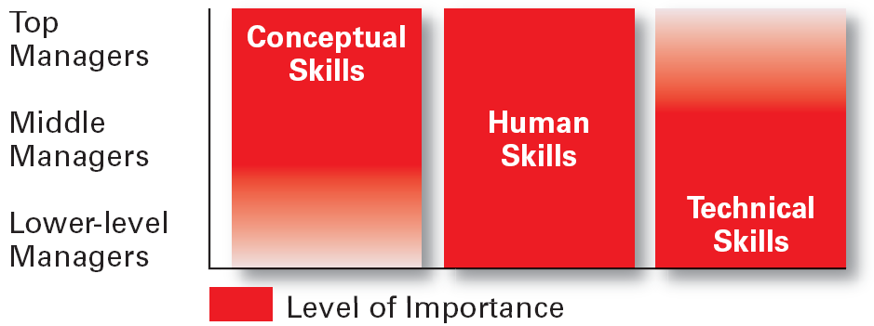
Skills Needed at Different Management Levels

Slide 16
Functions of Management
Four functions of Management:
Planning
Organizing
Leading
Controlling

Slide 17
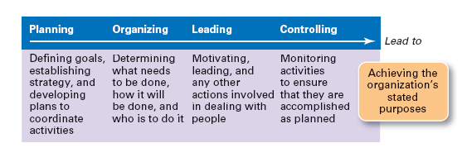
Management Functions

Slide 18
Planning
  Planning is Defining goals and performance objectives, and determine what actions should be taken to accomplish these goals (strategies).
  Planning involves two important aspects:
  Setting goals and Developing Plans
  1. Setting Goals (general) and Objectives (specific):
    Desired outcomes for all levels in the organization: individuals, groups, or entire organizations
    Provide direction and evaluation performance criteria

Slide 19
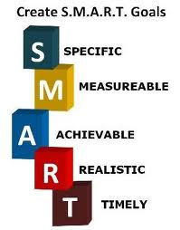
Planning
    Examples for business goals and objectives may include:
    A certain level of profit
    Gaining or holding a specific share of the market
    Recruiting a high-quality workforce
    Making a positive contribution to the society

Slide 20
Characteristics of Well-Designed Goals
Written in terms of outcomes, not actions
  Focuses on the ends, not the means.
Measurable and quantifiable
  Specifically defines how the outcome is to be measured and how much is expected.
Clear as to time frame
  How long before measuring accomplishment.
Challenging but attainable
  Low goals do not motivate.
  High goals motivate if they can be achieved.
Written down
  Focuses, defines, and makes goal visible.
Communicated to all
  Puts everybody “on the same page.”

Slide 21
Planning
  Planning involves two important aspects:
  2. Developing Plans
    Documents that outline how goals are to be accomplished
    Describe how resources are to be allocated and establish activity schedules
    Types of PLANS:
    Short-term (1 year) or long-term (> 3 years)
    Strategic plans or Operational plans (marketing, financial, product)
    Policies (sexual harassment policy) and Procedures (manuals)
    Schedules and Budgets

Slide 22
Strategic Management
Strategic management provides overall direction to the organization and involves specifying the organization's objectives, developing policies and plans designed to achieve these objectives, and then allocating resources to implement the plans.
SWOT analysis is the major tool used,
and is done by identifying: STRENGTHS,
WEAKNESSES, OPPORTUNITIES,
and THREATS

Slide 23
Strategic Management Process
Step 1: Identifying the organization’s current vision, mission, objectives, and strategies.
Step 2: Conducting an external analysis
  The environmental scanning of the environment, Focuses on identifying opportunities and threats

Slide 24
Strategic Management Process (cont’d)
Step 3: Conducting an internal analysis
  Assessing organizational resources, capabilities, activities, and culture:
    Strengths (what are we good at)
    Weaknesses (things done poorly or not at all)
Steps 2 and 3 combined are called a SWOT analysis. (Strengths, Weaknesses, Opportunities, and Threats)

Slide 25
Strategic Management Process (cont’d)
Step 4: Formulating strategies (based on SWOT)
  Match organizational strengths to environmental opportunities
  Correct weaknesses and guard against threats
Step 5: Implementing strategies.
Step 6: Evaluating Results
  How effective have strategies been?
  What adjustments, if any, are necessary?

Slide 26
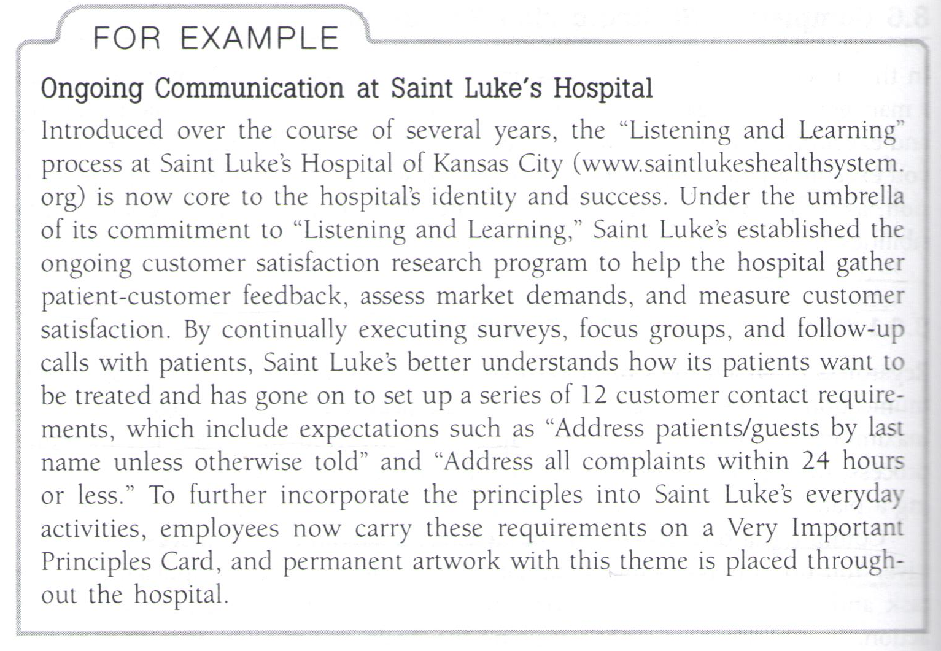

Slide 27
Homework!
Look for two mission statements related to one healthcare organization, and one other organization, institution or business.

