Slide 1
Epidemiology
Dr. Sireen Alkhaldi
Community Medicine 2015/ 1016
Faculty of Medicine, The University of Jordan

Slide 2
Definitions…
Public health
The science & art of
Preventing disease,
prolonging life,
promoting health & efficiency
through organized community effort
(Winslow, 1920)

Slide 3
Definitions
Epidemiology
The science of the mass phenomena of infectious diseases or the natural history of infectious diseases. (Frost 1927)
The science of infective diseases, their prime causes, propagation and prevention. (Stallbrass 1931.)

Slide 4
Definitions…
Epidemiology
“The study of the distribution and determinants of health related states or events in specified population and the application of the study to control of health problems“
(J.M. Last 1988)

Slide 5
Components of the definition
Study: Systematic collection, analysis and interpretation of data
Epidemiology involves collection, analysis and interpretation of health related data
Epidemiology is a science

Slide 6
Components of epidemiology
Disease frequency:
The core characteristics of epidemiology are to measure the frequency of diseases, disability or death in a specified population. it is always as the rate, ratio and proportion.
This falls in the domain of biostatistics, which is a basic tool of epidemiology.

Slide 7
Components…
Distribution: Distribution of an event by person, place and time
Epidemiology studies distribution of diseases
It answers the question who, where and when?
Epidemiology describes health events

Slide 8
Components…
Determinants:
Factors the presence/absence of which affect the occurrence and level of an event
Epidemiology studies what determines or influences health events:
It answers the question: how and why?
Epidemiology analyzes health events

Slide 9
Components…
Diseases & other health related events
Epidemiology is not only the study of diseases.
The focus of Epidemiology is not only patients’ health as individuals, but anything that may affect their health and well-being.
It studies all health related conditions
Epidemiology is a broad science

Slide 10
Components…
Human population
Epidemiology diagnoses and treats communities/populations
Clinical medicine diagnoses and treats patients
Epidemiology is a basic science of public health

Slide 11
Components…
Application
Epidemiological studies have direct and practical applications for prevention of diseases & promotion of health
Epidemiology is a science and practice
Epidemiology is an applied science

Slide 12
Basic tenets of epidemiology
The target of a study in epidemiology is human Population as Geographical area, Age, Sex, Ethnicity, Race etc.: the most common population in epidemiology is the population in a given area or country at a given time. Since the structure of population varies at each time such variations also have to be taken in to consideration during data analysis. All findings must relate to the defined population.
Enumeration is not enough in epidemiology, the population at risk of developing that disease need to be enumerated as well.

Slide 13
Basic tenets of epidemiology
Diseases do not occur randomly.
Conclusions are based on comparisons: comparing the rates of diseases frequency among the exposed and unexposed is an important epidemiological method.
Description of events by time, place and person. Getting answer for when, where and who are affected is very important in epidemiology to formulate hypothesis about its causation. Other important aspects are what, why and how of the events.

Slide 14
The ultimate aims of epidemiology can be concluded in to two followings points
To eliminate or reduce the health problem or its consequences
To promote the health and wellbeing of society as a whole.

Slide 15
Study design in Epidemiology
Observational Study
Descriptive studies
Analytical Studies
Ecological Study: Correlation Study, unit is a population.
Cross-Sectional Study: prevalence Study, Individual is the unit of study.
Case-Control Study: case-reference, with individual is the unit of study.
Cohort study: Follow up study, with individual is the unit of study.
Experimental Studies
Randomized Control Trials
Field Trials
Community Trials

Slide 16
The Five Ws of Epidemiologic Studies

Slide 17
History of Epidemiology
Seven land marks in the history of Epidemiology:
1) Hippocrates (460BC): Environment & human behaviors affects health
2) John Graunt (1662): Quantified births, deaths and diseases.
3) Lind (1747): Scurvy could be treated with fresh fruit

Slide 18
History…
4) William Farr (1839): Established application of vital statistics for the evaluation of health problems
5) John Snow (1854): tested a hypothesis on the origin of epidemic of cholera
6) Alexander Louis (1872): Systematized application of numerical thinking (quantitative reasoning)

Slide 19
History…
7) Bradford Hill (1937): Suggested criteria for establishing causation
Epidemiological thought emerged in 460 BC
Epidemiology flourished as a discipline in 1940s

Slide 20
History of epidemiology
John Snow was conducting a series of investigations in London that later earned him the title father of field epidemiology. Snow conducted his classical study in 1854 when an epidemic of cholera developed in the golden square of London. During the time of microscope development, snow conducted studies of cholera outbreak both to discover the causes of diseases and prevent its recurrences.
During that time two men (Farr and snow) had major disagreement about the cause of cholera. Farr adhered to what was the called miasmatic theory of diseases, according to this theory which was commonly held at a time diseases was transmitted by a miasma or cloud that clung low on the earth surface.

Slide 21
History of epidemiology
However Snow did not agree he believed that cholera is transmitted through contaminated water. He began his investigation by determining where in this area person with cholera lived and worked. He then used this information to map for distribution of diseases.
Snow believed that water was the source of infection for cholera. He marked the location and searched the relationship between cases and water sources.
He found that cholera was transmitted though contaminated water. This was a major achievement in epidemiology.

Slide 22
History of epidemiology
In the 1900s epidemiologists extend their methods to noninfectious diseases and studied the effect of behaviors and life style in human health.
There were some cornerstone achievements in epidemiology :
John Snow and cholera epidemic in London in 1848-1854.
Framingham heart study started in 1950 in Massachusetts, USA and still continuing to identify the factors leading to the development of the coronary heart diseases.
Smoking and lung cancer by Doll and Hill in 1964.
Polio Salk vaccine field trial in 1954 to study the protective efficacy of vaccine in a million school children.
Methyl Mercury poisoning 1950s In Minamata .

Slide 23
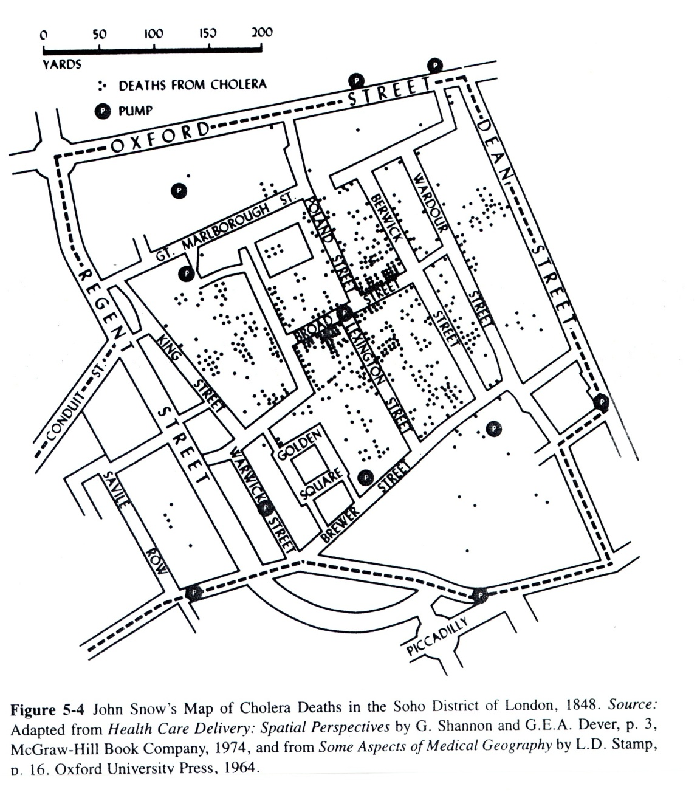

Slide 24
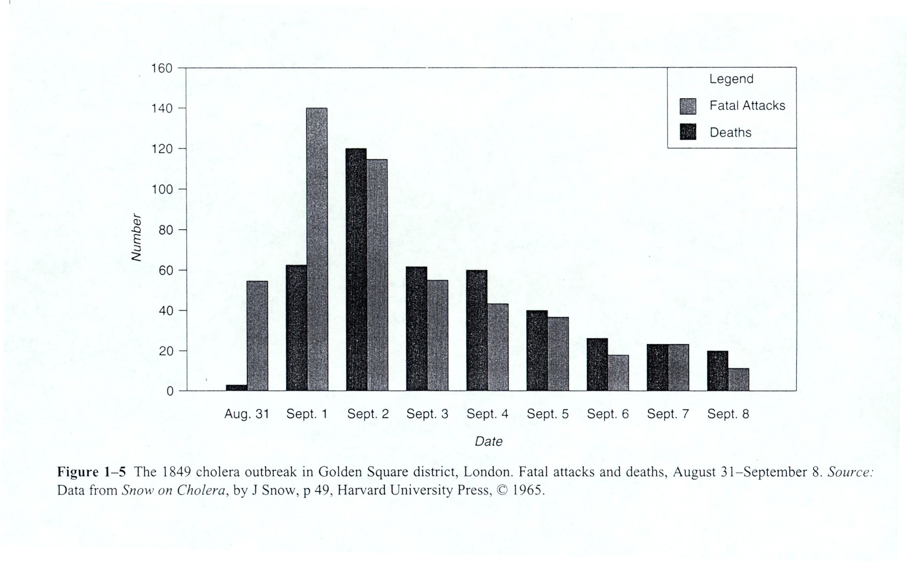

Slide 25
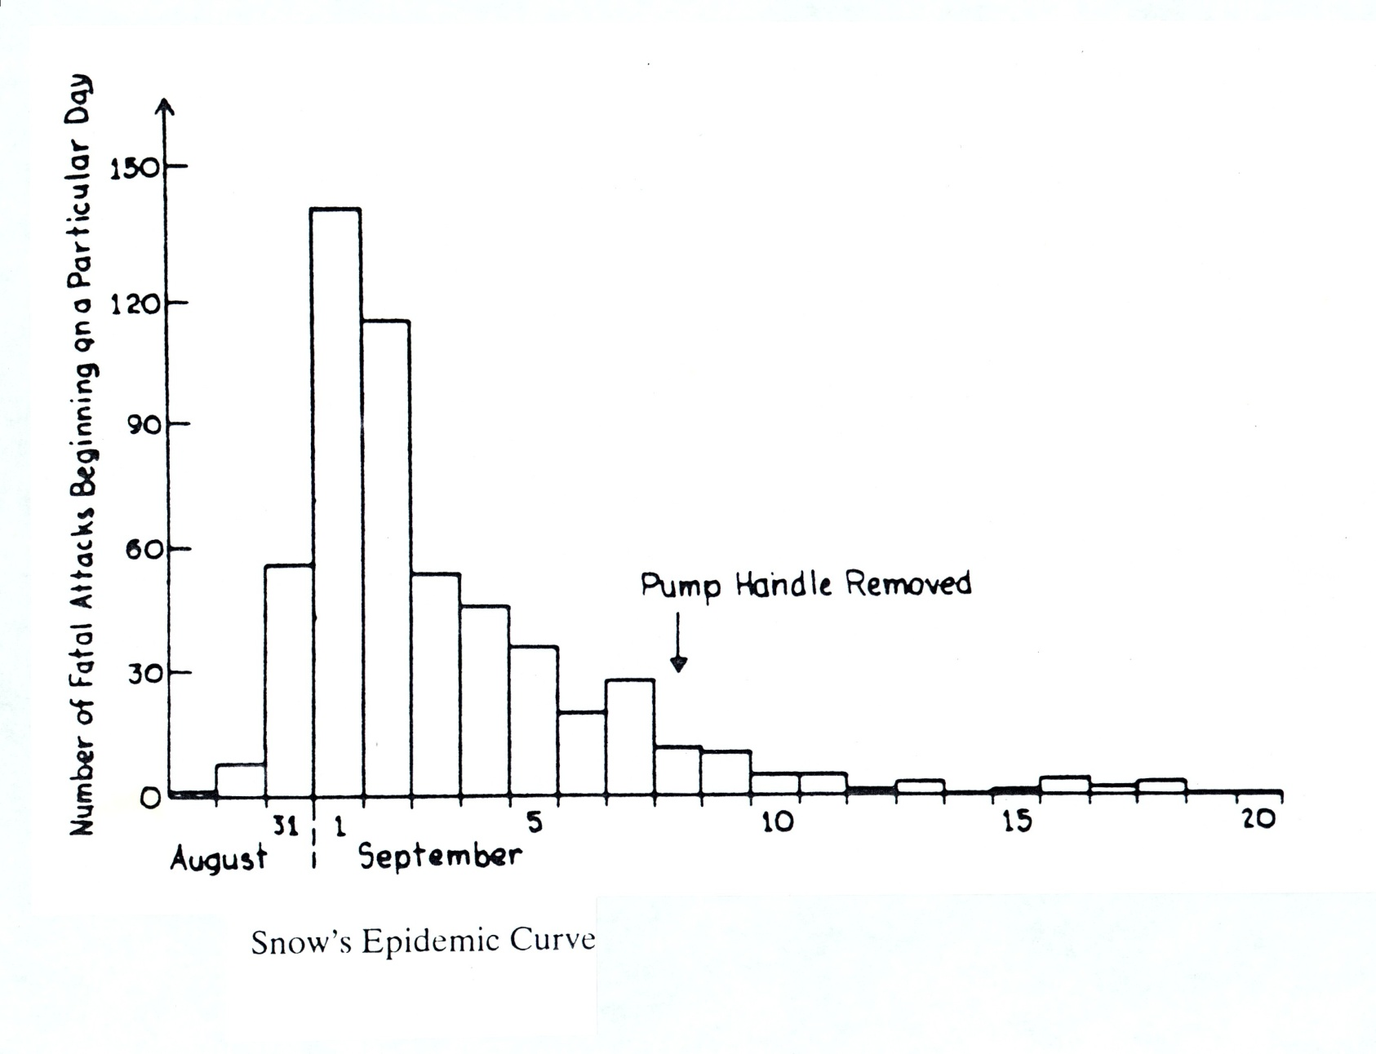

Slide 26
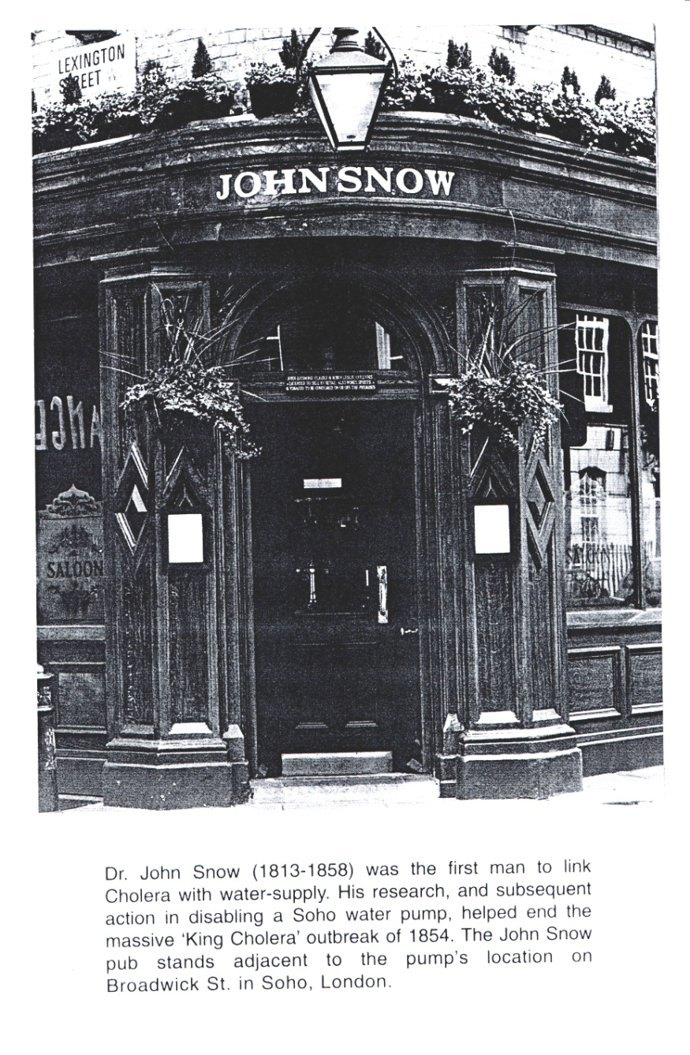

Slide 29
Measurement of Disease Occurrence Morbidity rates
Morbidity rates are rates that are used to quantify the magnitude/frequency of diseases
Two common morbidity rates:
Incidence rates(Cumulative incidence, incidence density)
Prevalence (Period prevalence, point prevalence)

Slide 30
Incidence rate
The proportion of a population that develops a disease overtime
The risk/probability of an individual developing a disease overtime
The rapidity with which new cases of a disease develop overtime
The proportion of unaffected individuals who on average will contract the disease overtime

Slide 31
Cumulative incidence
Number of new cases of a Cumulative = disease during a specified period
Incidence Population at risk in the same
Period of time

Slide 32
Practical challenges in measuring incidence rate
1. Identification of population at risk
Population at risk constitutes all those free of the disease and susceptible to it
2. Population is not static/it fluctuates/as a result of births, deaths and migration
3. People are at risk only until they get the disease and then no more at risk

Slide 33
Prevalence rate
It measures the proportion of a population with a disease during a specified period or at a point in time
Two types
Point prevalence rate
Period prevalence rate

Slide 34
Point prevalence rate
Measures the proportion of a population with a disease at a point in time
Point prevalence rate=All persons with a disease at a point in time/Total population
It is not a rate, but a true proportion

Slide 35
Period prevalence rate
Measures the proportion of a population with a disease in a specified time period
Period prevalence rate=All persons with a disease overtime period/Average(mid-year)population in the same period

Slide 36
Incidence Vs prevalence
Prevalence measures all of the current cases of the disease in the community.
It depends on the duration of the disease process
It depends on the incidence of the disease
It can be used to determine the health care needs of a community.
P = I X D
where P = Prevalence rate, I = Incidence rate, D = Duration of the disease.
Prevalence rate is equal to Incidence rate in case of diseases with short duration or highly fatal such as Rabies.

Slide 37
Relationship between prevalence & incidence rates
An increase in prevalence rate may not necessarily be due to an increase in incidence rate, it could be due to an increase in average duration of a disease due to decrease in death and/or recovery rates.

Slide 38
Calculation …
A survey of respiratory disease was conducted and the results are presented in the table below.
Calculate the prevalence of chronic bronchitis in each age group and in the total group.
Prevalence of chronic bronchitis, by age, in a sample of 2383 employed men: , 1981.
Age (years) | Number Surveyed | Frequency | Prevalence (%)
45-49 | 496 | 18 | 3.6
50-54 | 672 | 18 | 2.7
55-59 | 1215 | 18 | 1.5
Total | 2383 | 54 | 2.3
χ² = 0.983, p = 0.612
Prevalence = 54 / 2383 = 0.0226 x 100% = 2.3%
= 0.0226x 1000= 22.6 cases/ 1000 pop.

Slide 39
A study was conducted to examine the incidence of Carpal Tunnel Syndrome (CTS) among computer operators in a certain corporation. An initial survey was given to 12 administrative assistants. Two of the 12 administrative assistants had symptoms and 10 did not reveal signs or symptoms equivalent to CTS. The administrative assistants who did not reveal signs or symptoms equivalent to CTS were then recruited into a study and followed for 4 years. The findings are listed below:
3 of the 10 administrative assistants developed CTS during the 4 year follow-up period
Subjects Follow-up Time(yrs) CTS
1 1 yes
1 2.5 yes
1 3 yes
2 2 fired
1 1 transferred
4 4 no
Calculate: Cumulative Incidence (per 1,000)
Cumulative Incidence= 3/ 10 = 0.3 = 30%
= 0.3 x 1000 = 300 cases per 1,000 population

