Slide 1
FOREIGN BODIES

Slide 2
FOREIGN BODIES
FOREIGN BODY ASPIRATION

Slide 3
FOREIGN BODY ASPIRATION
Foreign body aspiration is a life-threatening emergency requiring immediate intervention.
The removal of a foreign body in the respiratory tract generally leads to a rapid recovery

Slide 4
Age incidence
Age : 9 to 30 months
due to children's mobility
Oral exploration of the environment
Older children and adults add to the problem by giving inappropriate foods

Slide 5
Factors that Make Young Children Susceptible to Aspiration
Children often cry, shout, run, and play with objects in their mouths
Absence of molars to chew certain foods adequately
Immature coordination of swallowing and airway protection
Immature laryngeal sphincter control

Slide 6
Types of F.B
Organic material
Peanut
Sunflower seed
Almond
Popcorn
Apple or Orange seeds
Nonorganic
Buttons
Toys parts
Pins and needles

Slide 7
Evaluation
The most important factor in evaluating a child who possibly aspirated an FB is an accurate history.
choking crisis occurred in 95%
persistent cough, hemoptesis, fever, malaise, and respiratory compromise
Inspiratory stridor and respiratory distress -larynx or subglottic area.
Wheeze -Foreign bodies in the trachea or bronchus cause

Slide 8
Symptoms
Penetration syndrome " defined as a sudden onset of choking and intractable cough with or without vomiting”
Cough
Fever
Breathlessness
Wheezing
Cyanosis
No symptoms

Slide 9
Radiographic examination
consists of anteroposterior and lateral views of the extended neck and chest.
56% of patients will have a normal chest radiograph
CXR findings:
air trapping : the most common sign
atelectasis
mediastinal shift
Pneumonia
a radiopaque object

Slide 10
Radiographic Findings in Patients With Foreign Body Aspiration
Adult Group, No. of Radiographs With Diagnosis (% Relative Frequency) | Child Group, No. of Radiographs With Diagnosis (% Relative Frequency)
9 (50%) | 11 (14%) | Atelectasis
3 (17%) | 49 (64%) | Air trapping
3 (17%) | 10 (13%) | Pneumonia
2 (11%) | 3 (4%) | Visible foreign body
2 (11%) | 9 (12%) | Normal radiograph

Slide 11
Air trapping

Slide 15
Progress of disease
Symptomatic phase
Asymptomatic phase
Complications
Pneumonia
Lung abscess
Bronchiectasis
Hemoptasis
Erosion & perforation

Slide 16
signs
Respiratory distress
Localized wheezing
Poor air entry

Slide 17
Complications of aspiration
obstruction due to granulation tissue or strictures,
atelectasis,
bronchiectasis,
pneumonia,
empyema,
lung abscess,
perforation with pneumothorax,
systemic sepsis.

Slide 18
Special consideration
Great care needs to be taken with peanuts, which is why they should not be given to young children. Not only can they obstruct the bronchus, but the oil content can also produce a lipoid pneumonia which is known to develop rapidly.

Slide 19
treatment
Bronchoscopic removal of the foreign body

Slide 20
ESOPHAGEAL FOREIGN BODIES

Slide 21
Esophageal FB
The most common site (70%) of lodgement is at the level of the cricopharyngeus muscle (the area between the clavicles on the x-ray).
The other two sites of lodgement are
mid-oesophagus
the gastro-oesphageal junction.
Coins and smooth blunt objects are the most commonly ingested items

Slide 22
Congenital and acquired esophageal anomalies that contribute to FB obstruction of the esophagus.
Esophageal anastomosis
vascular ring,
esophageal stricture

Slide 23
Clinical symptoms
pain in the pharyngeal or retrosternal region,
gagging
poor feeding
Drooling

Slide 24
Radiologic evaluation include a lateral view and an anteroposterior view of both the neck and chest

Slide 25
treatment
Esophagoscopic removal

Slide 26
Batteries unique injuries
Related to:
Direct caustic injury, alkaline corrosive
tissue necrosis from electrical discharge,
toxin release (mercury poisoning).
Disc batteries can cause corrosive injury to the esophagus within 4 hours

Slide 27
Complications caused by esophageal impaction of button batteries
Include:
tracheoesophageal fistula
esophageal burn with and without perforation,
Aortoesophageal fistula,
esophageal stricture,
death.

Slide 28
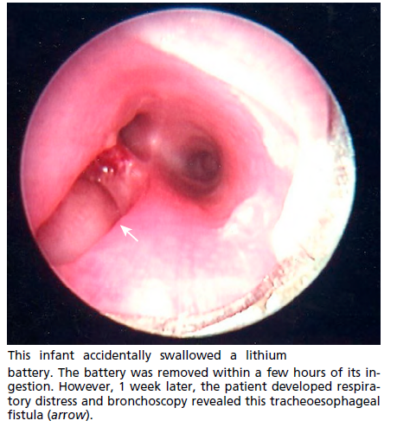

Slide 29
treatment
Emergency endoscopy must be performed for batteries retained in the esophagus because of the high propensity of early mucosal injury.

Slide 30
GASTROINTESTINAL FOREIGN BODIES

Slide 31
97% of ingested FBs that passed through the esophagus on radiographic study were spontaneously evacuated
Ingestion of multiple magnets causes
bowel perforation
volvulus
ischemia
enteroenteral fistulas.

Slide 32
types
Sharp objects
Blunt objects
Disc batteries
magnets

Slide 33
Sharp objects
Majority pass without problems
Need careful observation
Surgical intervention:
Peritonitis
Bleeding
Obstruction
Failure to progress

Slide 35
Blunt objects
Coins; buttons; marbles
Most of these objects pass
Observation at home
surgical intervention if complicated:
Peritonitis
Bleeding
Obstruction
Failure to progress within 4-6 weeks

Slide 36
Disc batteries
Serious complications because of
Corrosive injury
Electric current
Should be removed if no progress within 6 to 12 hours

