Slide 1
Follicular Lymphoma
Common (West), low-grade B-cell lymphoma
Affects elderly
Arises from germinal center B-cell
Lymphoma cells have specific translocation t(14:18), in which Bcl2 gene on chr18 fuses with IgH gene on chr14, causing overexpression of Bcl2
Patients has generalized lymphadenopathy
Lymphoma cells proliferate to form abnormal, large, crowded follicles
Patients have indolent course, transforms into high grade lymphoma in 40% of cases

Slide 2
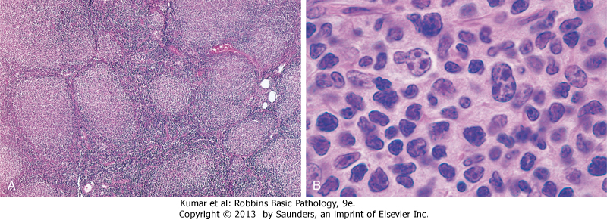
A, Nodular aggregates of lymphoma cells are present throughout the lymph node. They are positive for Bcl2 staining.
B, At high magnification, small lymphoid cells with condensed chromatin and irregular or cleaved nuclear outlines (centrocytes) are mixed with a population of larger cells with nucleoli (centroblasts).

Slide 3
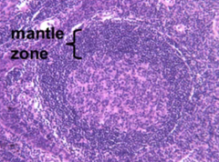
Mantle cell lymphoma
Rare
Old age
Disseminated, nodal and extranodal
Morphology: diffuse pattern, small cleaved centrocytes
Express CD5, cyclin D1

Slide 4
Diffuse Large B Cell Lymphoma
most common type of lymphoma in adults, accounting for approximately 50% of adult NHLs, also arises in children
Arises de novo, as a transformation from low grade B-cell lymphoma, in the setting of chronic immune stimulation, immune suppression (AIDS) or post transplant
A subtype is caused by HHV8, arises in body cavities (pleural and peritoneal fluid), called primary effusion lymphoma
High-grade lymphoma, progressive and fatal if not treated

Slide 5
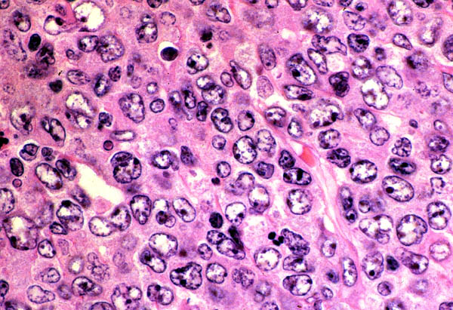
Tumor cells have large nuclei with open chromatin and prominent nucleoli.

Slide 6
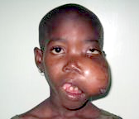
Burkitt lymphoma
High-grade B-cell lymphoma
Endemic in Africa (high association with EBV), sporadic worldwide
t(8:14), myc gene fuses with IgH gene, causing overexpression of myc, which activates other transcription factors and causes continuous cell proliferation
Lymphoma commonly arises in extranodal sites (jaw, ileum)
Lymphoma is rapidly growing and fatal if not treated

Slide 7
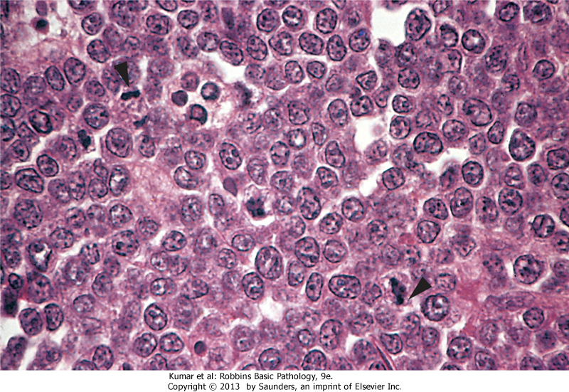
The tumor cells and their nuclei are fairly uniform, giving a monotonous appearance
high level of mitotic activity (arrowheads) and prominent nucleoli.

Slide 8
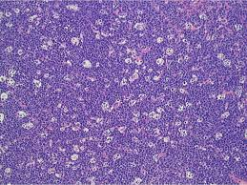
The "starry sky" pattern produced by interspersed, lightly staining, normal macrophages

Slide 9
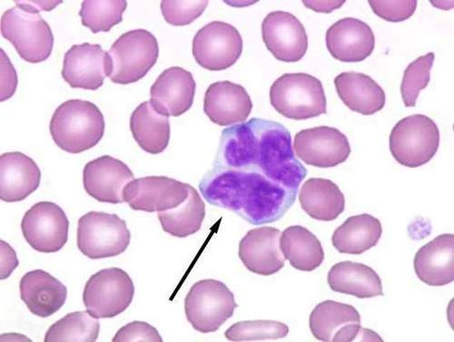
Mycosis Fungoides
T-cell lymphoma
Arises from CD4+ lymphocytes in skin
Patients present with red patches
With time evolves into tumorous masses
A clinical variant (Sezary syndrome), patients have diffuse erythema in the body, and neoplastic lymphocytes circulate the blood
Malignant lymphocytes show marked irregular nuclei (cerebriform)

Slide 10
Adult T Cell Leukemia/Lymphoma
CD4+ T cells that is caused by a retrovirus, human T cell leukemia virus type 1 (HTLV-1)
Endemic in southern Japan, the Caribbean basin, and West Africa, and occurs sporadically elsewhere
Lymphoma develops in 3-5% of infected persons, latent period 20-50 years
Patients develop skin erythema, enlargement of liver and spleen
Neoplastic cells express CD4, CD25
Aggressive

Slide 11
Hodgkin Lymphoma
a group of lymphoid neoplasms that differ from NHL in several respects
Localized to a single axial group of nodes, most commonly in cervical, axillary and mediastinal LNs
Orderly spread by contiguity
Extra-nodal presentation rare

Slide 12
Hodgkin Lymphoma
Presence of neoplastic giant cells called Reed-Sternberg cells
RS cells constitute only a minority of tumor size, the rest is composed of reactive lymphocytes, histiocytes and granulocytes
neoplastic RS cells are derived from crippled, germinal center, B cells
Immunophenotype is very different from normal B-cells (negative for CD3, CD20, positive for CD30)
EBV plays a role in the evolution of disease

Slide 13
Clinical features
Bimodal age distribution: children + old age
Presents as painless lymphadenopathy
Constitutional symptoms (B-symptoms), such as fever, night sweats, and weight loss are common
Spread: nodal disease first, then splenic disease, hepatic disease, and finally involvement of the marrow and other tissues

Slide 14
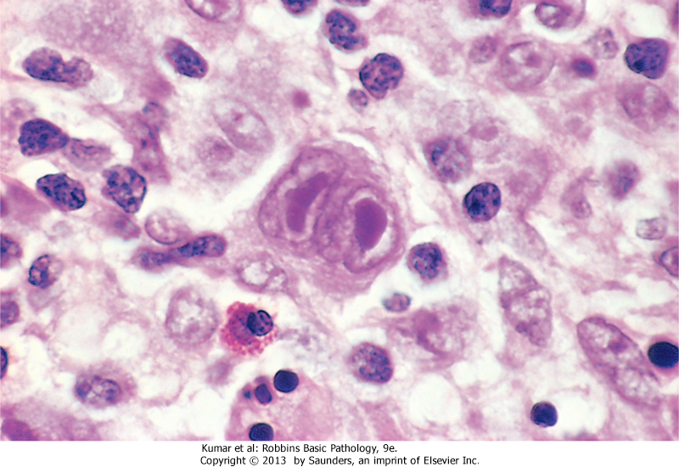
Reed-Sternberg cell, with two nuclear lobes, large eosinophilic e nucleoli, and abundant cytoplasm, surrounded by lymphocytes, macrophages, and an eosinophil

Slide 15
Plasma cell myeloma
Neoplasm of plasma cells that secrets monoclonal Immunoglobulin (M-protein)
10% of BM tumors
Arises from long-lived plasma cells in the BM
Aggressive tumor, difficult to control
Affects elderly
Clinically known as multiple myeloma

Slide 16
Pathogenesis
Risk factors: older age, male, blacks, radiation, family history, obesity?
Accumulation of genetic mutations and chromosomal aberrations
Transformed plasma cells proliferate modestly, interact with stromal cells in BM (resistant to chemotherapy)
Secrete IgG (>other Igs)
Plasma cell count ≥ 10%

Slide 17
Clinical symptoms
HyperCalcemia
Renal failure: protein cast (M-protein) blocks renal tubules
Amyloidosis
Anemia: normochromic normocytic, decreased production (cytokines) + effacement
Bone pain/ fracture: activation of osteoclasts
Recurrent infections: suppression of normal Ig
Hyperviscosity: blurred vision, CNS symptoms,

Slide 18
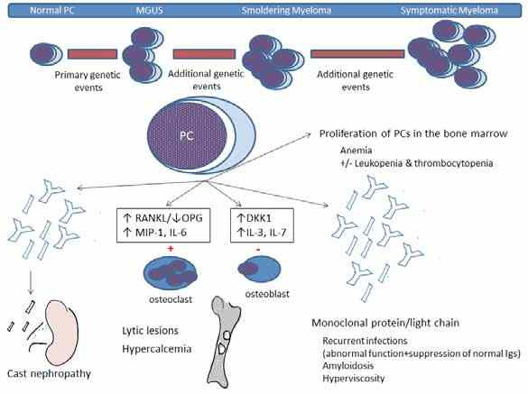

Slide 19
Morphology
Malignant plasma cells show large size, multinucleation, prominent nucleoli, ≥10%
If 3-10%: called monoclonal gammopathy of undetermined significance (MGUS), usually asymptomatic, commonly progress to myeloma
PB: RBS show rouleaux formation. Malignant plasma cells may circulate

Slide 20
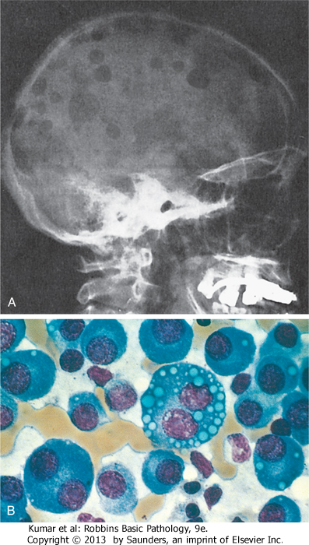
Normal marrow cells are largely replaced by plasma cells, including forms with multiple nuclei, prominent nucleoli, and cytoplasmic droplets containing Ig

Slide 21
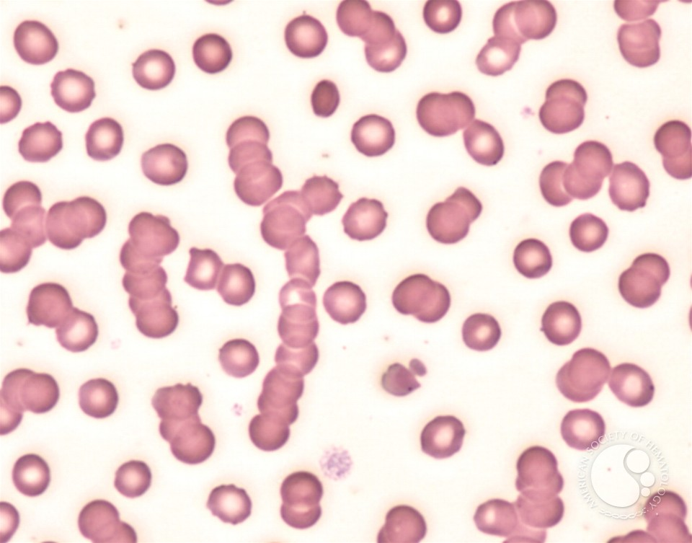
Rouleax formation of RBCs secondary to M-protein in plasma cell myeloma

Slide 22
Disorders of the Spleen
Splenomegaly
Hypersplenism:
Extravascular hemolytic anemia
Chronic infection (TB, typhoid, IM)
Autoimmune diseases
Infiltrative diseases:
Benign: sarcoidosis, amyloidosis, storage diseases
Malignant: lymphoma, metastasis, primary splenic tumor

Slide 23
Massive splenomegaly (>1 kg, >20 cm, crossing midline):
Myelofibrosis, CML, CLL
Leishmania, Malaria
Gaucher disease
Hairy cell leukemia
Hypersplenism results in cytopenia, especially platelets

Slide 24
Hairy cell leukemia
Mature B-cell neoplasm (memory B-cells)
Old age, M:F > 5
Distinctive morphology: long cytoplasmic poles
Very indolent disease
Responds well to chemotherapy
Patients always have splenomegaly, bone marrow infiltration, but very rarely lymph adenopathy
Pancytopenia

Slide 25
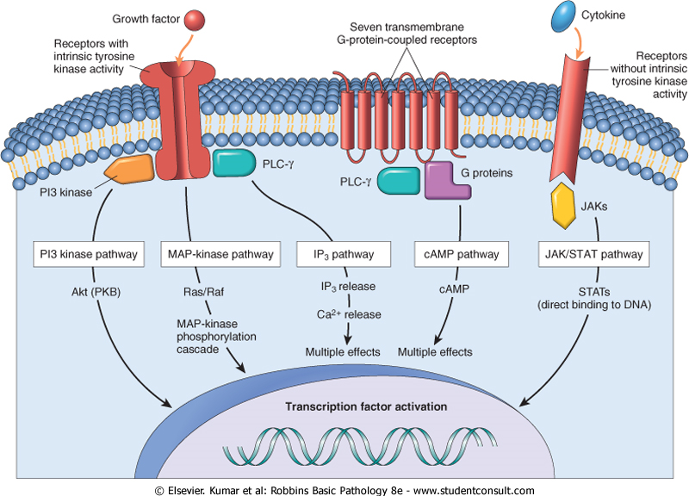
B-RAF mutation
Acquired mutation, present in all cases
B-RAF is a member of MAP-kinase pathway growth signal transduction

Slide 26
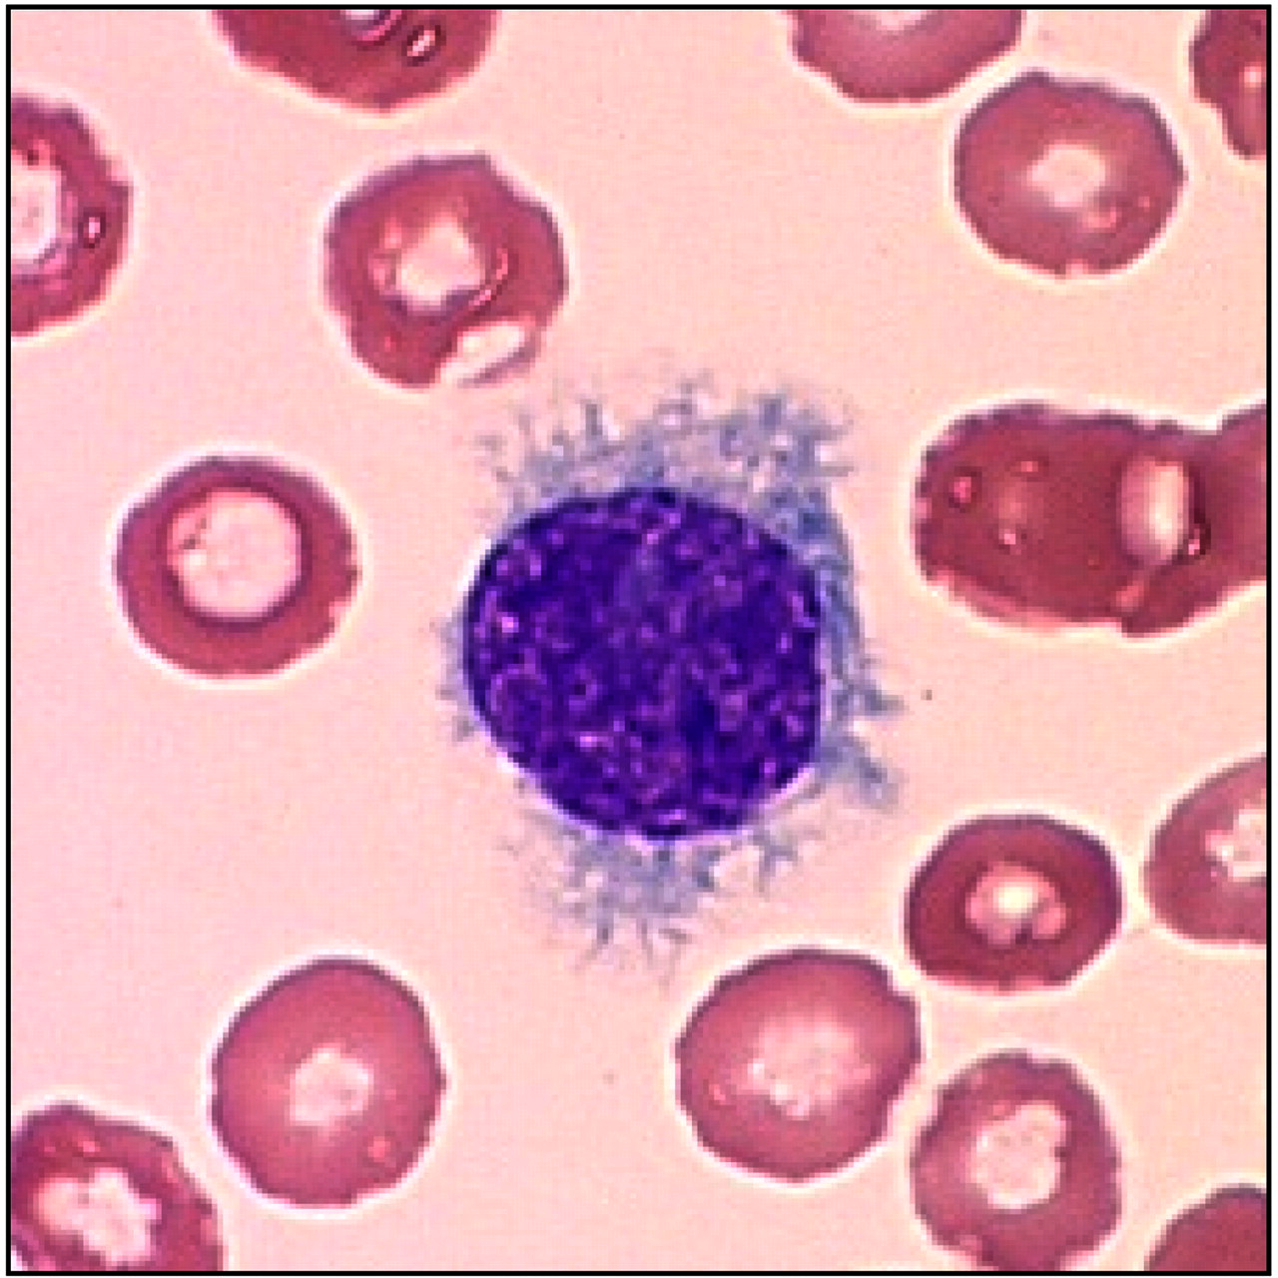
Morphology
Circumferential cytoplasmic long projections
(abnormal cytoskeleton)

Slide 27
Other features
Synthesis and binding to fibronectin by secreting fibroblast growth factor (stays in BM and spleen, few circulating cells)
Secretes transforming growth β, causing BM fibrosis, decreased hematopoiesis (dry tap)
Thus patients have pancytopenia, splenomegaly

Slide 28
Thymic disorders
Thymic hyperplasia
Thymoma

Slide 29
Thymic Hyperplasia
Normally, few B-cells are present in the thymus
In hyperplasia, or germinal centers appear within the medulla
Occurs in Myasthenia Gravis, rheumatoid arthritis, systemic lupus erythematosus

Slide 30
Thymoma
Can be benign or malignant
Malignant is more common
Mostly in middle aged people
Presentation:
1/3 asymptomatic
1/3 anterosuperior mediastinal mass
1/3 myasthenia gravis
Epithelial cell origin
Morphology shows a mixture of epithelial calls and lymphocytes

Slide 31
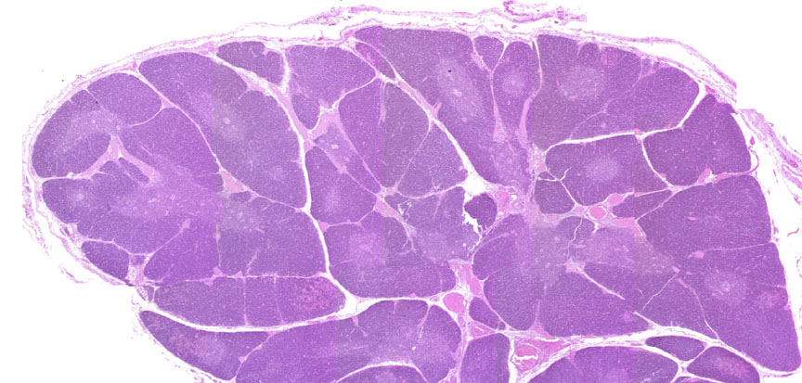
Benign thymoma
Encapsulated
Lobulated
Epithelial cells are spindle
Resemble normal medullary
Epithelium (medullary thymoma)

Slide 32
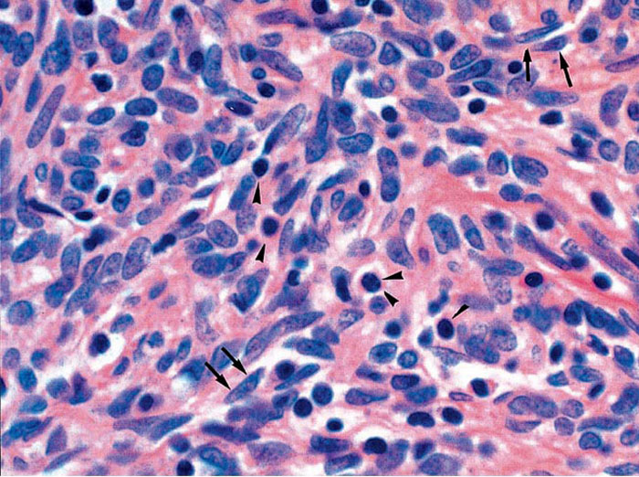

Slide 33
Malignant thymoma
Type I: morphologically benign, but shows invasion and / or metastasis
Type II: morphologically malignant (like squamous cell carcinoma)

