Slide 1
Introduction to Gapminder

Slide 2
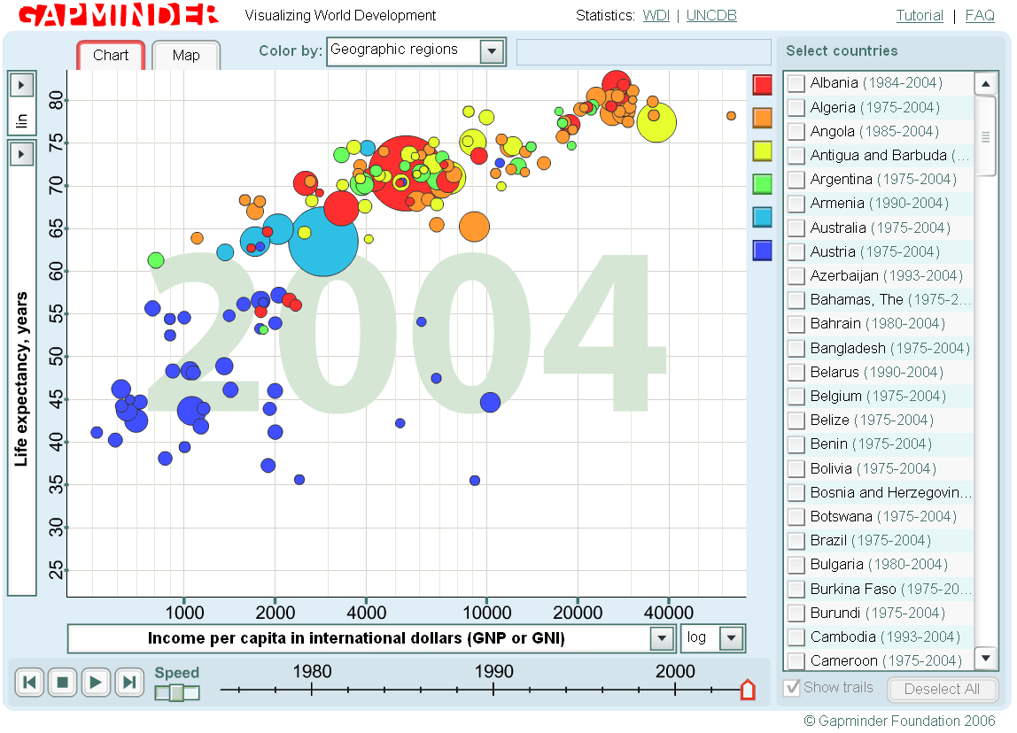
About Gapminder…
www.gapminder.org an amazing web site that heps you to analyze indicators that have influanced various countries' development through the ages.
It was created to make the data and statistics more fun, understandable and above all to have a place where all global health data can be collected and considered. It gives a view of the world.
The original purpose was to fight poverty and support and encourage Low Income countries to improve their health indicators and increase sustainability.

Slide 3
Hans Rosling
Professor of Global Health
Created Gapminder

Slide 4
Get to know Gapminder
Go to Gapminder.org/world
Read the instructions and try a little bit on your own before you decide on indicators.
Choose variables
Specify an indicator in the Y axis
Specify an indicator in X axis
Enter Jordan and two other countries with different development
Play the variable statistics
Place your pointer over the bubbles that protrude
Reflect on the result.

