Slide 1
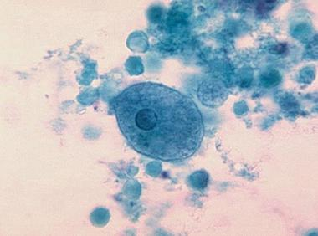
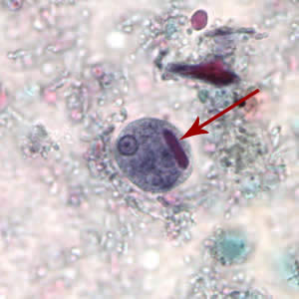
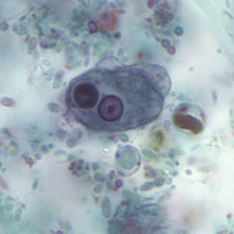
Entamoeba histolytica trophozoite
Entamoeba histolytica cyst

Slide 2
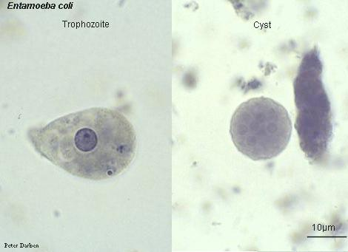
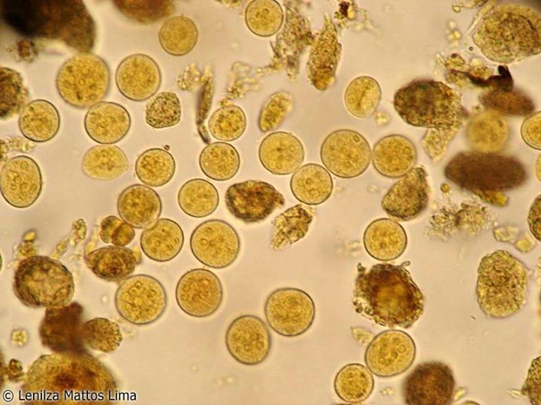
Entamoeba coli trophozoite
Entamoeba coli cyst

Slide 3
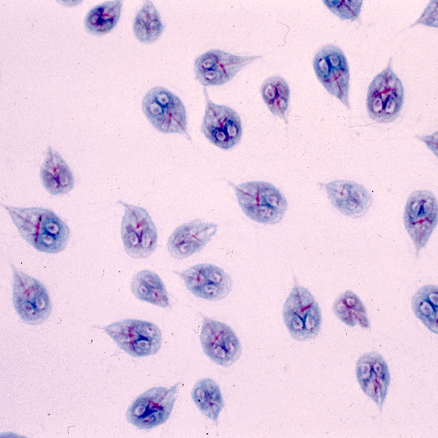
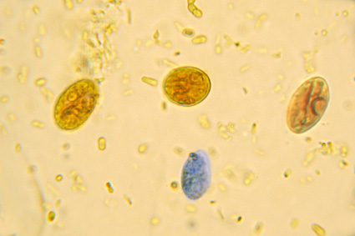
Giardia lamblia cyst
Giardia lamblia trophozoite

Slide 4
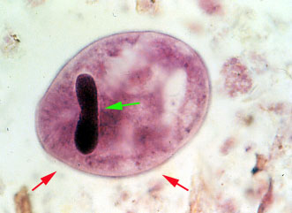
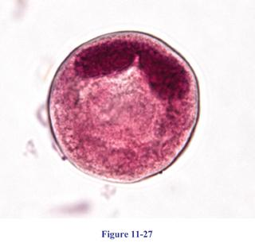
Balantidium coli trophozoite
Balantidium coli cyct

Slide 5
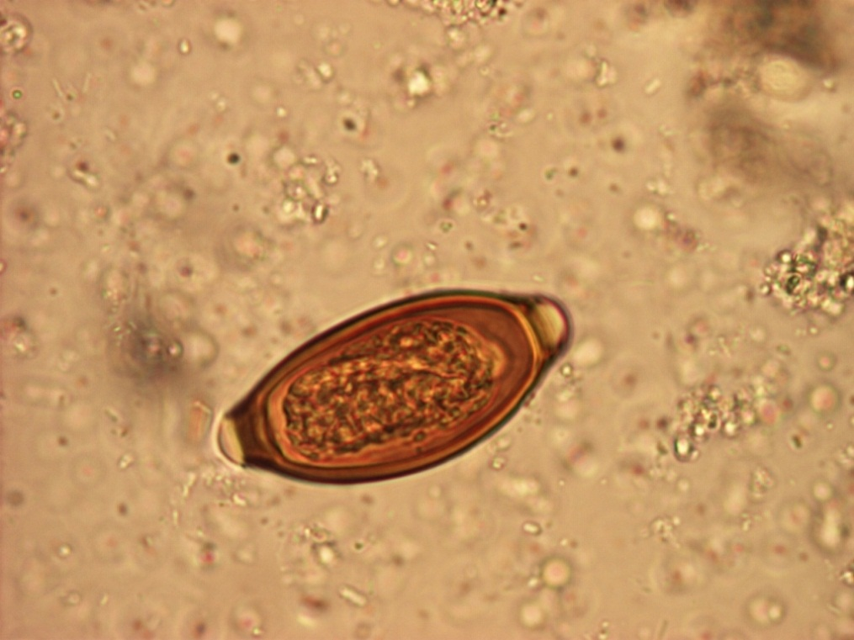
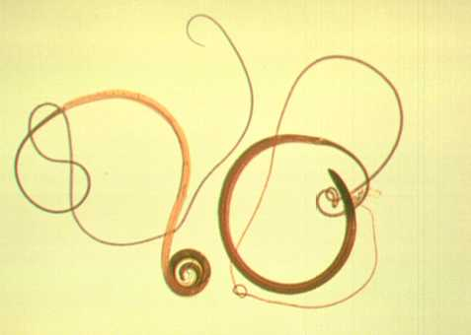
Trichrius trichura eggs
Trichrius trichura adult worm

Slide 6
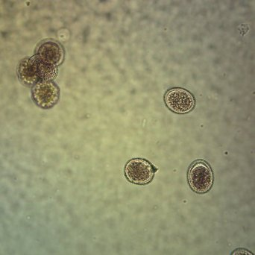
Ascaris eggs

Slide 7
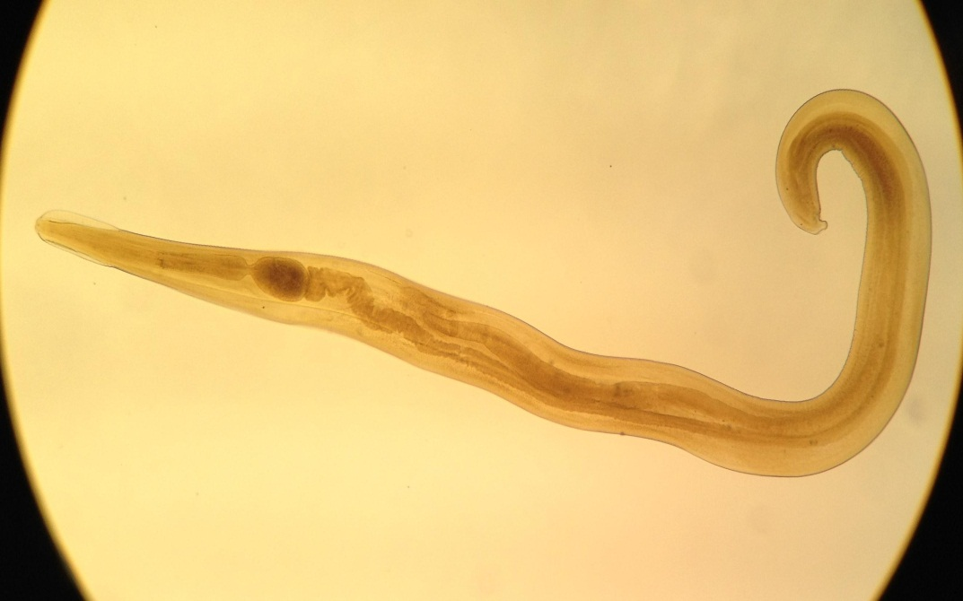
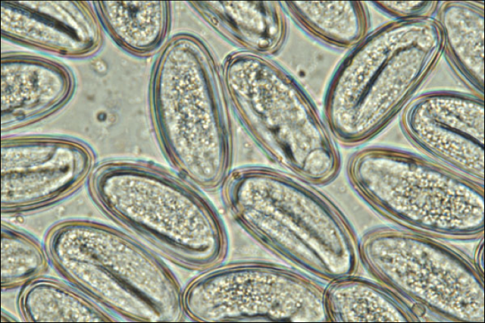
Entrobius vermicularis adult worm and eggs

Slide 8
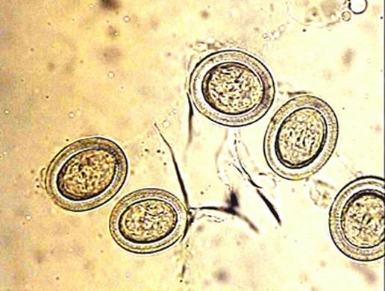

Slide 9
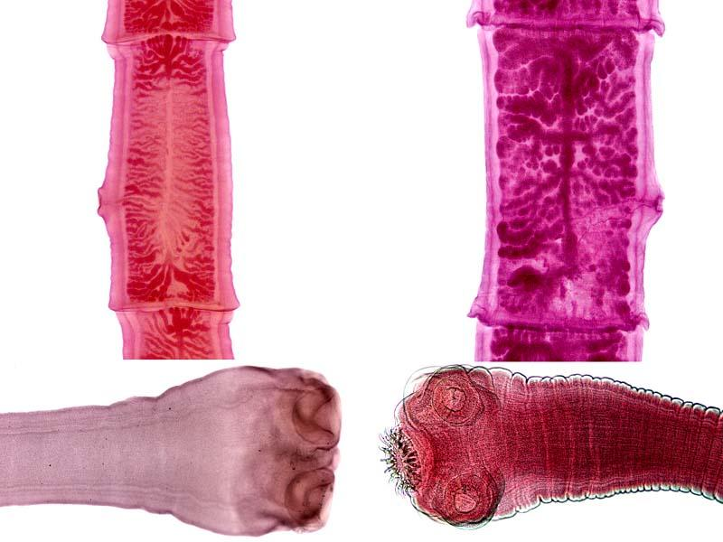
Taenia saginata scolex and proglottids
Taenia solium scolex and proglottids

Slide 10
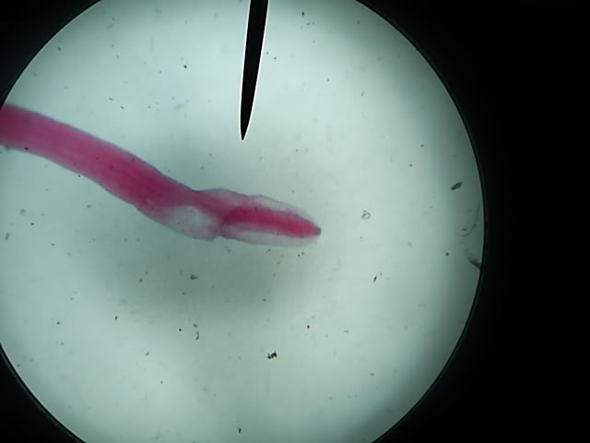
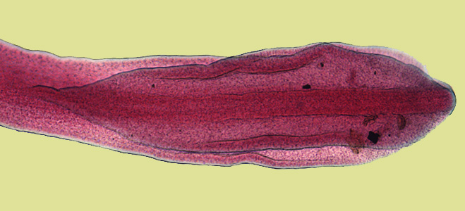
Diphyllobothrium latum scolex

Slide 11
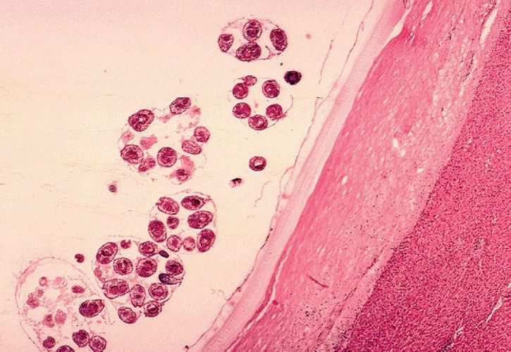
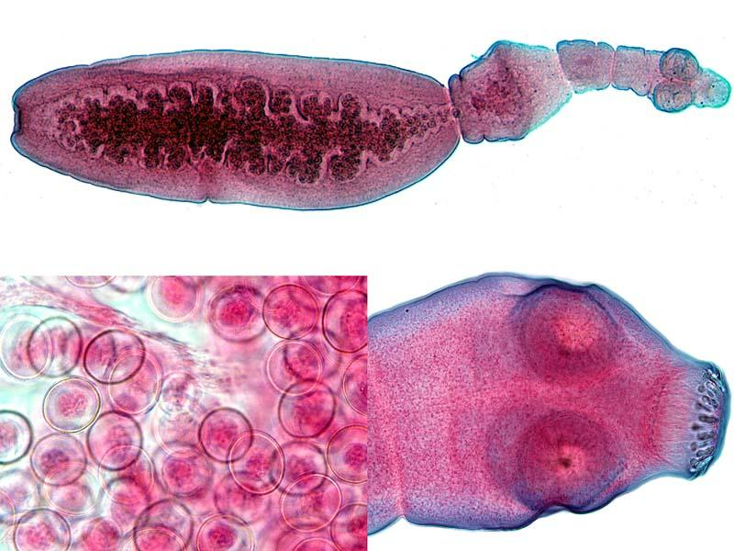
Echinococcus granulosus hydated cysts
Echinococcus granulosus adult worm
Echinococcus granulosus scolex and eggs

Slide 12
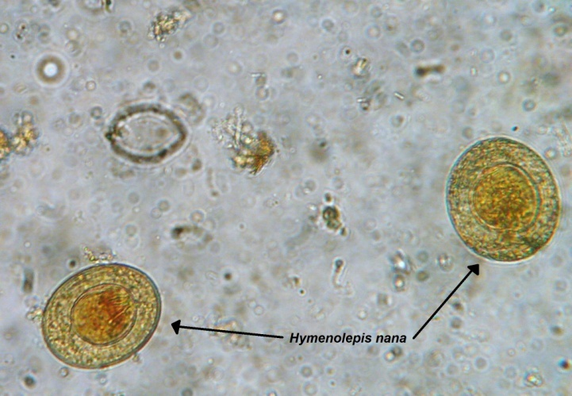
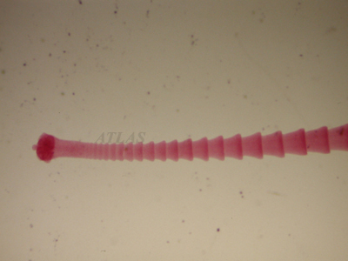
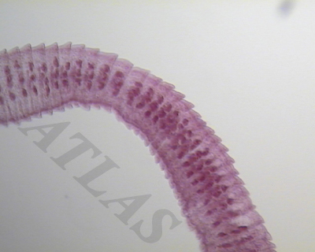
Hymenolepis nana proglottids
Hymenolepis nana eggs

Slide 13
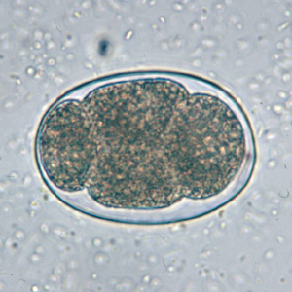
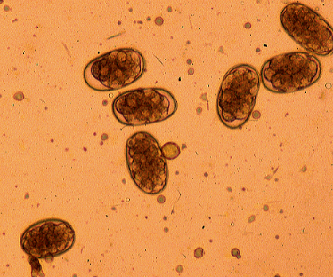
Necator americana adult
Necator americana egg

Slide 14
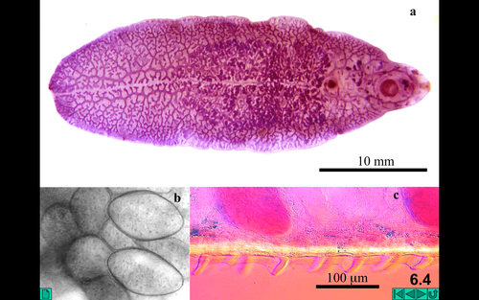
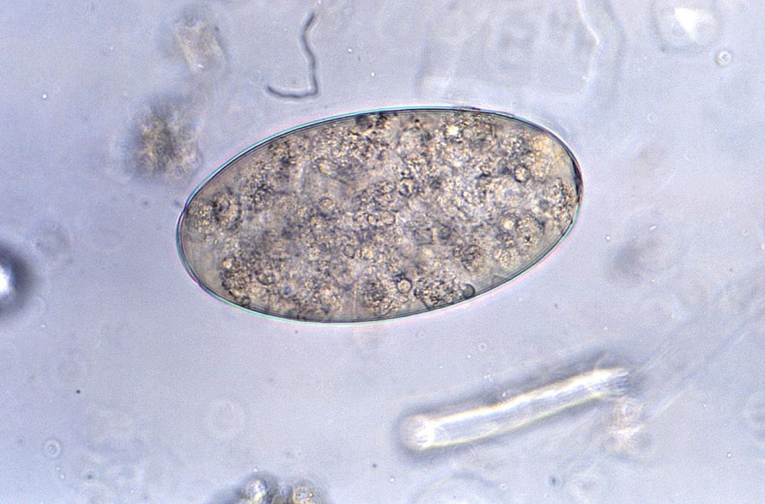
Fasciola hapatica adult worm
Fasciolopsis buski egg

