Slide 1

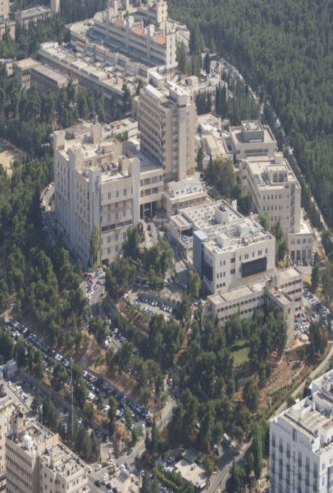

GI embryology 1
Clinical
Fareed Khdair , MD
Assistant Professor
Chief, Section of Pediatric Gastroenterology, Hepatology, and Nutrition
University of Jordan – School of Medicine

Slide 2
Outline
Clinical
Lecture one :
  Gut formation
  Foregut:
    esophagus, stomach, Duodenum
    Liver , gall bladder and pancreas
    Spleen
Lecture Two ( next week ):
  Mid gut : duodenum . Jejuno-ileum, colon
  Hind gut : distal transverse colon – anal canal

Slide 3
Clinical correlation
Symptoms related to GI tract development:
  Vomiting
  Jaundice
  Abdominal distension
  constipation

Slide 4
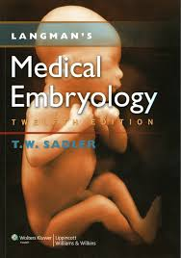
References
Lecture slides
Langman medical embryology
  Chap 15

Slide 5
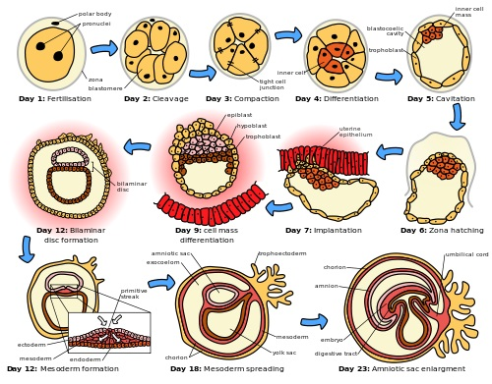
Quick review

Slide 6
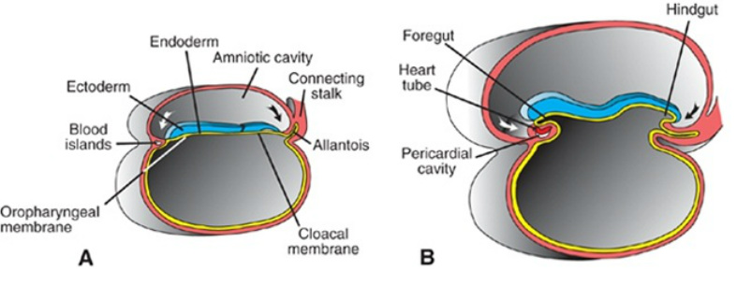
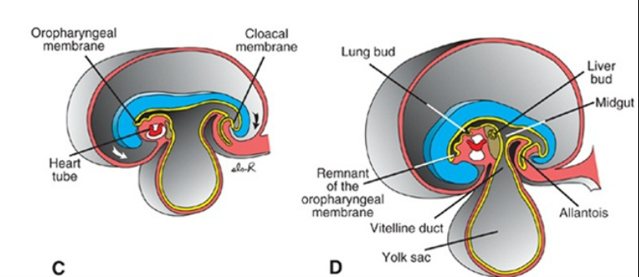
Embryo folding
One month

Slide 7
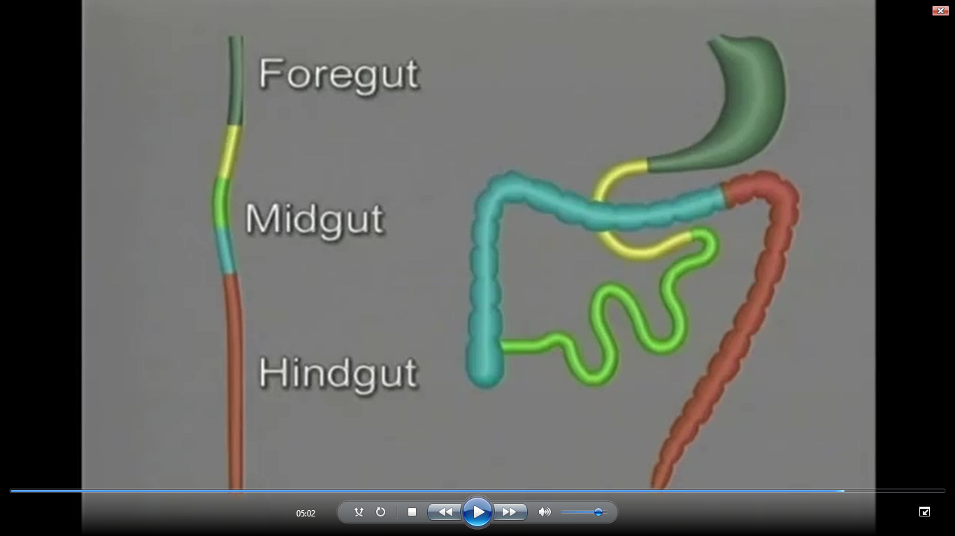
GI embryology

Slide 8
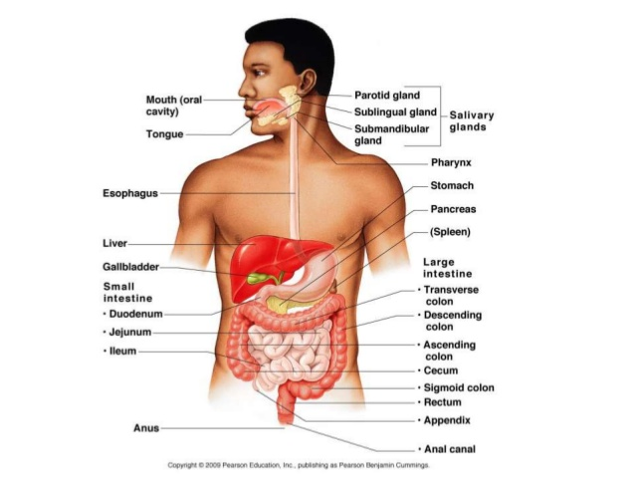
GI Tract

Slide 9
GI tract origin
Endoerm :
  Epithelial lining of GI tract
  Organ parenchyma : hepatocytes and pancreas glands
Mesoderm :
  Stroma ( connective tissue) of the GI glands
  Muscles, CT tissue, and gut peritoneum
  spleen

Slide 10
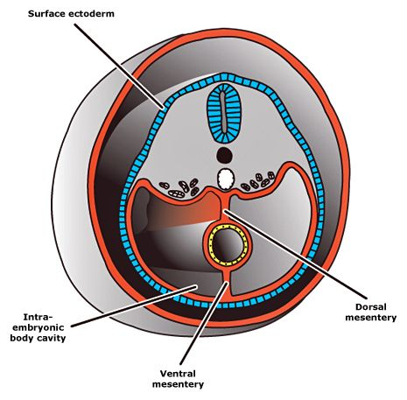
mesenteries

Slide 11
Mesenteries
Double layer of peritoneum
Suspend the gut tube in abdominal cavity
provide pathway for verves , blood vessels , and lymphatics to pass to the organs
Dorsal mesentery : from esophagus to lower hind gut
Ventral mesentery : esophagus to upper duodenum . Called septum transversum

Slide 12
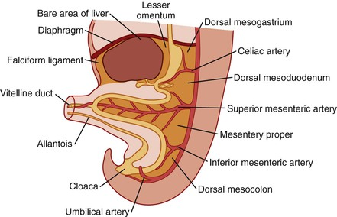
Dorsal and ventral mesentry

Slide 13
Clinical GI embryology

Slide 14
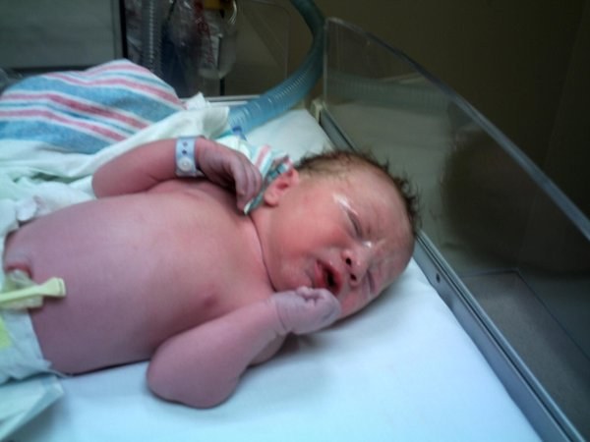
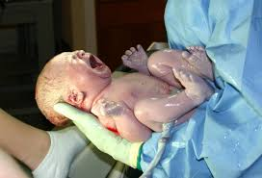
Case 1
Vomiting

Slide 15
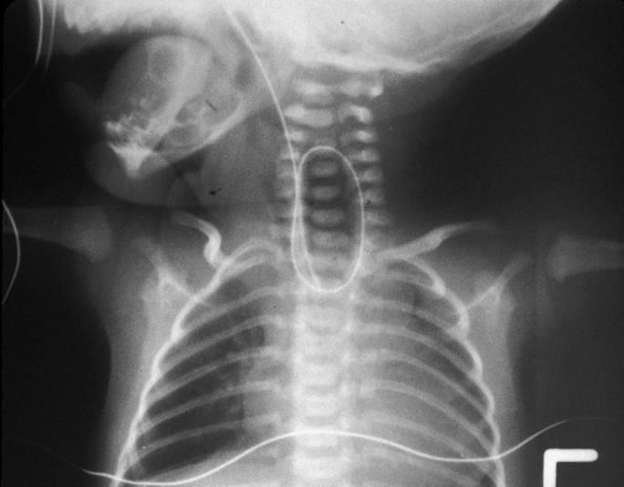
Esophageal atresia

Slide 16
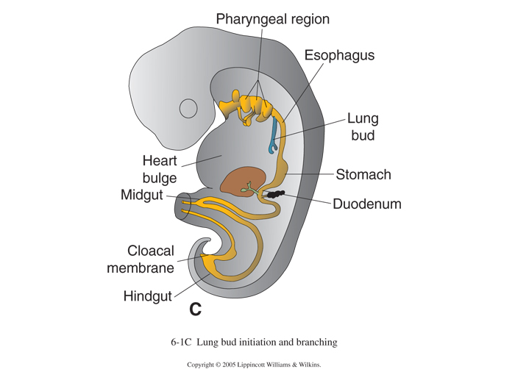
embryology of esophagus
4 weeks old embryo
respiratory diverticulum (lung bud) : an outgrowth from the ventral wall of the foregut

Slide 17
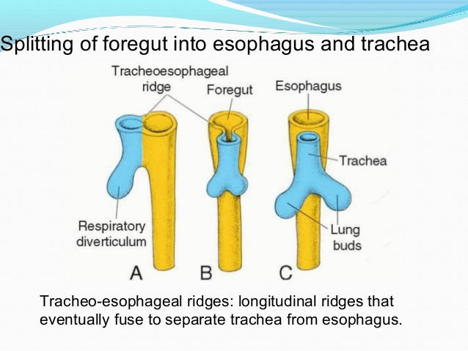
Stages of development
1. the lung bud is in open communication with the foregut
2. diverticulum expands caudally
3. the tracheoesophageal ridges, separate it from the foregut
4. The 2 ridges fuse : tracheoesophageal septum
5. the foregut is divided into :
- dorsal portion: the esophagus
- ventral portion: the trachea and lung buds
The respiratory primordium maintains its communication with the pharynx through the laryngeal orifice

Slide 18
Stages of development
At first the esophagus is short
but with descent of the heart and lungs it lengthens rapidly

Slide 19
Esophageal Abnormalities

Slide 20
Esophageal atresia tracheoesophageal fistula
Surgery
results either from:
spontaneous posterior deviation of the tracheoesophageal septum .
or from some mechanical factor pushing the dorsal wall of the foregut anteriorly
most common form :
the proximal part of the esophagus ends as a blind sac, and the distal part is connected to the trachea by a narrow canal just above the bifurcation
Atresia of the esophagus prevents normal passage of amniotic fluid into the intestinal tract :polyhydramnios

Slide 21
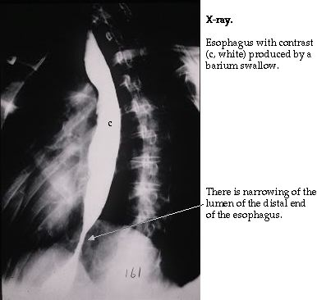
Other causes for vomiting
esophageal stenosis
usually in the lower third
caused by :
  incomplete recanalization
  vascular abnormalities /accidents : compromise blood flow

Slide 22
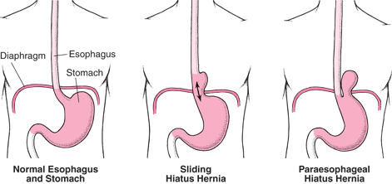
congenital hiatal hernia
the esophagus fails to lengthen sufficiently
the stomach is pulled up into the esophageal hiatus through the diaphragm.

Slide 23
Esophagus muscle layers
formed by surrounding splanchnic mesenchyme.
Upper 2/3: striated and innervated by the vagus
lower third : smooth and is innervated by the splanchnic plexus

Slide 24
Stomach

Slide 25
STOMACH
fourth week of development
fusiform dilation
of the foregut
appearance and position
change
growth in various regions
of its wall

Slide 26
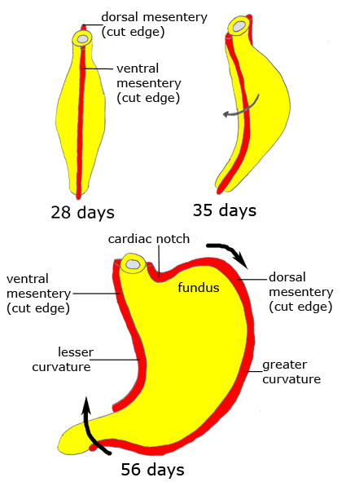
Stomach development
rotates 90◦ clockwise around its longitudinal axis :
left side to face anteriorly and its right side to face posteriorly
the left vagus nerve :innervates the anterior wall
the right vagus nerve innervates the posterior wall
During this rotation the original posterior wall of the stomach grows faster than the anterior portion, forming the greater and lesser curvatures

Slide 27
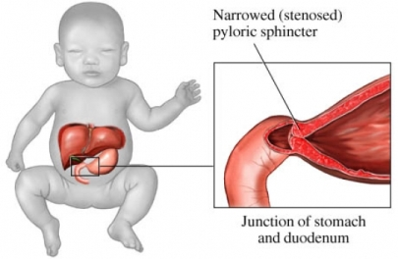
Another cause of vomiting
Pyloric stenosis
Due to hypertrophy of the pylorus muscles
One of the most common abnormalities of the stomach in infants.
develops during fetal life (3-6) weeks
Surgery

Slide 28
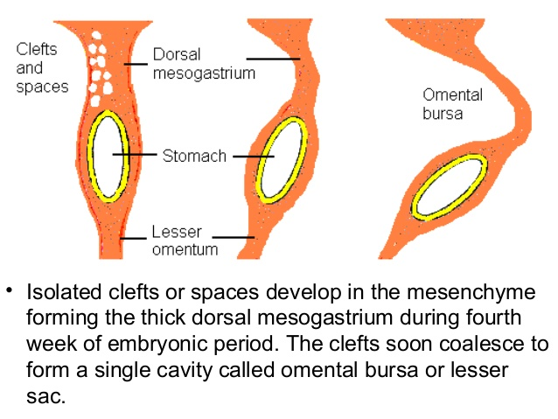
Stomach attachments
to the dorsal body wall by the dorsal mesogastrium .
to the ventral body wall by the ventral mesogastrium
its rotation and disproportionate growth alter the position of these mesenteries.
Rotation about the longitudinal axis pulls the dorsal mesogastrium to the left, creating a space behind the stomach called the omental bursa (lesser peritoneal sac)
This rotation also pulls the ventral mesogastrium to the right.

Slide 29
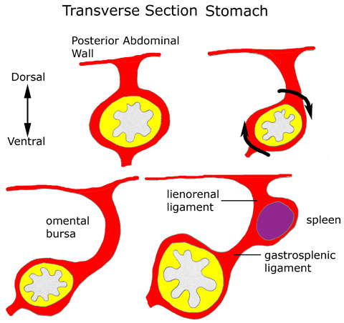

Slide 30
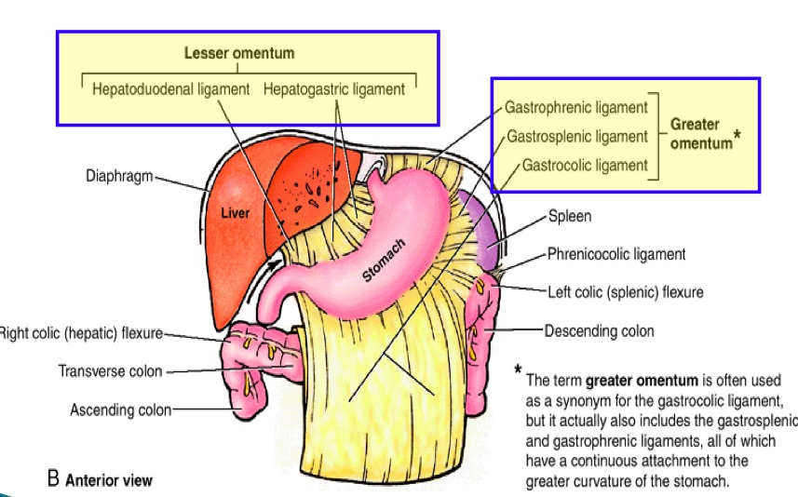
With stomach rotation
the dorsal mesogastrium bulges down
It continues to grow down and forms a double-layered sac over the transverse colon and small intestinal loops
greater omentum

Slide 31
Spleen

Slide 32
Spleen
fifth week
spleen primordium appears .
Mesenchyme
between the two leaves of the dorsal mesogastrium
Intraperitoneal structure

Slide 33
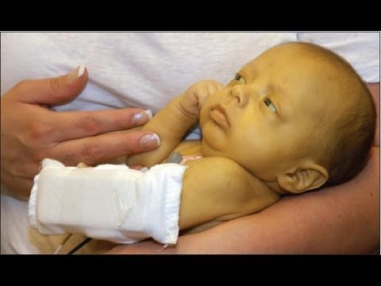
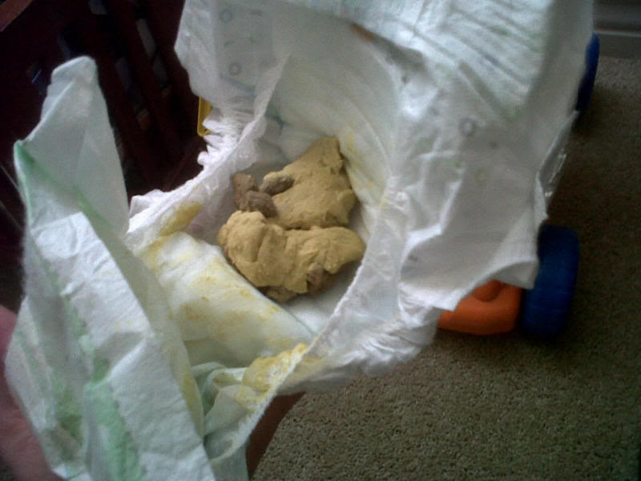
Case 2!
Jaundice
Biliary
Atresia

Slide 34
Liver & Gall Bladder

Slide 35
Liver and gall bladder
middle of the third week
hepatic diverticulum, or liver bud
Outgrowth of foregut
penetrates the septum transversum
( ventral mesentery)
connection between the hepatic diverticulum and the foregut (duodenum) narrows, forming the bile duct
A small ventral outgrowth is formed by the bile duct to give :
gallbladder and the cystic duct

Slide 36
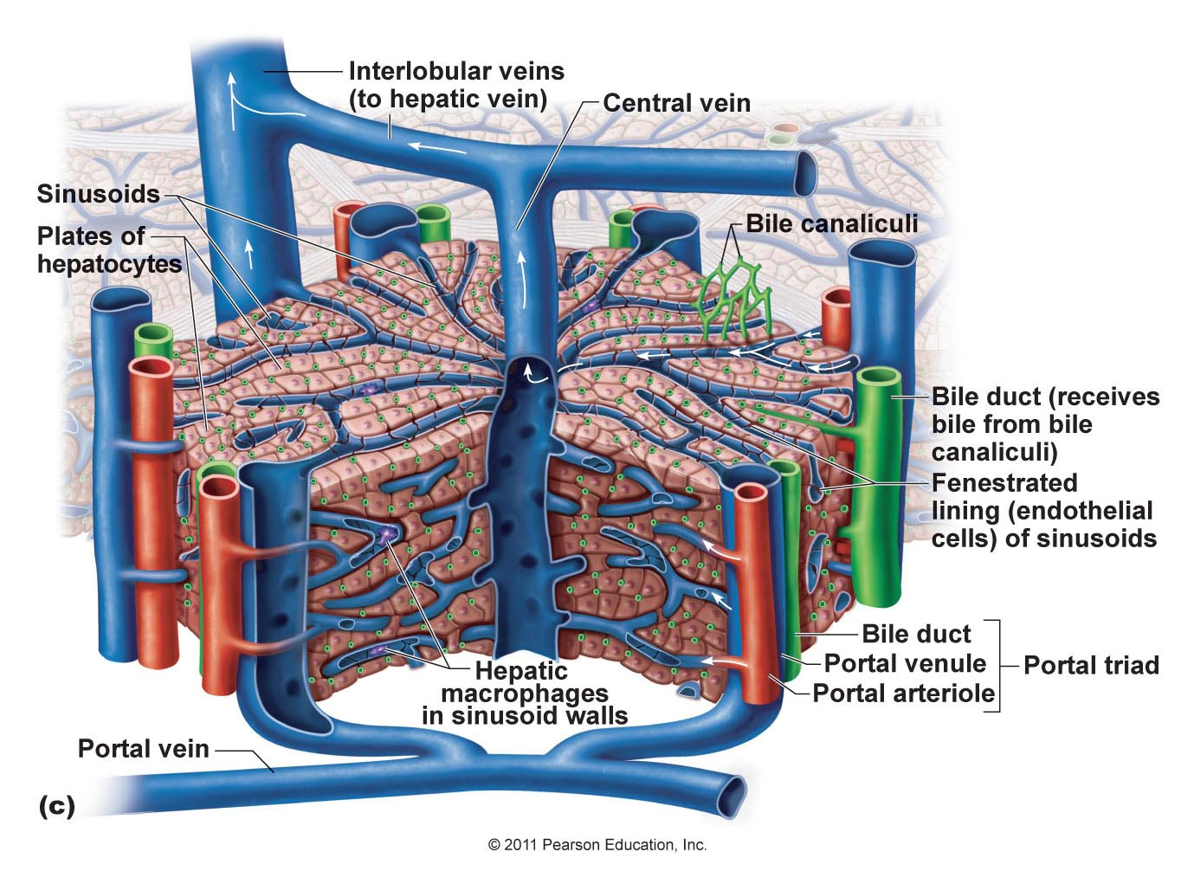
Liver parenchyma
Hepatocytes and bile ducts lining : from epithelial liver cords
Hepatic sinusoids: combination from epithelial liver cords and umbilical veins and viteline ducts
Hematopoietic cells, Kupffer cells, and connective tissue cells are derived from mesoderm of the septum transversum

Slide 37
Liver ligaments
Septum transversum :
falciform ligament + lesser omentum

Slide 38
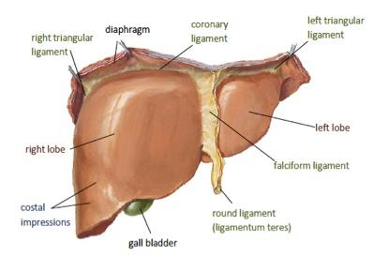
Liver ligaments
The free margin of the falciform ligament contains the umbilical vein
Umbilical vein is obliterated after birth to form the round ligament of the liver : Liagmentum teres hepatis

Slide 39
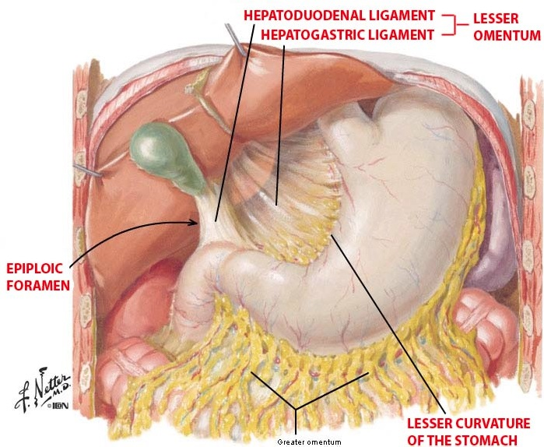
Lesser omentum
The free margin of the lesser omentum connects
duodenum and liver
(hepatoduodenal ligament)
contains the bile duct, portal vein, and hepatic artery (portal triad).
This free margin forms the roof of the epiploic foramen of Winslow: opening connecting the omental bursa (lesser sac) with the rest of the peritoneal cavity (greater sac)

Slide 40
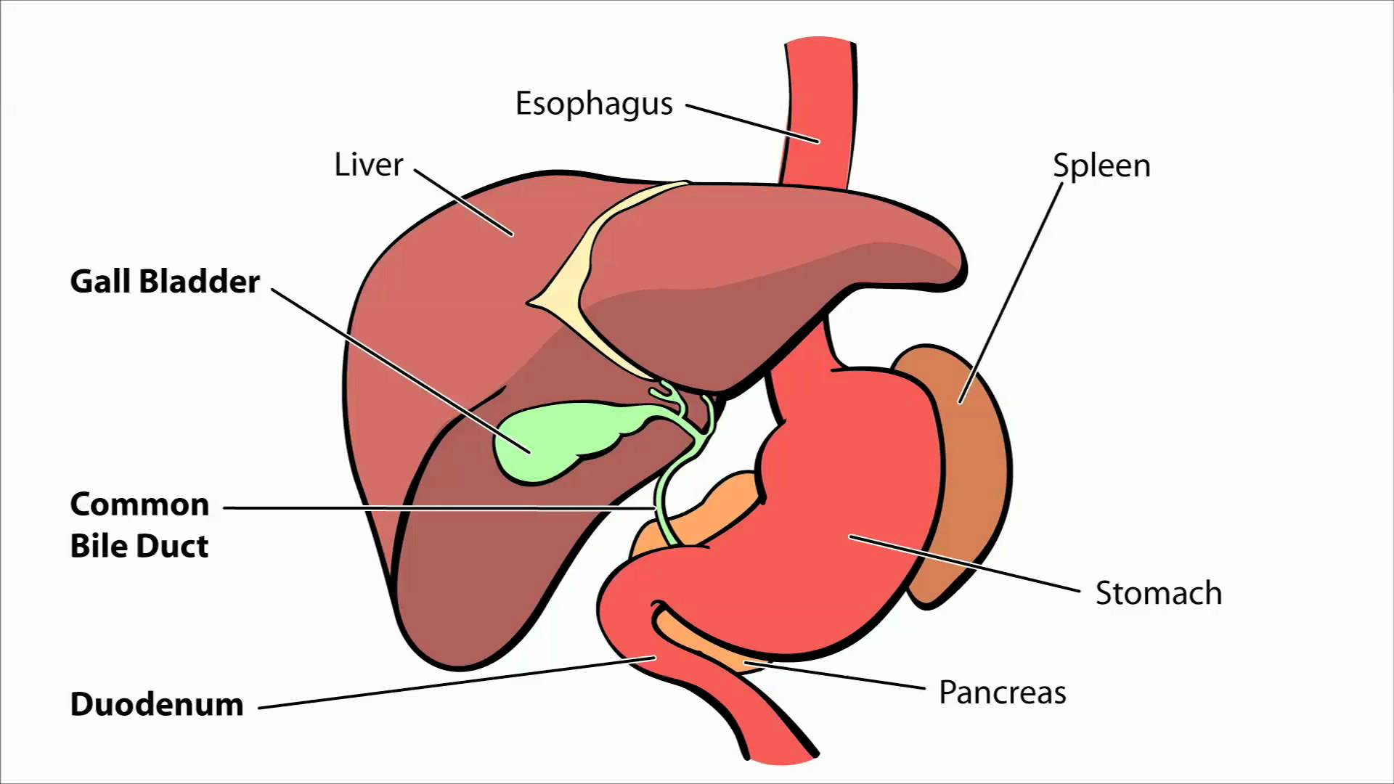
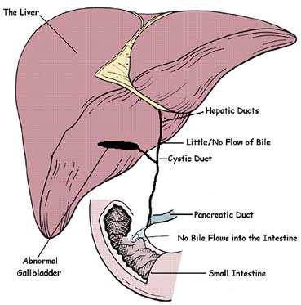
Liver and Gallbladder Abnormalities
Biliary atresia
Unknown etiology
Surgery

Slide 41
Duodenum
From : terminal part of the foregut and the cephalic part of the midgut .
The junction of the two parts is distal to the origin of the liver bud
As the stomach rotates, the duodenum takes on the form of a C-shaped loop and rotates to the right
Retroperitoeal except : duodenal cap

Slide 42
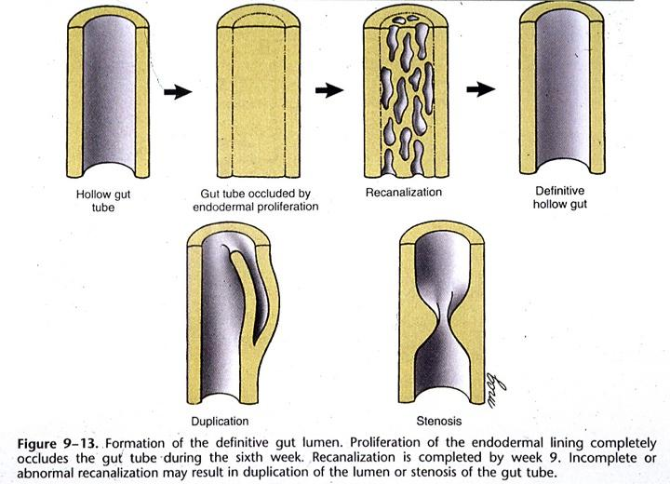
Duodenum
During the second month, the lumen of the duodenum is obliterated by proliferation of cells in its walls.
It is recanalized shortly thereafter
Failure to recanalize : duodenal atresia
Bilious vomiting
Surgery

Slide 43
Pancreas

Slide 44
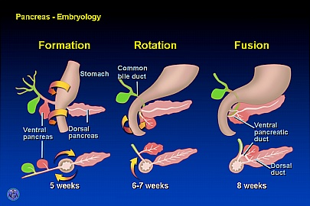
PANCREAS
formed by two buds from the endodermal lining of the duodenum
dorsal pancreatic bud in dorsal mesentery & ventral pancreatic bud is close to the bile duct
When the duodenum rotates to the right and becomes C-shaped, the ventral pancreatic bud rotates dorsally along withthe bile duct
the ventral bud fuses with the dorsal bud

Slide 45
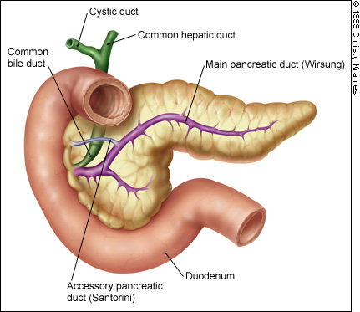
Pancreas
The ventral bud forms the uncinate process and inferior part of the head of the pancreas
The remaining part of the gland is derived from the dorsal bud.
The main pancreatic duct (of Wirsung) is formed by the distal part of the dorsal pancreatic bud and the entire ventral pancreatic bud
The proximal part of the dorsal pancreatic bud either is obliterated or persists as a small channel, the accessory pancreatic duct (of Santorini).

Slide 46
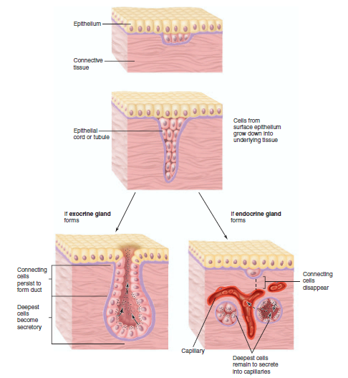
Development of the glands
proliferation of epithelial cells to project into the underlying connective tissue
EXOCRINE GLANDS
retain their continuity with the surface via a duct
ENDOCRINE glands
lose direct continuity with the surface (ducts degenerate )
Endocrine glands are either arranged in cords or follicles

Slide 47
Pancreas hormones
Insulin secretion begins at approximately the fifth month
Glucagon- and somatostatin-secreting cells also develop from parenchymal cells.
Splanchnic mesoderm surrounding the pancreatic buds forms the pancreatic connective tissue

Slide 48
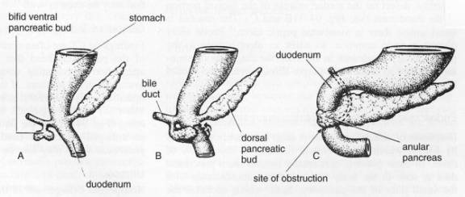
Pancreatic Abnormalities
Annular pancreas
the right portion of the ventral bud migrates along its normal route, but the left migrates in the opposite direction.
the duodenum is surrounded by pancreatic tissue, and an is formed
constricts the duodenum and causes complete obstruction
Bilious vomiting
Surgery

Slide 49
The End

Slide 50
WAPWON.COM_10-_The_development_of_the_gastrointestinal_tract.mp4

Slide 51


Questions?

Slide 52
WAPWON.COM_10-_The_development_of_the_gastrointestinal_tract.mp4
WAPWON.COM_Embryological_Development_of_Gastro-Intestinal_Tract_ACLAND.mp4
WAPWON.COM_Embryological_Rotation_of_the_Midgut.mp4

