Slide 1
Global Health
Global Health refers to those health issues which transcend national boundaries and governments and call for actions on the global forces and global flows that determine the health of people.
Kickbusch 2006

Slide 2
3 key dimensions of global health
Public health can no longer be pursued just at the national level – it needs strong global institution, mechanisms and funding
The health sector can no longer deal with the emerging challenges on its own – it needs multisectoral action and broad public and private partnerships at national and international level
Health can no longer be seen as a purely professional and technical endeavour – it needs the strong voice and the support of civil society and of political leaders to address the equity and human rights issues at stake.

Slide 3
A new global environment
“(…) the interdependence produced by globalization has broken down traditional ways of conceptualizing and organizing the medical, economic, political and technological means to improve health”
Nick Drager and David Fidler Foreign policy, trade and health: at cutting edge of global health diplomacy The World Health Organization Bulletin, Volume 85, number 3, March 2007, the Editorials.

Slide 4
Global health governance:
a mechanism of collective problem solving for improved health through the interplay of different institutional forms and actors at different levels.
Like other forms of governance it is subject to reconfigurations of power – it is therefore always also a political undertaking.

Slide 5
The global health dynamics
The growing health gap between and within countries
The return of infectious diseases
The chronic disease epidemic
Health is a determinant of growth and productivity, wealth and quality of life
Direct and indirect economic impact of disease outbreaks and lifestyle changes

Slide 6
Global inequality and poverty
Health
Gender
Demography
Education
Social disparities
Information
Security
Geopolitics

Slide 7
Trans-boundary collective human security issues
Trade/mobility
Global Crime
Terrorism
Environment
Infectious disease
Intellectual property
Disaster response

Slide 8
Global Health Diplomacy
Globalization impacts health
Health impacts globalization
Kickbusch 2006

Slide 9
Global Health Diplomacy
Health diplomacy may be defined as a political activity that meets the dual goals of improving global health while maintaining and strengthening international relations, particularly in conflict areas and resource-poor environments
(Novotny, Leslie, Adams, Kickbusch 2008)
Global Health Diplomacy refers to the multi-level and multi actor negotiation processes that shape and manage the global policy environment for health.
(Kickbusch 2007)

Slide 10
3 key objectives of Global Health Diplomacy
Ideally global health diplomacy results in
better health security and population health outcomes for each of the countries involved (thus serving the national and the global interest)
improving the relations between states and strengthening the commitment of a wide range of actors to work to improve health
a common endeavour to ensure health as a human right and a global public good and delivering results that are deemed fair ( “for all” - reducing poverty, increasing equity)
.

Slide 11
The diplomatic space
A major part of global health diplomacy takes place within the United Nations specialized agency for health - the World Health Organization - but the range of actors and “spaces” is expanding rapidly. This includes venues such as the World Trade Organization, the World Bank, regional organizations and new organizations such as global alliances, global funds and global forums.

Slide 12
The new health diplomats
Increasingly the negotiations on global health matters are not only conducted between public health experts representing health ministries of nation states but include a growing array of other national actors as well as major players in the global arena such as NGOs, the private sector, academia and foundations .

Slide 13
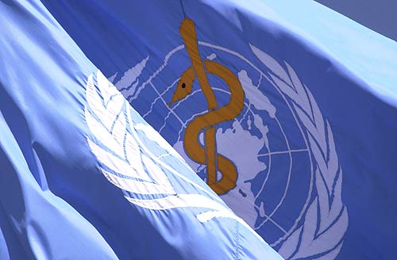
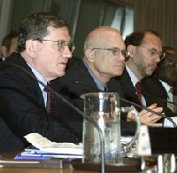
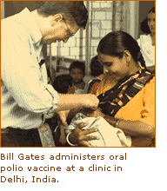
Global Health Diplomacy within a fragmented POLITICAL ECOSYSTEM
MSF
CLINTON
BONO
WEF
PHA
150 PPPH
World Bank

Slide 14
1945 San Fransisco Conference agrees to establish a health organization
1946 Constitution is adopted
1948 Constitution comes into force
1951 International Sanitary regulations
1969 International health regulations
1978 Alma Ata

Slide 15
WHO
„the coordinating authority
on international health work“
First decade: major diseases
Second decade: liberation of former colonies – health manpower development
Third decade: eradication of small pox, new issues such as family planning
Fourth decade: Primary health care WHO UNICEF Health for All – Equity – cooperation
Fifth decade: investment in health, poverty eradication
Sixth decade: common health security and health as a global public good

Slide 16
Role of WHO in public health 6 core functions
Providing leadership, engaging in partnerships
Shaping the research agenda
Setting norms and standards
Articulating ethical and evidence-based policies
Providing technical support, catalysing change, building sustainable institutions
Monitoring health situation and trends
Critical aspects of emergency preparedness/response should be linked to core public health functions

Slide 17
Alma Ata 1978
The conference strongly affirms that health…. is a fundamental human right and that the attainment of the highest possible level of health is a most important world wide social goal whose realization requires the action of many other social and economic sectors in addition to the health sector.

Slide 18
Alma Ata 1978
The existing gross inequality in the health status of the people particularly between developed and developing countries as well as within countries is politically, socially and economically unacceptable and is,therefore, of common concern to all countries.

Slide 19
Alma Ata 1978
Governments have a responsibility for the health of their people which can be fulfilled only by the provision of adequate health and social measures. A main social target of governments, international organizations and the whole world community in the coming decades should be the attainment by all peoples of the world by the year 2000 of a level of health that will permit them to lead a socially and economically productive life.

Slide 20
Diplomacy today
„Today‘s diplomat has a dual responsibility:to promote his or her country‘s interest and to advance the interests of the global community“
Muldoon et al 2005

