Slide 1
Mahmoud ABU-ABEELEH
Associate Professor of Surgery
Division of Cardiothoracic Surgery
School of Medicine
The University Of Jordan
24-10-2016
CORONARY ARTERY DISEASE/VALVE DISEASES SURGICAL ASPECTS

Slide 2
INTRODUCTION
HISTORY OF CARDIAC SURGERY
CORONARY ARTERY ANATOMY
ATHEROSCLEROSIS CAD
DIAGNOSIS
MANAGEMENT
VALVE DISEASES
SURGICAL INDICATIONS /TECHNIQUES

Slide 3
Adult Cardiac Surgery: Ischemic Heart Disease (History)
Arthur Vineberg
  1940’s- Mobilization of left internal mammary artery with implantation of bleeding end into the left ventricle.
  1964- follow-up study on 140 patients
    33% mortality
    85% relief from angina

Slide 4
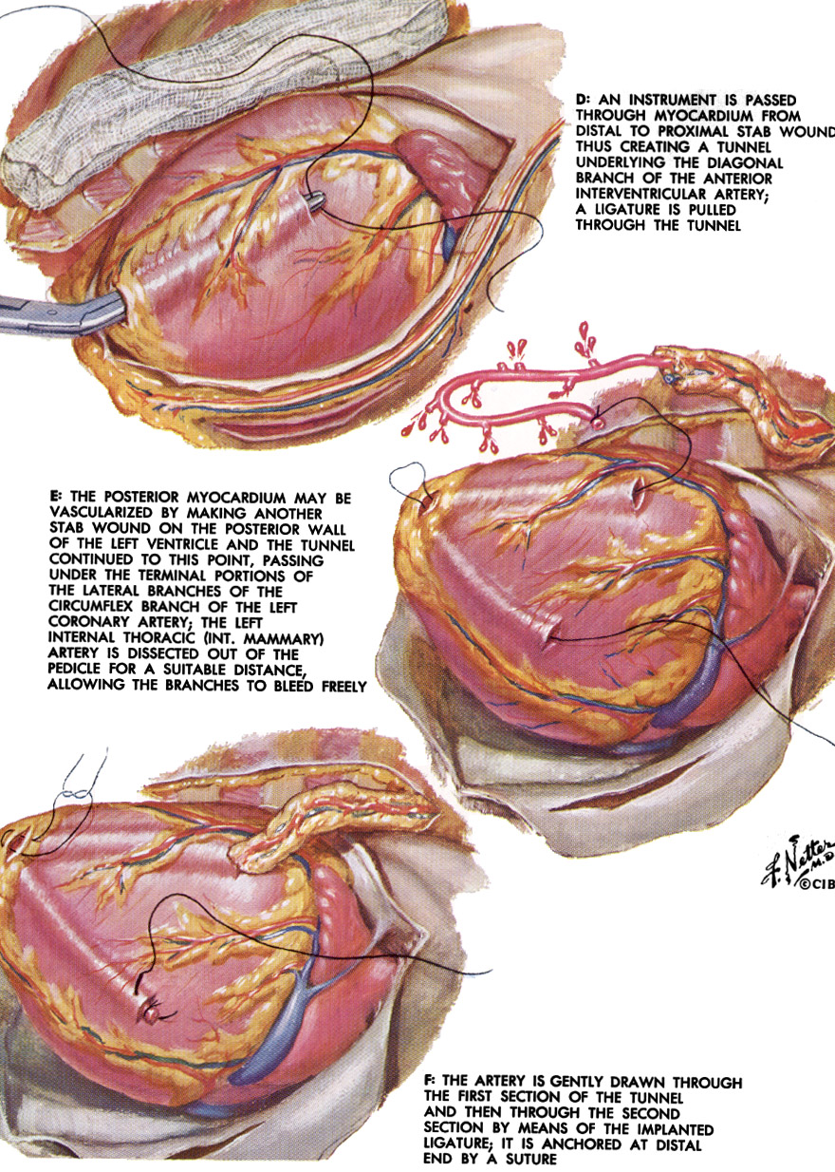

Slide 5
Adult Cardiac Surgery: Ischemic Heart Disease (History)
Mason Sones,
      1962- direct and reproducible catheterization of the coronary arteries.
      “Collectively, all of the cardiological advances in this century pale in comparison with this priceless achievement.”
      Floyd Loop, MD

Slide 6
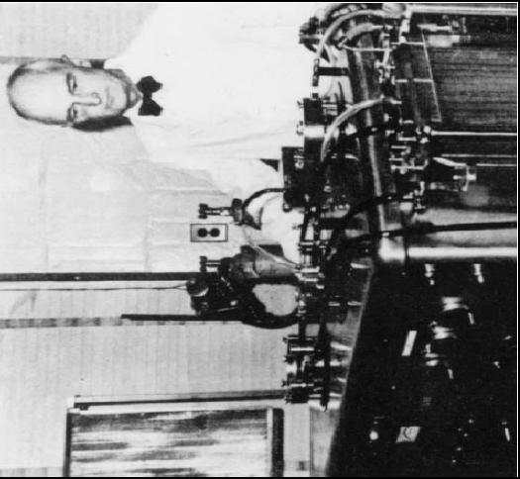
Adult Cardiac Surgery: Ischemic Heart Disease (History)
John H. Gibbon, Jr.
  “During the long night, helplessly watching the patient struggle for life as her blood became darker and her veins more distended, the idea naturally occurred to me that if it were possible to remove some of the blue blood…put oxygen into that blood and allow carbon dioxide to escape from it, and then to inject continuously the now-red blood back into the patient’s arteries, we might have saved her life.”
  Heart-lung machine
  May 6, 1953- ASD closure

Slide 7
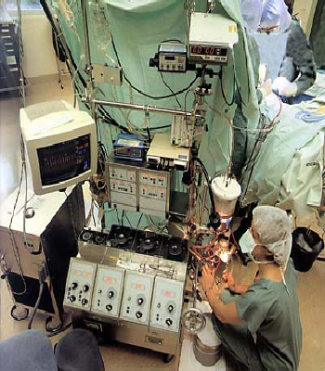
Heart Lung Machine

Slide 8
Adult Cardiac Surgery: Ischemic Heart Disease (History)
KOLOSOV LIMA -LAD 1964 IN Russia
Frank Spencer/George Green
  Internal mammary artery

Slide 9
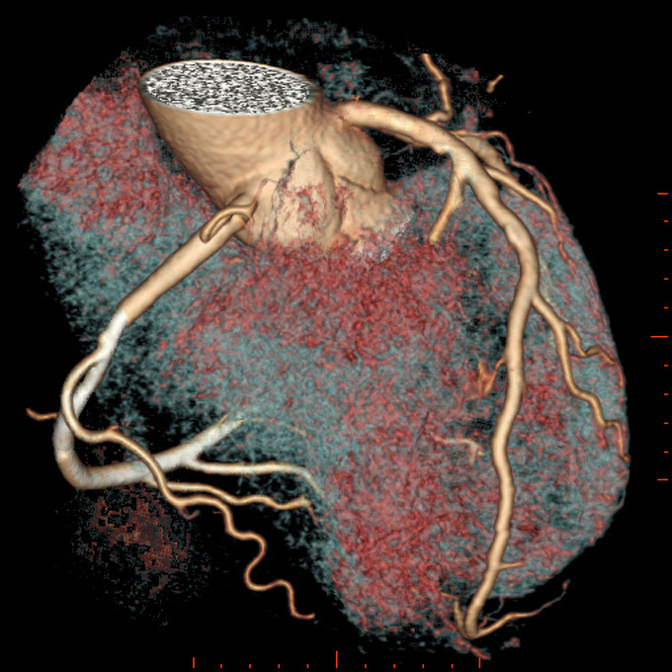
Coronary Artery Anatomy

Slide 10
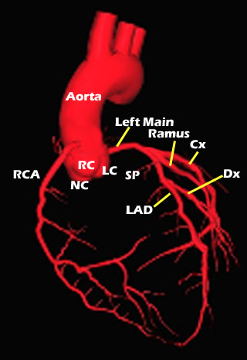
Coronary Artery Anatomy

Slide 11
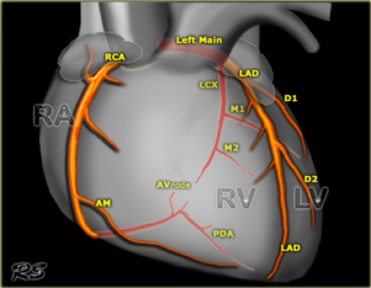
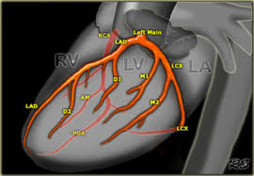
The Normal Heart - Coronary Artery Anatomy

Slide 12
Ischaemic Heart Disease
It results from imbalance between oxygen demand and supply

Slide 13
Canadian Cardiovascular Society
Classification
I: No angina with ordinary physical activity
II: Slight limitation of ordinary activity
III: Marked limitation of ordinary activity
IV: Symptoms with any activity or at rest

Slide 14
Aetiology
Atherosclerosis (>90%)
Embolisation
Coronary spasm
Vasculitis
Ostial stenosis
Severe LVH
Congenital anomalies of the coronary artereis (e.g anomalous origin of LAD artery from pulmonary artery)

Slide 15
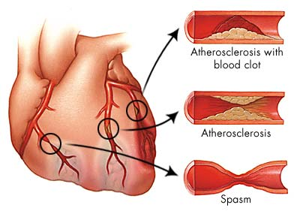

Slide 16
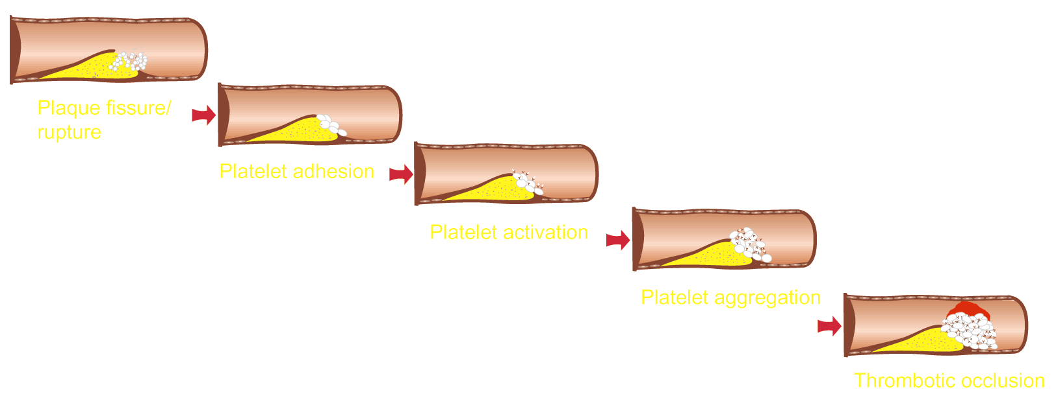
Pathogenesis of ACS

Slide 17
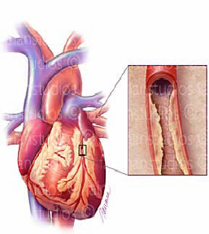
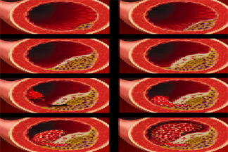
ATHEROSCLEROSIS

Slide 18
Risk Factors
Uncontrollable
Controllable
Sex
Hereditary
Race
Age
High blood pressure
High blood cholesterol
Smoking
Physical activity
Obesity
Diabetes
Stress and anger

Slide 19
CAD
Diagnosis
History
Physical examination
ECG findings
cardiac enzymes

Slide 20
Investigations
ECG
Cardiac enzymes
Chest x-ray
FBS
Serum lipids
TMT
Stress or pharmacologic stress myocardial perfusion studies
Cardiac CT-Scan
Coronary angiography

Slide 21
Treatment of CAD
Nitrates
Beta blockers
Aspirin/PLAVIX DUAL ANTIPLATELT THERAPY
Ca-channel blockers(in coronary spasm)
Treating the associated risk factors
Treating the precipitating factor
Revascularization ( if indicated)
SURGICAL VS INTERVENTIONAL

Slide 22
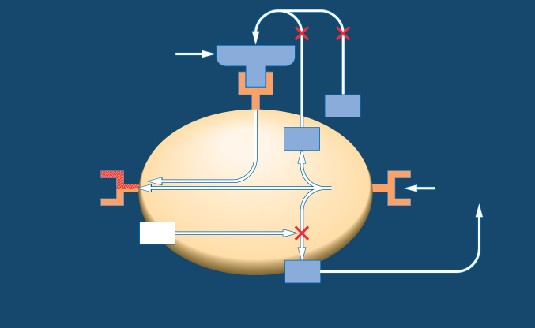
Synergistic Mode of Action with Clopidogrel and ASA¹
CLOPIDOGREL
C
ADP
ADP
GPllb/llla
(Fibrinogen receptor)
Collagen thrombin
TXA
Activation
2
ASA
COX
ASA
TXA
2
COX (cyclo-oxygenase)
ADP (adenosine diphosphate)
TXA₂ (thromboxane A₂)
Notes:
The key to understanding atherothrombosis is that the benefit in event reduction from clopidogrel is additive not duplicative of the ASA benefit.
As ASA and clopidogrel inhibit different pathways of platelet activation, there is potential for synergy between the two agents.
Clopidogrel is a potent, non-competitive inhibitor of ADP-induced platelet aggregation, irreversibly inhibiting the binding of ADP to its platelet membrane receptors.^{1,2} The inhibition is specific and does not significantly affect cyclo-oxygenase or arachidonic acid metabolism.³
ADP binding is necessary for activation of the GPIIb/IIIa receptor, which is the binding site for fibrinogen. Fibrinogen links different platelets together thus forming the platelet aggregate.¹ Therefore, clopidogrel ultimately inhibits the activation of the GPIIb/IIIa receptor and its binding to fibrinogen.
ASA inhibits the cyclo-oxygenase enzyme, preventing the production of prostaglandin and thromboxane A₂ (TXA₂) from arachidonic acid. TXA₂ activates the GPIIb/IIIa binding site on the platelet, allowing fibrinogen to bind.¹
References:
1. Schafer AI. Am J Med 1996; 101: 199–209.
2. Clopidogrel Prescribing Information, US, February 2002.
3. Schrör K. Platelets 1993; 4: 252–61.

Slide 23
Indications for open-heart surgery
  Coronary Artery Bypass Grafting: (CABG)
Triple vessel disease
Lf main coronary artery disease
Unstable angina ,failed Mx therapy
Complications of PTCA
Life threatening complications of MI
Anomalies of Coronary arteries.

Slide 24
Adult Cardiac Surgery: CABG Techniques
Median sternotomy
Cardiopulmonary bypass
Cardioplegic arrest
Mammary artery, reversed saphenous vein, radial artery.

Slide 25
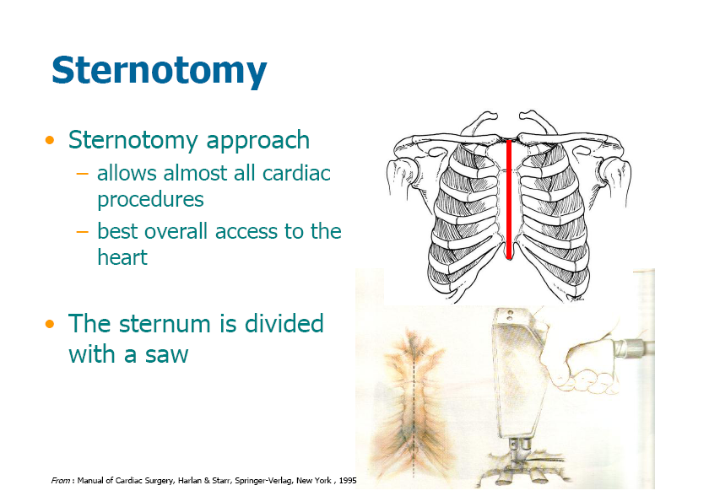

Slide 26
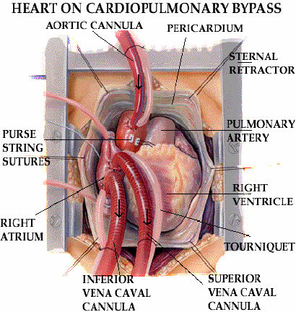

Slide 27
Heart Lung Machine

Slide 28
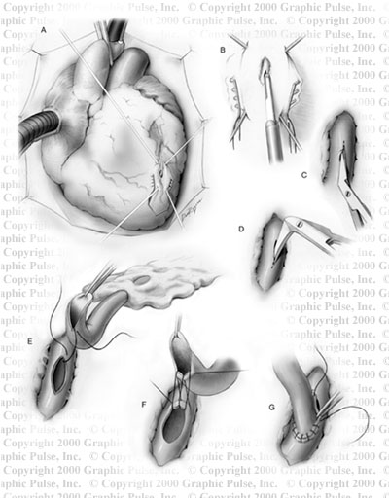

Slide 29
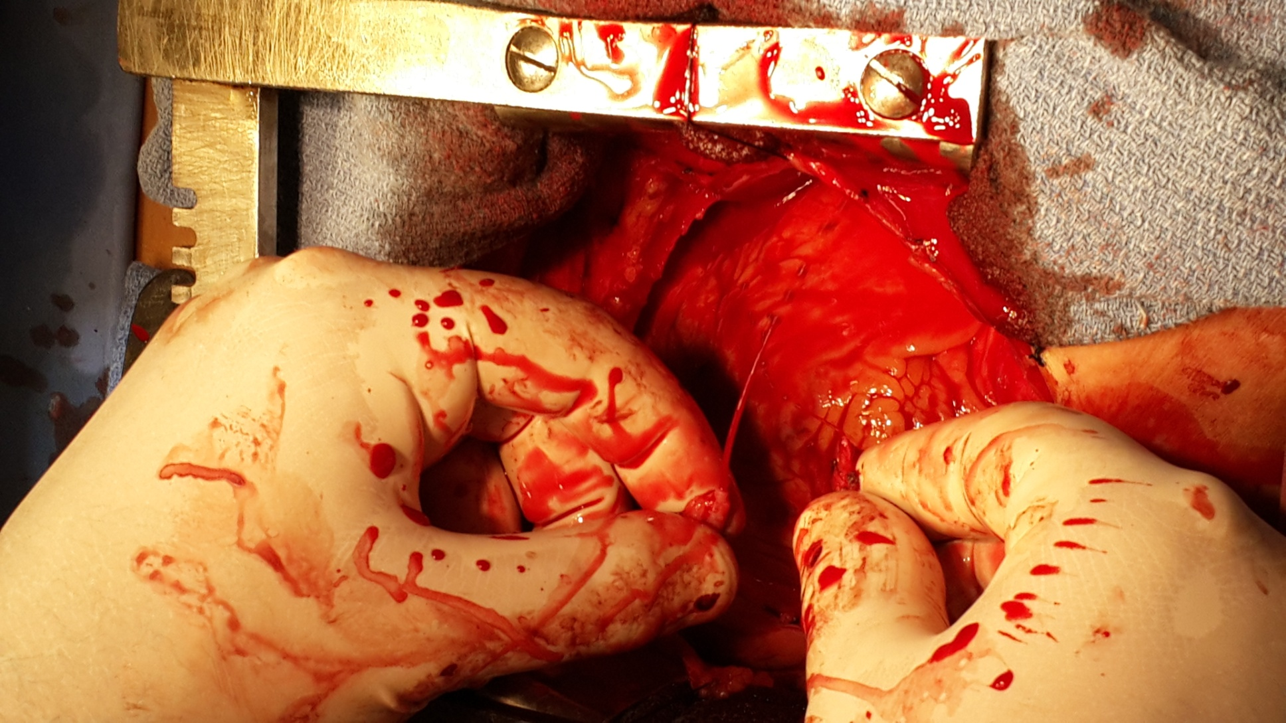

Slide 30
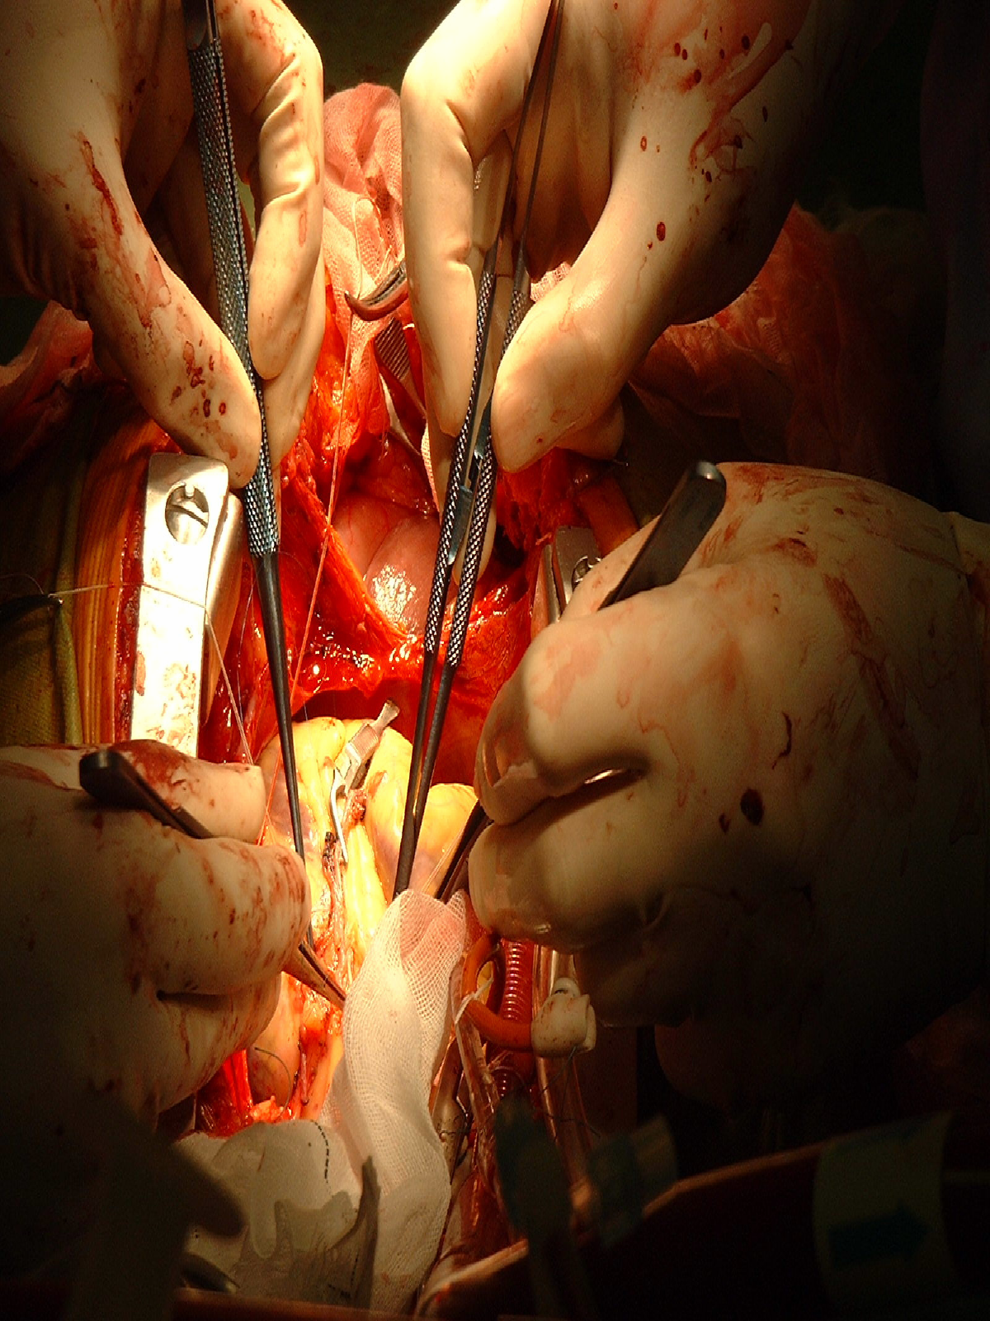

Slide 31
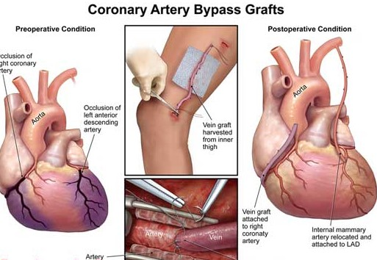

Slide 32
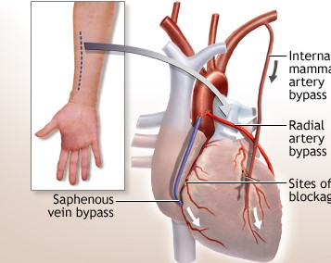
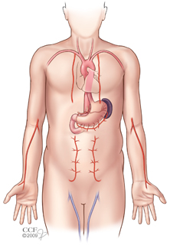
Arterial vs Venous conduits

Slide 33
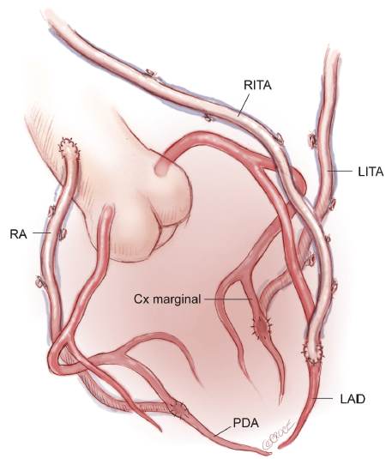
Total arterial revascularization

Slide 34
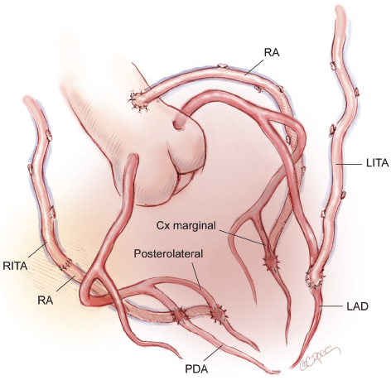

Slide 35
PTCA

Slide 36
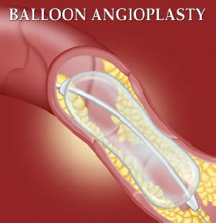

Slide 37
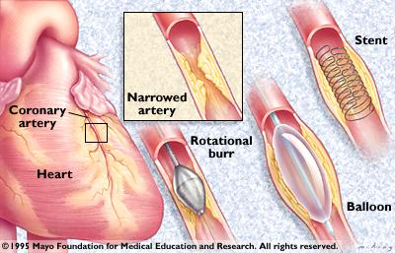

Slide 38
Adult Cardiac Surgery: Valvular Heart Disease
Aortic stenosis-
  Age-related degenerative
  Mild AS: AVA > 1.5cm² ; Moderate 1-1.5cm² ; Severe <1cm²
  Indications for surgery largely based on symptoms
    Syncope, angina, dyspnea and CHF
Aortic regurgitation-
  Calcific aortic disease, idiopathic degenerative disease, endocarditis, rheumatic disease, bicuspid valve, aortic dissection, Marfan, etc.
  Indications for surgery
    Acute AR- inadequate time for ventricular compensation
    Chronic AR- symptoms, decreasing EF, LVEDD >75mm, LVESD >55mm

Slide 39
Adult Cardiac Surgery: Valve Prostheses
Mechanical Valves
  Caged-ball valves
  Tilting disc valves
    single leaflet
    bileaflet
Tissue Valves
  Animal tissue (porcine aortic valves, bovine pericardium)
  Human tissue (Homografts, Autografts)

Slide 40
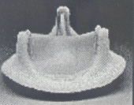
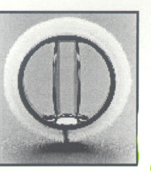
Adult Cardiac Surgery

Slide 41
Adult Cardiac Surgery: Aortic Valve Replacement
Median sternotomy, hemi-sternotomy
Cardiopulmonary bypass
Cardioplegic arrest
Excision of the valve
Debridement
Implantation

Slide 42
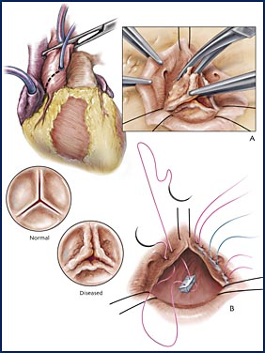

Slide 43
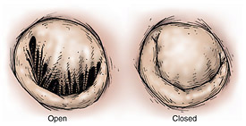
Adult Cardiac Surgery : Valvular Heart Disease
Mitral Regurgitation-
  Myxomatous degeneration, ischemic, rheumatic valve disease, endocarditis, chordal rupture, dilated cardiomyopathy, etc.
  Surgical indications
    Symptomatic with 3+ to 4+ MR, asymptomatic with 3+ to 4+ MR and a decrease in EF, LV dilatation, new onset of atrial fibrillation
Mitral Stenosis-
  Rheumatic heart disease, annular/leaflet calcification, congenital deformities, endocarditis, etc.
  Surgical indications
    MVA ≤ 1.0cm²

Slide 44
Adult Cardiac Surgery : Mitral Valve Surgery
Repair more commonly performed than replacement.
Replacement necessary in some cases
  Rheumatic heart disease, endocarditis, complications of MI, etc.
Median sternotomy
Minimal access incisions
Cardiopulmonary bypass
Cardioplegic arrest

Slide 45
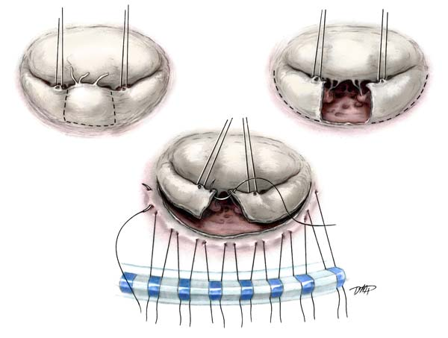

Slide 46
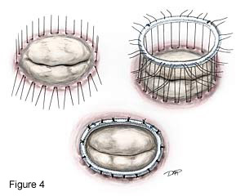

Slide 47
Adult Cardiac Surgery: ACC/AHA
All patients with mechanical valves require warfarin therapy. Even with warfarin, risk of thromboembolism (TE) is 1-2%/yr.
Risk of TE in patients with biological valves in NSR is 0.7%/yr.
Risk of TE is greater with a valve in the mitral (mechanical or biological) than aortic position.

Slide 48
Adult Cardiac Surgery: ACC/AHA Task Force: 1998
Aortic position
  Bileaflet- INR of 2-3
  Other disk valves and Starr-Edwards- INR 2.5-3.5
  In patients with higher risk of TE, INR 2.5-3.5 with addition of aspirin 80-100mg/d. (AF, ↓EF, prior TE, hypercoagulable state)
Mitral position
  All- INR 2.5-3.5

Slide 49
Adult Cardiac Surgery: ACC/AHA
Tissue prosthesis-
  Anticoagulation recommended in first 3 months, although aspirin alone in aortic position in some centers. INR 2.5-3.5
  After 3 months, discontinue unless other circumstances

Slide 50
Recovery for all patients after heart surgery
Quitting smoking
Treating high cholesterol
Managing high blood pressure and diabetes
Exercising regularly
Maintaining a healthy weight
Eating a heart-healthy diet
Participating in a cardiac rehabilitation program
Following up for regular clinic visits

Slide 51
Any Questions

Slide 52
SUMMARY

