Slide 1
Hemorrhoids

Slide 2
Anatomy

Slide 3
Anatomy

Slide 4
Anatomy
Hemorrhoids are not varicose veins.
everyone has anal cushions. The anal cushions are composed of blood vessels, smooth muscle (Treitz’s muscle), and elastic connective tissue in the submucosa
They are located in the upper anal canal, from the dentate line to the anorectal ring

Slide 5
Anatomy

Slide 6
Anatomy
Three cushions lie in the following constant sites:
left lateral, right anterolateral, and right posterolateral.
Smaller discrete secondary cushions may be present between the main cushions. The configuration is remarkably constant and apparently bears no relationship to the terminal branching of the superior rectal artery

Slide 7
PREVALENCE
prevalence rate of 4.4%.
peak between age 45 and 65 years
Hemorrhoidectomies are performed 1.3 times more commonly in males than in females

Slide 8
ETIOLOGY AND PATHOGENESIS
hemorrhoids are no more common in patients with portal hypertension than in the population at large
Thomson concluded that a sliding downward of the anal cushions is the correct etiologic theory (shearing)
Hemorrhoids result from disruption of the anchoring and flattening action of the musculus submucosae ani (Treitz’s muscle) and its richly intermingled elastic fibers. Hypertrophy and congestion of the vascular tissue are secondary
higher anal resting pressures in patients with hemorrhoids

Slide 9
ETIOLOGY AND PATHOGENESIS
Constipation
Prolonged straining
Diarrhea
Pregnancy
Heredity
Erect posture
Absence of valves within the hemorrhoidal sinusoids,
Increased intra-abdominal pressure
Aging (deterioration of anal supporting tissues)
Internal sphincter abnormalities

Slide 10
FUNCTION OF ANAL CUSHIONS

Slide 11
FUNCTION OF ANAL CUSHIONS
compliant and conformable plug. Hemorrhoidectomy impairs continence to infused saline
account for approximately 15%–20% of the anal resting pressure
sensory information that enables individuals to discriminate between liquid, solid, and gas

Slide 12
NOMENCLATURE AND CLASSIFICATION
External skin tags are discrete folds of skin arising from the anal verge.
independent of any hemorrhoidal problem.
External hemorrhoids comprise the dilated vascular plexus that is located below the dentate line and covered by squamous epithelium.

Slide 13
NOMENCLATURE AND CLASSIFICATION
Internal hemorrhoids are the symptomatic, exaggerated, submucosal vascular tissue located above the dentate line and covered by transitional and columnar epithelium.

Slide 14
NOMENCLATURE AND CLASSIFICATION
Grade1 internal hemorrhoids are those that bulge into the lumen of the anal canal and may produce painless bleeding.
Grade 2 internal hemorrhoids are those that protrude at the time of a bowel movement but reduce spontaneously.
Grade 3 internal hemorrhoids are those that protrude spontaneously or at the time of a bowel movement and require manual replacement.
Grade 4 internal hemorrhoids are those that are permanently prolapsed and irreducible despite attempts at manual replacement. They may or may not be complicated

Slide 15
Classic sites

Slide 16
DIFFERENTIAL DIAGNOSIS
Rectal mucosal prolapse
Hypertrophied anal papillae
Rectal polyps
melanoma
carcinoma
rectal prolapse
Fissure
intersphincteric abscess

Slide 17
Symptoms: Bleeding
Bleeding is bright red and painless and occurs at the end of defecation.
The patient complains of blood dripping or squirting into the toilet bowl.
The bleeding also may be occult, resulting in anemia, which is rare, or guaiac-positive stools

Slide 18
Other symptoms
Prolapse
Pain when complicated
Mucous and fecal leakage
Pruritus
Excoriation of the perianal skin

Slide 19
EXAMINATION
Inspection; Straining
Digital examination; SOFT IMPALPABLE
Anoscopy
Proctoscopy or flexible sigmoidoscopy
Colonoscopy

Slide 20
Grade 4 hemorrhoids

Slide 21
treatment
Medical; 1st and 2nd degree
Minor procedures; failed medical Rx 1st and 2nd degree, some 3rd degree
Surgery; 3rd and 4th degree

Slide 22
Medical
Diet and bulk-forming agents
Ointments, creams, gels, suppositories, foams, and pads
Vasoconstrictors, Protectants, Astringents, Antiseptics, Keratolytics, Analgesics, Corticosteroids.

Slide 23
Other procedures
Sclerotherapy
Cryotherapy???
Infrared coagulation
Doppler guided hemorrhoidal artery ligation
Anal Stretch; ??? obsolete

Slide 24
Rubber Band Ligation

Slide 25
Rubber Band Ligation

Slide 26
Infrared Photocoagulation

Slide 27
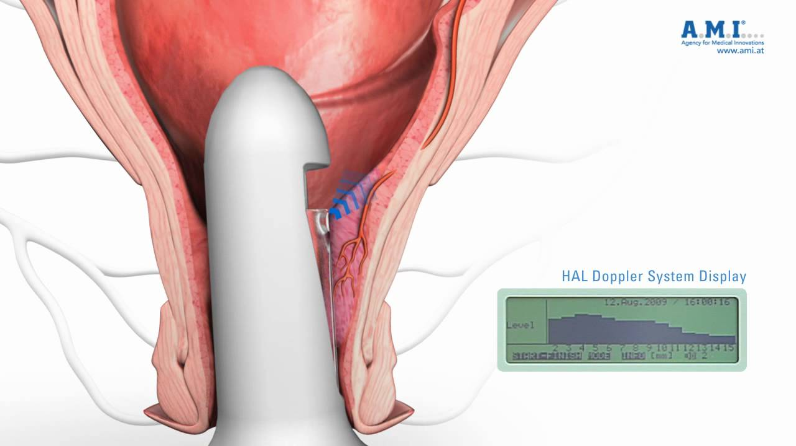
Doppler guided hemorrhoidal artery ligation

Slide 28
Hemorrhoidectomy
Closed hemorrhoidectomy
Open hemorrhoidectomy =Excision and Ligation
Whitehead Hemorrhoidectomy
Laser Hemorrhoidectomy
Stapled hemorrhoidectomy

Slide 29
Stapled Hemorrhoidectomy

Slide 30
THROMBOSED EXTERNAL HEMORRHOIDS
an abrupt onset of an anal mass and pain that peaks within 48 hours.
The pain becomes minimal after the fourth day.
If left alone, the thrombus will shrink and dissolve in a few weeks.
Occasionally, the skin overlying the thrombus becomes necrotic, causing bleeding and discharge or infection, which may cause further necrosis and more pain.
A large thrombus can result in a skin tag

Slide 31
THROMBOSED EXTERNAL HEMORRHOIDS

Slide 32
THROMBOSED EXTERNAL HEMORRHOIDS

Slide 33
Anal Fissure
Younger and middle aged adults but also may occur in infants, children, and the elderly. Fissures are equally common in both sexes.
Anterior fissures are more common in women than in men

Slide 34
Anal Fissure
Acute fissure; a tear
Chronic fissure; sentinel pile, hypertrophied anal papilla, fibrous induration
Abscess and fistula

Slide 35
PREDISPOSING FACTORS
Primary; hypertonic Internal anal sphincter (IAS)
Secondary fissures (low pressure fissure)
Anatomic anal abnormality (e.g. postpartum)
Inflammatory bowel disease
HIV

Slide 36
symptoms
pain in the anus during and after defecation
Bleeding; streaks
Constipation; cause and consequence
large sentinel pile
Discharge

Slide 37
site

Slide 38
When is it chronic
History more than 1month
Presence of
Sentinel pile
Hypertrophied anal papilla
Fibrosis
Submucous fistula

Slide 39
anal fissure Acute vs. chronic

Slide 40
Chronic anal fissure

Slide 41
Treatment; Acute fissure
Conservative
Bulk-forming agents
Local preparations
Warm Sitz baths
Pharmacologic Sphincterotomy; Glyceryl Trinitrate, Calcium Channel Antagonists, Botulinum Toxin
Sphincterotomy

Slide 42
Treatment Chronic fissure
Conservative; same as acute
Internal sphincterotomy (lateral partial)
Classic Excision
V-Y Anoplasty (Advancement Flap Technique)
Finger Anal Sphincter Stretch; ??? Obsolete
Controlled intermittent anal dilatation

Slide 43
Partial lateral internal sphincterotomy

Slide 44
Treatment Chronic fissure

