Slide 1

HEPATITIS C

Slide 2
Hepatitis C: A Global Health Problem
170-200 Million (M) Carriers Worldwide
Far East Asia
60 M
Western
Europe
5 M
Eastern
Europe
10 M
United States
3-4 M
Southeast Asia
30-35 M
Americas
12-15 M
Africa
30-40 M
Australia
0.2 M
Notes:
Hepatitis C: A Global Health Problem
According to CDC estimates, approximately 3-4 million people in the US are currently infected with the hepatitis C virus (see map). There are, however, a few distinct geographic regions where infection is especially common. In Egypt, for example, HCV infection occurs in 10% to 30% of the general population. Likewise, the prevalence of infection is greater than 10% in certain parts of Asia and high rates of infection have been found in certain geographic regions of Japan, Taiwan, and Italy. In such areas, HCV infection is generally more prevalent among persons over the age of 40 and uncommon under the age of 20. This cohort effect suggests that transmission probably occurred through a practice that has been discontinued, such as traditional folk remedies or reuse of needles for injection. In developing countries, nosocomial transmission is most likely the principal route of HCV infection. Evidence from Egypt, Romania, and other nations, before economic transition, point to various percutaneous practices performed in the context of traditional and nontraditional medical care.
The incidence of acute hepatitis C in the US has decreased during the last decade, from approximately 180,000 cases per year to approximately 30,000 to 50,000 cases per year.
References
Cohen J. The scientific challenge of hepatitis C. Science. 1999;285(5424):26-27.
Alter MJ. Epidemiology of Hepatitis C. Hepatology. 1997;26(suppl 1):62S-65S.
World Health Organization. Weekly epidemiological report. 1999;74:421-428. Available at: http://www.who.int/wer/pdf/1999/wer7449.pdf. Accessed February 19, 2003.

Slide 3
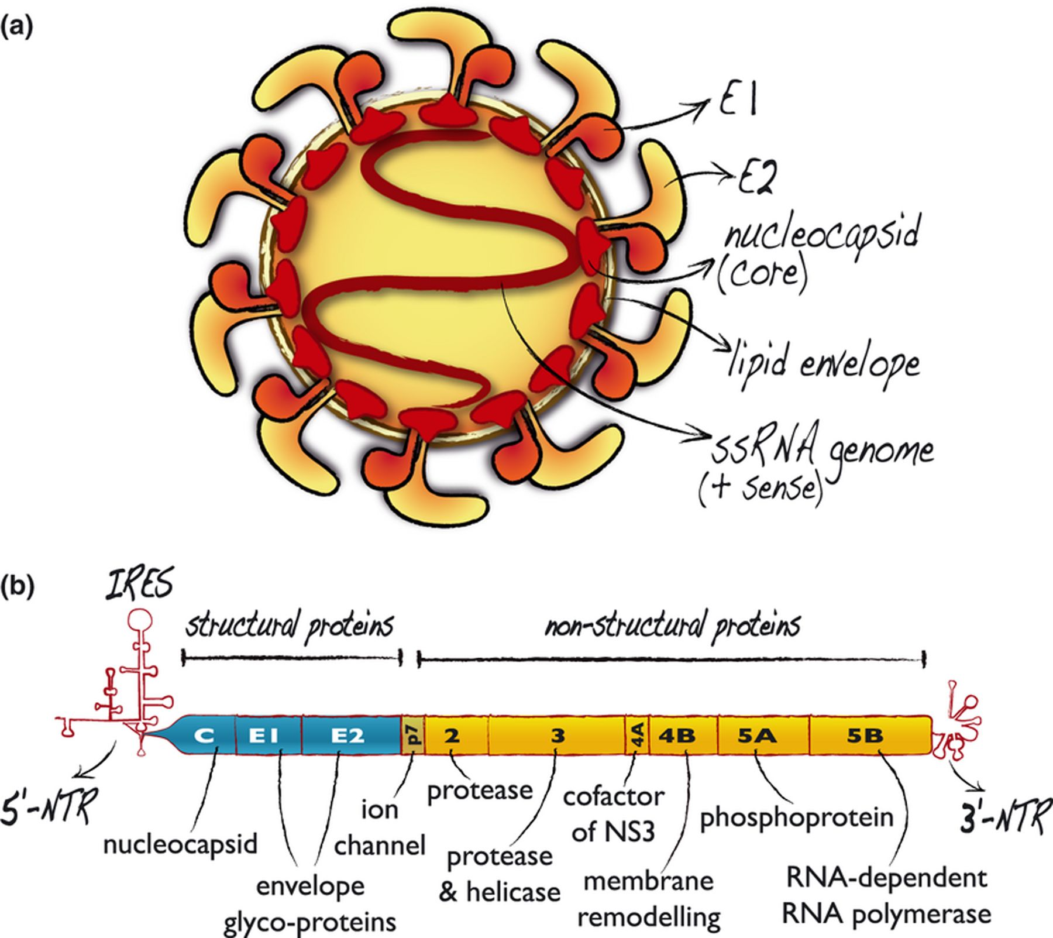

Slide 5
Characteristics of hepatitis C viruses
Virus | Hepatitis C
Family | Flaviviridae
Genus | Hepacivirus
Virion | 60 nm spherical
Envelope | Yes
Genome | ssRNA
Genome size | 9,4 kb
Stability | Ether-sensitive, acid-sensitive
Transmission | Parenteral
Prevalence | Moderate
Fulminant disease | Rare
Chronic disease | Often
Oncogenic | Yes

Slide 7
HEPATITIS C PATHOGENESIS

Slide 8
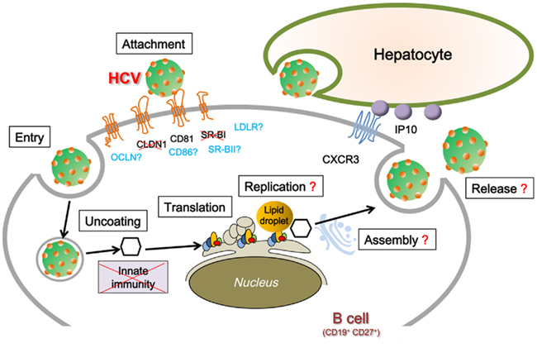

Slide 9
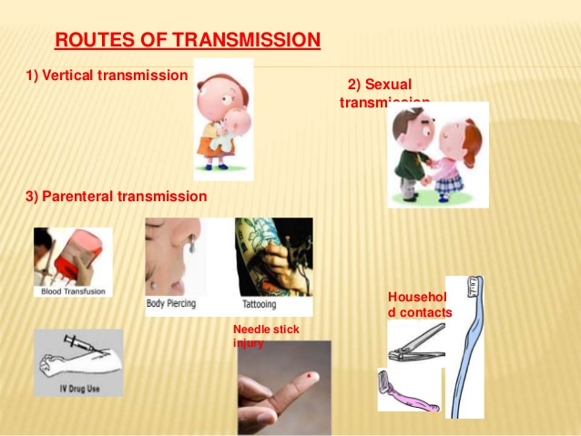

Slide 10
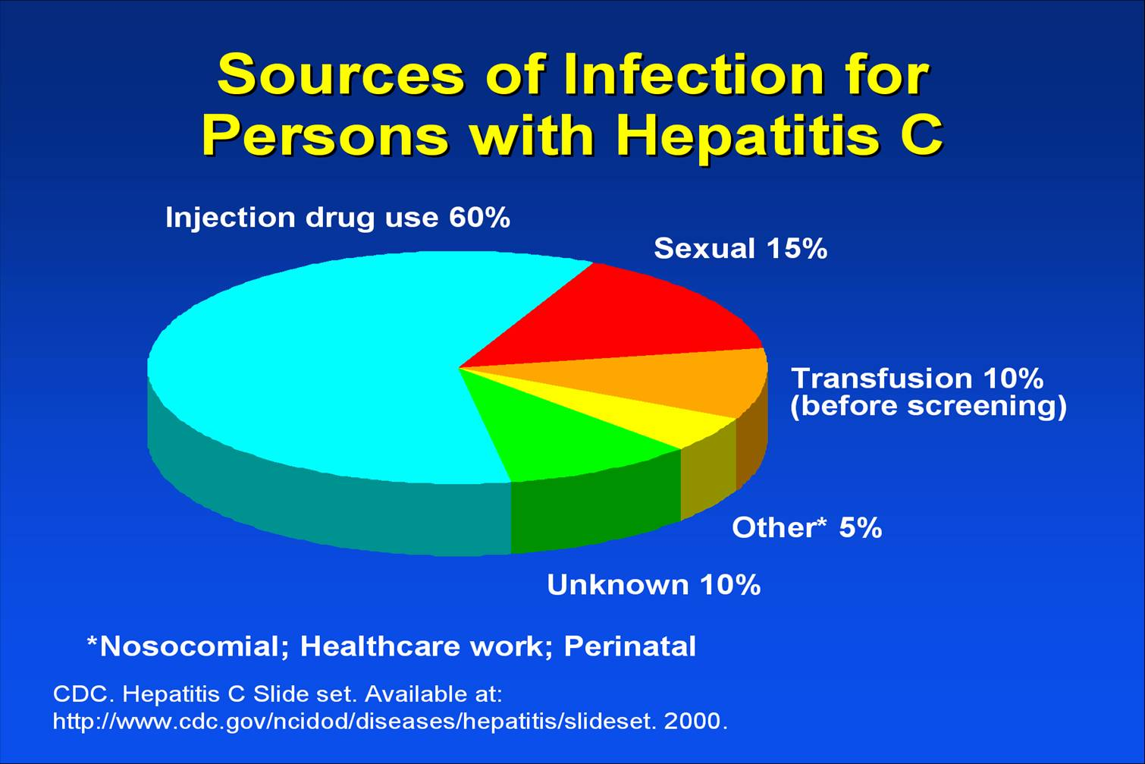
Notes:
Lecture Notes
Approximately 60% of cases of hepatitis C are due to injection drug use. Fifteen percent of cases may be sexually transmitted. Ten percent of cases are due to transfusion-related infections. Unknown sources account for approximately 10% of cases and nosocomial, occupational, and perinatal exposure together account for another 5%.¹
Reference
1. CDC. Hepatitis C Slide set. Available at:
http://www.cdc.gov/ncidod/diseases/hepatitis/slideset. September 25, 2000.
Accessed: February 5, 2002.

Slide 11
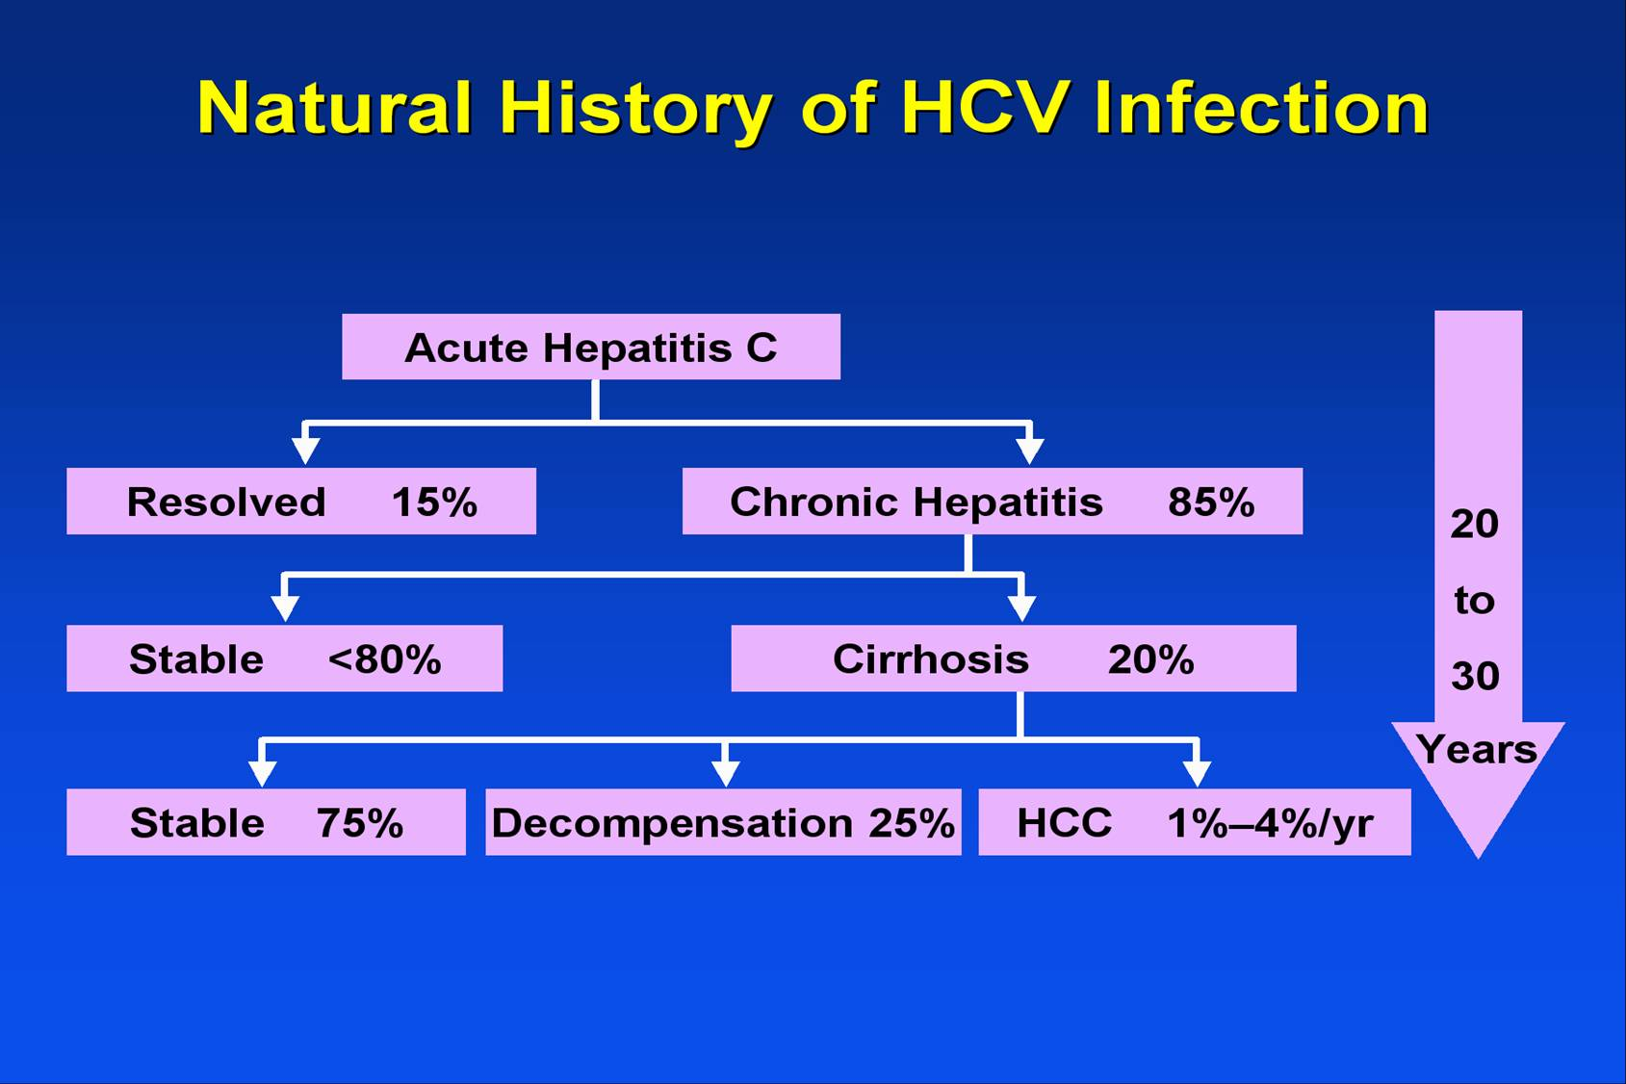
Notes:
Lecture Notes
Approximately 85% of infected individuals will develop chronic hepatitis. Of these, 20% to 50% will progress to develop cirrhosis. One quarter of those with cirrhosis will progress to hepatic decompensation and 1% to 4% will progress to hepatocellular carcinoma. This progression typically takes place over the course of 20 to 30 years.

Slide 12
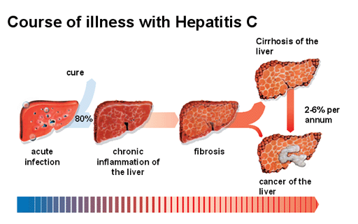

Slide 14
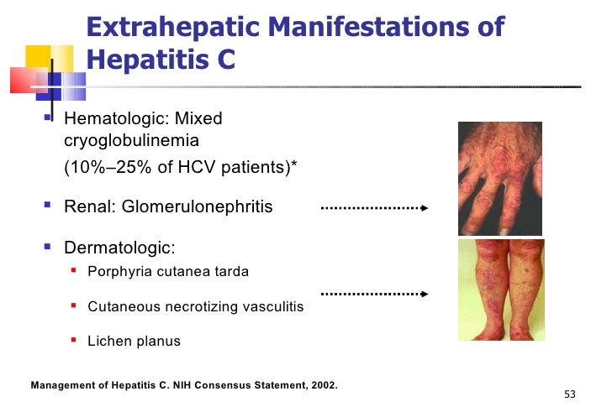

Slide 15
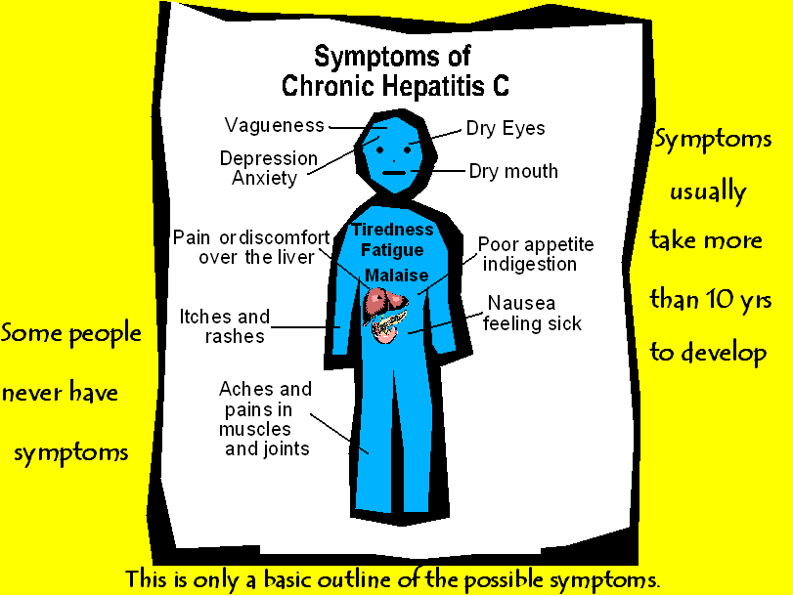

Slide 17
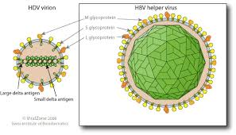
HEPATITIS D

Slide 18
Characteristics of hepatitis D viruses
Virus | Hepatitis D
Family | Unclassified
Genus | Deltavirus
Virion | 35 nm spherical
Envelope | Yes (HBsAg)
Genome | ssRNA
Genome size | 1,7 kb
Stability | Acid-sensitive
Transmission | Parenteral
Prevalence | Low, regional
Fulminant disease | Frequent
Chronic disease | Often
Oncogenic | ?

Slide 21
HDV INFECTION PATTERNS
COINFECTION
  ACUTE SIMULTANEOUS INFECTION WITH HBV AND HDV
  OFTEN RESULTS IN FULMINANT INFECTION (70% CIRRHOSIS)
  SURVIVORS RARELY DEVELOP CHRONIC INFECTION (< 5%)
Notes:
51

Slide 22
HDV INFECTION PATTERNS
SUPERINFECTION
  RESULTS IN HDV SUPERINFECTION IN AN HBsAg CARRIER (CHRONIC HBV)
  CAN OCCUR ANYTIME DURING CHRONIC DISEASE
  USUALLY RESULTS IN RAPIDLY PROGRESSIVE SUBACUTE OR CHRONIC HEPATITIS
Notes:
52

Slide 24
HDV
Transmission:
Oral | No
Percutaneous | Common
Sexual | Yes, rare
Perinatal | No
Incubation period | 21 - 45 days
Jaundice | Unknown
Fulminant | 2 – 7.5%
Diagnostic tests:
Acute infection | IgM anti-HDV
Chronic infection | IgG anti-HDV, HBsAg +
Immunity | Not applicable
Case-fatality rate | 1 – 2%
Chronic infection:
Superinfection | 80%
Coinfection | < 5%

Slide 25
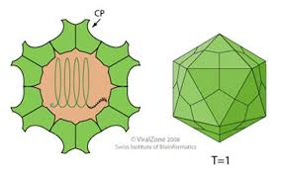
HEPATITIS E

Slide 26
HEPATITIS E VIRUS
Virus | Hepatitis E
Family | Caliciviridae
Genus | Unnamed
Virion | 30-32 nm, icosahedral
Envelope | No
Genome | ssRNA LINEAR
Genome size | 7,6kb
Stability | Heat-stable
Transmission | Fecal-oral
Prevalence | Regional
Fulminant disease | In pregnancy
Chronic disease | Chronic and acute
Oncogenic | No

Slide 28
PATHOGENESIS
Feco oral transmission
Primary replication in the GI tract
Liver replication releases the virus in the bile and stool as well as in the blood
Non cytopathic damage immune mediated
Cholestatic hepatitis is often present

Slide 29
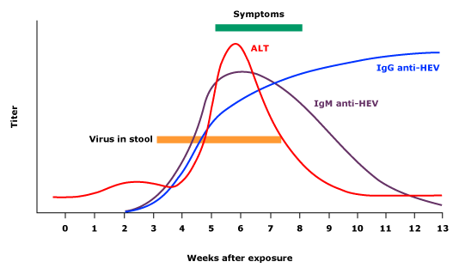

Slide 30
Epidemiology
Contaminated water supplies in tropical or subtropical developing countries
Mainly young adults
Can infect primates, swine, sheep, rats
Swine may be reservoir of infection in North America (attenuated virus)
Maternal-infant transmission occurs and is often fatal mortality might reach up to 20 %
Notes:
Slide 316
Epidemiology
Transmission is not usually directly from human to human, as the attack ratre within households is only about 2% [Smith]. Contaminated water supplies are usually the route of infection in large epidemics. Sporadic cases often have no clear source of infection. The rare individuals who acquire infection from swine seem to have a mild illness due to attenuation of the virus.
Hepatitis E is a dangerous illness in the last trimester of pregnancy, because essentially all newborns acquire the infection from their mothers and the case fatality rate is high (next slide).

Slide 31
Clinical features
Incubation period 2-8 weeks
Typically self limiting disease resolving without sequelae
Clinical manifestation similar to HAV just with higher mortality 1% vs 0.2%
Severe infections during pregnancy mortality up to 20%
Bilateral involvement of cervical nerve roots and/or plexus, elevated liver function tests, and abnormal CSF are typical features of HEV-associated Neurologic amyotrophy. The pathogenesis involves possible immune-mediated mechanisms.

Slide 33
THANK YOU

