Slide 1
HIRSCHSPRUNG DISEASE

Slide 2
Neonatal bowel obstruction

Slide 3
Cardinal manifistation
the triad of:
  bile-stained vomiting,
  abdominal distension
  failure to pass meconium

Slide 4
Bile-stained vomiting in the neonatal period always is significant and must be evaluated carefully as it is indicative of bowel obstruction.

Slide 5
The normal neonate passes meconium within 24 h after birth. Neonates with bowel obstruction do not pass meconium, with three notable exceptions:
  babies with Hirschsprung disease may pass meconium, after rectal examination;
  some sticky meconium pellets may be passed in meconium ileus
  onset of symptoms in malrotation with volvulus may be delayed for some time after birth.

Slide 6
definitions
Congenital megacolon
HD is characterized by the absence of myenteric and submucosal ganglion cells in the distal alimentary tract; resulting in decreased motility in the affected bowel segment

Slide 7
Pathophysiology
Hirschsprung disease results from the absence of parasympathetic ganglion cells in the myenteric and submucosal plexus of the rectum and/or colon.
Ganglion cells, which are derived from the neural crest, migrate caudally with the vagal nerve fibers along the intestine.
These ganglion cells arrive in the proximal colon by 8 weeks of gestational age and in the rectum by 12 weeks of gestational age.
Arrest in migration leads to an aganglionic segment.

Slide 8
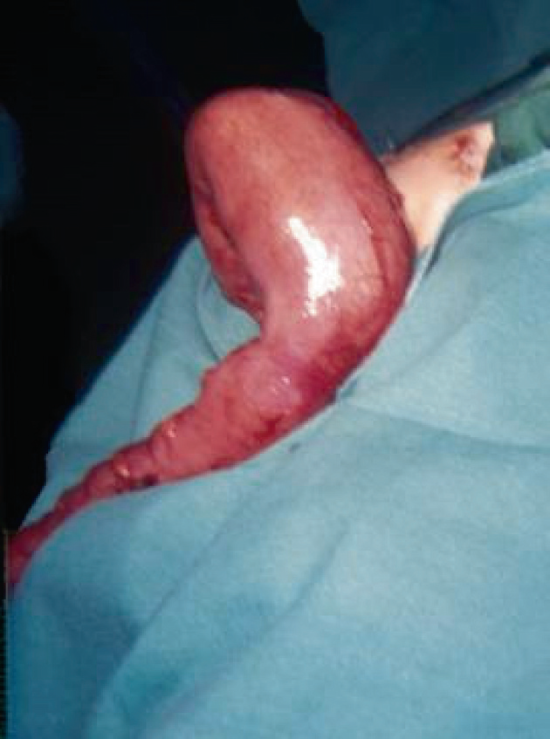
transitional zone

Slide 9
Frequency
Hirschsprung disease occurs in approximately 1 per 5000 live births.
Sex: 4 times more common in males than females.
Age:
  Nearly all children with Hirschsprung disease are diagnosed during the first 2 years of life.
  one half are diagnosed before they are aged 1 year.
  Minority not recognized until later in childhood or adulthood.

Slide 10
HD can be classified by the extension of the aganglionosis as follows:
Classical HD (75% of cases): Rectosegmoid
Long segment HD (20% of cases)
Total colonic aganglionosis (3-12% of cases)
rare variants include the following:
  Total intestinal aganglionosis
  Ultra-short-segment HD (involving the distal rectum below the pelvic floor and the anus)

Slide 11
Clinical presentation:
Newborns :
  Failure to pass meconium within the first 48 hours of life
  Abdominal distension that is relieved by rectal stimulation or enemas
  Vomiting
  Neonatal enterocolitis
Symptoms in older children and adults include the following:
  Severe constipation
  Abdominal distension
  Bilious vomiting
  Failure to thrive

Slide 12
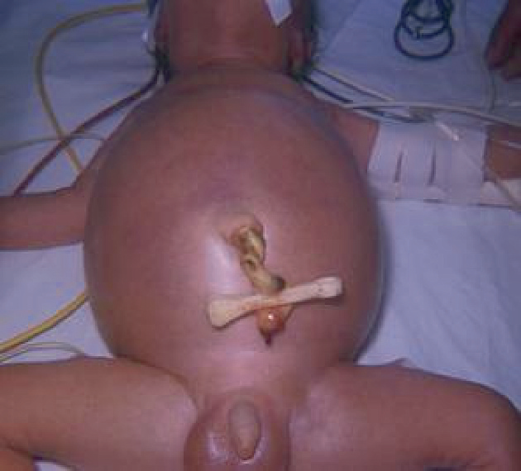

Slide 13
Differential Dx
Intestinal atresias or stenosis
Small left colon syndrome
Meconium plug syndrome
Intestinal malrotation

Slide 14
diagnostic workup
Plain abdominal radiography
Contrast enema
Biopsy

Slide 15
Abdomenal X-Ray
Dilated bowel
Air-fluid levels.
Empty rectum

Slide 16
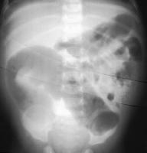
AXR

Slide 17
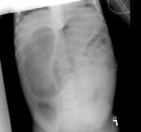
AXR

Slide 18
barium enema
Transition zone
Abnormal, irregular contractions of aganglionic segment
Delayed evacuation of barium

Slide 19
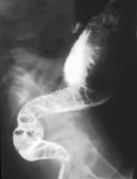
Ba-enema

Slide 20
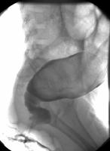
Ba-enema - TZ

Slide 21
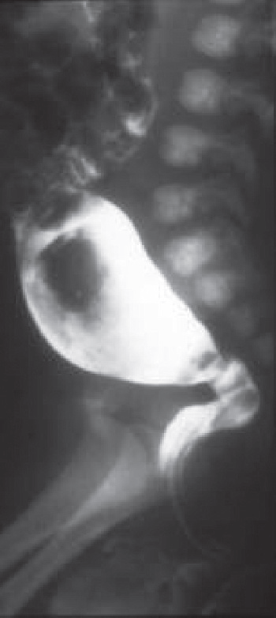

Slide 22
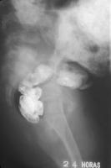
Ba-enema- delayed emptying

Slide 23
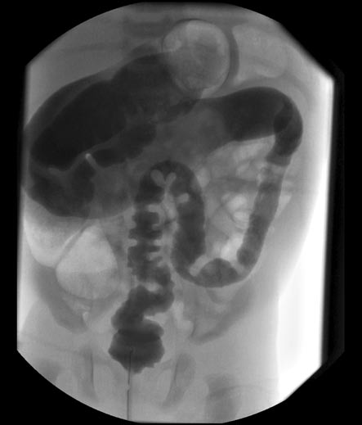

Slide 24
Biopsy
Types:
  rectal suction biopsy
  full-thickness rectal biopsy.
In HD, the biopsy reveals:
  absence of ganglion cells
  hypertrophy and hyperplasia of nerve fibers,
  increase in acetylcholinesterase-positive nerve fibers in the lamina propria and muscularis mucosa.

Slide 25
treatment
The treatment is surgical removal or bypass of the aganglionic bowel,
This can be performed by means of:
  preliminary colostomy followed by a definitive pull-through procedure or,
  primary definitive procedure.
Examples include:
  Soave pull-through procedure,
  Duhamel procedure,
  Swenson procedure.

Slide 26
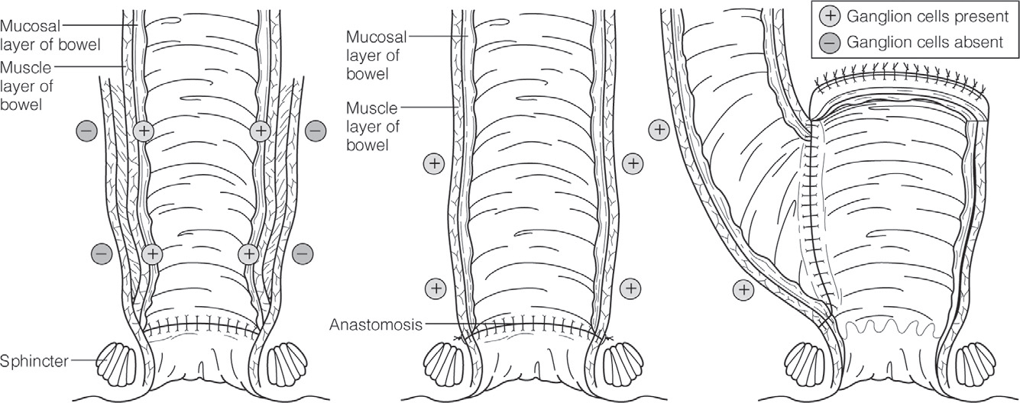
The three most commonly performed operations
A, Soave. B, Swenson. C, Duhamel

Slide 27
Enterocolitis
Enterocolitis accounts for significant morbidity and mortality in patients with Hirschsprung disease.
  Patients typically present with explosive diarrhea, abdominal distention, fever, vomiting, and lethargy.
  Approximately 10-30% of patients with Hirschsprung disease develop enterocolitis. Long-segment disease is associated with an increased incidence of enterocolitis.
  Treatment consists of rehydration, intravenous antibiotics and colonic irrigations.

Slide 28
Post operative complications
anastomotic leak
anastomotic stricture
intestinal obstruction
pelvic abscess
wound infection

Slide 29
Prognosis
The long-term outcome is difficult to determine because of conflicting reports in the literature.
Some investigators report a high degree of satisfaction, while others report a significant incidence of constipation and incontinence.
approximately 1% of patients with Hirschsprung disease require a permanent colostomy to correct incontinence.
patients with associated trisomy 21 have poorer clinical outcomes.

