Slide 1
Introduction to pathology Inflammation lecture 1
Dr H Awad
FRCPath
First trimester 2015/16

Slide 2
inflammation

Slide 3
Inflammation Definition
Protective response
involving (1)host cells, (2)blood vessels and (3)chemical mediators ,
intended to
(1)eliminate (a)the initial cause of injury and the (b)necrotic tissue resulting from the insult
(2)initiate repair.

Slide 4
Unintended outcomes!
Inflammation is a protective mechanism….. Not a disease
However… cells and mediators that destroy injurious agents can destroy normal tissue.

Slide 5
Signs of inflammation
Calor ……. hotness
Rubor …….. redness
Tumor…….. swelling
Dolor……… pain
Functio laesa.. Loss of function

Slide 6
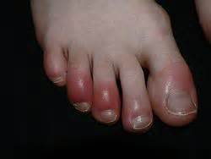

Slide 7
Causes of inflammation any cause of cell injury
Infections
Trauma
Physical : thermal injury, burns
Chemicals
Tissue necrosis: ischemia or physical insult
Foreign bodies
Immune reaction

Slide 8
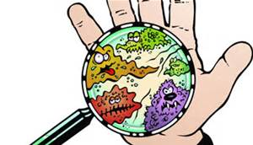
Infection versus inflammation
What are the differences????

Slide 9
Acute versus chronic
Acute: rapid onset, short duration, fluid and plasma protein exudation, predominantly neutrophils.
Chronic: insidious onset, longer duration ( days to years), lymphocytes and macrophages, vascular proliferation and fibrosis.

Slide 10
Acute versus chronic inflammation
feature | acute | chronic
onset | Fast: Minutes to hours | Slow: days
cells | neutrophils | Lymphocytes & macrophages
Tissue injury and fibrosis | Mild and self limited | Severe, progressive
Local and systemic signs | prominent | May be subtle

Slide 11
mechanisms
So.. Cells and molecules needed for the inflammatory response.
These are present in the blood.
The goal of the inflammatory reaction is to bring these cells and mediators to the site of injury.

Slide 12
Chemical mediators
Secreted from inflammatory and host cells (e:g cytokines)
Derived from plasma proteins (complement)

Slide 13
Self control
Inflammation is controlled and self limited.
Inflammatory cells are short lived, and degraded or become inactive.
Anti inflammatory mediators.

Slide 14
Recognition of injurious agent
Receptors on several cells recognize injurious agents.
These receptors present on macrophages, dendritic cells , epithelial cells and others.
These receptors are called pattern recognition receptors because they recognize structures common to many microbes or dead cells.

Slide 15
Pattern recognition receptors
Two families:
Toll like receptors.
inflammasomes

Slide 16
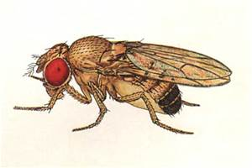
Toll like receptors

Slide 17
Toll like receptors
Microbial sensors.
10 mammalian types:
Can recognize bacterial products : endotoxins or DNA.
Can recognize viral products: RNA

Slide 18
Toll like receptors
Located on plasma membrane and endosomes.
So: can recognize extracellular and ingested microbes.

Slide 19
Toll like receptors
Once they recognize the microbe… transcription factors activation… which stimulate production of chemical agents (inflammatory mediators)

Slide 21
Inflammasome
Multi-protein cytoplasmic complex.
Recognizes products of dead cells… uric acid, extracellular ATP, crystals, some microbes..
When stimulated, inflammasome activates caspase 1.
Caspase 1.. Cleaves and thus activates IL- 1 which is a potent mediator.

Slide 22
Inflammasome in action
1)Gout
Urate crystals deposited in joints.. Ingested by macrophages.. Activate inflammasome… IL 1 production… inflammation
2)Inflammasome stimulated by cholesterol crystals.. Possible role of inflammasome in atherosclerosis.
3) Also activated by free fatty acids in obese people… development of type 2 DM.
???TREATMENT BY blocking IL 1

Slide 23
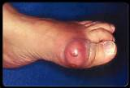
gout

Slide 24
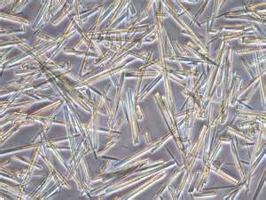
Uric acid crystals

Slide 25
Acute inflammation
Vascular changes:
*vasodilation and increased vascular permeability.
*endothelial cell activation to increase leukocyte adhesion and migration .
Cellular events:

Slide 26
Vascular changes
1)Transient vasoconstriction.. Seconds.
2)Vasodilation… increased blood flow.
3) Increased vascular permeability… extravascular edema
4) loss of fluids from capillaries increases blood viscosity… slowing of circulation = stasis
5) stasis.. Neutrophils accumulate at the epithelial side = margination (the first step in leukocyte activation)

Slide 27
Increased vascular permeability
Results in edema.
Edema caused by inflammation is usually an exudate
Transudate versus exudate???

Slide 28
exudate
Edema fluid caused usually by inflammation.
Fluid rich in protein, cell debris and leukocytes.
High specific gravity
Transudate… low protein, low cell debris, no cells…. Due to changes in hydrostatic or osmotic pressure….. Here only fluid is lost

Slide 29
Causes of increased vascular permeability in inflammation
Endothelial cell contraction.. Increasing the gaps through which fluid is lost
Endothelial injury.. Loss of the barrier that prevents fluid to go out of the vessels.
Increased transocytosis
Leakage from new blood vessels.

Slide 30
Endothelial cell contraction
Most common cause of increased permeability.
Rapid response due to histamine, bradykinin and leukotrienes.
Short lived.
A similar response occurs due to cytokines.. Changes to cytoskeleton increasing the gaps.. This is slower but more prolonged.

Slide 31
Endothelial injury
Damage due to severe injury.. E:g burns or infections.
Can start immediately but lasts for several hours or days till the vessel is thrombosed
If injury is mild effect (permeability increase) can be delayed but long lived. E:g in mild thermal injury or certain bacterial toxins

Slide 32
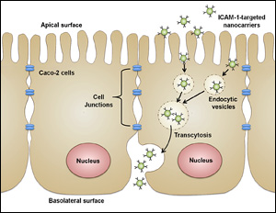
Increased transocytosis

Slide 33
neovascularization
New blood vessels formed during repair.
Leaky till proliferation of endothelial cells matures adequately to form intracellular junctions.

