Slide 1
Inflammation lecture 2
Dr Heyam Awad
FRCPath

Slide 2
Cellular events
Inflammation,,,,,, recruitment and activation of leukocytes.
These leukocytes ingest offending agents but also produce mediators capable of tissue destruction

Slide 3
Leukocyte recruitment
Margination
Rolling
Firm adhesion
Transmigration
Chemotaxis

Slide 4
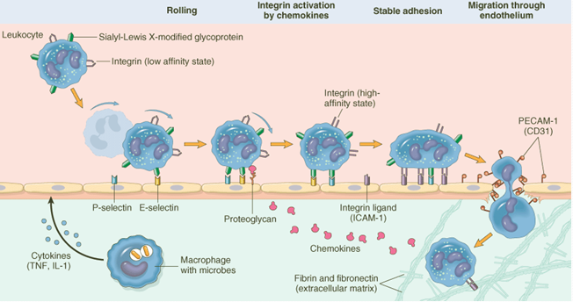

Slide 5
Margination
Accumulation of WBC at the periphery of the vessel walls.
Due to stasis.

Slide 6
Rolling
Endothelial cells activated by cytokines express adhesion molecules to which WBCs adhere loosely
WBCs attach and detach…. Roll
Rolling slows them down
Adhesion molecules responsible : selectin family.

Slide 7
Selectins
On WBCs and endothelium.
E selectin… endothelium
P selectin…. Platelets and endothelium
L selectin… leukocytes

Slide 8
Selectins bind oligosaccharides.
Endothelial selectins present at low levels or not at all on resting endothelial cells.
Cytokines.. Increase expression of selectins.
This overexpression occurs locally at the site of injury.

Slide 9
adhesion
Integrin family of adhesion molecules.
Present on leukocytes and have ligands on endothelial cells.
Integrins expressed normally on plasma membrane on a low affinity form…. Activation by chemokines changes the affinity.
Conformational change and clustering of integrins changes the affinity.

Slide 10
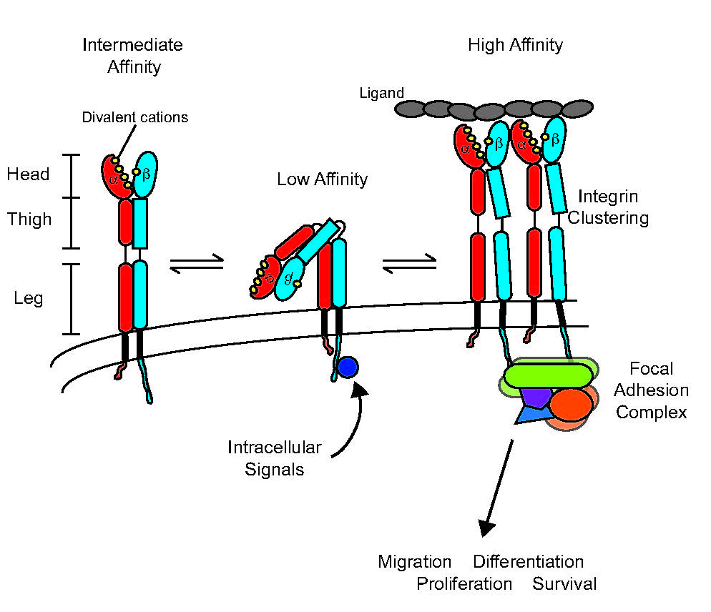
Integrins

Slide 11
Endothelial ligands of integrins
Il 1 and TNF activate endothelial cells to express integrin ligands.
Result: firm stable attachment of leukocytes to endothelial ells.

Slide 12
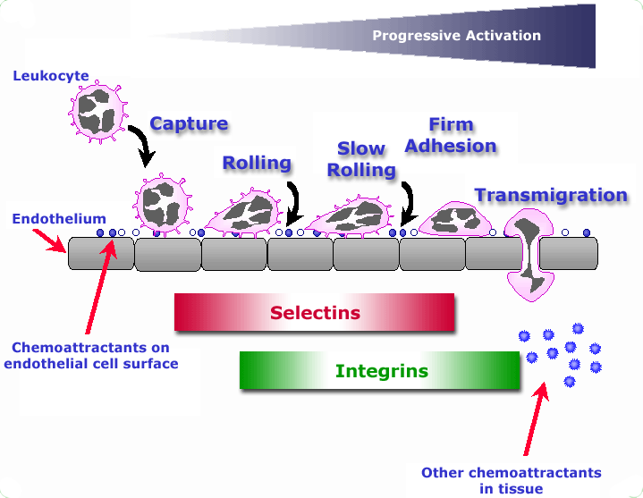
Rolling and adhesion

Slide 13
Transmigration
Leukocytes migrate through vessel walls by squeezing through junctions between endothelial cells.
=Diapedesis.
This occurs in the venules of systemic circulation and capillaries of pulmonary circulation.

Slide 14
Transmigration is stimulated by chemokines.
PECAM 1 an adhesion molecule expressed on endothelial and leukocytes facilitates diapedesis.
Leukocytes secrete collagenase to pass through basement membrane.

Slide 15
chemotaxis
Movement of WBCs to site of injury along a chemical gradient,

Slide 16
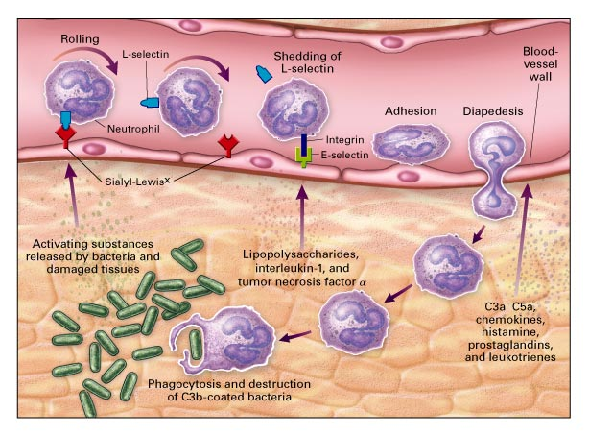
chemotaxis

Slide 17
Chemotactic agents
Bacterial products
Cytokines, especially chemokines
Complement components, C5a
Products of arachidonic acid ; leukotriene B4

Slide 18
Chemotaxis
Chemotactic agents bind to cell surface receptors that cause assembly of cytoskeletal contractile elements which are important for movement.
WBCs move by extending pseudopods that fix ECM and pull the cell in the direction of the pseudopod.
High density of chemokine receptors at the leading edge of the cell directs this movement.

Slide 19
Leukocyte activation
Phagocytosis
Intracellular destruction of phagocytosed microbes and dead cells.
Production of mediators.
Liberation of substances that kill extracellular microbes and dead tissues.

Slide 20
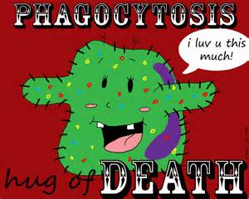

Slide 21
phagocytosis
Three steps:
1. recognition and attachment
2.engulfment
3.killing

Slide 22
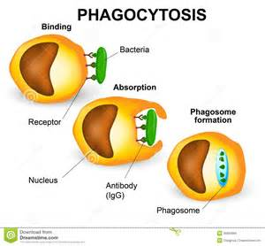

Slide 23
recognition
By cell receptors to
1. microbial components.
2. Dead cells.
3. host proteins = opsonins ( coat microbes and target them for phagocytosis)

Slide 24
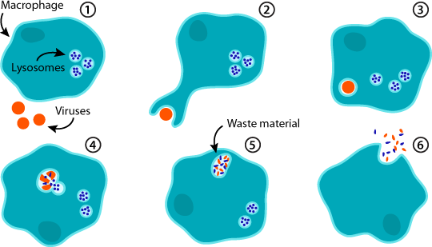
Engulfment

Slide 25
Killing and degradation
Killing by :
Lysosomal enzymes
Oxygen free radicals
Reactive nitrogen species

Slide 26
Reactive oxygen species
Produced by NADPH oxidase… produces superoxide ion.
Superoxide converted by spontaneous dismutation to Hydrogen peroxide.
Hydrogen peroxide converted to HOCL radical by neutrophil myeloperoxidase. .

Slide 27
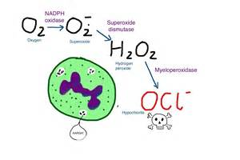

Slide 28
Lysosomal enzymes
Acid hydrolases.
Most important: elastase.

Slide 29
NET
Extracellular fibrillar networks produced by neutrophils in response to infections.
Contain nuclear chromatin and enzymes.
Trap and kill infectious agents.

Slide 30
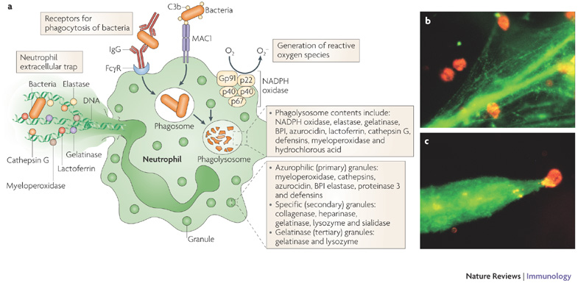
NET

Slide 31
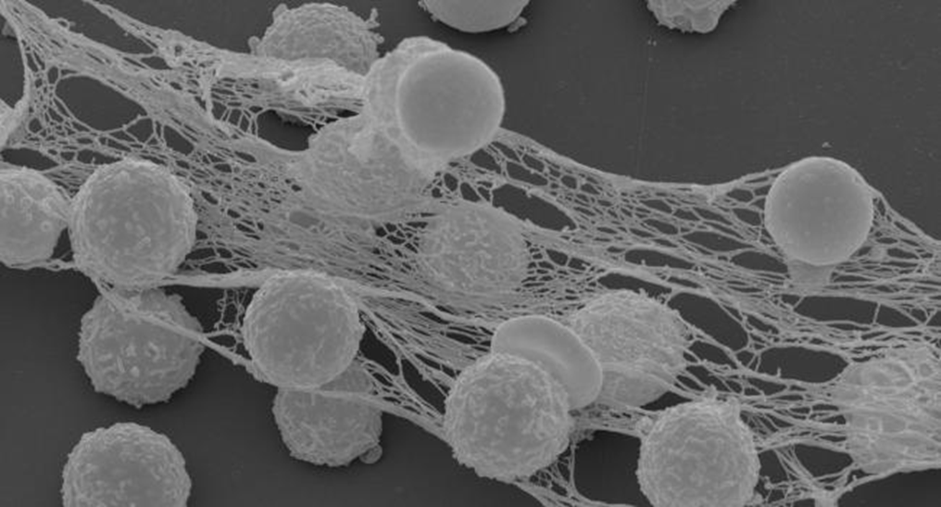
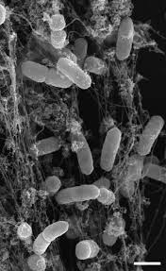
NET

