Slide 1
Inflammation 3
Dr H Awad
FRCPath

Slide 2
Chemical mediators
1- locally produced by cells at the site of inflammation.
or
2- circulating in the plasma in an inactive form that need to be activated at the site of inflammation

Slide 3
Action of mediators
Act by binding to receptors.
One mediator… several actions.
One mediator… receptors on several cells.

Slide 4
Regulation of mediators' actions
The actions of most mediators are tightly regulated by:
Quick decay (e.g., arachidonic acid metabolites)
Enzymatic inactivation (e.g., kininase inactivates bradykinin)
elimination (e.g., antioxidants scavenge toxic oxygen metabolites),
inhibition (complement-inhibitory proteins)

Slide 5
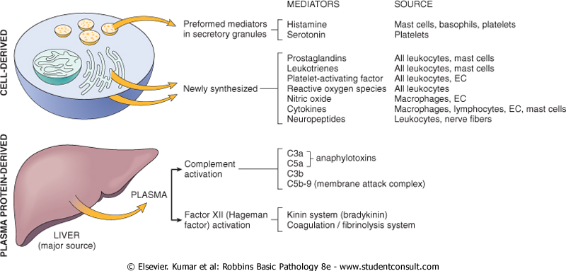
The principal chemical mediators of inflammation

Slide 6
Mediator |  | Source |  | Principal Actions
Cell-Derived
Histamine | Mast cells, basophils, platelets |  | Vasodilation, increased vascular permeability, endothelial activation
Serotonin | Platelets |  | Vasodilation, increased vascular permeability
Prostaglandins | Mast cells, leukocytes |  | Vasodilation, pain, fever
Leukotrienes | Mast cells, leukocytes |  | Increased vascular permeability, chemotaxis, leukocyte adhesion and activation
Platelet-activating factor | Leukocytes, endothelial cells |  | Vasodilation, increased vascular permeability, leukocyte adhesion, chemotaxis, degranulation, oxidative burst
Reactive oxygen species | Leukocytes |  | Killing of microbes, tissue damage
Nitric oxide | Endothelium, macrophages |  | Vascular smooth muscle relaxation; killing of microbes
Cytokines (e.g. TNF, IL-1) | Macrophages, lymphocytes, endothelial cells, mast cells |  | Local endothelial activation (expression of adhesion molecules), systemic acute-phase response; in severe infections, septic shock
Chemokines | Leukocytes, activated macrophages |  | Chemotaxis, leukocyte activation
Plasma Protein-Derived
Complement | Plasma (produced in liver) |  | Leukocyte chemotaxis and activation, opsonization, vasodilation (mast cell stimulation)
Kinins | Plasma (produced in liver) |  | Increased vascular permeability, smooth muscle contraction, vasodilation, pain
Proteases activated during coagulation | Plasma (produced in liver) |  | Endothelial activation, leukocyte recruitment

Slide 7
Vasoactive amines
histamine and serotonin
Histamine
causes vasodialtion, increased permeability.
Responsible for edema.
Preformed in mast cells, basophils and platelets.
Inactivated by histaminase.

Slide 8
serotonin
Stored in mast platelet granules
Vasoconstrictor, especially during clot formation.
neurotransmitter.

Slide 9
Arachidonic acid metabolites

Slide 10
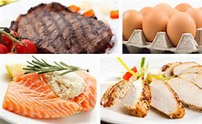
SOURCES OF AA

Slide 11
Arachidonic acid (AA) metabolites
AA … fatty acid present in cell membrane.
Phospholipase, during inflammation releases it from membrane to cytoplasm.
Two enzymes act upon it to form two families of mediators.
Metabolites: eicosanoids (20 carbon) fatty acids.

Slide 12
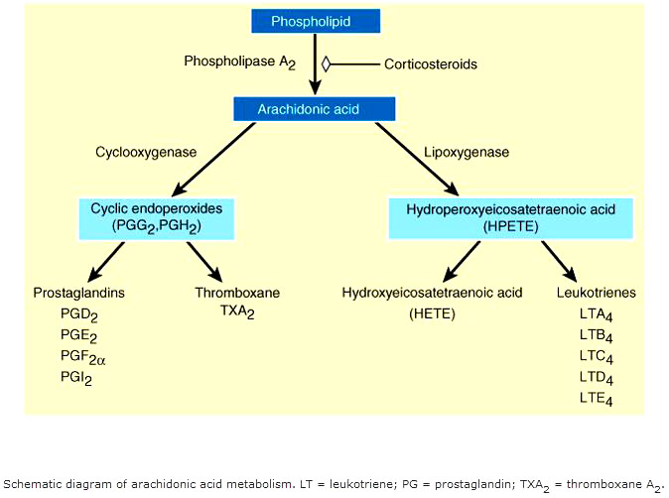
AA metabolites

Slide 13
Cyclooxygenase pathway
Produces: prostaglandins.
PG E2
PG I 2(Prostacyclin)
PG D2
THROMBOXANE A2

Slide 14
Each of the prostaglandins is derived from a different intermediate precursor and by a different enzyme.
E:g
Platelets.. Thromoboxane A2 synthase.
Endothelial cells… prostacyclin synthase

Slide 15
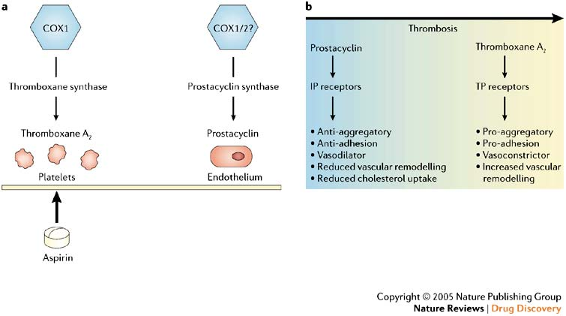

Slide 16
PG E2 and PG D2 have similar effect:
-vasodilatation.
-edema.
-pain.
-interact with cytokines to cause fever.

Slide 17
Lipooxygenase pathway
Produced leukotrienes and lipoxins.

Slide 18
Leukotrienes LT
LT B4… CHEMOTACTIC AGENT. Produced mainly in neutrophils
LT C4
LT D4
LT E4
C4, D4 AND E4…. Cause bronchospasm and increased vascular permeability.
These are produced mainly in mast cells.

Slide 19
Lipoxins (LX)
LX A4 AND LX B4
Anti-inflammatory effects.
Inhibit neutrophil adhesion and chemotaxis.

Slide 20
Principal Inflammatory Actions of Arachidonic Acid Metabolites (Eicosanoids)
Action | Eicosanoid
Vasodilation | PGI₂ (prostacyclin), PGE₁, PGE₂, PGD₂
Vasoconstriction | Thromboxane A₂,
Increased vascular permeability | Leukotrienes C₄, D₄, E₄
Chemotaxis, leukocyte adhesion | Leukotriene B₄

Slide 21
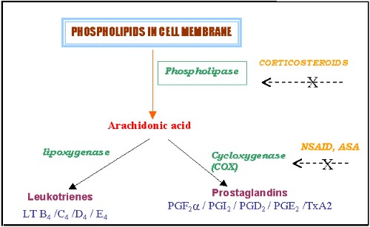
Antiinflammatory drugs

Slide 22
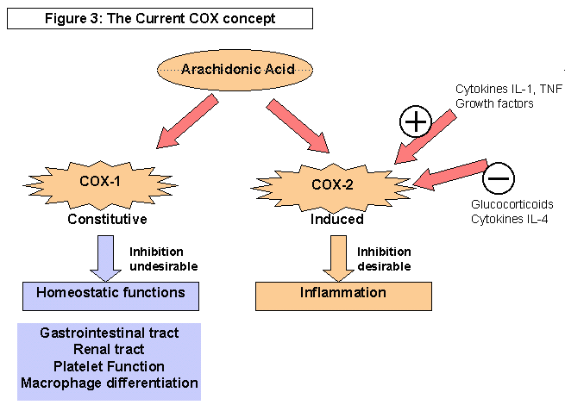

Slide 23
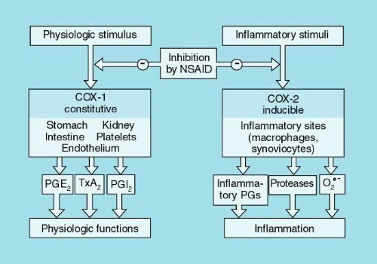

Slide 24
