Slide 1
Inflammation lecture 4
Dr Heyam Awad
FRCPath

Slide 2
Chemical mediators of inflammation
VASOACTIVE AMINES
AA METABOLITES
PAF
CYTOKINES
REACTIVE OXYGEN SPECIES
REACTIVE NITROGEN SPECIES
LYSOSOMAL ENZYMES
NEUROPEPTIDE
COMPLEMENT SYSTEM
KININ SYSTEM

Slide 3
Platelet activating factor
Generated from membrane phospholipids by phospholipase A2.
Neutrophils, monocytes, basophils, platelet, endothelial cells and other cells.
Potent broncho-constrictor.
Potent vasodilator.
Stimulates synthesis of other mediators.

Slide 4
cytokines
Polypeptides.
MAJOR CYTOKINES:
TNF,
IL 1,
IL 6
CHEMOKINES.

Slide 5
TNF and IL 1
Main role: endothelial activation.
Stimulate expression of adhesion molecules on endothelial cells.
Increase production of other cytokines and AA metabolites.

Slide 6
TNF and IL1
Cause systematic effects:
Fever
Lethargy
Decreased blood pressure

Slide 7
chemokines
Small protein that are chemoattractant to WBCs.
Most important: IL8.
They also activate WBCs… e: g by increasing affinity of leukocyte integrins to their ligands on endothelium.

Slide 8
neuropeptide
E: g substance P.
Transmit pain signals.
Regulate vessel tone.

Slide 9
Nitric oxide
Short lived soluble free radical gas.
Synthesized de novo from arginine by nitric oxide synthase (NOS)

Slide 10
NOS
Type 1, neuronal.. No role in inflammation.
Type 2.. inducible, macrophages and endothelial cells
Type 3 in endothelial cells.

Slide 11
Effects of NO
Microbicidal
Vasodilator
Reduced leukocyte recruitment

Slide 12
Plasma derived mediators
Complement system
Coagulation system
Kinin system

Slide 13
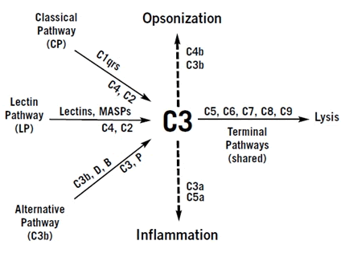
complement

Slide 14
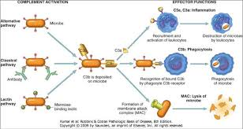

Slide 15
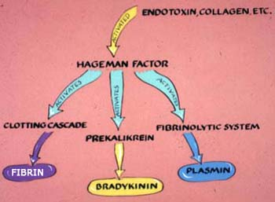
Coagulation and kinin

Slide 17
Systemic effects of inflammation
= acute phase reaction:
Most importan mediators: TNF, IL 1 , IL 6.
Fever,
elevated acute phase proteins,
leukocytosis.
Increased heart rate and blood pressure.

Slide 18
fever
Pyrogens are substances that stimulate prostaglandin synthesis in the hypothalamus.
PG in hypothalamus.. Stimulate production of neurotransmitters which increase temperature.
Internal (IL 1 and TNF) and external pyrogens( bacterial lipopolysaccharides).

Slide 19
Elevated acute phase proteins
Acute phase proteins: plasma proteins synthesized in the liver due to influence of cytokines, mainly IL 6.
Most important: C reactive protein (CRP), fibrinogen and serum amyloid A (SAA)
CRP and SAA act as opsonins.
Fibrinogen binds to RBCs so they form aggregates that sediment more rapidly at unit gravity than individual erythrocytes.

Slide 20
ESR
Erythrocyte sedimentation rate.
Measures the sedimentation of RBCs .
Good measure of inflammation.

Slide 21
leukocytosis
WBCs 15-20 000 cells/ml in inflammation.
Rarely reaches 40-100000 =leukemoid reaction.

Slide 22
Other systemic manifestations
Increased heart rate.
High blood pressure.
Decreased sweating.
Malaise
Anorexia.

