Slide 1
Inflammation 5
Dr Heyam Awad
FRCPath

Slide 2
topics to be covered in this lecture
Outcome of acute inflammation.
Morphology of acute inflammation.
Chronic inflammation

Slide 3
Outcome of acute inflammation
1. resolution: regeneration and repair.
2. chronic inflammation.
3. scarring

Slide 4
Resolution - definition
Restoration of normal structure and function.

Slide 5
resolution
Happens when:
1. Injury is limited and short lived.
2. No or minimal tissue damage.
3. Injured tissue can regenerate.

Slide 6
Chronic inflammation
Happens if:
Offending agent not removed.

Slide 7
scarring
If there is extensive tissue destruction
Or in tissues that cannot regenerate.

Slide 8
Morphologic patterns of acute inflammation
Serous inflammation
Fibrinous
Suppurative
ulcer

Slide 9
Serous inflammation
Occurs if injury is mild.
Watery protein-poor fluid.
Happens in skin blisters due to burns or viral infections
Occurs also in body cavities: serous effusions.

Slide 10
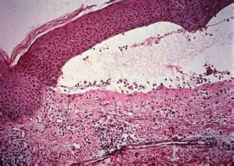
Serous inflammation

Slide 11
Fibrinous inflammation
More severe injury.
Greater vascular permeability.
So: edema fluid contains fibrin.
In body cavity lining… pericarditis.

Slide 12
fibrin
Protein.
Eosinophilic meshwork of threads.

Slide 13
Fibrinous inflammation
Outcome:
Resolution if mild
Scarring if more severe.

Slide 14
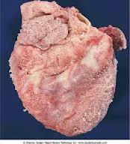
Fibrinous pericarditis

Slide 15
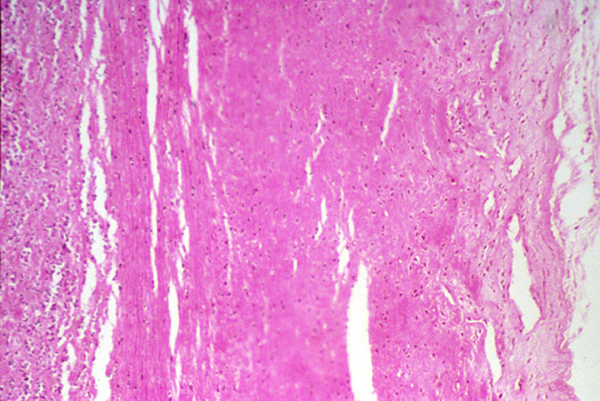
Fibrinous pericarditis

Slide 16
Suppurative inflammation
In bacterial infections.
Pus formation… composed of neutrophils.
Abscess: focal collections of pus.
Usual outcome: scarring

Slide 17
ulcer
Local defect of the surface of an organ or tissue produced by cellular necrosis and shedding of necrotic and inflammatory tissue.

Slide 18
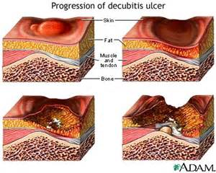
ulcer

Slide 19
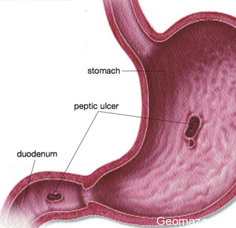
ulcer

Slide 20
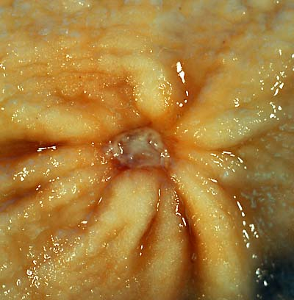
ulcer

Slide 21
Chronic inflammation

Slide 22
Chronic Inflammation
Characterized by:
Inflitration with mononuclear cells.
Tissue destruction
Repair ( new angiogenesis & Fibrosis)

Slide 23
Causes of chronic inflammation
1- Unresolving acute inflammation
2- Persistent infections: (TB, Syphilis, Fungi, viruses)
3- Prolonged exposure to toxic agents. (Silica, plasma lipids like in atherosclerosis)
4- Autoimmune disease (Rheumatoid arthritis, Inflammatory bowel disease)

Slide 24
Cells of chronic inflammation
Macrophages.
Lymphocytes
Plasma cells
Eosinophils
Mast cells

Slide 25
Macrophages
Are the dominant cells of chronic inflammation
derived from blood monocytes
normally diffusely scattered in most connective tissues, and also in organs such as the liver ( Kupffer cells), spleen and lymph nodes (called sinus histiocytes), central nervous system (microglial cells), and lungs (alveolar macrophages).

Slide 26
M1 and M2 macrophages
M1 .. Classical pathway… inflammation
M2… alternative pathway… anti-inflammation and tissue repair and necrosis.

Slide 27
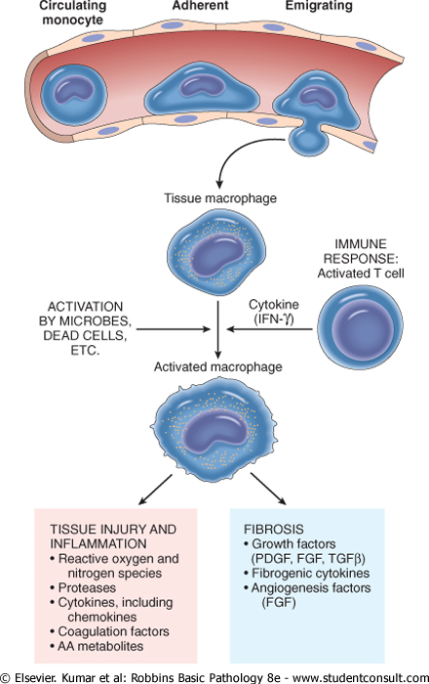

Slide 28
Lymphocytes and Plasma Cells
Lymphocytes and macrophages interact in a bidirectional way, and these interactions play an important role in chronic inflammation
Activated T lymphocytes produce cytokines, including IFN-γ, a powerful activator of macrophages,

Slide 29
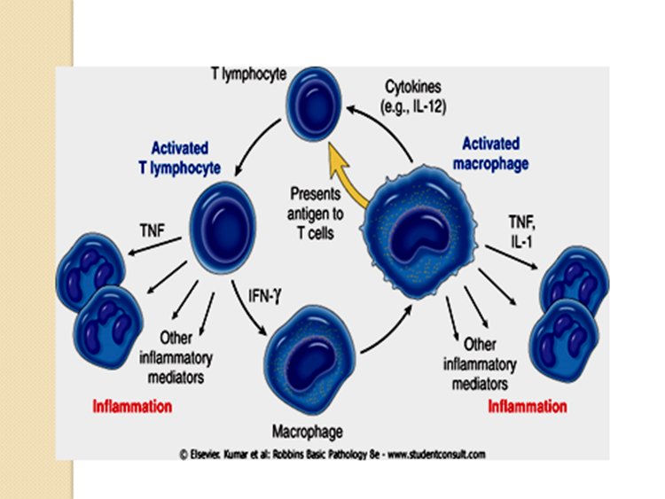

Slide 30
Plasma cells
develop from activated B lymphocytes.
produce antibodies against persistent antigens or against altered tissue components.

Slide 31
Eosinophils
characteristically found in inflammatory sites around:
parasitic infections or
as part of immune reactions mediated by IgE, typically associated with allergies.

Slide 32
Granulomatous Inflammtion
-Aggregates of epithelioid histiocytes
-Mechanism:
Persistent T-cell response to certain microbes as M. tuberculosis,
Foreign bodies. E.g. suture, splinter.

Slide 33
Diseases associated with granulomatous inflammation include:
Tuberculosis
Leprosy
sarcoidosis

Slide 34
Granuloma morphology
Macrophages in granulomas have pink, granular cytoplasm with indistinct cell boundaries (epitheloid macrophages)
These are surrounded by a collar of lymphocytes
Older granulomas may have a rim of fibroblasts and connective tissue, and frequently, multinucleated giant cells

Slide 35
Caseating granulomas
hypoxia and free-radical injury leads to a central zone of necrosis.
Grossly, this has a granular, cheesy appearance (caseous necrosis)
Microscopically, amorphous, structure-less, granular debris, with complete loss of cellular details.
Seen mainly in TB.

Slide 36
Caseating granulomas
a combination of hypoxia and free-radical injury leads to a central zone of necrosis. Grossly, this has a granular, cheesy appearance and is therefore called caseous necrosis. Microscopically, this necrotic material appears as amorphous, structureless, granular debris, with complete loss of cellular details.
Healing of granulomas is accompanied by fibrosis that may be quite extensive.

Slide 37
Granuloma: microscopic morphology

