Slide 1

Injuries
Dr. Sireen Alkhaldi, DrPH
Community Medicine
First Semester/2015

Slide 2
Injuries
Introduction
Injuries and violence are among the most prominent public health problems in the world.
As well as being a leading cause of mortality – particularly among children and young adults – many of the millions of non-fatal injuries result in life-long disabilities and health consequences.
Tens of millions more people suffer long-term psychological health effects as a result of an injury or an act of violence.

Slide 3
Injuries
Definition and causes
An injury is damage to the body.
It is a general term that refers to harm caused by traffic collisions, drowning, poisoning, falls, burns, and violence - from assault , self-inflicted violence or acts of war.
Reference:
World Health Organization, Injuries and Violence, the Facts, 2014.

Slide 4
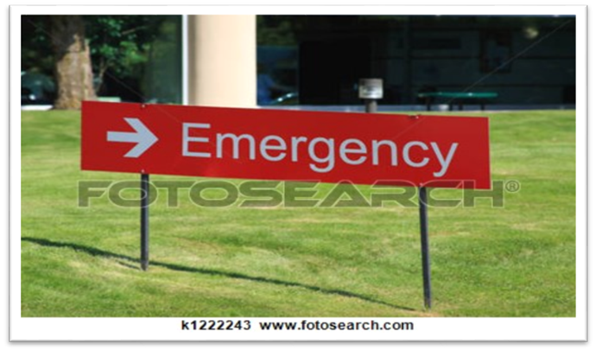
Injuries … magnitude
Injuries kill more than five million people worldwide annually and cause harm to millions more.
Injuries account for 9% of global mortality, and are a threat to health in every country of the world. Nearly 1.7 times the number of fatalities that result
from HIV/AIDS, tuberculosis and malaria combined

Slide 5
Injuries …. magnitude
Every six seconds someone in the world dies as a result of an injury
For every death, it is estimated that there are dozens of hospitalizations, hundreds of emergency department visits and thousands of doctors’ appointments.
A large proportion of people surviving their injuries incurs temporary or permanent disabilities.

Slide 6
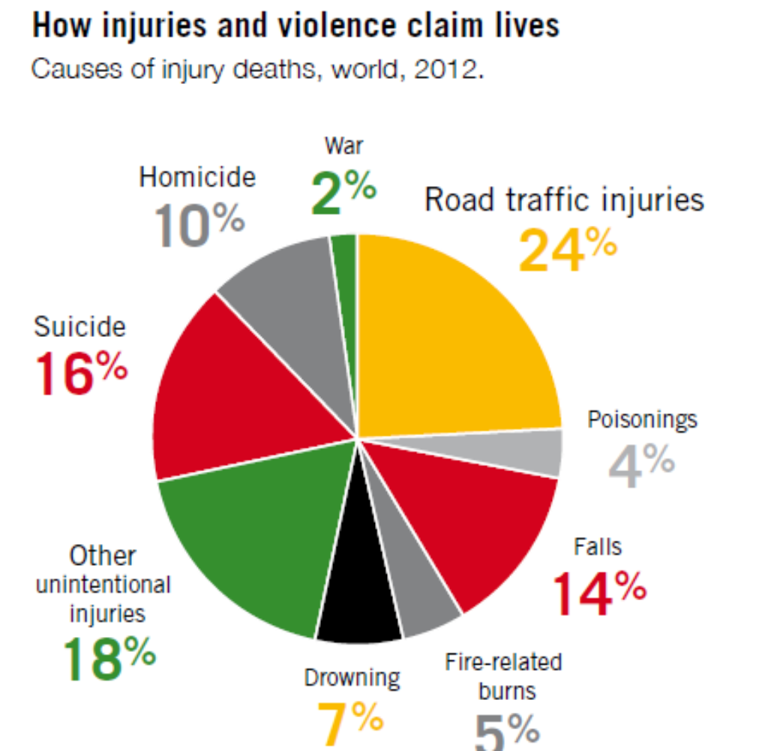
Injuries and Violence as a Cause of Death:
1. Road Traffic Injuries
2. Suicide
3. Falls

Slide 8
Injuries, as a cause of death
Two of the three leading causes of injury deaths – road traffic injuries and falls – are predicted to rise in rank compared to other causes of death.
Road traffic injuries are predicted to become the 7th leading cause of death by 2030 (table 1), with falls rising to become the 17th leading cause of death and suicide remaining in the top 20.

Slide 9
Injuries, the non-fatal consequences
The millions of deaths that result from injuries represent only a small fraction of those injured.
Tens of millions of people suffer injuries that lead to hospitalization, emergency department or general practitioner treatment, or treatment that does not involve formal medical care.
The relative numbers of fatal and nonfatal injuries are graphically depicted in a pyramid, as shown in Figure 4.

Slide 11
Injuries …non-fatal Consequences
Many of those who survive acts of violence, road traffic crashes, suicide attempts or other causes of injury are left with temporary or permanent disabilities.
All causes of injury have health consequences beyond the physical injury (Figure 5).

Slide 13
Injuries …non-fatal Consequences
In particular, child maltreatment, intimate partner violence and sexual violence have been shown to have a broad array of adverse health effects that can persist over a lifetime.
These forms of violence contribute significantly to depression, sexually transmitted diseases and unwanted pregnancies, while also increasing the likelihood of engaging in risky behaviours, such as smoking and the harmful use of alcohol and drugs.
Via these behaviours, they can lead to cancers, cardiovascular diseases, diabetes, liver disease and other chronic diseases.

Slide 14
Injuries and Violence …
Who is more vulnerable?
The nature of injuries and violence varies considerably according to age, gender, region and income group.
For example, in low- and middle-income countries in the Western Pacific, the leading injury-related causes of death are road traffic injuries, suicide and falls. The leading cause of injury death in the high-income countries of the world is suicide, with road traffic injuries and falls second and third.

Slide 15
Injuries are a leading cause of death among young people
Injuries affect all age groups but have a particular impact on young people and people in their prime working years.
For people between the ages of 15 and 29 years, three injury-related causes are among the top five causes of death. Road traffic injuries are the leading cause of death in this age group, with suicide and homicide the second and fourth leading causes of death respectively – together accounting for more than one quarter of all deaths in this age group.
Among the elderly, falls are the most common cause of injury death.

Slide 16
Poverty Increases the Risk of Injury
About 90% of injury-related deaths occur in low- and middle-income countries.
Across the world, injury death rates are higher in lower-income countries than in higher-income countries (see Figure 6).

Slide 17
Poverty Increases the Risk of Injury
Even within countries, injuries show strong social class gradients. This means that people from poorer economic backgrounds have higher rates of death from injury and non-fatal injuries than wealthier people.
This uneven distribution of injuries is related to a number of factors such as living, working and travelling in less safe conditions, less focus on prevention efforts in poorer areas, and poorer access to quality emergency trauma care and rehabilitation services.

Slide 18
Poverty Increases the Risk of Injury
As well as being at increased risk, disadvantaged families are hardest hit by the financial pressure resulting from injuries.
Poor families are less likely to have the financial resources to pay the direct costs (e.g. medical bills) as well as the indirect costs (e.g. lost wages) related to injuries.

Slide 19
Injuries and violence are unevenly distributed between males and females
More males than females are killed by injuries and violence— almost twice as many each year.
The three leading causes of death from injuries for males are: road traffic injuries, suicide and homicide
The three leading causes of injury-related death for females are: road traffic injuries, falls and suicide.

Slide 21
Injuries and violence are unevenly distributed between males and females
It is important to look beyond the mortality statistics and note that some types of injuries and violence predominantly affect women.
More than 1 in 3 women (35%) have experienced intimate partner violence (domestic violence), or sexual violence (rape) perpetrated by someone who was not an intimate partner.

Slide 22
Injuries and violence impose heavy costs on individuals and on society
As well as the huge emotional toll that injuries and violence impose on those affected, they also cause considerable economic losses to victims, their families, and nations as a whole.
These losses arise from the cost of treatment, including rehabilitation, and incident investigation as well as reduced or lost productivity in the form of wages for those killed or disabled by their injuries, and for family members who need to take time off work to care for the injured.

Slide 23
Road Traffic Accidents (RTA’s) in Jordan
In Jordan, as a result of RTA’s: a car accident happens every 5 minutes, one person is injured every 29 minutes, and a person dies every 9 hours .
In Jordan, 368 deaths from road traffic accidents were reported between January and August 2015 (12 out of the 368 were ran over by the vehicle parking at their home).
In 2014, RTA’s caused 688 deaths and 14,790 injured (102,400 accidents)
In 2013, RTA’s caused 768 deaths and 15,954 injured (107,800 accidents)
1/3 of these deaths is caused by a run over accident (for pedestrians).

Slide 24
Measures to Prevent Violence and Injuries
As more governments around the world come to recognize that injuries and violence can and must be prevented, many are trying to get a better understanding of the problem in their countries as a basis for designing effective prevention strategies (see Figure 10).
For example, a study in the United States found that every dollar spent on smoke detectors saves US$ 28 in health-related expenditure.

Slide 25
Measures to Prevent Violence and Injuries

Slide 26
Evidence-based measures to reduce key causes of injury-related deaths include the following:
Road traffic crashes
Setting and enforcing laws on speeding, on seat belts, and on drinking and driving
• Setting and enforcing laws on motorcycle helmets
• Setting and enforcing laws on child restraints
• Developing safer roadway infrastructure
• Implementing vehicle and safety equipment standards
• Introducing a graduated driver licensing system for new young drivers

Slide 27
Evidence-based measures to reduce key causes of injury-related deaths include the following:
Interpersonal violence
• Developing safe, stable and nurturing relationships between children and their parents or caregivers
• Developing life skills in children and adolescents
• Reducing the availability and harmful use of alcohol
• Reducing access to guns and knives
• Promoting gender equality to prevent violence against women
• Changing cultural and social norms that support violence
• Reducing violence through victim identification, care and support programs

