Slide 1
UROGENITAL SYSTEM LAB -1
You need to know minimal theory information about the condition because the q will not be identify

Slide 2
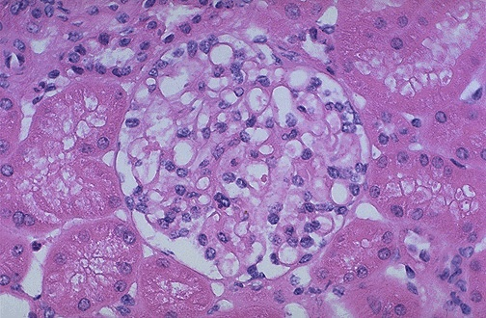
CV: 10 yrs old boy was brought to pediatric clinic because of generalized edema. Urinalysis: large amount of prteinurea. No HTN neither azotemia Analysis of the case: Nephrotic presentation Pt is young You look into the figure: nothing abnormal i.e. no light microscopic changes in a child with nephrotic syndrome Dx: minimal change disease

Slide 3
Minimal change disease
Prevalence in children? Most common cause of nephrotic syndrome in children
LM findings?none
IF findings? none
EM findings? Effaced podocyte foot processes

Slide 4
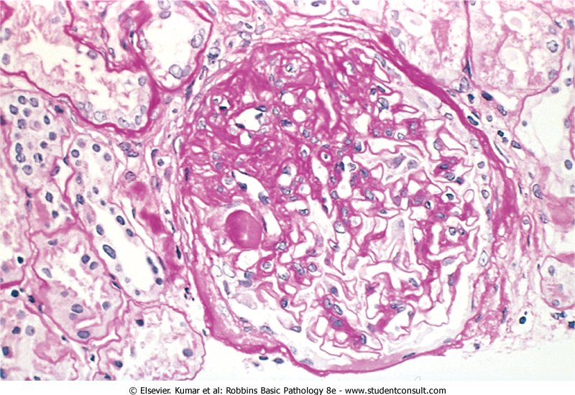
CV: A female 35yrs old is complaining of heavy proteinurea and mild hematuria. Biopsy of her kidney is showen in the figure. Analysis of the case: heavy proteinurea→ Nephrotic syndrome. The light microscopic picture is diagnostic part or a segment of the glomerulous is more intensley pink than the rest of the glomerulus. Dx: FSGS

Slide 5
Focal and segmental glomerulosclerosis (FSGS)
Prevalence in adults? Most commomn cause of nephrotic syndrome in adults
LM findings? Segmental sclerosis affecting some of the glomeruli.
IF findings? negative

Slide 6
Membraneous glomerulopathy
Nephrotic
Spike and dome pattern of depostion
Immune complexes deposited in the basement membrane
Types? 1ry (idiopathic) and 2rdy
Causes of 2dry?
Drugs
heavy metals
Infections
malignancy
Spikes are a reaction from the BM
Electron microscope: Whit and black Show details like foot processes that could not be seen by light microscope

Slide 7
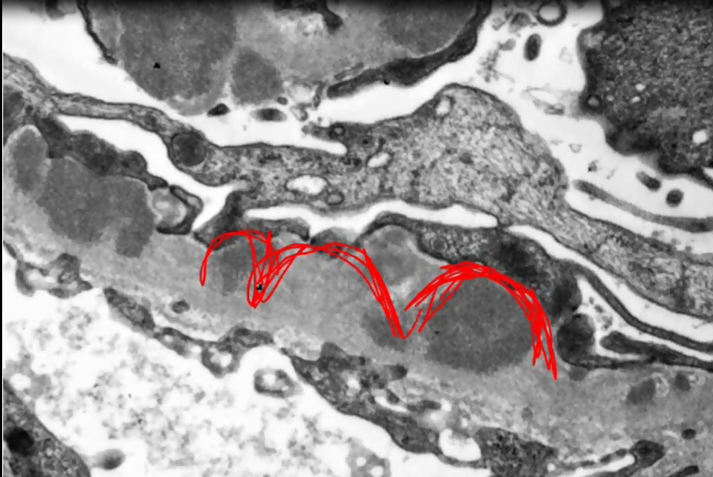
EXTRA
SPIKE
DOME

Slide 8
Rapidly Progressive (Crescentic) Glomerulonephritis
Crescents are parietal epithelial cells and inflammatory cells
CRESCENTS

Slide 9
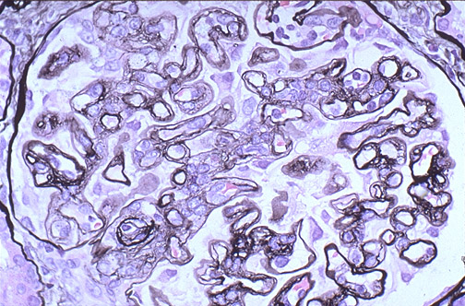
MPGN (membranoproliferative glomerulonephritis) 2 types: MPGN1 and MPGN2
Nephritic
What type of special stain is this? Silver stain. Stains the BM with black
What is the characteristic light microscopic finding you see here.
Double countor of glomerular basement membrane “tram track appearnce” مثل سكة القطار لأن لها خطين

Slide 10
Hydronephrosis: significant dilation of the renal pelvis and calycis
Causes ? Congenital (eg: vlave fprmation) and acquired. Eg: stones, tumor, kinking and ptosis of the ureter
Consequences? Chronic renal failure if not treated early

Slide 11
Simple renal cysts
Single or multiple usually confined to the cortex
what is the clinical significance? You should differentiate them from tumors

Slide 12
PKD (polycystic kidney disease) Adult type, Autosomal dominant
what is the clinical significance? -A major cause of renal failure. -Extra renal manifestations; HTN, aneurysms in the circle of Willes complicated bt subarachnoid hemorrhage
name genetic abnormalities. PKD1, PKD2

Slide 13
Clear renal cell carcinoma (cells look clear)
Kidney tumor in a 60 yrs old man Bx in the figure below
Name a genetic predisposing factor for it?
VHL
Genetics and renal cell carcinoma: Clear: VHL gene Papillary: MET gene Chromophoboe: Hypodiploidy

Slide 14
Wilms tumor (WT)
Kidney tumor in a child Bx: Cells are blue. Tend to form primitive tubules and glomeruli
genetic mutations? WT1, WT2
age group of patients? 3rd most common solid cancer in children

Slide 15
RCC (بأشكالها المختلفة)
Types?
morphology ? Spherical, yellowish in color, involves one pole of the kidney
name a paraneoplastic syndrome associated with this tumor. Polycythemia caused by production of EPO by neoplastic cells
The tumor usually grow into the renal vein

Slide 16
Urothelial papillary carcinoma- low grade
Papillary cancer involving the urinary bladder
Risk factors? For urinary bladder cancer
Cyclophosphamide, smoking, β- naphthylamine Schistosomiosis
Finger like shape, hence the name (papillary)

