Slide 1
Viral Infections of GIT
Dr. Sameer Naji, MB, BCh, PhD (UK)
Dean Assistant
Head of Basic Medical Sciences Dept.
Faculty of Medicine
The Hashemite University
Edited by Mohammad qussay Al-Sabbagh, according to section 1 recerod

Slide 2
VIRAL AGENTS CAUSING GASTROENTERITIS
Required
Pathogens discussed in our lectures
Rotavirus
Enteric adenoviruses
Caliciviruses
Astroviruses
Toroviruses

Slide 3
Viruses as a causative organism of diarrheal disease
Required
Detection of a specific virus in the stool of symptomatic patients is not sufficient to establish the role of the virus in causing disease. These criteria need to be fulfilled:
Virus is detected in ill patients significantly more than asymptomatic controls and virus shedding correlate with symptoms
Significant humoral or secretory antibody response or both in patients shedding the disease.
Reproduce the disease by experimental inoculation of nonimmune human or animal hosts
Exclude other causes of diarrhea such as bacteria, bacterial toxins and protozoa.

Slide 4
Feature | Rotavirus | Calicivirus | Astrovirus | Adenovirus | Torovirus
Nucleic acid | DS RNA | SS RNA | SS RNA | DS DNA | SS RNA
Shape | Naked, Double shelled capsid | Naked, round | Naked, star shaped | Naked, icosahedral | Enveloped, donut shaped
Replication in CC | Usually incomplete | None | None | None or incomplete | None
Serotypes | 5 | >4 | 8 | unknown | unknown
Site of infection | Duodenum, jejunum | Jejunum | Small intestine | Small intestine | Small intestine
Immunity | Local IgA | unknown | unknown | unknown | unknown
Seasonality | winter | Not known | Not known | Not known | Not known
Ages primarily affected | Infants, < 2 yrs | Older children, adults | Infants, children | Infants, children | Infants, children
Transmission | Fecal-oral | Fecal-oral | Fecal-oral | Fecal-oral | Fecal-oral
IP (days) | 1-3 | 0.5-2 | 1-2 | 8-10 | -----------------
Dx | EIA, EM | IEM, PCR | EM, PCR | EIA, EM | EM, ELISA

Slide 5
ROTAVIRUS
Required
Family Reoviridae
Genus Rotavirus
Other genera Orthreovirus, Coltivirus, orbivirus (sheep)
Note: Only immunity, seasonality, ages and transmission are required from last slide

Slide 6
ROTAVIRUS- discovery
Required
First isolated in 1973 in Australia by Ruth Bishop at the Royal Children's Hospital in Melbourne.
EM identification from duodenal biopsies from children with diarrhea.
"Virus particles in epithelial cells of duodenal mucosa from children with acute non-bacterial gastroenteritis," Lancet, 1:1281-3, 1973.
Described in stool samples from children by Albert Z. Kapikian, in the US
Human and animal strains are recognized
Important

Slide 7
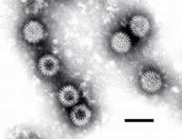
ROTAVIRUS EM STRUCTURE

Slide 8
STRUCTURAL FEATURES OF ROTAVIRUS
65-75nm in size
Non-enveloped virus (naked)
EM appearance of a wheel with radiating spikes
Icosahedral symmetry
Double capsid (outer and inner capsid)
Double stranded (ds) RNA in 11 segments
Core with genome
Capsid is cleaved by trypsin to form ISVP
[intermediate/infective sub-viral particle]
Read only

Slide 9
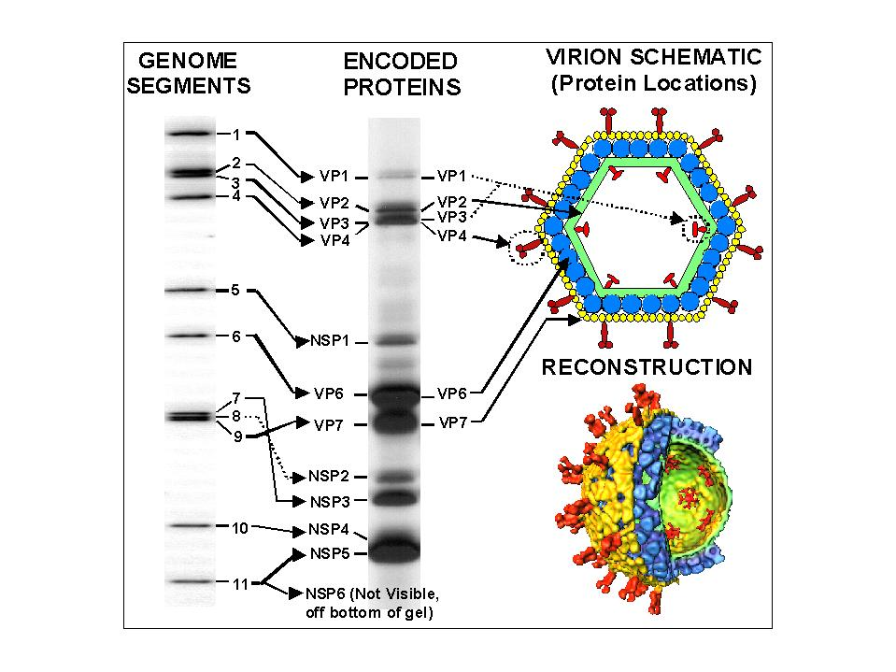
Rotavirus structure

Slide 10
VIRAL STRUCTURAL PROTEINS (VP)
Important
Outer structural proteins - VP7 and VP4 VP7 - Glycoprotein
VP4 - protease-cleaved, P protein, viral hemagglutinin; forms spikes from the surface
Inner core structural proteins VP 1, 2, 3, 6
VP6 is an important antigenic determinant

Slide 11
CLASSIFICATION- Groups
Required
7 Groups (A through G) and 2 subgroups (I and II) based on
VP6 differences
Group A is the most common
Group B (outbreaks in China)
Group C (worldwide)

Slide 12
CLASSIFICATION - Serotypes
Read only
Serotypes based on viral capsid proteins inducing neutralizing Ab
14 G serotypes based on G protein (VP 7) differences
5 predominant strains in U.S. (G1-G4, G9) account for 90% of isolates
Strain G1 accounts for 73% of infections
20 P serotypes based on P protein (VP4) with P4/P8 predominance
Common PG combinations are: P8G1, P8G2, P4G2, P8G4

Slide 13
ROTAVIRUS - Properties
Required
Virus is stable in the environment (months)
Relatively resistant to handwashing agents
Susceptible to disinfection with 95% ethanol, Lysol, formalin

Slide 14
PATHOGENESIS
Required
Targeted host cells - mature enterocytes lining the tips of intestinal villi
Intermediate/infective sub-viral particle (ISVP) produced through proteolysis
Enter host cell by endocytosis
Virus replicates in the host cell cytoplasm

Slide 15
REPLICATION
Read only
mRNA transcription with viral RNA polymerase
Capsid proteins formed, assembled into immature capsid
RNA replicated to form double stranded RNA genome

Slide 16
HISTOPATHOLOGY
Read only
Mature enterocytes lining the tips of intestinal villi are affected
Villous atrophy and blunting
Death of the mature enterocytes
Infiltration of lamina propria with mononuclear cells
Repopulation of the villous tips with immature secretory cells [crypt hyperplasia]

Slide 17
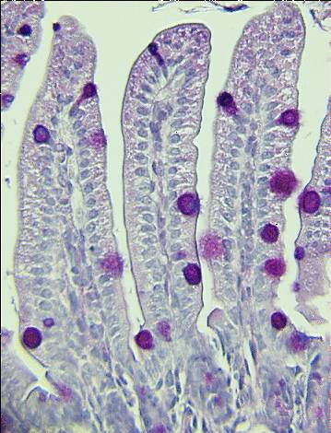
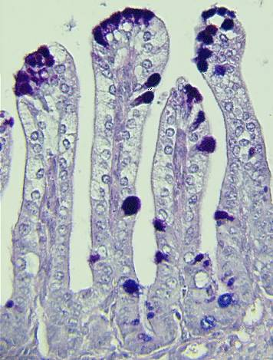
HISTOPATHOLOGY

Slide 18
EPIDEMIOLOGY
Required
A major cause of diarrhea-associated hospitalizations and deaths
Sero-prevalence studies show that antibody is present in most (90%) by age 4 years

Slide 19
ROTAVIRAL DISEASE BURDEN Worldwide

Slide 20
EPIDEMIOLOGY
Required
Age- children 4 months - 2 years are most affected Protection of younger infants through transplacental antibody transfer
Asymptomatic infections are common, especially in adults
Nosocomial infections
Outbreaks
Severe Disease young, immunocompromised
Seasonality Winter months
Incubation period - thought to be <4 days

Slide 21
TRANSMISSION
Required
Mainly person to person via fecal-oral route
Food and water-borne spread is possible
Fomites
Spread via respiratory route is speculated

Slide 22
EPIDEMIOLOGY - spread
Important
Contagious from before onset of diarrhea to a few days after end of diarrhea
Large amounts of viral particles are shed in diarrheal stools
Infective dose 10-100 pfu

Slide 23
Rotavirus Immunity
Read only
Type specific humoral antibody (VP7 and VP4) are partially protective (they last for years)
Type specific secretory (IgA) antibodies are produced in the GIT
First infection usually does not lead to permanent immunity
Reinfection can occur at any age
Subsequent infections generally less severe
Breast feeding protect against rotavirus disease:
Colostrum and breast milk IgA antibodies
Breast milk mucin glycoproteins: bind rotavirus and inhibit their replication

Slide 24
CLINICAL FEATURES
Required
Incubation period - thought to be <4 days
Fever- can be high grade (>39°C in 30%)
Vomiting (1-3 days), nausea precede diarrhea
Diarrhea
usually watery (no blood or leukocytes)
lasts 3-9 days
longer in malnourished and immune deficient individuals.
Necrotizing enterocolitis (NEC) and hemorrhagic GE seen in neonates
Dehydration is the main contributor to mortality
Secondary malabsorption of lactose and fat, and chronic diarrhea are possible
Important
Important

Slide 25
MECHANISM OF DIARRHEA
Read only
Rotavirus localizes to duodenum and proximal jejunum leading to:
destruction of villous epithelial cells
blunting of the villi
Infiltration of the villi with inflammatory cells
Watery diarrhea due to net secretion of intestinal fluid and loss of absorptive surface (recover in 3-8 weeks)
Activation of the enteric nervous system
Role of nonstructural glycoprotein (NSP4) peptide regions as an enterotoxin
Notes:
NSP4 non structural protein 4

Slide 26
DIAGNOSIS
Required
Antigen detection in stool
ELISA
EM- non-Group A viruses also
Culture- Group A rotaviruses can be cultured in monkey kidney cells
Serology for epidemiologic studies

Slide 27
TREATMENT and PREVENTION
Required
Treatment
Supportive - oral, IV rehydration
Prevention
Hand hygiene and disinfection of surfaces
Vaccine

Slide 28
Rotavirus Vaccine (Rota)
Read only
Human
Animal
Reassortant
Tissue
Culture
Created by genetic reassortment
Causes nonhuman rotavirus strains to express human rotavirus
antigens on their surface
Nonhuman rotaviruses have low pathogenicity for humans
Replicate but do not cause disease

Slide 29
RotaTeq® (Merck)
Read only
Live oral vaccine licensed 2006 in US
Contains 5 reassortants (WC3 bovine strain with viral surface proteins of human serotypes G1-4 and P1A)
Contains no preservatives or thimerosal
3-dose schedule – age 2,4,6 month
Minimum age of first doses is 6 weeks
First dose should be administered between 6 and 12 weeks of age (until age 13 weeks)
Do not initiate series after 12 weeks of age

Slide 30
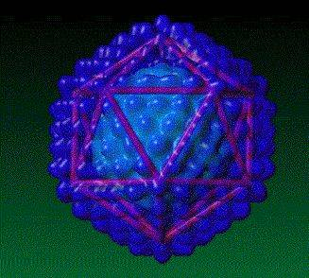
GASTROENTERITIS DUE TO ENTERIC ADENOVIRUS
Notes:
30

Slide 31
Adenovirus Gastroenteritis
Only this is required
Isolated in 1953 by Rowe from adenoidal tissue
Virion:
Icosahedral, non-enveloped,70-90 nm in diameter, 252 capsomeres; fibers project from each other
Composition: DNA (13%), protein (87%)
Genome: Double-stranded DNA, linear, 26-45 kbp, protein-bound to termini, infectious
Proteins: Important antigens (hexon, penton base, fiber) are associated with the major outer capsid proteins
Replication: Nucleus
Virus classification: Group I: ds DNA; Family: Adenoviridae; Genus: Mastadenovirus; Species: Human adenovirus (H Ad)
At least 51 serotypes are known
classified into 6 subgenera: A to F
Notes:
31

Slide 32
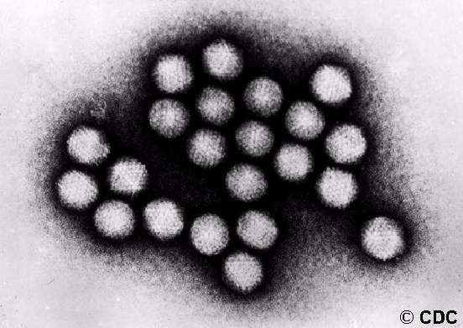
Known oncogenic potential of some serotypes
Commonly used as vectors in gene therapy and vaccine delivery

Slide 33
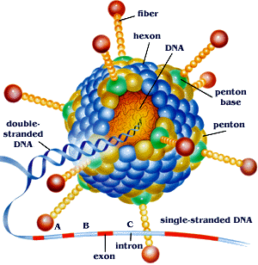
Adenoviral structure
Read only
Outstanding characteristics
Excellent models for molecular & biochemical studies of eukaryotic cell processes; a few models serve as models for cancer induction in animals
Largest viruses (maximum size able to be transported through the endosome)
virion has unique "spike" or fiber associated with each penton base of the capsid that aids in attachment to the host cell via the coxsackie-adenovirus receptor on the surface of the host cell
Adenovirus has tropism for cells of epithelial origin
Replicative cycle is sharply divided into EARLY & LATE events

Slide 34
Adenovirus pathogenesis
Required
Virus replicate in epithelial cells producing cell necrosis and inflammation
After acute infection; the virus may remain in tissues (tonsils, adenoids, peyer’s patches) and become reactivated and shed asymptomatically 6-18 months.
Reactivation enhanced by stressful events
Integration of adenoviral DNA into host cell genome may occur leading to latency in tonsils and peripheral lymphocytes
Some times smudgy intranuclear inclusions may be seen
Notes:
34

Slide 35
Required
Adenovirus infection leads to the following:
Pentons have toxic effects on host cells
Encode a protein in the E3 genomic region that binds class I MHC antigens in the ER which restricts their expression on the surface of infected cells and interfere with recognition and targeting by cytotoxic T cells. (Helps in latency)
E1A protein has been associated with increased susceptibility of infected cells to destruction by TNF and other cytokines.
Adenovirus death protein; important for efficient lysis of infected cells and release of progeny virions.

Slide 36
Diarrhea due to Enteric Adenovirus
Required
Cause 5-15% of all viral gastroenteritis
Belong to serogroup F (Types 40, 41) 38??
Age <4 years
Year round
Spread via fecal-oral route
Isolation requires special media-Graham 29
ELISA for rapid detection is available
Notes:
36

Slide 37
CLINICAL FEATURES - Adenovirus gastroenteritis
Required
Important
Incubation period 3 -10 days
Diarrhea lasts for 10 -14 days
Can also cause intussusception, mesenteric adenitis, appendicitis
Treatment with cidofovir promising for severe disease in immunocompromised
Notes:
37

Slide 38
HUMAN CALICIVIRUSES (HuCV)
Read only
Family Caliciviridae
Non-enveloped RNA viruses with ss [+] sense RNA
27-35 nm in size
Icosahedral capsid
Contains single capsid protein
Resistant to acid, ether and heat
Have not been effectively propagated in cell culture
Notes:
38

Slide 39
HUMAN CALICIVIRUSES

Slide 40
Calicivirus
Only this is required
Norwalk virus and “Norwalk-like”
“Sapporo-like” viruses
Vesivirus
Lagovirus
NLV (Norovirus) round shaped
Norwalk virus
Hawaii virus
Snow Mountain virus
Montgomery county virus
Taunton (England)
SLV (Sapovirus) star shaped
Sapporo virus
Manchester virus
Houston/86
London/92

Slide 41
MORPHOLOGY- typical
Read only
32 cup-like depressions
EM appearance of “Star”
31-35 nm size
E.g.- Sapporo-like viruses
Notes:
41

Slide 42
Morphology of HuCV- atypical
Read only
Smaller size- approx. 27 nm
Rough, feathery surface but no internal pattern
Small Round Structured viruses, e.g.- Norwalk-like viruses
Notes:
42

Slide 43
Norwalk virus
Required
“winter vomiting disease” 1968, Norwalk OH
(sometimes known as winter vomiting bug in the UK)
Causes 40% of nonbacterial epidemics
45% foodborne, 52% shell fish associated outbreaks
Explosive epidemics
camps, cruise ships, nursing homes
Food borne illness
raw shellfish

Slide 44
EPIDEMIOLOGY - Noroviruses
Required
Worldwide distribution
Affects all ages
>23 million cases/year in the U.S.
Major cause of food-borne outbreaks of GE (>50%)
Prevalence of antibodies reach ~50% by the fifth decade.
Asymptomatic infections- seroconversion but asymptomatic shedding of virus
Low infective dose (~10 pfu)
Viral shedding 3-4 days
Mucosal changes revert in ~2 weeks.
Protective immunity short-lived
NLV cross protection?
Notes:
44

Slide 45
Norwalk virus: Clinical Features
Required
24 hour (range 10-50hr) incubation period
Vomiting prominent
Headache, myalgia, fever
Diarrhea 1-3 days, less severe than rotavirus
Treatment symptomatic
rehydration, antidiarrheals
Complications rare
immunocompromised

Slide 46
SPREAD
Required
Person-to-person fecal-oral spread (stool/vomitus)
Fecal contamination of food or water (uncooked shellfish)
Fomites (stool/vomitus)
Ingestion of aerosolized particles
Survive on surfaces for several days
Survive in water chlorinated at routine levels (up to 10 ppm)
Survive freezing, heating up to 60°C (30min)
Evidently survive in steamed shellfish
Notes:
46

Slide 47
DIAGNOSIS
Required
Specimen- stool, vomitus, food, environmental swabs (during outbreak investigations)
RT-PCR in state public health labs.
Serology for epidemiologic purposes
Immune EM is less used
Notes:
47

Slide 48
HUMAN ASTROVIRUS

Slide 49
ASTROVIRUS
Required
Described in relation to an outbreak of gastroenteritis in 1975
Detected by EM
Immunologically distinct from Hu CV
Animal strains are known
Notes:
49

Slide 50
Classification of Astrovirus
Read only
Family Astroviridae
Genus Astrovirus
Human serotypes: HuAstV 1-8
Notes:
50

Slide 51
ASTROVIRUS- structure
Read only
Small ss RNA virus
Non-enveloped
27-32nm in size
Round with an unbroken, smooth surface
EM appearance of a 5 or 6 pointed star within smooth edge
Contain 3 structural proteins
Genome has been sequenced
Notes:
51

Slide 52
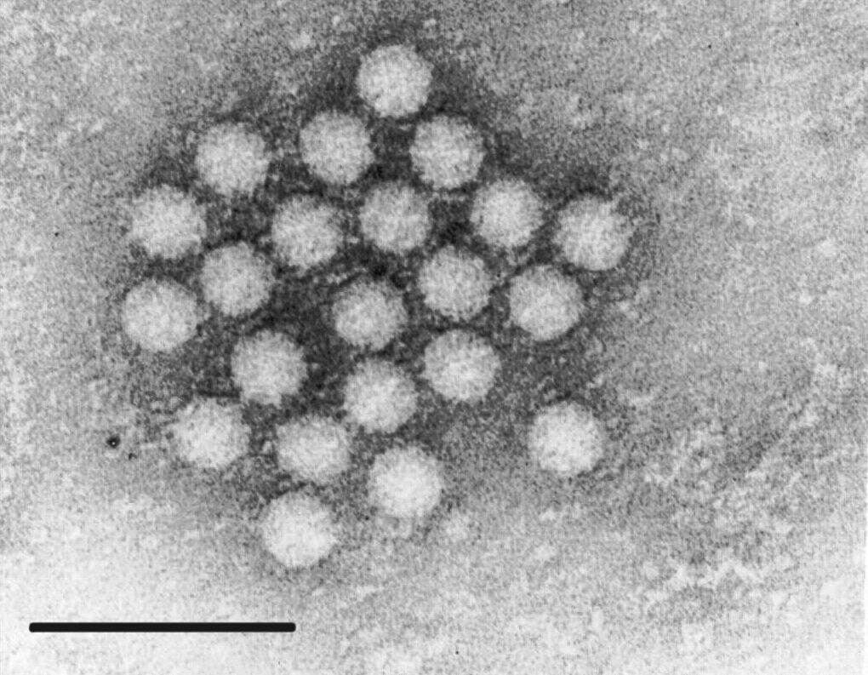
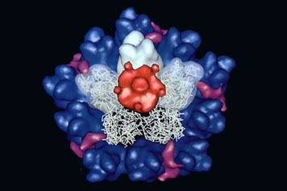
ASTROVIRUS- STRUCTURE
heat stable
acid resistant
Replication cycle not characterized
Notes:
52

Slide 53
ASTROVIRUS - Clinical Features
Required
Infants and children are most often affected
Elderly and immune compromised persons as well
Short incubation period 1-4 days
Nausea, vomiting, abdominal cramping and watery diarrhea
Constitutional symptoms-fever, malaise, headache
Symptoms last 3-4 days
Notes:
53

Slide 54
ASTROVIRUS - Epidemiology
Required
Endemic worldwide
Astroviruses are associated with 5%–9% of cases of gastroenteritis in young children
Mainly in children <7 years of age
Transmission- person-to-person [fecal-oral]
Outbreaks due to fecal contamination of
sea-food or water
Notes:
54

Slide 55
ASTROVIRUS - Diagnosis
Required
EM (virus shed in stool in great numbers)
EIA
RT-PCR
Notes:
55

Slide 56
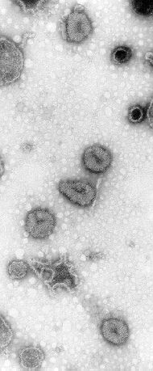
Toroviruses
Required
Family Coronaviridae
Genus Torovirus
They cause gastroenteritis in mammals,
but rarely in humans
Enveloped, ss (+) RNA virus
Core “doughnut-shaped” (torus)
Watery diarrhea in 2 – 12 months old
Diagnosis: EM, ELISA, HI

