Slide 1
Health Care Systems
Dr. Sireen Alkhaldi, BDS, MPH, DrPH
Community Health / First Semester 2014/2015
Department of Family and Community Medicine
Faculty of Medicine/ The University of Jordan

Slide 2
What is a Health Care System?
The term is usually used to refer to the system or program by which health care is made available to the population and financed by government, private enterprise, or both.

Slide 3
Goals of a Health Care System
The goals for health systems, according to the World Health Report (WHO, 2000), are:
Good health (improving health)
Responsiveness to the needs and expectations of the population
Fair financial contribution.
Efficient to achieve the best outcomes possible given available resources and circumstances

Slide 4
Key components of a well functioning health system
Health System Building Blocks
The building blocks alone do not constitute a system, any more than a pile of bricks constitutes a functioning building.
It is the multiple relationships and interactions among the blocks – how one affects and influences the others, and is in turn affected by them – that convert these blocks into a system.

Slide 5
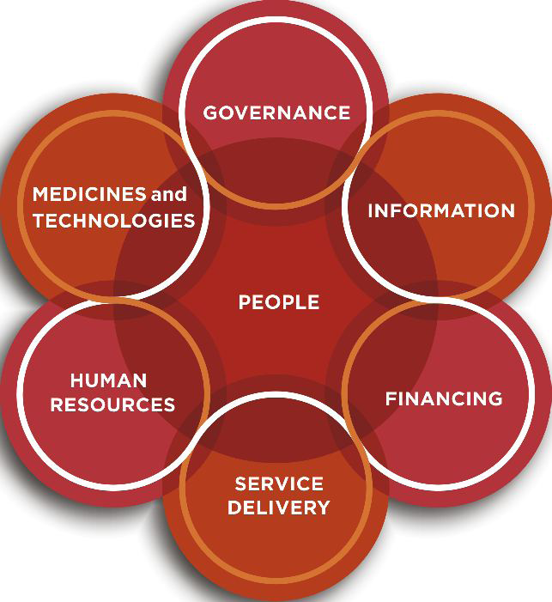
Figure 1.2 The dynamic architecture and interconnectedness of the health system building blocks

Slide 6
Levels of Health Care
One concept is essential to understanding the “topography” of any health care system, is the organization of care into primary, secondary, and tertiary levels.

Slide 7
1. Primary Care:
Primary Care is the usual point at which an individual enters the health care system.
It involves common health problems (eg, sore throat, sprained ankle, or hypertension) and preventive measures (e.g., vaccinations) that account for 80%-90% of visits to a physician or other caregivers.
Its major task is the early detection and prevention of disease. This level of care contains the routine care of individuals with common health problems and chronic illnesses that can be managed in the home or through periodic visits to an outpatient facility.

Slide 8
Primary care, cont.
Care givers at this level are general practitioners (PG’s) who’s main responsibility is ambulatory care.
They can be located in community and neighborhood health centers, hospital outpatient departments, physicians' offices, and school and college health units.

Slide 9
2. Secondary or acute care
It involves problems that require more specialized clinical expertise. Entry into the system at this level is either by direct admission to a health care facility or by referral.
Providers in this level are physicians in specialties such as internal medicine, pediatrics, neurology, psychiatry, obstetrics and gynecology, and general surgery.
Secondary-level physicians are located at hospital-based clinics and they provide care to hospitalized patients.

Slide 10
3. Tertiary Care:
Includes highly specialized technical services for the treatment of rare complex diseases.
Providers of tertiary care are sub-specialists in a particular clinical area such as cardiac surgeons, immunologists, and pediatric hematologists .
They are located at a few tertiary care medical centers and highly specialized units of general hospitals; for example, a coronary care unit.
Entry into the health care system at this level is gained by referral from either the primary or secondary level.

Slide 11
Two contrasting approaches…
Two contrasting approaches can be used to organize a health care system around these levels of care:
(1) The carefully structured regionalized health care (The Dowson Model).
(2) A more free-flowing model.

Slide 12
1. The Highly Structured System (the Dowson model)
It is based on the concept of regionalization:
The Organization and coordination of all health resources and services within a defined area.
This model emphasizes the primary care base. This model is typical for the British National Health Services (NHS), most European countries, and health maintenance organizations (HMO’s) in the United States.

Slide 13
Patient Flow in the Highly Structured System
Patient flow moves in a stepwise fashion across the different levels. Except in emergency situations.
All patients are first seen by GP’s, who may then steer the patients toward more specialized levels of care through a formal process of referral. This is called Gatekeeping.
Patients may not refer themselves to a specialist.
GP’s comprise two-thirds of physicians in the UK.

Slide 14
The Structured Model: Planning with population focus
Planning of physicians and hospital resources occurs with a population focus:
GP groups follow the primary-secondary-tertiary care structure and provide care to a population of 5000-50,000 persons, depending on the number of GP’s in the practice.
District hospitals are local facilities equipped for basic inpatient services, and have a catchment area population of 50,000 – 500,000 persons.
Tertiary care hospitals serve as a referral centers and handle highly specialized inpatient care needs for a population of 500,000 – 5 million persons.

Slide 15
2. The Free-Flowing Model
An alternative model allows for more fluid roles for caregivers, and more free-flowing movement of patients, across all levels of care.
This model tends to place higher value on services at the tertiary care than at the primary care base.
This is a more dispersed, fragmented structure of health care, which is typical for the United States health care system.

Slide 16
The Free-Flowing Model
Insured patients in the United States are traditionally able to refer themselves and enter the system directly at any level.
Instead of having a designated primary care physician (PCP), patients in the US are used to taking their symptoms directly to the specialist they choose.
Physicians in the US have less clear defined roles.
Only 13% of physicians in the US are general or family practitioners.

Slide 17
Which Model is Right?
The structured model is characterized with:
Continuity of care: sustaining a patient-caregiver relationship over time, which is associated with greater use of preventive services (eg, regular source of care results in better control of hypertension and less reliance on emergency care).
Comprehensiveness: the ability of the GP to manage a wide range of health care needs, in contrast to specialty care which focuses on a particular organ.
Coordination: through referral and follow-up, the primary care provider integrates services delivered by other caregivers.
Patient satisfaction and better patient outcomes, as a result of compliance with medications, and reduced hospitalization and decline of overall costs.

Slide 18
Which Model is Right?
The Free-Flowing model is partially blamed for the high cost of health care in the US, and quality of care also suffers.
(eg, when many hospitals perform small numbers of surgical procedures such as coronary artery bypass grafts, mortality rates are higher than when such procedures are regionalized in a few higher-volume canters).
This is due to the less integrated care.
On the other hand, the Free-Flowing model promotes flexibility and convenience in the availability of facilities and personnel. The emphasis on specialization and technology is compatible with values and expectations in the US (patients value direct access to specialists and autonomy in selecting caregivers).

Slide 19
Which Model is Right?
International comparisons of health systems have indicated that nations with greater primary care orientation tend to have more satisfied patients and better performance on health indicators such as infant mortality and life expectancy.
Within the US, states with greater supply of primary care physicians, but not specialists, have lower mortality rates.

Slide 20
