Slide 1
The last lecture. شد الهمة واستعن بالله
Added stuff is italic
Topics: Male reproductive pathology
Testicular neoplasms
Tumors of the prostate

Slide 2
Testicular Neoplasms
- In the 15- to 34-year-old age group, they are the most common tumors of men.
- include:
I. Germ cell tumors : (95%); all are malignant.
II. Sex cord-stromal tumors: from Sertoli or Leydig cells; usually benign.
Extra: Notice that there is no surface epithelium in contrast with ovarian cancer.

Slide 3
Risk factors:
1. whites > blacks.
2. Cryptorchidism
3- to-5 folds risk of cancer in undescended testis, and an increased risk of cancer in the contralateral descended testis.
3. Intersex syndromes
-Androgen insensitivity syndrome (AKA testicular feminization); Gonadal dysgenesis
4. Family history most important risk factor Brothers of males with germ cell tumors have an 8-10-fold increased risk over that of the population
Increased risk in both testicles

Slide 4
5. cancer in one testis markedly increased risk of neoplasia in the contralateral testis.
6. isochromosome of the short arm of chromosome 12, i(12p), found in all germ cell tumors, regardless of histologic type.
7. Most testicular tumors in postpubertal males arise from the in situ lesion intratubular germ cell neoplasia; present in conditions associated with a high risk of developing germ cell tumors (e.g., cryptorchidism, dysgenetic gonads
Remember: an isochromosome is a chromosome that has two copies of one arm and no copies of the other. So i(12p) has 2 short arms of chromosome 12 and no long arm
Intratubular: in seminefrous tubule

Slide 5
Testicular germ cell tumors are subclassified into:
I. Seminomas Best prognosis. Treatment: Radiosensitive
II. Non-seminomatous germ cell tumors(NSGCT)
A group of different types put together because they have similar clinical presentation, tratment and prognosis
Treatment: aggressive chemotherapy
- The histologic appearances may be:
1. Pure (single histologic type; 60%)
2. Mixed (40%). More than one type, Each component changes the prognosis,

Slide 6
I. Seminomas,
- 30-40% of all testicular tumors (most common)
- 40 yr +
- rare in prepubertal children
- progressive painless enlargement of the testis
- histologically identical to ovarian dysgerminomas and to germinomas occurring in the CNS and other extragonadal sites.

Slide 7
MORPHOLOGY
Gross
- soft, well-demarcated tumors
usually without hemorrhage.
Hemorrhage in a testicular mass= malignancy

Slide 8
Now we start with Non-seminomas
Added slide
سلايد مضاف
Numbering starts with 2 since seminomas were the first type

Slide 9
2. Embryonal carcinomas :
ill-defined, invasive masses containing foci of hemorrhage and necrosis
Microscopically
The tumor cells are large and primitive-looking. The cytoplasm is basophilic.
Bad prognosis

Slide 10
3. Yolk sac tumors
the most common primary testicular neoplasm in children younger than 3 yr.
composed of cells forming Microcysts, Lacelike (reticular) patterns.
A distinctive feature is the presence of structures called ***Schiller-Duvall bodies. *Diagnostic
- AFP elevated in serum. So it’s used as a tumor marker

Slide 11
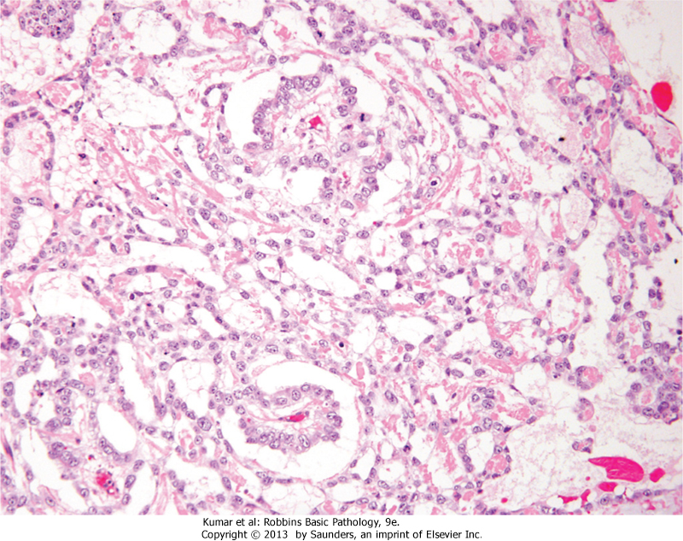
Yolk sac tumor black arrows: Schiller-Duvall bodies.

Slide 12
4. Choriocarcinomas
- trophoblastic cells.(cytotrophoblasts and syncetiotrophoblasts)
- 5%
may be small lesions, even those with extensive systemic metastases
Microscopic examination
composed of sheets of (cytotrophoblasts) irregularly intermingled with large multinucleated cells ( syncytiotrophoblasts).
HCG (secreted by syncytiotrophoblasts) is elevated in serum. Used as a tumor marker
**Charectarestically too hemorrhagic
*If pure: decemal prognosis

Slide 13
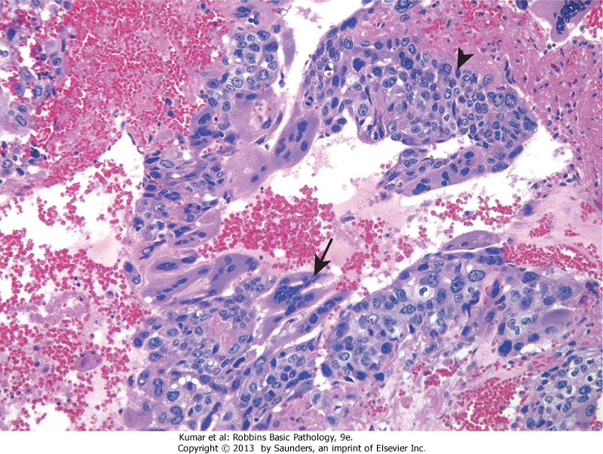
Choriocarcinoma: arrows represents syncytiotrophoblasts

Slide 14
5. Teratomas
- Looks like teratoma of ovary
Pure forms of teratoma are common in infants
and children , being second in frequency only to yolk sac tumors
In adults, teratomas are usually mixed with other types
May be mature or immature

Slide 15
Prognosis:
In prepubertal males, teratomas are typically benign
whereas teratomas in postpubertal males (adults) are malignant, being capable of metastasis
regardless of whether they are composed of mature or immature elements

Slide 16
Teratomas in males/ behavior and prognosis
Added slide
سلايد مضاف
Children (less than 3 yrs) | Mostly pure 2nd most common testicular neoplasm in this age group (secondary to yolk sac tumors)
Prepubertal males | Usually benign behavior
Adults | Usually mixed Poor prognosis Malignant and metastesize
Most common
In adults: Seminomas
In children:
1. Yolk sac tumors
2. Pure teratoma

Slide 17
Clinical Features of all testicular germ cell neoplasms
1- produce a painless testicular mass.
2- Biopsy is associated with risk of tumor spillage (outside the confines of the tumor) (contraindicated), so best to do excision of the scrotal skin in addition to orchiectomy.
So orchiectomy is diagnostic and therapeutic at the same time.

Slide 18
3 - Seminomas and nonseminomatous tumors differ in their behavior and clinical course:
I. Seminomas
-better prognosis (because they tend to be confined to the testis for a long time)
II. Nonseminomatous germ cell neoplasms
- Worse prognosis (metastasize earlier, by lymphatic and hematogenous routes (most common to liver and lungs).

Slide 19
Assay of tumor markers secreted by germ cell
a. These markers are helpful diagnostically and in follow up (response of tumors to therapy):
I. Human chorionic gonadotropin (hCG)
- elevated in choriocarcinoma.
Increased alpha fetoprotein (AFP)
- indicates a yolk sac tumor.
lactate dehydrogenase (LDH)
mainly secreted by the liver not secreted by germ cells, but correlate with the tumor burden in the body and magnitude of metastasis.
Tumor burden is how much destruction of surrounding tissue and metastasis the tumor caused.
So we are not only concerened about whether LDH is high or not but also how much high it is(titer)

Slide 20
Clinical Vinette:
Added slide
سلايد مضاف
A male 30 yrs old with painless testicular mass was evaluated for testicular markers (tumor assay), results are:
high HCG, AFP –ve, LDH –ve
possible diagnosis: Choriocarcinoma
After orchioctomy patient received chemotherapy
For follow-up patient was having the tumor assay
A year later he had high HCG, -ve AFP, high LDH
These results indicate the patient has metastasis

Slide 21
treatment of testicular germ cell neoplasms
I. Seminoma: radiosensitive ; best prognosis (95% of early-stage disease can be cured) (radiotherapy after surgery)
II. nonseminomatous tumors: aggressive chemotherapy
Good rates of complete remission.
-Pure choriocarcinoma carries a dismal prognosis.

Slide 22
Prostate gland pathology

Slide 23
Benign Prostatic Hyperplasia (Nodular Hyperplasia)
- extremely common by 40; frequency rises with age.
androgen-dependent (elevated levels of androgens; relative or absolute are essential for the development of this condition)
proliferation of both stromal and epithelial elements (because it’s benign and not monoclonal but is androgen dependent), with enlargement of gland and, in some cases, urinary obstruction.
does not occur in males castrated (sterilized by removal of the testis) before puberty

Slide 24
symptoms
- only 10% of cases
lower urinary tract obstruction:
(hesitancy- problems starting urine stream;
urgency- sudden, strong urge to urinate,
frequency- needing to urinate more often,
and nocturia- frequent need to urinate at night).
- ↑ risk of urinary tract infections.

Slide 25
Carcinoma of the Prostate
- older than 50 years of age.
- most common form of cancer in men
- significant drop in mortality, due to increased detection of the disease through screening test (like cervical cancer)
Screening: PSA + digital rectal examination
Remember that in the age group between 15- to 34-year germ cell tumors are the most common tumor among men

Slide 26
PATHOGENESIS
1. Androgens.
does not develop in males castrated before puberty.
- Cancers regress in response to surgical (removal of the testis) or chemical (treatment with antiandrogens) castration
So males castrated before puberty do not develop androgen dependent types of pathology

Slide 27
2. Heredity –
↑risk among first-degree relatives of patients with prostate cancer.
3. Environment
- Geographical variations
- diet

Slide 28
4. Acquired somatic mutations
androgen-regulated promoter of the TMPRSS2 gene and the coding sequence of ETS family transcription factors (the most common being ERG).
- TMPRSS2-ETS fusion genes occur in 40% to 50% of prostate cancers

Slide 29
Clinical Features
80% in peripheral glands →Good because:palpable on digital rectal examination.
Bad because: Symptoms appear later because it is distant from the urethra so it doesn’t cause urinary obstruction until very late
elevated serum prostate-specific antigen (PSA) level screening tests. (specific for the prostate)
Bone metastases (axial skeleton) →osteoblastic (bone-producing) lesions on bone scans
Extra: Remember from MSS that most metastatic lesions in bone are osteoclastic

