Slide 1
بسم الله الرحمن الرحيم
الحمد لله رب العالمين والصلاة والسلام على نبينا محمد خاتم الأنبياء وسيد المرسلين وعلى آله وصحبه أجمعين وبعد

Slide 2
Maternal and child health
Maternal and child health (MCH) care is the health service provided to mothers (women in their child bearing age) and children. The targets for MCH are all women in their reproductive age groups, i.e., 15 - 49 years of age, children, school age population and adolescents.

Slide 3
Throughout the world, especially in the developing countries, there is an increasing concern and interest in maternal and child health care.

Slide 4
Learning Objectives MCH
• Understand the importance and role of MCH care
• Outline the objectives of the MCH programs
• Describe major health problems of mothers and children
• Identify the factors that affect the health of mothers and children

Slide 5
• Major causes of maternal and child mortality and prevention
• Recognize the available maternal and child heath services
• Describe the role of these services in preventing maternal and child morbidity and mortality

Slide 6
Objectives of Maternal Child Health Services
1-To reduce morbidity and mortality among mothers and children, through health promotion activities rather than curative interventions.
2-To improve the health of women and children through expanded use of fertility regulation methods, adequate antenatal coverage, and care during and after delivery.

Slide 7
3-To reduce unplanned or unwanted pregnancies through sex education and the wider use of effective contraceptives.
4-To reduce perinatal and neonatal morbidity and mortality.
5-.Promotion of reproductive health and the physical and psychosocial development of the child and adolescent within the family.

Slide 8
6. To reduce the incidence and prevalence of sexually transmitted
infections, in order to reduce the transmission of HIV infection.
7. To reduce the incidence and prevalence of cervical cancer

Slide 9
8. To reduce female genital mutilation and provide appropriate care for
females who have already undergone genital mutilation
9. To reduce domestic and sexual violence and ensure proper management of the victims.

Slide 10
10-To increase political awareness on the need to develop comprehensive intersectoral population policies using all available resources

Slide 11
Justifications for the provision of MCH Care
1-Mothers and children make up over 1/2 of the whole population.
Children < 15 years are = 37.3% of the population
Women in reproductive age (15 – 49) constitute around 20%.

Slide 12
2-Maternal mortality is an adverse outcome of many pregnancies.
3-Miscarriage, induced abortion, and other factors, are causes for over 40 percent of the pregnancies in developing countries to result in complications, illnesses, or permanent disability for the mother or child.

Slide 13
4-About 80 percent of maternal deaths in are directed obstetric deaths. They result "from obstetric complications of the pregnant state (pregnancy, labor, and puerperium), from intervention, omissions, incorrect treatment, or from a chain of events resulting from any of the above.

Slide 14
5- Most pregnant women in the developing world receive insufficient or no prenatal care and deliver without help from appropriately trained health care providers. More than 7 million newborn deaths are believed to result from maternal health problems and their
mismanagement.

Slide 15
6-Poorly timed unwanted pregnancies carry high risks of morbidity and mortality, as well as social and economic costs, particularly to the adolescent and many unwanted pregnancies end in unsafe abortion.
7-Poor maternal health hurts women's productivity, their families‘ welfare, and socio-economic development.

Slide 16
8- Large number of women suffers severe chronic illnesses that can be exacerbated by pregnancy and the mother's weakened immune system and levels of these illnesses are extremely high.
9- Many women suffer pregnancy-related disabilities like uterine prolapse long after delivery due to early marriage and childbearing and high fertility.

Slide 17
10- Nutritional problems are severe among pregnant mothers and 60 to70 percent of pregnant women in developing countries are estimated to be anemic. Women with poor nutritional status are more likely to deliver a low-birth -weight infant.

Slide 18
11- Majority of perinatal deaths are associated with maternal complications, poor management techniques during labour and delivery, and maternal health and nutritional status before and during pregnancy

Slide 19
12-The large majority of pregnancies that end in a maternal death also result in fetal or perinatal death. Among infants who survive the death of the mother, fewer than 10 percent live beyond their first birthday.

Slide 20
13- Ante partum hemorrhage, eclampsia, and other complications are associated with large number of perinatal deaths each year in developing countries plus considerable suffering and poor growth and development for those infants who survive.

Slide 21
14-Physiological changes that the mother and her child pass through
15- More sensitive to the environmental factors changes.

Slide 22
بسم الله الرحمن الرحيم
الحمد لله رب العالمين والصلاة والسلام على نبينا محمد خاتم الأنبياء وسيد المرسلين وعلى آله وصحبه أجمعين وبعد

Slide 23
Content of MCH Care Services and Priorities:
M.C.H. Care at various stages of development: (Services):
Maternal:
Infant and Child.

Slide 24
Maternal Health
Learning Objectives
• Understand the magnitude of maternal health problems / Maternal Morbidity
• Describe the factors that affect the health of mothers
• Describe maternal mortality
• Outline the major causes of maternal mortality
• Understand effects of maternal health on children, family and community

Slide 25
Reproductive Health
Reproductive health care is defined as the constellation of methods, techniques and services that contribute to reproductive health and well-being through preventing and solving reproductive health problems.

Slide 26
It also includes sexual health, the purpose of which is the enhancement of life and personal relations, and not merely counseling and care related to reproduction and sexually transmitted diseases.

Slide 27
Reproductive health as PHC Service
. Reproductive health care in the context of primary health care should include: family-planning counseling, information, education, communication and services;.

Slide 28
education and services for prenatal care, safe delivery, and post-natal care, especially breast-feeding, infant and women's health care; prevention and appropriate treatment of infertility; . .

Slide 29
prevention of abortion and the management of the consequences of abortion; treatment of reproductive tract infections; sexually transmitted diseases and other reproductive health conditions;

Slide 30
and information, education and counseling, as appropriate, on human sexuality, reproductive health and responsible parenthood.

Slide 31
Referral for family-planning services and further diagnosis and treatment for complications of pregnancy, delivery and abortion, infertility, reproductive tract infections, breast cancer and cancers of the reproductive system, sexually transmitted diseases and HIV/AIDS should always be available, as required.

Slide 32
Some indicators of health status of women
1-Maternal Mortality Rate /100,000 (15-49 years death duet Pregnancy , Labor and post partum period)The most sensitive indicator for maternal health..
2- Malnutrition among women in reproductive age group
3-Teen-age pregnancy

Slide 33
4- Low birth weight deliveries (<2.5kg.)
5-Weight gains during pregnancy
Normal ( 8-11 Kg.)
6-% of women visited ANC clinics.
7-% of Labor attended by Medical Staff.
8-% of women receiving family Planning Services.
.

Slide 34
General Consideration
More than 150 million women become pregnant in developing countries each year and an estimated 500,000 of them die from pregnancy-related causes. Maternal health problems are also the causes for more than seven million pregnancies to result in stillbirths or infant deaths within the first week of life.

Slide 35
Maternal death, of a woman in reproductive age, has a further impact by causing grave economic and social hardship for her family and community.

Slide 36
Other than their health problems most women in the developing countries lack access to modern health care services and increases the magnitude of death from preventable problems.

Slide 37
A-Maternal Survices: Essential Health Sector Interventions for Safe Motherhood
SAFE
MOTHERHOOD
Postabortion
Clean/safe Delivery
Family Planning
Antenatal Care
Postpartum Care
Essential Obstetric Care
BASIC HEALTH SERVICES
EQUITY
EMOTIONAL AND PSYCHOLOGICAL SUPPORT
Antenatal Care: Overview
37
Notes:
10/21/2015
37
Essential for any safe motherhood interventions is the understanding that no one intervention can make a difference for maternal morbidity and mortality.
Good antenatal care must be provided within a larger context where equity, emotional and psychological support, and a commitment to provide basic health services are priorities.
Antenatal Care is still a big pillar of Safe Motherhood.
Antenatal services also need to be linked with quality emergency obstetric services, should the woman experience a complication at any time during her pregnancy.
Finally, good safe motherhood services must be part of a continuum of services in which family planning, postabortion care, intrapartum and postpartum care are all provided and support one another.
Department of Reproductive Health and Research

Slide 38
1-Premarital.
2-Preconceptional.
3-Conceptional: Care during pregnancies and labor: A.N.C. (Risky Pregnancy)
4-Delivery Care( Centers, Staff and Equipment’s)
5-Postnatal and Family Planning Services.

Slide 39
Premarital
Family health education
Sexuality and puberty
Marriage and parenthood
Nutrition and weight monitoring.
Avoiding hazards ( smoking, Alcohol,drugs.)

Slide 40
Immunization.
Medical history , past medical history.
STD
Past Menstrual history.
Physical examination.
Genetic Counseling.

Slide 41
Fertility investigation.
Hormonal for females.
Semen analyses for males.

Slide 42
Pre conception
-Past and recent Medical history.
Social history.
Controlling risk factors.
Psychological and social counseling.

Slide 43
Conceptional: Objectives of ANC
Antenatal Care: Overview
43
1-Promote and maintain the physical, mental and social health of mother and baby by providing education on nutrition, personal hygiene and birthing process
2-Detect and manage complications during pregnancy, whether medical, surgical or obstetrical
Notes:
10/21/2015
43
Objectives of ANC:
Promote and maintain the physical, mental and social well-being of both the mother and baby by providing education on danger signals, nutrition, rest, sleep and personal hygiene PLUS the environment of the pregnancy and birth; Keeping normal “normal”
Detect and manage complications, whether medical, surgical or obstetric: current problems, not predictions
Develop birth preparedness plan: who attends, where, communication/transportation, birth attendant, who accompanies, necessary items (blanket/towels, clean plastic cover, clean razor blade, clean setting
Develop complication readiness plan: where, who accompanies, who stays with children, who makes decisions if primary decision-maker not available, potential blood donor, finances, transportation, communication
Help prepare the mother to breastfeed successfully, experience normal puerperium, and take good care of the child physically, psychologically and socially

Slide 44
3-Assess the risk of complications in later
pregnancy, labour or delivery and arrange for a suitable level of care.
4-Develop birth preparedness and complication readiness plan
5-Help prepare mother to breastfeed successfully, experience normal puerperium, and take good care of the child physically, psychologically and socially

Slide 45

What is antenatal care
Antenatal care is a systemic supervision of a women during pregnancy to monitor the progress of foetal growth and to ascertain the well being of the mother and the foetus
A proper antenatal check ups provides necessary care to the mother and to help identify any complications of pregnancy

Slide 46

Why antenatal care is important

Slide 47

Why antenatal care is important
Prevent development of complications
Decrease maternal and infant mortality and morbidity
Remove the stress and worries of the mother regarding the delivery process
Teach the mother about child care, nutrition, sanitation and hygiene
Advice about family planning

Slide 48
Antenatal checks and tests
Weight and height checks
to calculate BMI (body mass index)
urine tests
urine is checked for several things , including protein or albumin
Blood pressure test
Blood tests
ultrasound scan

Slide 49
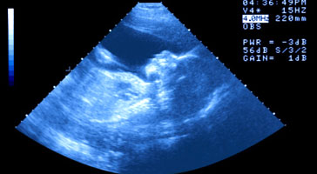
What can an ultrasound scan be used for?
To check the baby size.
To detect abnormalities.
To show the position of the baby and the placenta. For example, when the placenta is low down in late pregnancy, a caesarean section may be advised.
To check that the baby is growing normally
* http://www.nhs.uk/conditions/pregnancy-and-baby/pages/ultrasound-anomaly-baby-scans-pregnant.aspx

Slide 50
The aim of prenatal care is to assess the risk of complications in later
pregnancy, labour or delivery and arrange for a suitable level of care.
Ante natal care can also play a role in identifying danger signs or predicting complications around delivery by screening for risk factors and arranging for appropriate delivery care when indicated.

Slide 51
Pregnancy risk factors that should be considered in ANC :
1-Age under 18 or above 35
2-Ht.( less 150 cm) And Wt. under or over wt.
3-Residency
4-Education
5-Income
6-Parity (Primigravida , More than 6 pregnancies )
7-Twins, Hydrominos ,Pre eclampsia
Notes:
51

Slide 52
8-Past Medical history:
Diabetes, cardiac problem, renal disease etc.
9-Past obstetric history:
• Previous caesarean section, vacuum, or forceps delivery
• Previous perinatal death, stillbirth
• Previous Post partum haemorrhage
• Previous ante partum haemorrhage
Notes:
52

Slide 53
10-General condition of the woman pre-conceptional (Hb level, nutritional, blood pressure and general condition.)
11- Social history : Smoking, Alcohol or any drug therapy , work load, birth attendant, economic status.

Slide 54
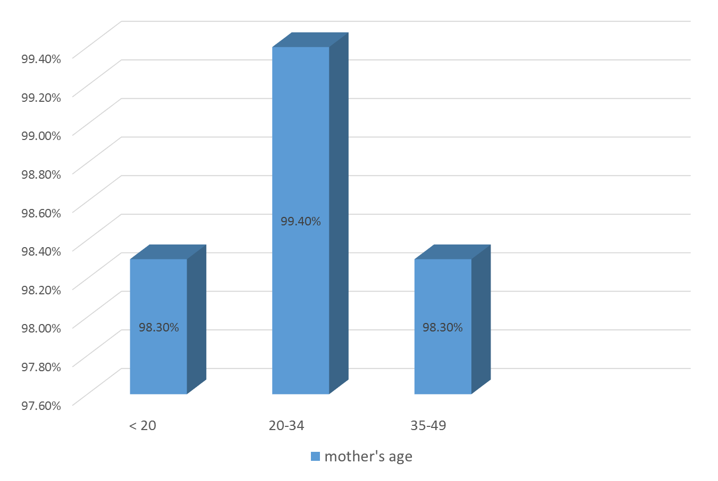
Antenatal care in Jordan (according to mother’s age ) in 2012 JPFHS

Slide 55
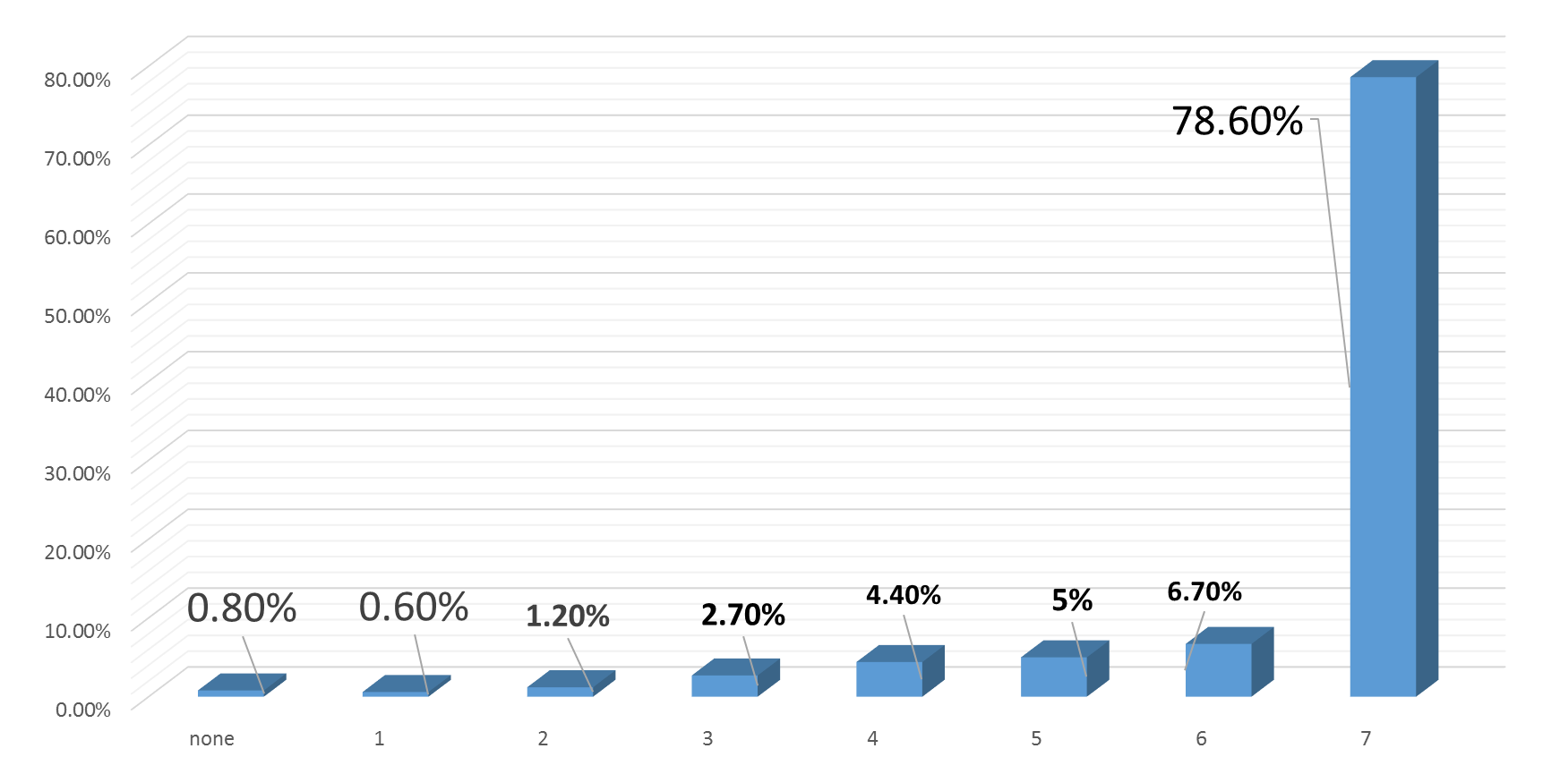
Antenatal care in Jordan( according to number of visits ) in 2012 JPFHS
Number of visits

Slide 56
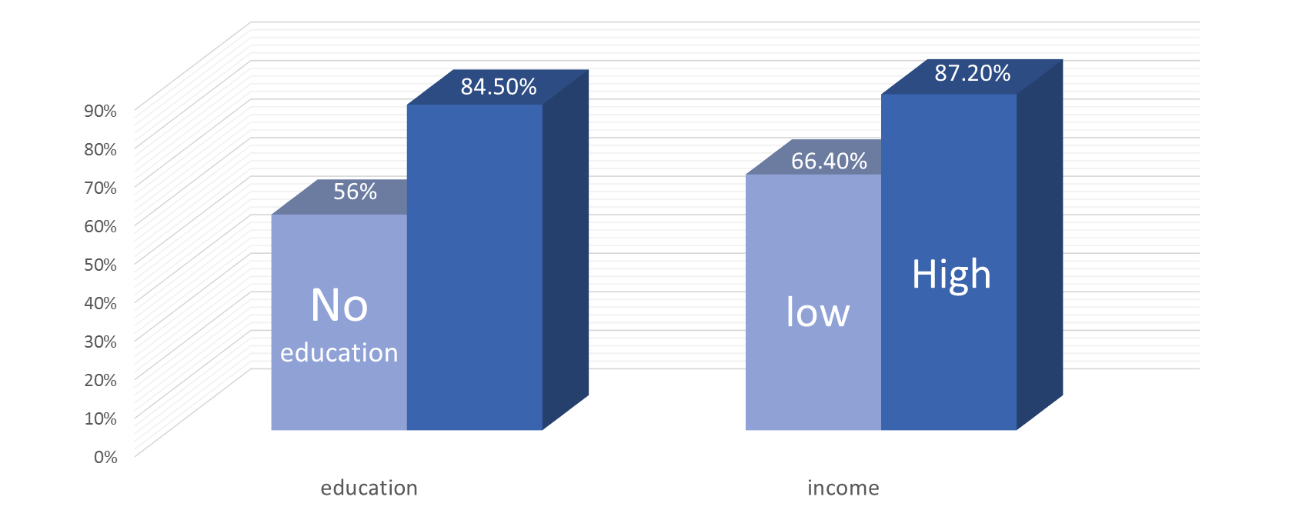
Antenatal care in Jordan in 2012 JPFHS
High

Slide 57

Antenatal care centers should provide programs to seek out women unable or unwilling to attend a clinic and take the services to them, and so attaining a coverage of 100% as we are not far from reaching this number

Slide 58
Antenatal classes in Europe
topics covered by antenatal classes are:
health in pregnancy, including a healthy diet
exercises to keep fit and active during pregnancy
what happens during labour and birth
coping with labour and information about different types of pain relief
relaxation techniques during labour and birth
information about different kinds of birth and interventions
caring for the baby, including feeding
health after birth
"refresher classes" for those who've already had a baby

Slide 59
Antenatal care and pregnancy complications
Problem | Symptoms
Anemia Hb.< 10 | Feel tired or weak Look pale Feel faint Shortness of breath
Gestational diabetes Too high blood sugar levels during pregnancy | Usually, there are no symptoms. Sometimes, extreme thirst, hunger, or fatigue Screening test shows high blood sugar levels
High blood pressure (pregnancy related) High blood pressure that starts after 20 weeks of pregnancy and goes away after birth | High blood pressure without other signs and symptoms of preeclampsia

Slide 60
Miscarriage Pregnancy loss from natural causes before 20 weeks. As many as 20 percent of pregnancies end in miscarriage. Often, miscarriage occurs before a woman even knows she is pregnant | Signs of a miscarriage can include: Vaginal spotting or bleeding* Cramping or abdominal pain Fluid or tissue passing from the vagina * Spotting early in pregnancy doesn't mean miscarriage is certain. Still, contact your doctor right away if you have any bleeding.
Preeclampsia A condition starting after 20 weeks of pregnancy that causes high blood pressure and problems with the kidneys and other organs. Also called toxemia. | High blood pressure Swelling of hands and face Too much protein in urine Stomach pain Blurred vision Dizziness Headaches
Preterm labour – Going into labour before 37 weeks of pregnancy | Increased vaginal discharge Pelvic pressure and cramping Back pain radiating to the abdomen Contractions

Slide 61
• WHAT IS MATERNAL MORBIDITY??
Any departure, subjective or objective, from a state of physiological or psychological maternal well-being; during pregnancy, childbirth and the postpartum period up to 42 days of delivery, related to changes taking place in these periods.

Slide 62
*Most frequently reported maternal morbidities "from the most to the least common“ (taken from WHO's systematic review of maternal mortality and morbidity (2003) that covered all published and unpublished reports on maternal mortality and morbidities from 1997 to 2002)

Slide 63
l.Hypertensive disorders
2.Stillbirth
3.Abortion
4.Hemorrhage
5.Preterm delivery
6.Anemia in pregnancy
7.Diabetes in pregnancy
8.Ectopic pregnancy
9. Perineal tears
10. Uterine rupture
11. Depression
12.0bstructed labour
13. Postpartum sepsis

Slide 64
HYPERTENSIVE DISORDERS OF PREGNANCY
• Chronic hypertension is defined as blood pressure exceeding 140/90 mm Hg before pregnancy or before 20 weeks' gestation. When hypertension first is identified during a woman's pregnancy and she is at less than 20 weeks' gestation, blood pressure elevations usually represent chronic hypertension.

Slide 65
In contrast, new onset of elevated blood pressure readings after 20 weeks' gestation mandates the consideration and exclusion of preeclampsia. Preeclampsia occurs in approximately 5% of all pregnancies, 10% of first pregnancies, and 20-25% of women with a history of chronic hypertension. Hypertensive disorders in pregnancy may cause maternal and fetal morbidity and remain a leading source of maternal mortality.

Slide 66
Although the exact path physiologic mechanism is not clearly understood, preeclampsia can be thought of as a disorder of endothelial function with vasospasm. (Fetal ischemia)
Evidence also indicates that an altered maternal immune response to fetal/placental tissue may contribute to the development of preeclampsia.

Slide 67
RISK FACTORS
Maternal risk factors:
First pregnancy
New partner/paternity
Age younger than 18 years or older than 35 years
History of preeclampsia
Family history of preeclampsia in a first-degree relative
Black race

Slide 68
Medical risk factors:
Chronic hypertension
Secondary causes of chronic hypertension such as hypercortisolism, hyperaldosteronism, pheochromocytoma, or renal artery stenosis
Preexisting diabetes (type 1 or type 2), especially with microvascular disease
Renal disease
Systemic lupus erythematosus
Obesity -

Slide 69
Anemia of pregnancy
• Anaemia is defined during pregnancy as a haemoglobin (Hb) level below 11 Ogr/L (WHO, 1992). During pregnancy, the Hb level is lower than normal, and it varies according to gestational age. Most women with Hb levels below this limit have normal pregnancies. Using the above definition, 20 to 50% of women, and even more in some areas, are considered as anemic.

Slide 70
Anaemia
Anaemia is very prevalent among women in developing countries, as a result of iron and/or folate deficiency and of malaria and other parasitic diseases. WHO estimated that around 60 percent of pregnant women in developing countries (other than China) had nutritional anaemia despite efforts in iron supplementation, fortification and dietary modification?

Slide 71
Anaemia contributes to maternal mortality by making women more susceptible to infection and less able to withstand infection or the effects of haemorrhage. Anaemia is known to give rise to considerable long term morbidity in women, and at extreme levels may be associated with low birth weight.

Slide 72
PATHOPHYSIOLOGIC CAUSES
~ HEMODILUTION: Anemia during pregnancy can be thought of as a physiologic process of hemodilution; i.e. this anemia is relative and is not associated with a total decrease in oxygen carrying capacity.
~ IRON DEFICIENCY is responsible for 95% of anemia of pregnancy.
~ FOLATE DEFICIENC1 due to Increased turnover or requirements of folate can occur during pregnancy - because of the transfer of folate to the fetus- and during lactation; giving rise to Megaloblastic anemia.

Slide 73
RISK FACTORS
Twin or multiple pregnancy
Poor nutrition, especially multiple vitamin deficiencies Smoking, which reduces
absorption of important nutrients Excess alcohol consumption, leading to poor
nutrition Any disorder that reduces absorption of nutrients Use of anticonvulsant medications

Slide 74
EPIDEMOLOGY
Region % of women Hb <11
World 51
Developing 56
Developed 18
Africa 52
Asia (except Japan .. ) 60
Latin America 39
North America 17
Europe 17

Slide 75
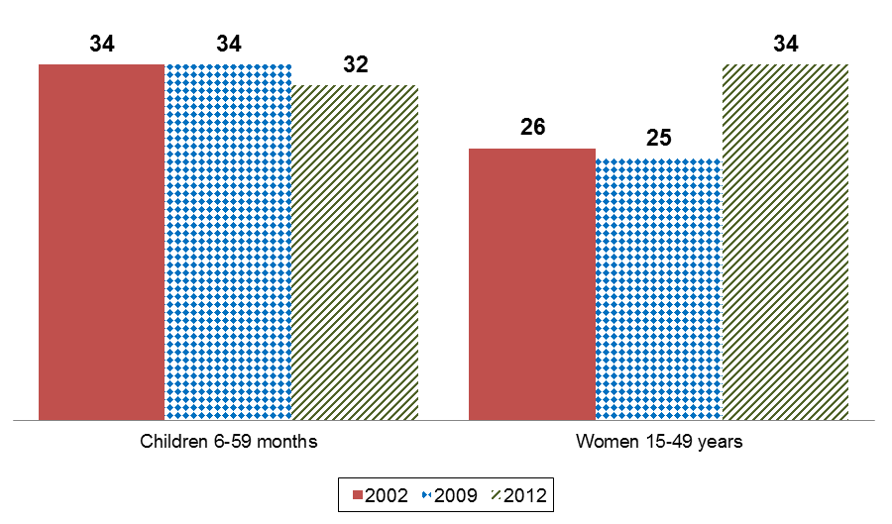
Trends in prevalence of anemia, 2002, 2009 and 2012

Slide 76
Reproductive Tract Infections:
Vulvovaginitis
Endometritis (infection of the uterus)
Pelvic Inflammatory disease (PID) an infection of the upper genital tract

Slide 77
Urinary Tract Infection :
The short urethra & its intimate relationship with the vagina considerably increase the risk of a woman developing UTI.

Slide 78
Symptoms are dysuria, frequency & urgency of micturition It has been estimated that about 20% of women may complain of an episode of dysuria each year.
In over 80% of cases, E. coli is the infecting organism treatment is by antibiotics .

Slide 79
Sexually transmitted diseases:
These are diseases that are transmitted through sexual contact. Can cause pain, infertility & death if not treated .
Each year, there are about 330 million new cases of STD & 1 million case of AIDS in the world .

Slide 80
Examples of STDs:
1) Gonorrhea
2) syphilis
3) chlamydia.
4) genital herpes
5) trichomonas vaginatis

Slide 81
Maternal Morbidity In Jordan
Maternal Morbidity is a challenging social and health issue worldwide. All countries have been
trying to identify and resolve maternal morbidities to promote better maternal health and prevent maternal mortality. The fact that each case of maternal death carries with it at least 16 cases of maternal morbidity makes it an important public health problem..

Slide 82
In developing countries, it is estimated that maternal morbidities are five times greater than that of developed ones. Jordan, which is one of the developing countries has been facing many challenges related to maternal morbidities. Studies on the contributing factors related to maternal morbidities
are very rare

Slide 83
In developing countries, it is estimated that maternal morbidities are five times greater than that of developed ones. Jordan, which is one of the developing countries has been facing many challenges related to maternal morbidities. Studies on the contributing factors related to maternal morbidities
are very rare.

Slide 84
Realizing the importance of such a study, the Higher Population Council, with technical and financial support from UNFPA, initiated an explorative study on maternal morbidities in 2005, and followed up on its recommendation to conduct a more in-depth national
Maternal Morbidity Study covering all governorates and health sectors.

Slide 85
Causes of maternal morbidities in Jordan
Urinary tract infections
Vaginal infections
Anemia
Early bleeding
Hypertension
Gestational diabetes
Pre-eclampsia
Late bleeding
Multiple pregnancy
Kidney diseases
Thyroid disorders
Disseminated intravascular coagulopathy
Heart Disease

Slide 86
Results:
The study main findings indicated that the overall morbidity rate during all current pregnancy,labor, delivery, and post partum, was 60.8%. Morbidities ranged from mild conditions to severe
life threatening complications.
potential confounders using

Slide 87
- The total morbidity rate during current pregnancy was 41.3%.
- A total of 34.5% of women suffered from at least one morbidity during current labor and delivery.
- During current post partum, 18.7% of women suffered from one or more morbidities.

Slide 88
- The rate of cesarean sections was higher in this study (27.7%) compared to previous reports, and also the 2007 Jordan Population and Family Health Survey (18.5%).
- Prevalence rates of anemia (Hb <11 gm/dl) at enrollment and delivery were 20.1% and 26.3%, respectively.

Slide 89
Although still high, these rates are well below previously reported national figures (about 35% in 2002, MOH) and suggest that progress has been achieved in this regard. The national flour fortification with iron and folic acid and the supplementation of pregnant women
with iron and folic acid could among of contributing factors to this decline in anemia.

Slide 90
It should be noted that most cases of anemia were mild anemia which means Hb between 10-12mg/dl with only 5.9% of women having hemoglobin levels less than 10 gm/dl.

Slide 91
- Urinary tract infections (20.2%) and genital infections (19.4%) were the commonest morbidities during current pregnancy.

Slide 92
بسم الله الرحمن الرحيم
الحمد لله رب العالمين والصلاة والسلام علي سيدنا محمد الصادق الوعد الأمين ، اللهم أخرجنا من ظلمات الجهل والوهم ، إلى نور المعرفة والعلم..
10/21/2015
92
Notes:
92

Slide 93
Delivery
3W When, Where and Who
3 c’s
• Clean hands
• Clean delivery service
• Clean cutting of the cord
How :Normal or CS

Slide 94
Maternal Mortality
General Consideration
Maternal mortality is defined as the death of a woman while pregnant or within 42 days of termination of pregnancy irrespective of the site and duration of pregnancy from any acutely related to or aggravated by the pregnancy or its management but not from accidental or incidental causes.

Slide 95
Maternal mortality is the leading cause of death among women of reproductive age in most of the developing world. Globally, an estimated 500,000 women die as a result of pregnancy each year. It is the statistical indicator, which shows the greatest disparity between developed, and developing countries.

Slide 96
Maternal mortality in developing countries is given least attention, despite the, fact that almost all of the suffering and death is preventable with proper management.
Maternal mortality constitutes a small part of the larger maternal morbidity and suffering, because for every maternal death there are a lot of women suffering from acute and chronic illnesses during pregnancy, delivery and 6 weeks after.

Slide 97
Most of the deaths, 99%, are in developing countries the magnitude of
maternal death is very high in Sub-Saharan Africa and South Asia, where
material mortality ratios (material deaths per 100,000 live births) may be
as much as 200 times higher than those in industrial countries.

Slide 98
This is widest disparity in human development indicators yet reported.
This difference is further expressed when comparing lifetime risk of women: one in every 21 women in Africa dies of complications of pregnancy, delivery, or abortion, while with only one in every 10,000 in Northern Europe.

Slide 99
The maternal mortality rate in Western Europe, a century ago, was less than most developing countries.
Poverty, though not a disease in biological sense, it affects maternal health adversely and is reflected by maternal death. The difference in maternal mortality between developed and developing countries strengthen the above fact.

Slide 100
The risk of maternal mortality is also related to the mother’s previous health and nutritional status, issues of gender discrimination, and access to health services. Adolescent pregnancy carries a higher risk due to the danger of incomplete development of the pelvis, and there is a higher prevalence of hypertensive disorders among young mothers. Frequent pregnancies also carry a higher risk of maternal and infant death.

Slide 101
Concern for maternal mortality is not only for the mother’s life. It is related to:
• The health and deaths of the seven million newborns who die annually as a result of maternal health problems and
• The health and socio-economic impact on children, families, and communities.

Slide 102
Causes of Maternal Mortality
Pregnancy and Childbirth-Related Deaths to Women, by Cause, 1997
Note: Total exceeds 100 percent due to rounding.
Source: World Health Organization, Reduction of Maternal Mortality: A Joint WHO/UNFPA/UNICEF/World Bank Statement, Geneva, 1999.
Notes:
Nearly three-quarters of maternal deaths are due to direct complications of pregnancy and childbirth, such as severe bleeding, infection, unsafe abortion, hypertensive disorders (eclampsia), and obstructed labor.
Women also die of indirect causes aggravated by pregnancy, such as malaria, diabetes, hepatitis, and anemia.

Slide 103
Notes on Causes of Maternal Mortality
Nearly three-quarters of maternal deaths are due to direct complications of pregnancy and childbirth, such as severe bleeding, infection, unsafe abortion, hypertensive disorders (eclampsia), and obstructed labor.
Women also die of indirect causes aggravated by pregnancy, such as malaria, diabetes, hepatitis, and anemia.

Slide 104
Maternal Mortality, by Region
Source: UNICEF, Maternal Mortality in 2000: Estimates Developed by WHO, UNICEF, and UNFPA, 2003.
Notes:
Over 99 percent of maternal deaths occur in less developed countries, particularly in Asia and Africa.
While high-quality, accessible health care has made maternal death a rare event in more developed countries, the lack of such health care has fatal consequences for pregnant women in less developed countries.

Slide 105
Notes on Maternal Mortality, by Region
Over 99 percent of maternal deaths occur in less developed countries, particularly in Asia and Africa.

Slide 106
While high-quality, accessible health care has made maternal death a rare event in more developed countries, the lack of such health care has fatal consequences for pregnant women in less developed countries.

Slide 107
Maternal Mortality in Jordan
1990-2008 WHO, UNICEF, UNFPA, WB
( SEP, 2010)
Notes:
107

Slide 108
Improve maternal health
Targets and Indicators
Target 5a: Reduce by three quarters the maternal mortality ratio
5.1 Maternal mortality ratio
5.2 Proportion of births attended by skilled health personnel
Target 5b: Achieve, by 2015, universal access to reproductive health
5.3 Contraceptive prevalence rate
5.4 Adolescent birth rate
5.5 Antenatal care coverage (at least one visit and at least four visits)
5.6 Unmet need for family planning
Notes:
108

Slide 109
Millennium development goal 5 (MDG5) Target 5A
Calls for the reduction of maternal mortality rate (MMR) by three quarters between 2000 and 2015
Notes:
109

Slide 110
What does that mean for Jordan?
Reduction of MMR from 41 maternal death per 100,000 live births in 2000
To
12/100,000 by the year 2015
Notes:
110

Slide 111
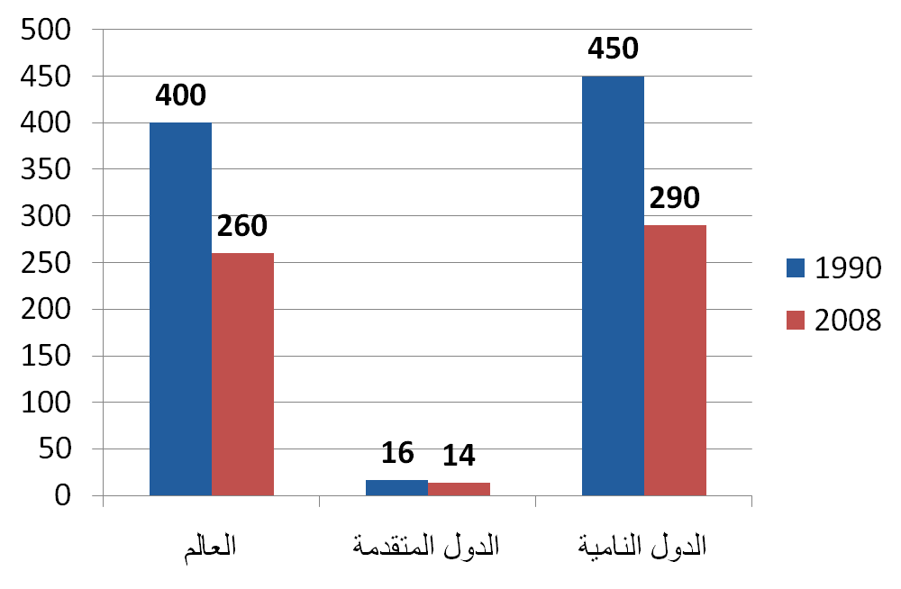
اتجاهات معدل وفيات الأمهات عالميا
Maternal death per 100000 live birth
Trends in Maternal Mortality 1990-2008 WHO, UNICEF, UNFPA, WB
( SEP, 2010)
Notes:
111

Slide 112
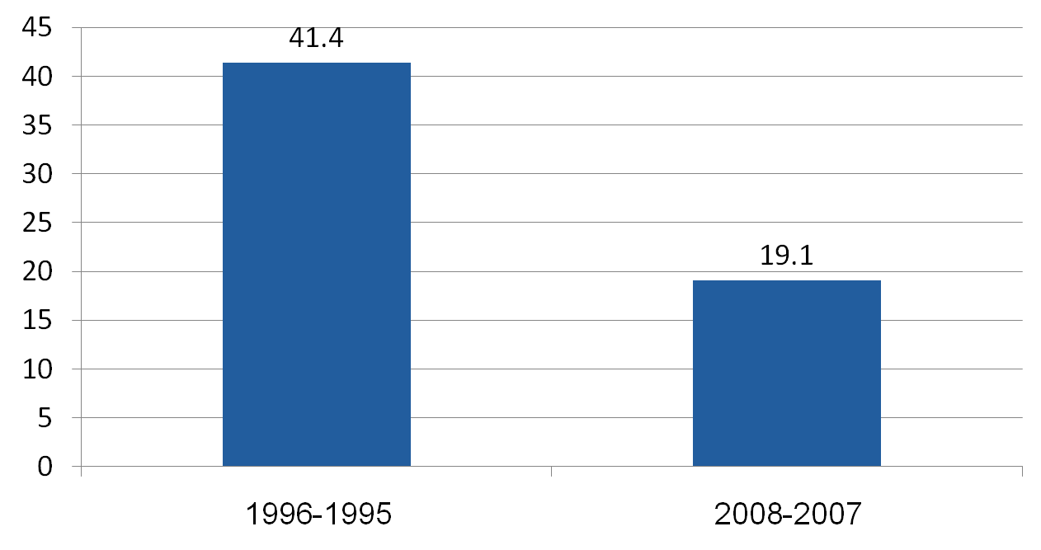
معدل وفيات الأمهات في الأردن
Maternal death per 100000 live birth
Maternal Mortality Study – Jordan 2007-2008- Higher Population Council, 2009
Notes:
112

Slide 113
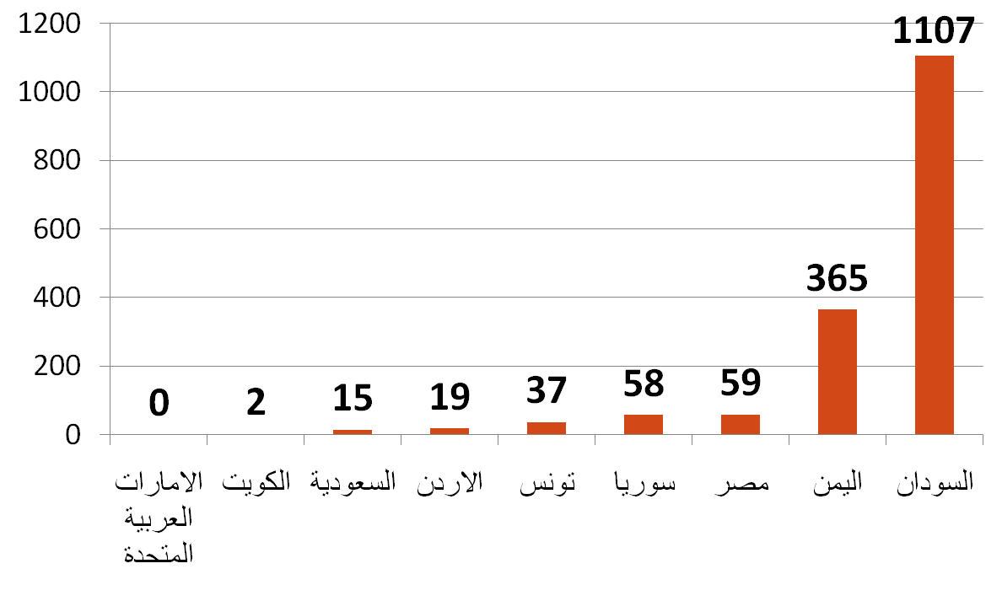
وفيات الأمهات في الأردن مقارنة بالدول العربية
Maternal death per 100000 live birth
Notes:
113

Slide 114
Causes of Maternal Mortality
Haemaorrage
25%
Thromoboembolism
Septisemia
Notes:
114

Slide 115
أسباب وفيات الأمهات في الأردن(2007-2008)
(الاسباب غير المباشرة)
الاسباب غير المباشرة | 26.3%
امراض القلب | 10.5%
امراض الجهاز العصبي المركزي: الحوادث الوعائية الدماغية،الصرع | 7.9%
الامراض السارية | 5.2%
فقر الدم المزمن | 1.3%
الفشل الكلوي | 1.3%
المصدر:الدراسة الوطنية لوفيات الامهات في الاردن(2007-2008)،المجلس الاعلى للسكان،2009
Notes:
115

Slide 116
بسم الله الرحمن الرحيم
الحمد لله رب العالمين والصلاة والسلام علي سيدنا محمد الصادق الوعد الأمين ، اللهم أخرجنا من ظلمات الجهل والوهم ، إلى نور المعرفة والعلم..
10/21/2015
116
Notes:
116

Slide 117
Post Natal
• Observe physical status
• Advise, and support on breast-feeding
• Provide emotional and psychological support.
• Health education on weaning and food preparation.
• Advise on Family Planning

Slide 118
Family Planning Services
Dr. Samar Sharif
MD. MPH.
Community and Family Medicine Department.
Medical School
University of Jordan

Slide 119

What is family planning?
Family planning services are defined as "educational, comprehensive medical or social activities which enable individuals, including minors, to determine freely the number and spacing of their children and to select the means by which this may be achieved. [1] WHO website
US Dept. of Health, Administration for children and families(2012)
Notes:
119

Slide 120
Goals of Family Planning services
10/21/2015
120
1- Enable women and men to limit family size
2- It safeguards individual health and rights
3- Preserves our planet’s resources
4- Improves the quality of life for individual women, their partners, and their children
Notes:
120

Slide 121
10/21/2015
121
5- Prevent unwanted or risky pregnancies
6- Decreases incidence of congenital abnormalities
7- Decreases Maternal and infant mortality rates
8- Control the world population size
9- Improves all aspects of life standers economical , educational, and health psychological
Notes:
121

Slide 122
Counseling
10/21/2015
122
GREAT
a) Great
b) Reassure
c) Explain
d) Answer
e) Therapy.
Notes:
122

Slide 123
Counseling
10/21/2015
123
Choosing a birth control method is an important decision . Some of the things you might want to consider when choosing a method are :
1- Personal consideration
2- Effectiveness
3- Safety
4- Cost
Notes:
123

Slide 124
Counseling on Family Planning:
1) A detailed history
2) Information on all available methods
3) All practical points related to the use of the selected method must be discussed in detail
10/21/2015
Notes:
124

Slide 125
Contraceptive efficiency:
It is the measurement of unplanned pregnancies even after the use of contraceptive measures.

Slide 126
Contraceptive Methods:
10/21/2015
126
1-Traditional or Natural Methods
a-Abstinence : not having sexual intercourse
b-Withdrawal ( Coitus interrupts ): pulling out
c-Fertility Awareness Method (FAM) : basal body temperature (BBT) .
d-Safe period.
Notes:
126

Slide 127
Traditional Methods
d) Breast Feeding
LAM (Lactation Amenorrhea Method).
- Risk of pregnancy is 1.8% at the end of 6 months after delivery in women who exclusively breast-feed & who have not yet started to menstruate.
- Cheap method
- No side effects
- Many other advantages of breast feeding.
10/21/2015
127
Notes:
127

Slide 128
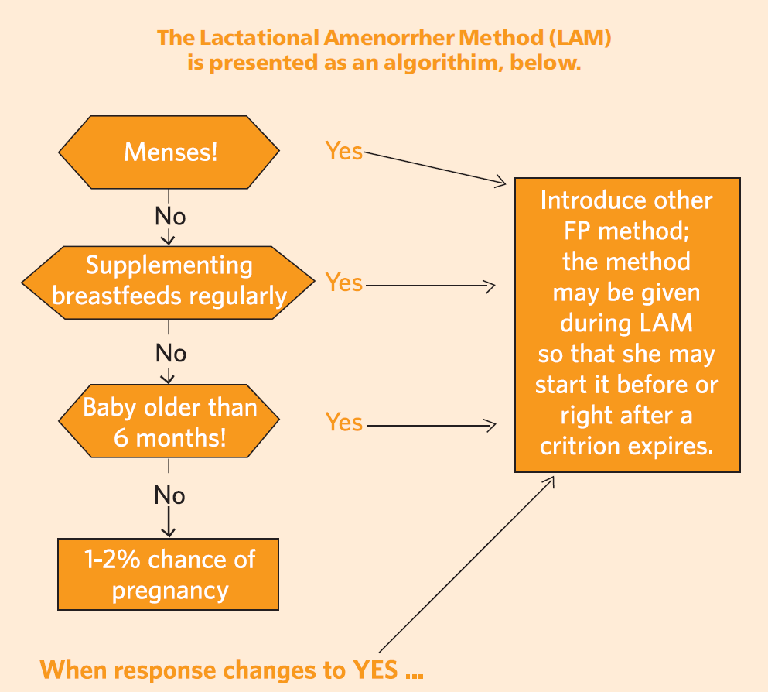
Lactational Amenorrhea Method Algorithm
10/21/2015
128

Slide 129
Abstinence : Safe Period
10/21/2015
129
Drawbacks:
Irregular cycle so difficult to predict
Only for educated and responsible couples
Programmed Sex
High Failure rate

Slide 130
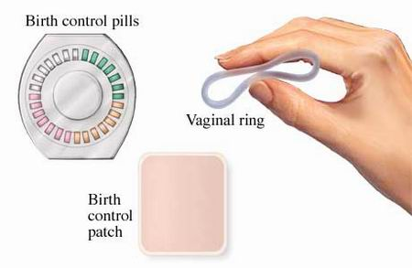
2-Hormonal methods
10/21/2015
130

Slide 131
Classification of hormonal contraceptives
Hormonal contraceptives
Oral Pills
Combined pills
Progesterone only pills (POP)
Depot Preparations
Injectables
Once – a – month (long acting) pills
Male pill
Subdermal Implants
Vaginal Rings
10/21/2015
131

Slide 132

Oral Contraceptives
10/21/2015
132

Slide 133
Combined pills
Composition:
In early 1960s –
    Oestrogen - 100-200µg and
    Progesterone - 10mg
Greater side effects
Nowadays
    Oestrogen - 30-35µg and
    Progesterone - 0.05-0.15mg.
Taken from 5th to 25th day of menstrual cycle, followed by a break of 7 days (withdrawal bleeding).
Failure rate: 0.1
10/21/2015
133

Slide 134
Mechanism of action:
Prevents ovulation
Prevents implantation
Makes cervical secretions thick
Effectiveness
100% effective if taken correctly.
10/21/2015
134

Slide 135
Untoward Effects with Combination Oral Contraceptives
  Cardiovascular effects
  hypertension in 5% users
  myocardial infarction
  Stroke ; ischemic or haemorrhagic
  DVT’s especially smokers >35, overweight and sedentary
  Cancers (increase risk of)
  breast
  hepatocellular
  cervical
  Endocrine and metabolic effect, impaires glucose tolerance and responses to glucose challenge
  Breast tenderness, Weight gain, Headache and migraine

Slide 136
Contraindications to OCP Use
Absolute Contraindications
  Cancer of breast and Genitals
  H/O venous thromboembolism
  Vascular disease- CAD or CVD
  Liver disease ( i.e. Viral hepatitis, cirrhosis)
  Pregnancy
  Congenital hyperlipidaemia
    Relative Contraindications
  Age above 40 yrs.
  Smoking and age above 35 yrs
  HTN with SBP>160, DBP>99
  Chronic renal diseases
  Epilepsy , Migraine
  Hyperlipidemia LDL>160
  DM with secondary complications
  Infrequent bleeding, Amenorrhoea.
10/21/2015
136

Slide 137
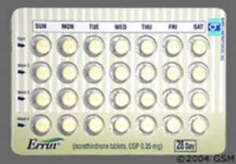
Progesterone only pills
Minipill or Micropill.
Composition:
Low dosage of progesterone, mainly Norgestrel 0.075mg
Dosage:
One tab daily throughout the menstrual cycle
It is mainly given in older women in whom combined pills are C/I as in CVDs
Efficacy 96-98%
Failure rate:0.5/HWY
10/21/2015
137

Slide 138
Pop (contd...)
Mechanism of action:
Makes cervical mucosa thick – action starts in 2-4 hrs last for 24hrs.
Decreases the motility of Fallopian tubes.
Prevent pregnancy without preventing ovulation, as ovulation occurs in 20-30% women.
Suitable for
  Lactating women
  Smokers above 35 yrs old
  Estrogen sensitive women
Disadvantages:
Higher risk of neoplasia in women taking POP than in women on Combined Pills
Poor control of cycle.
10/21/2015
138

Slide 139





Post coital pills
Morning after pills
types.
Levonorgestrel only , combined form,mifepristone.
Dosage:
1st tab within 72hrs of intercourse
2nd tab after 12 hrs of 1st tab
In WHO multicentric randomized trial- within 120 hours of exposure to unprotected sex, a single dose of LNG 1.5 mg is as effective as 2 doses given 12 hours apart.
Indications:
Contraceptive failure
Rape
Unprotected intercourse.
Failure Rate: 2/HWY
10/21/2015
139

Slide 140

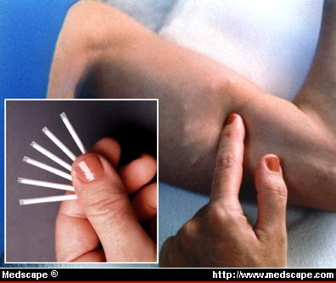
Depot preparations
10/21/2015
140

Slide 141
Injectable
Subdermal implants
Vaginal rings
Depot preparations
10/21/2015
141

Slide 142
10/21/2015
142
Side effects:
Disruption of normal menses
Amenorrhoea
Contraindications:
Breast cancer
Genital cancer
Undiagnosed uterine bleeding
Suspected malignancy
Lactating women
Failure rate: 0.3/HWY

Slide 143
Terminal methods
Terminal methods
Male sterlisation
Vasectomy
No scalpel vas occlusion
Female sterlisation
Tubectomy
Laparoscopic occlusion
Tubal inserts (no incision)
10/21/2015
143

Slide 144
Failure Rate: 0.15/HWY (due to mistaken identification of vas)
COMPLICATIONS:
Operative
Sperm granules
Spontaneous recanalisation
Autoimmune response
Psychological response
10/21/2015
144

Slide 145
Mechanical Methods
Intrauterine Device:
Plastic T – shaped piece, covered with copper, inserted in the uterus
Efficacy rate: 1/100 women/year
ADVANTAGES OF IUDs:
Safe, Effective, Reversible
Inexpensive
High continuation rate
DISADVANTAGES OF IUDs:
Heavy bleeding and pain
Pelvic Inflammatory diseases
Ectopic pregnancy
May come out accidently if not properly inserted
10/21/2015
145
Notes:
145

Slide 146
IDEAL IUD CANDIDATE:
Who has borne at least 1 child
Has no history of PID
Has normal menstrual periods
Is willing to check IUD tail
Has an access to follow up and treatment of potential problems
Is in monogamous relationship

Slide 147

Condoms:
Rubber pouches which prevent the ejaculation from
reaching the vagina
No side effects whatsoever
Effective in prevention of STD transmission
Does not affect lactation
Contraindicated in cases of sensitivity to latex DISADVANTAGE:
Chances of slip off and tear off
Failure rate: 2-3%
10/21/2015
147
Notes:
147

Slide 148
Why Family planning is needed In Jordan ?
Before the start of family planning services in the late of 1970 ‘s , Jordan was considered one of the world’s fastest growing young population.in addition , Jordan suffers from a severely limited financial, energy, water, and other natural resources, the Government of Jordan (GOJ) recognizes that population increase hinders further socioeconomic progress.

Slide 149
Therefore the GOJ has set the goal of reducing the 2009 fertility rate of 3.8 children per woman to less than 3 children per woman in 2020 by promoting Family planning in Jordan .

Slide 150
Family Planning in Jordan
10/21/2015
150
At current fertility levels JPFHS (Jordan Population and Family Health Survey) 2012, a woman in Jordan will have an average of 3.5 children – a total fertility rate that is 50 percent lower than the rate recorded in 1976 ( 7.4 children per woman)
Notes:
150

Slide 151
10/21/2015
151
Effective family planning is increasingly seen as an important part of Jordan's overall development strategy.
In contrast to several years ago, such programs are openly discussed and rarely encounter public opposition.
Notes:
151

Slide 152
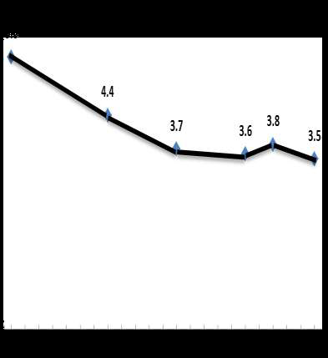
Fertility Rates in Jordan:
The figure shows the overall fertility rates in Jordan from 1990(5.6)-2012(3.5).

Slide 153
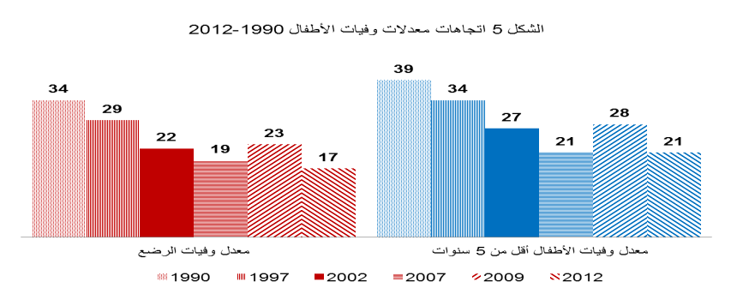
Decrease of infant and child mortality/1000 live birth with decrease of fertility rate

Slide 154
Its obvious how the rapid the fertility rate decreased from 5.6 in 1990 to 3.7 in 2002. and then the fertility rate is fluctuating between 3.5 and 3.8 between 2002 and 2012.
Family Planning had a great role in controlling and decreasing fertility rates during this period.

Slide 155
Family planning in Jordan:
Jordan is one of the most modern countries of the Middle East with a population that has grown from 2.1 million to reach 6.3 million in 2012.
Fertility declines in Jordan have contributed to a slowing down in the population growth rate from 3.2 % in the second half of 1990, to 2.3 % 2007, to 2.2 in 2012.

Slide 156
The high rates of growth have been due to the influx of immigrants to the east bank from the west bank, the inflow of large numbers of foreign workers, and the return of about 300,000 Jordanians from the gulf area as a result of the 1990 gulf war.
The rapid increase in the population has created several problems for the country such as food shortage , water, housing and employment.

Slide 157
Birth Control and Current Use of Contraceptives:
The level of current use of contraception is one of the indicators most frequently used to assess the success of family planning activities.

Slide 158
Overall, use of any method among currently married women has increased substantially in the last two decades—Contraception Prevalence Rate:
40% of women in the 1990 JPFHS survey
53% in the 1997 JPFHS,
56% in the 2002 JPFHS,
57%in the 2007 JPFHS
59% in the 2009 JPFHS
and 61% in the 2012 JPFHS
*JPFHS : Jordan Population and Family Health Survey.

Slide 159
Results from the 2012 JPFHS indicate that 61% of currently married women are using a contraceptive method;
42% are using modern methods
19% are using traditional methods.

Slide 160
The IUD is the most widely adopted modern method (21 %), followed by the pill and male condom (8% each), female sterilization (2%), and LAM and injectables (1% each).
Less than 1 % of women rely on other modern methods.
Withdrawal (14%) and rhythm (4%) are the most common traditional methods.

Slide 161
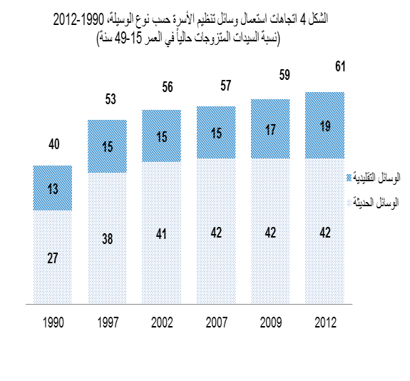

Slide 162
The sources of contraceptive methods also vary by the method used:
Pharmacies are the primary source for users of methods that require resupply, including the pill (35 %) and condoms (39 %).
Private hospitals and clinics are the primary source for IUDs (22 %), followed by government health centers and JAFPP(Jordanian Association of Family Planning and Protection (19 % each).

Slide 163
Government hospitals are the primary source for most female sterilizations (54 %), followed by the Royal Medical Services (24 %) and private hospitals (20 %).
Government health centers are the major source of injectables (63 %), followed by government maternal and child health (MCH) centers (18 %).
[4] department of statistics (year book of 2012)

Slide 164
Comparison between Jordan and the other Regional Countries
Country | Jordan | Egypt | Lebanon | Saudi Arabia | India
TFR | 3.2 | 3.1 | 1.60 | 2.78 | 2.50
Table 1 The fertility rare

Slide 165
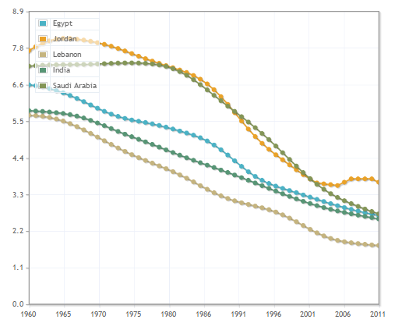
Fig 1 shows fertility rate in ( Jordan , Egypt , India ,Lebanon and Saudi Arabia from 1960’s till 2011

Slide 166
References
Contraceptive Updates, Reference Manual for Doctors 2009, by MOHFW & UNFPA,India.
WHO - Medical eligibility criteria for contraceptive use – 4th ed 2009.
WHO, Family Planning A GLOBAL HANDBOOK FOR PROVIDERS Update 2011
“Guidelines for administration of emergency contraceptive pills by medical officers,” Research Studies and Standard Division, Department of Family Welfare, Government of India, June 2009.
The essentials of Contraceptive Technology, a handbook for clinic staff, John Hopkins Population Information Program, 2010
Projestin Only Injectables: Fact Sheet. UNFPA India, 2004
Guidelines for IUDs for medical officers, research studies and standard division, Department of Family Welfare, Government of India - June 2007
10/21/2015
166

Slide 167
References contd…
Westhoff C, Heartwell S, Edwards S. Initiation of Oral Contraceptives Using a Quick Start Compared With a Conventional Start: A Randomized Controlled TrialObstet Gynecol. 2007 Jun;109(6):1270-1276.
Jick SS et al. Risk of non fatal VTE in women using a contraceptive transdermal patch and oral contraceptives containing 35 mcg EE and norgestimate. Contraception 2006;73(3):223-8.
Sheng J et al. The LNG-IUS study on adenomyosis: a 3–year follow-up study on the efficacy and side effects of the use of levonorgestrel intrauterine system for the treatment of dysmenorrhea associated with adenomyosis. Contraception. 2009 Mar;79(3):189-93.
Grimes DA et al. Cochrane systematic reviews of IUD trials: lessons learned. Contraception. 2007 Jun;75(6 Suppl):S55-9.
Lethaby AE et al. Progesterone or progestogen-releasing intrauterine systems for heavy menstrual bleeding. Cochrane Database Syst Rev. 2005 Oct 19;(4)
K.Park, Text book of preventive and social medicine,contraceptive methods pp.457-474,21st edition,Bhanot publication,Jabalpur, India.
Jordan Population and Family Health Survey 1012.
10/21/2015
167

Slide 168

Thank you!!!
10/21/2015
168

Slide 169

تم بحمد الله

