Slide 1
Millinium Developement Goals (MDGs) & Sustainable Developement Goals (SDGs)

Slide 2
MDG – brief background
189 (193/244) UN member states and 23 international organizations signed the United Nations Millennium Declaration.
These nations agreed to achieve 8 goals by 2015 to eliminate extreme poverty.
Millennium Development Goals
Notes:
There has been numerous inputs to the agenda, notably a set of Sustainable Development Goals (SDGs) proposed by an open working group of the General Assembly, the report of an intergovernmental committee of experts on sustainable development financing, GA dialogues on technology facilitation and many others.

Slide 3
A global compact: The Millennium Development Goals
The Millennium Development Goals are time-bound and measurable goals and targets to be achieved between 1990 and 2015, they include:
halving extreme poverty and hunger
achieving universal primary education
promoting gender equality
reducing under-five mortality by two-thirds
reducing maternal mortality by three-quarters
reversing the spread of HIV/AIDS, malaria and TB
ensuring environmental sustainability
developing a global partnership for development, with targets for aid, trade and debt relief

Slide 5
Eradicate extreme poverty and hunger
Target 1.A: Halve, between 1990 and 2015, the proportion of people whose income is less than $1.25 a day
Target 1.B: Achieve full and productive employment and decent work for all, including women and young people
Target 1.C: Halve, between 1990 and 2015, the proportion of people who suffer from hunger
Notes:
1a - The target of reducing extreme poverty rates by half was met five years ahead of the 2015 deadline.
The global poverty rate at $1.25 a day fell in 2010 to less than half the 1990 rate. 700 million fewer people lived in conditions of extreme poverty in 2010 than in 1990. However, at the global level 1.2 billion people are still living in extreme poverty.
1b – Globally, 384 million workers lived below the $1.25 a day poverty line in 2011—a reduction of 294 million since 2001.
The gender gap in employment persists, with a 24.8 percentage point difference between men and women in the employment-to-population ratio in 2012.
1c - The hunger reduction target should be almost met by 2015.
Globally, about 842 million people are estimated to be undernourished.
More than 99 million children under age five are still undernourished and underweight.

Slide 7
Achieve universal primary education
Target 2.A: Ensure that, by 2015, children everywhere, boys and girls alike, will be able to complete a full course of primary schooling
Notes:
Enrolment in primary education in developing regions reached 90 per cent in 2010, up from 82 per cent in 1999, which means more kids than ever are attending primary school.
In 2011, 57 million children of primary school age were out of school.
Even as countries with the toughest challenges have made large strides, progress on primary school enrolment has slowed. One in ten children of primary school age was still out of school in 2012.
Gender gaps in youth literacy rates are also narrowing. Globally, 781 million adults and 126 million youth (aged 15 to 24) worldwide lack basic reading and writing skills, and more than 60 per cent of them are women.

Slide 8
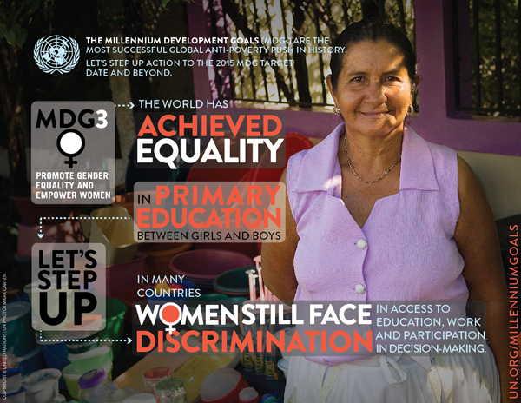

Slide 9
Promote gender equality and empower women
Target 3.A: Eliminate gender disparity in primary and secondary education, preferably by 2005, and in all levels of education no later than 2015
Notes:
The world has achieved equality in primary education between girls and boys, but few countries have achieved that target at all levels of education.
The political participation of women keeps increasing. In January 2014, in 46 countries more than 30 per cent of members of parliament in at least one chamber were women.
In many countries, gender inequality persists and women continue to face discrimination in access to education, work and economic assets, and participation in government. For example, in every developing region, women tend to hold less secure jobs than men, with fewer social benefits.
Violence against women continues to undermine efforts to reach all goals.
Poverty is a major barrier to secondary education, especially among older girls.
Women are largely relegated to more vulnerable forms of employment.

Slide 10
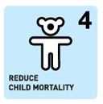

Slide 11
Reduce child mortality
Target 4.A: Reduce by two thirds, between 1990 and 2015, the under-five mortality rate
Notes:
Despite population growth, the number of deaths in children under five worldwide declined from 12.6 million in 1990 to 6.6 million in 2012, which translates into about 17,000 fewer children dying each day.
Since 2000, measles vaccines have averted over 14 million deaths.
Despite determined global progress in reducing child deaths, an increasing proportion of child deaths are in sub-Saharan Africa and Southern Asia. Four out of every five deaths of children under age five occur in these regions.
As the rate of under-five deaths overall declines, the proportion that occurs during the first month after birth is increasing.
Children born into poverty are almost twice as likely to die before the age of five as those from wealthier families.
Children of educated mothers—even mothers with only primary schooling—are more likely to survive than children of mothers with no education.

Slide 13
Improve maternal health
Target 5.A: Reduce by three quarters, between 1990 and 2015, the maternal mortality ratio
Target 5.B: Achieve, by 2015, universal access to reproductive health
Notes:
5a - The maternal mortality ratio dropped by 45 per cent between 1990 and 2013, from 380 to 210 deaths per 100,000 live births. All regions have made progress but accelerated interventions are required in order meet the target.
In Eastern Asia, Northern Africa and Southern Asia, maternal mortality has declined by around two-thirds.
The proportion of deliveries in developing regions attended by skilled health personnel rose from 56 in 1990 to 68 per cent in 2012.
The maternal mortality ratio in developing regions is still 14 times higher than in the developed regions.
The rural-urban gap in skilled care during childbirth has narrowed.
5b - More women are receiving antenatal care. In developing regions, antenatal care increased from 65 per cent in 1990 to 83 per cent in 2012.
Only half of women in developing regions receive the recommended amount of health care they need.
Fewer teens are having children in most developing regions, but progress has slowed.
The large increase in contraceptive use in the 1990s was not matched in the 2000s.
The need for family planning is slowly being met for more women, but demand is increasing at a rapid pace.
Official Development Assistance for reproductive health care and family planning remains low.

Slide 14
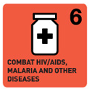

Slide 15
Combat HIV/AIDS, malaria and other diseases
Target 6.A: Have halted by 2015 and begun to reverse the spread of HIV/AIDS
Target 6.B: Achieve, by 2010, universal access to treatment for HIV/AIDS for all those who need it
Target 6.C: Have halted by 2015 and begun to reverse the incidence of malaria and other major diseases
Notes:
6a - New HIV infections continue to decline in most regions.
The number of new HIV infections per 100 adults (aged 15 to 49) declined by 44 per cent between 2001 and 2012.
An estimated 2.3 million cases of people of all ages are newly infected and 1.6 million people died from AID-related causes.
Comprehensive knowledge of HIV transmission remains low among young people, along with condom use.
About 210,000 children died of AIDS-related causes in 2012, compared to 320,000 in 2005.
6b - Antiretroviral medicines to treat HIV were delivered to 9.5 million people in developing regions in 2012.
Over 900,000 pregnant women living with HIV globally were receiving antiretroviral prophylaxis or treatment by December 2012.
6c – Between 2000 and 2012, the substantial expansion of malaria interventions led to a 42 per cent decline in malaria mortality rates globally.
In the decade since 2000, 3.3 million deaths from malaria were averted, and the lives of three million young children were saved.
Thanks to increased funding, more children are sleeping under insecticide-treated bed nets in sub-Saharan Africa.
Treatment for tuberculosis has saved some 22 million lives between 1995 and 2012.

Slide 17
Ensure environmental sustainability
Target 7.A: Integrate the principles of sustainable development into country policies and programmes and reverse the loss of environmental resources
Target 7.B: Reduce biodiversity loss, achieving, by 2010, a significant reduction in the rate of loss
Target 7.C: Halve, by 2015, the proportion of the population without sustainable access to safe drinking water and basic sanitation
Target 7.D: Achieve, by 2020, a significant improvement in the lives of at least 100 million slum dwellers
Notes:
7a – Forests are a safety net for the poor, but they continue to disappear at an alarming rate.
Global emissions of carbon dioxide (CO2) have increased by more than 50 per cent since 1990.
In the 26 years since the adoption of the Montreal Protocol on Substances that Deplete the Ozone Layer, there has been a reduction of over 98 per cent in the consumption of ozone-depleting substances.
Afforestation and the natural expansion of forests have reduced the net loss of forest from an average of 8.3 million hectares annually in the 1990s to an average of 5.2 million hectares annually between 2000 and 2010.
7b – Protected ecosystems covered 14 per cent of land and coastal marine areas worldwide by 2012.
7c – The world has met the target of halving the proportion of people without access to improved sources of water, five years ahead of schedule.
Between 1990 and 2012, 2.3 billion people gained access to improved drinking water sources.
Over a quarter of the world’s population has gained access to improved sanitation since 1990, yet one billion people still resort to open defecation.
The vast majority – 82 per cent – of people practicing open defecation now live in middle-income, populous countries.
In 2012, 748 million people remained without access to an improved source of drinking water.
Despite progress, 2.5 billion in developing countries still lack access to improved sanitation facilities.
7d – The target was met well in advance of the 2020 deadline. More than 200 million of these people gained access to improved water sources, improved sanitation facilities, or durable or less crowded housing, thereby exceeding the MDG target
863 million people are estimated to be living in slums in 2012 compared to 650 million in 1990 and 760 million in 2000

Slide 18
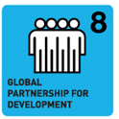

Slide 19
A global partnership for development
Target 8.A: Develop further an open, rule-based, predictable, non-discriminatory trading and financial system
Target 8.B: Address the special needs of least developed countries
Target 8.C: Address the special needs of landlocked developing countries and small island developing States
Target 8.D: Deal comprehensively with the debt problems of developing countries
Target 8.E: In cooperation with pharmaceutical companies, provide access to affordable essential drugs in developing countries
Target 8.F: In cooperation with the private sector, make available benefits of new technologies, especially information and communications
Notes:
8a - Official development assistance hit a record high of $134.8 billion in 2013.
Aid shifted away from the poorest countries where attainment of the MDGs often lags the most.
8b – Net bilateral aid to Africa (where 34 of the 48 least developed countries are located) fell by 5.6 per cent in 2013, to $28.9 billion in real terms.
Eighty per cent of imports from developing countries enter developed countries duty-free.
8c – Aid to landlocked developing countries fell in 2010 for the first time in a decade, while aid to small island developing States increased substantially.
8d – The debt burden on developing countries remains stable at about 3 per cent of export revenue, which was a near 75 per cent drop since 2000.
8e – Resources available for providing essential medicines through some disease-specific global health funds increased in 2011, despite the global economic downturn.
There has been little improvement in recent years in improving availability and affordability of essential medicines in developing countries.
8f - Two-thirds of the world’s Internet users are in developing regions, where the number of Internet users doubled between 2009 and 2014.
In 2014, Internet use penetration in developing countries grew by 8.7 per cent, twice as fast as in the developed world where its usage rose by 3.3 per cent.
In Africa, almost 20 per cent of the population are online, up from 10 per cent in 2010.
Thirty per cent of the world’s youth are digital natives, active online for at least five years.
More than four billion people do not use the Internet, and 90 per cent of them are from the developing world.

Slide 20
Transforming our world – The 2030 Agenda for Sustainable Development
What happens after 2015?
Need for a new agenda
Sustainable Development Knowledge Platform
On September 25-27, UN member states will meet at the UN General Assembly in NY to adopt a new roadmap.
Notes:
“Breaking Down the Silos: Integrating Environmental Sustainability in the Post-2015 Agenda : eight-month consultation process that engaged academia, think tanks, representatives of civil society
Integrated development (advances multiple benefits across the three
dimensions of sustainable development (social, environmental, and economic) ensures that
poverty eradication and environmental sustainability go hand-in-hand;)
Equality (in relation to access to natural resources and the benefits of a healthy environment
as well as engagement in related decision-making processes is fundamental for both
environmental sustainability and human development)
Human rights (A human rights-based approach to environmental sustainability recognizes that the realization
of human rights depends on a healthy environment)
Resilience (The resilience of communities to resist tomorrow’s shocks without reversing today’s
achievements in human well-being depends on the vital role of natural resources
and ecosystems)
A Million Voices: The World We Want - 88 national consultations, 11 thematic dialogues, and through the MY World global survey. Around 1 million participated one way or another to give their views
to finish what the MDGs started: that is there are still important goals to be achieved from the MDGs, also not just halve the amount of poor people it should be reduced to none
combat growing inequalities and insecurities: particularly for poor and marginalized people and groups
create an integrated, holistic sustainable development agenda: because the challenges are complex and interlinked they require integrated approaches with holistic views and universal to all countries and people
human rights approach with values of equality and justice: the agenda should have values base underpinned by human rights and equality and justice
keep concrete goals but improve measurement of progress: important that the goals are measurable but the improvement of measurements of progress is needed.
SDGs – conference created SDGs to emphasize the needed focus on environmental issues and sustainability (something that the thought was lacking in the MDGs)
Be based on Agenda 21 and the Johannesburg Plan of Implementation. – agenda 21 – a program of action for sustainable development for the 21st century
Fully respect all the Rio Principles. – 27 principles proclaimed at the Rio conference 92. e.g. Human beings are at the centre of concerns for sustainable development, they are entitled to a healthy and productive life in harmony with nature. To achieve sustainable development and a higher quality of life for all people, states should reduce and eliminate unsustainable patterns of production and consumption and promote appropriate demographic policies.
Be consistent with international law.
Build upon commitments already made.
Contribute to the full implementation of the outcomes of all major summits in the economic, social and environmental fields.
Focus on priority areas for the achievement of sustainable development, being guided by the outcome document.
Address and incorporate in a balanced way all three dimensions of sustainable development and their interlinkages.
Be coherent with and integrated into the United Nations development agenda beyond 2015.
Not divert focus or effort from the achievement of the Millennium Development Goals.
Include active involvement of all relevant stakeholders, as appropriate, in the process.

Slide 21
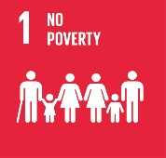
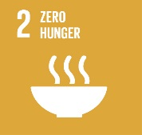
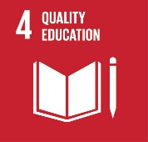
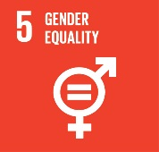
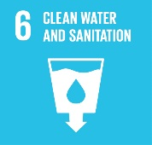
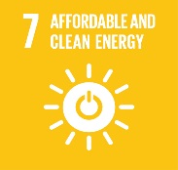
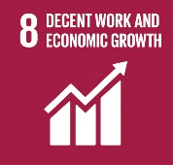
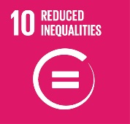
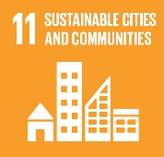
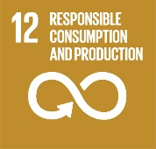
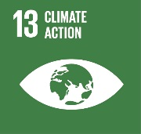
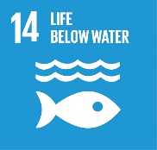
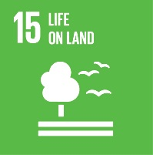
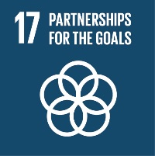
SDGs
UN Secretary general appointed a “High Level Panel of Eminent Persons” to advise on the Post-15 development agenda.
Every goal consists of several main targets.

Slide 22
SDGs
Goal 1. End poverty in all its forms everywhere
Goal 2. End hunger, achieve food security and improved nutrition, and promote sustainable agriculture
Goal 3. Ensure healthy lives and promote wellbeing for all at all age
Goal 4. Ensure inclusive and equitable quality education and promote lifelong learning opportunities for all

Slide 23
SDGs
Goal 5. Achieve gender equality and empower all women and girls
Goal 6. Ensure availability and sustainable management of water and sanitation for all
Goal 7. Ensure access to aff ordable, reliable, sustainable, and modern energy for all
Goal 8. Promote sustained, inclusive and sustainable economic growth, full and productive employment, and decent work for all

Slide 24
SDGs
Goal 9. Build resilient infrastructure, promote inclusive and sustainable industrialisation, and foster innovation
Goal 10. Reduce inequality within and among countries
Goal 11. Make cities and human settlements inclusive, safe, resilient, and sustainable
Goal 12. Ensure sustainable consumption and production patterns
Goal 13. Take urgent action to combat climate change and its impacts

Slide 25
SDGs
Goal 14. Conserve and sustainably use the oceans, seas, and marine resources for sustainable development
Goal 15. Protect, restore, and promote sustainable use of terrestrial ecosystems, sustainably manage forests, combat desertifi cation, and halt and reverse land degradation and halt biodiversity loss
Goal 16. Promote peaceful and inclusive societies for sustainable development, provide access to justice for all and build eff ective, accountable, and inclusive institutions at all levels
Goal 17. Strengthen the means of implementation and revitalise the global partnership for sustainable development

