Slide 1
Mechanisms of Relaxation of Vascular Smooth Muscle
1. Increasing cGMP: cGMP facilitates the dephosphorylation of myosin light chains, preventing the interaction of myosin with actin. Nitric oxide is an effective activator of soluble guanylyl cyclase and acts mainly through this mechanism. Important molecular donors of nitric oxide include nitroprusside and the organic nitrates used in angina. Atherosclerotic disease may diminish endogenous endothelial NO synthesis, thus making the vascular smooth muscle more dependent upon exogenous sources of NO.

Slide 2
Mechanisms of Relaxation of Vascular Smooth Muscle
2. Decreasing intracellular Ca²⁺: Calcium channel blockers predictably cause vasodilation because they reduce intracellular Ca²⁺, a major modulator of the activation of myosin light chain kinase (Figure 12–1) in smooth muscle.
Beta blockers and calcium channel blockers also reduce Ca²⁺influx in cardiac muscle fibers, thereby reducing rate, contractility, and oxygen requirement under most circumstances.

Slide 3
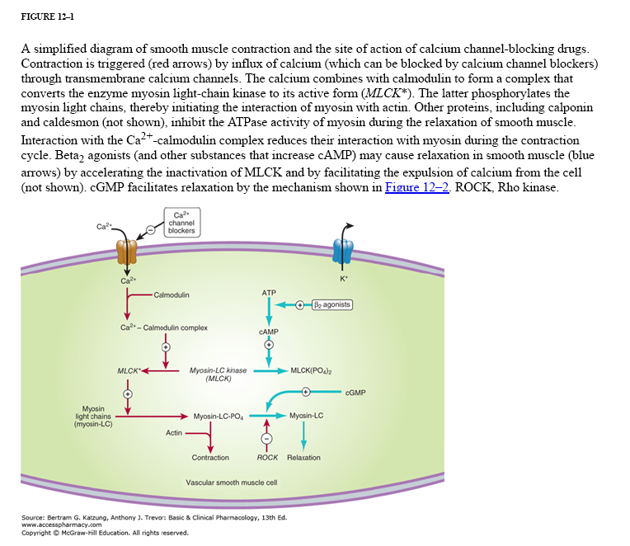

Slide 4
Mechanisms of Relaxation of Vascular Smooth Muscle
3. Stabilizing or preventing depolarization of the vascular smooth muscle cell membrane: The membrane potential of excitable cells is stabilized near the resting potential by increasing potassium permeability. cGMP may increase permeability of Ca²⁺-activated K⁺ channels. Potassium channel openers, such as minoxidil sulfate (see Chapter 11) increase the permeability of K⁺ channels, probably ATP-dependent K⁺ channels.

Slide 5
Mechanisms of Relaxation of Vascular Smooth Muscle
4. Increasing cAMP in vascular smooth muscle cells: As shown in Figure 12–1, an increase in cAMP increases the rate of inactivation of myosin light chain kinase, the enzyme responsible for triggering the interaction of actin with myosin in these cells. This appears to be the mechanism of vasodilation caused by β₂ agonists, drugs that are not used in angina (because they cause too much cardiac stimulation), and by fenoldopam, a D₁ agonist used in hypertensive emergencies.

