Slide 1
MICROBIOLOGY
OF CARDITIS
Dr. Sameer Naji, MB, BCh, PhD (UK)
Assistant Professor
Head of Dept. of Basic Medical Sciences
Faculty of Medicine
The Hashemite University
Edited by: Mohammad Qussay Al-Sabbagh

Slide 2
Intravascular Infections, Bacteremia, and Endotoxemia
In many cases the presence of circulating microorganisms in the blood is either a part of the natural history of the infectious disease or a reflection of serious, uncontrolled infection. Depending on the class of agent involved, this process is described as viremia, bacteremia, fungemia, or parasitemia.
The terms sepsis and septicemia refer to the major clinical symptom complexes generally associated with bacteremia. (While bacteremia means presence of the bacteria only, with or without symptoms)

Slide 3
The clinical findings may develop acutely, as in septic shock, or slowly, as in most forms of infective endocarditis. Viremia is usually a very early, even prodromal, event accompanied by fever, malaise, and other constitutional symptoms, such as muscle aches. With the exception of a few specific infections, the detection of viremia does not play a role in the diagnosis or management of viral infections.
The presence of bacteremia defines some of the most serious and life-threatening situations in medical practice, and it has a marked impact on the management and outcome of bacterial infections.
constitutional symptom: a symptom that affects the general well-being or generalstatus of a patient. Examples include weight loss, shaking,chills, fever, and vomiting

Slide 4
Bacteremia or fungemia may also result from microbial growth on the inner or outer surfaces of intravenous devices (ex: cannula, catheterization or central venous line). Clinical manifestations may be minor initially, but may later become severe.
Because the bloodstream is sterile in healthy individuals, bacteremia is considered potentially serious regardless of the symptoms present; however, transient bacteremia may occur when there is manipulation or trauma to a body site that has a normal flora. After such events, species indigenous to the site may appear briefly in the blood, but they are soon cleared (forming antigen-antibody comolexes) . Such transient bacteremias usually have no immediate clinical significance, but they are important in the pathogenesis of infective endocarditis.

Slide 5
INTRAVASCULAR INFECTION
Intracardiac infections (endocarditis) and those primarily involving veins thrombophlebitis) or arteries (endarteritis) are usually caused by bacteria, although other agents including fungi and viruses have been occasionally implicated.
Infections of the cardiovascular system are usually extremely serious and, if not promptly and adequately treated, can be fatal. They commonly produce a constant shedding of organisms into the bloodstream that is often characterized by continuous, low-grade bacteremia (1 to 20 organisms / mL of blood) in untreated patients.

Slide 6
Infective Endocarditis
The term infective endocarditis is preferable to the commonly used term bacterial endocarditis, simply because not all infections of the endocardial surface of the heart are caused by bacteria.
Most infections occur on natural or prosthetic cardiac valves, but can also develop on septal defects (VSD and ASD) , shunts (eg, patent ductus arteriosus), or the mural endocardium.
Infections involving coarctation of the aorta are also classified as infective endocarditis??! because the clinical manifestations and complications are similar.

Slide 7
Pathogenesis
The pathogenesis of infective endocarditis involves several factors that, if concurrent, result in infection:
1. The endothelium is altered to facilitate colonization by bacteria and deposition of platelets and fibrin. Most infections involve the mitral or aortic valves (if affects the left site, as it faces high pressure blood) , which are particularly vulnerable when abnormalities such as valvular insufficiency, stenosis, intracardiac shunts (eg, ventricular septal defect), or direct trauma (eg, catheters) exist.
The turbulence of intracardiac blood flow that results from such abnormalities can lead to further irregularities of the endothelial surfaces that facilitate platelet and fibrin deposition. These factors produce a potential nidus(أرضية/أساس) for colonization and infection.

Slide 8
Very important slide
2. Transient bacteremia is common, but it is usually of no clinical importance. Often seen for a few minutes after a variety of dental procedures, it has also been shown to develop after normal childbirth and manipulations such as bronchoscopy, sigmoidoscopy, cystoscopy, and some surgical procedures. Even simple activities such as tooth brushing or chewing candy can cause such bacteremia. (Very important)
The organisms responsible for transient bacteremia are the common surface flora of the manipulated site such as viridans streptococci (oropharynx) and are usually of low virulence. Other, more virulent strains may also be involved, however; for example, intravenous drug abuse may lead to transient bacteremia with Staphylococcus aureus or a variety of Gram negative aerobic and anaerobic bacteria.
Whether or not the organisms causing bacteremia (or fungemia) are of high virulence, they can colonize and multiply in the heart if local endothelial changes are suitable.

Slide 9
3. Circulating organisms adhere to the damaged surface, followed by complement activation, inflammation, fibrin, and platelet deposition and further endothelial damage at
the site of colonization. The resulting entrapment of organisms in the thrombotic “mesh” platelets, fibrin, and inflammatory cells leads to a mature vegetation, which protects the organisms from host humoral and phagocytic immune defenses, and to some extent from antimicrobial agents. As a result, the infection can be exceedingly difficult to treat.
The vegetation can also create greater hemodynamic alterations in terms of obstruction to flow and increased turbulence. Parts of vegetations may break off and be deposited in smaller blood vessels (embolization) with resultant obstruction and secondary sites of infection. Emboli may be transported to the brain or coronary arteries, for example, with disastrous results.

Slide 10
Another phenomenon shown to contribute to the infective endocarditis syndrome is the development of circulating immune complexes of microbial antigen and antibody. These complexes can activate complement and contribute to many of the peripheral manifestations of the disease, including nephritis, arthritis, and cutaneous vascular lesions.
Frequently, there is a widespread stimulus to host cellular and humoral immunity, particularly if the infection continues for more than about 2 weeks. This condition is characterized by hyperglobulinemia, splenomegaly, and the occasional appearance of macrophages in the peripheral blood.

Slide 11
Some patients develop circulating rheumatoid factor (IgM anti-IgG antibody), which may play a deleterious role by blocking IgG opsonic activity and causing microvascular damage. Antinuclear antibodies, which also appear occasionally, may contribute to the pathogenesis of the fever, arthralgia, and myalgia that is often seen.
In summary, infective endocarditis involves an initial complex of endothelial damage or abnormality, which facilitates colonization by organisms that may be circulating through the heart. This colonization, in turn, leads to the propagation of a vegetation, with its attendant local and systemic inflammatory, embolic, and immunologic complications.
Important

Slide 12
Clinical Features
Infective endocarditis has often been classified by the progression of the untreated disease.
Acute endocarditis is generally fulminant(شديد) with high fever and toxicity, and death may occur in a few days or weeks. Subacute endocarditis progresses to death over weeks to months with low-grade fever, night sweats, weight loss, and vague constitutional complaints. The clinical course is substantially related to the virulence of the infecting organism; S. aureus, for example, usually produces acute disease, whereas infections by the otherwise avirulent viridans streptococci are more likely to be subacute.
Before the advent of antimicrobial therapy, death was considered inevitable in all cases.
Physical findings often include a new or changing heart murmur, splenomegaly, various skin lesions (petechiae, splinter hemorrhages, Osler’s nodes, Janeway’s lesions “read only” ), and retinal lesions.

Slide 13
Complications include the risk of
congestive heart failure as a result of hemodynamic alterations,
rupture of the chordae tendinea of the valves, or perforation Abscesses of the myocardium or valve ring can also develop.
Other complications relate to the immunologic and embolic phenomena that can occur.
The kidney is commonly affected, and hematuria is a typical finding. Renal failure, presumably from immune complex glomerulonephritis, is possible.
Left-sided endocarditis can readily lead to coronary artery embolization and “mycotic” aneurysms. In addition, more distant emboli to the central nervous system can lead to cerebral infarction and infection. Right-sided endocarditis often causes embolization and infarction or infection in the lung.

Slide 14
Etiologic Agents
Alphahemolytic streptococci and enterococci are involved in just over 50% of the cases.
In the so called culture-negative group, infective endocarditis is diagnosed on clinical grounds, but cultures do not confirm the etiologic agent. This group of patients is difficult to treat, and the overall prognosis is considered poorer than when a specific etiology has been determined.
Negative cultures may result from:
1. prior antibiotic treatment;
2. fungal endocarditis with entrapment of these relatively
large organisms in capillary beds; (fungal blood cultures need longer incubation than bacteria)

Slide 15
3. fastidious, nutritionally deficient, or cell wall-deficient
organisms that are difficult to isolate;
4. infection caused by obligate intracellular parasites, such as
chlamydiae (Chlamydia psittaci), rickettsiae (Coxiella
burnetii), Rochalimaea species, or viruses;
5. immunologic factors (eg, antibody acting on circulating
organisms); or
6. subacute endocarditis involving the right side of the heart, in
which the organisms are filtered out in the pulmonary
capillaries.
Some special circumstances alter the relative etiologic possibilities, such as intravenous drug addiction, prosthetic valves, and immunocompromise.

Slide 16
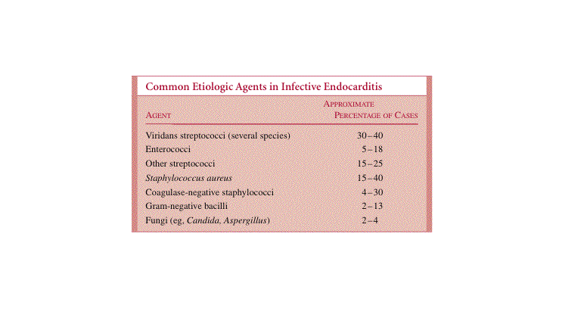
Memorize first 4

Slide 17
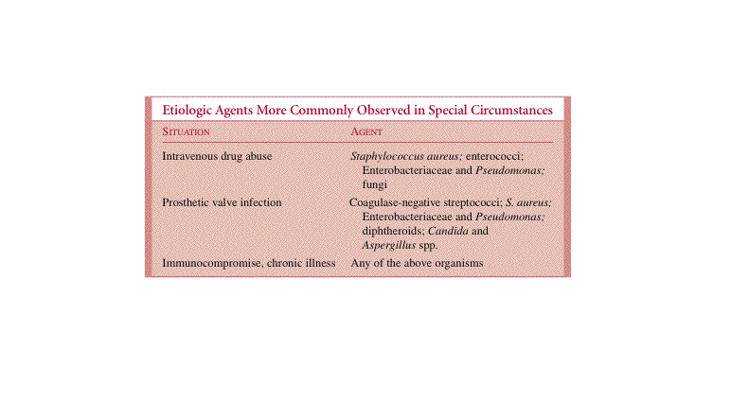
Correction:
Coagulase –ve staphylococci

Slide 18
General Diagnostic Approaches
The diagnosis of infective endocarditis is usually suspected on clinical grounds; however, he most important diagnostic test for confirmation is the blood culture. In untreated cases, the organisms are generally present continuously in low numbers (1 to 20/ mL) in the blood. If an adequate volume of blood is obtained, the first culture will be positive in over 95% of culturally confirmed cases. Most authorities recommend three cultures over 24 hours to ensure detection, and an additional three if the first set is negative. Multiple cultures yielding the same organism support the probability of an intravascular or intracardiac infection.
In acute endocarditis, the urgency of early treatment may require collection of only two or three cultures within a few minutes so that antimicrobial therapy can begin.
Cardiologic procedures such as transthoracic or transesophageal echocardiography can delineate the nature and size of the vegetations and progression of disease. They are also helpful in prediction of some complications such as embolization.
One set of blood culture: two bottles, the first is aerobic and the second is for anaerobic Bacteria

Slide 19
General Principles of Management
Because of the nature of the lesions and their pathogenesis, response to therapy may be low and cure is sometimes difficult. Therefore, specific antimicrobial therapy must be aggressive, using agents that are bactericidal (rather than bacteriostatic) and can be given in amounts that achieve high continuous blood levels without causing toxicity to the patient.
Treatment may involve a single antimicrobial if the organism is highly susceptible in vitro, or antimicrobial combinations if synergistic effects are possible (eg, a penicillin and an aminoglycoside for enterococcal endocarditis). Parenteral therapy is begun to produce adequate blood levels, and the patient may need to be monitored frequently to ensure antimicrobial activity in the serum sufficient to kill the organisms without causing unnecessary toxicity.
Therapy is usually prolonged, lasting longer than 4 weeks in most cases.
In some cases, surgery may be required to excise the diseased valve and replace it with a valvular prosthesis. The decision for surgery is sometimes difficult, requiring consultation with both a cardiologist and a surgeon.

Slide 20
Prophylaxis can prevent the development of endocarditis in persons with known congenital or acquired cardiac lesions that predispose to bacterial endocarditis.
When they undergo procedures known to cause transient bacteremia (eg, dental manipulations or surgical procedures involving the upper respiratory, gastrointestinal, or genitourinary tracts), administration of high doses of antimicrobics is begun just before the procedure and continued for 6 to 12 hours thereafter.

Slide 21
An example of prophylaxis is the case of a patient with rheumatic valvular disease who is planning to undergo dental work.
The organism most likely to produce transient bacteremia would be a penicillin-sensitive member of the oral flora, especially viridans streptococci. Thus, an intramuscular dose of penicillin or ampicillin within 30 minutes before the procedure, followed by a high dose of intramuscular penicillin or oral amoxicillin 6 hours later, would be expected to afford protection.
Several regimens similar to this approach are recommended, depending on the patient, the nature of the procedure, and the organisms that might be expected to be involved.
Note: group A streptococcal infection may lead to rheumatic valvular disease and glomerulonephritis, but not both. As a result of the homology between Strep. A antigens and some cardiac or renal antigens in some patients.

Slide 22
Mycotic Aneurysm
The term mycotic aneurysm is somewhat misleading, because it suggests infection by fungi.
Originally used by Sir William Osler to describe the mushroom-shaped arterial aneurysm that can develop in patients with infective endocarditis, the term now applies to infection with any organism that causes inflammatory damage and weakening of an arterial wall with subsequent aneurysmal dilatation.
This sequence can progress to rupture, with a fatal outcome.

Slide 23
Read only
Arterial infection can result from direct extension of an intracardiac infection or from septic microemboli from a cardiac focus, with seeding of vasa vasorum within the arterial wall. In addition to infective endocarditis, other predisposing factors include damaged arterial intima by atherosclerotic plaques, vascular thrombi, congenital malformations, trauma, or spread from a contiguous focus of infection directly into the artery.
The clinical features vary according to the site of involvement. Common findings may include pain at the site of primary arterial supply (eg, back or abdominal pain in abdominal aortic infections) and fever.
In many cases, the initial presentation is the result of a catastrophic hemorrhage, particularly intracerebral aneurysms. The etiologic agents, diagnosis, and management are similar to infective endocarditis.

