Slide 1
Hematopoietic malignancies
Myeloid
Lymphoid
Histiocytic

Slide 2
Myeloid neoplasms
(1) Myeloproliferative neoplasms
(2) Myelodysplastic syndromes
(3) Acute myeloid leukemia
Features:
Recurrent genetic mutations
Increased bone marrow cellularity
Tendency to progress to AML
Risk factors:
Chemicals (benzen, pesticides), radiation, congenital diseases (Fanconi), smoking, PNH

Slide 3
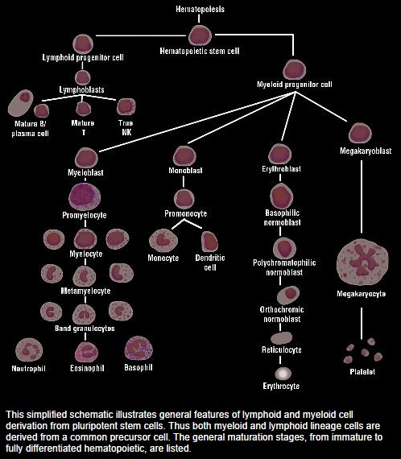
Normal Adult cell count in BM aspirate smear
Blasts: <5%
Monocytes: <5%
M:E 3-4
Plasma cells: <3%

Slide 4
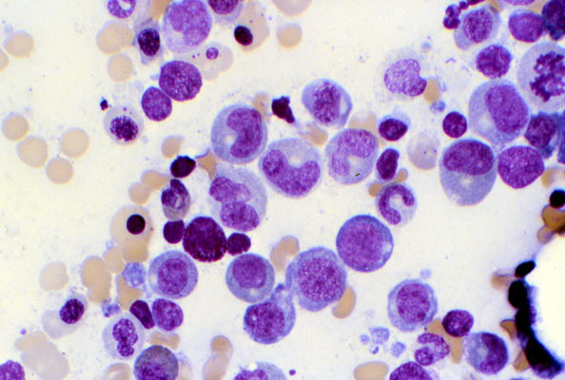
Aspirate smear from bone marrow shows normal myelogenesis and erythropoiesis

Slide 5
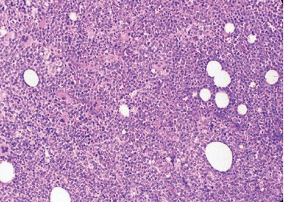
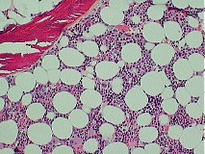
Normal bone marrow cellularity depends on age (100-age)%

Slide 6
Myeloproliferative neoplasms
Chronic disorders
hyperproliferation of neoplastic myeloid progenitors that retain the capacity for terminal differentiation
Mutation in tyrosine kinase proteins which results in permanent activation of growth factors
Persistent peripheral blood cytosis (one or more lines)
The neoplastic progenitors tend to seed secondary hematopoietic organs (the spleen, liver, and lymph nodes), resulting in hepatosplenomegaly (caused by neoplastic extramedullary hematopoiesis)

Slide 7
Chronic myelogenous leukemia
a balanced (9;22) translocation that moves ABL from chromosome 9 to a position on chromosome 22 adjacent to BCR
The new chr22 is known as Philadelphia chromosome
The BCR-ABL fusion gene has a tyrosine kinase activity, stimulating the proliferation and prolonged survival of granulocytic and megakaryocytic cells

Slide 8
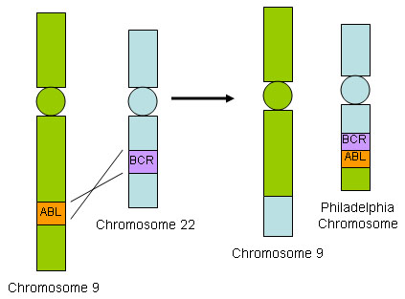

Slide 9
manifestations
Peripheral blood shows markedly increased WBC count, sometimes exceeding 100,000 cell/uL
Most of the cells are neutrophils, metamyelocytes and myelocytes
Basophils and eosinophils are also increased
Thrombocytosis and anemia are common
The bone marrow is hypercellular owing to increased numbers of granulocytic and megakaryocytic precursors
Spleen is enlarged with extramedullary hematopoiesis

Slide 10
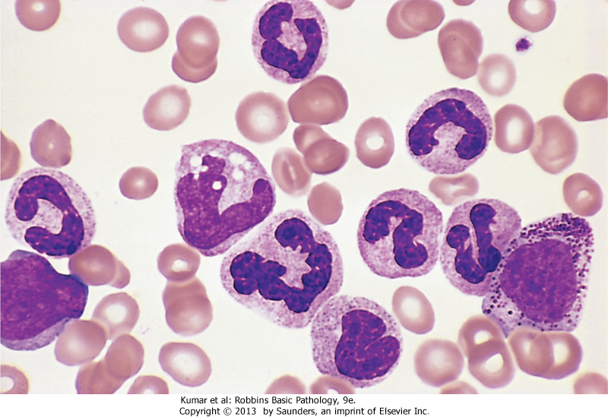
Chronic myelogenous leukemia-peripheral blood smear. Granulocytic forms at various stages of differentiation are present

Slide 11
Primary Myelofibrosis
Brief period of granulopoiesis and megakaryopoiesis, rapidly followed my BM fibrosis and elimination of hematopoietic elements
The fibroblast proliferation is stimulated by platelet-derived growth factor and transforming growth factor β released from neoplastic megakaryocytes
Hematopoiesis takes place in spleen and liver
RBC’s escaping the fibrotic stroma in BM are deformed and take the shape of “tear-drops”

Slide 12
Manifestations
BM is initially hypercellular with increased atypical megakaryocytes
PB: leukocytosis, shift to left, thrombocytosis, anemia, nucleated RBCs, tear drop cells
Later in disease, become fibrotic and hypocellular, pancytopenia
Spleen shows marked extramedullary hematopoiesis

Slide 13
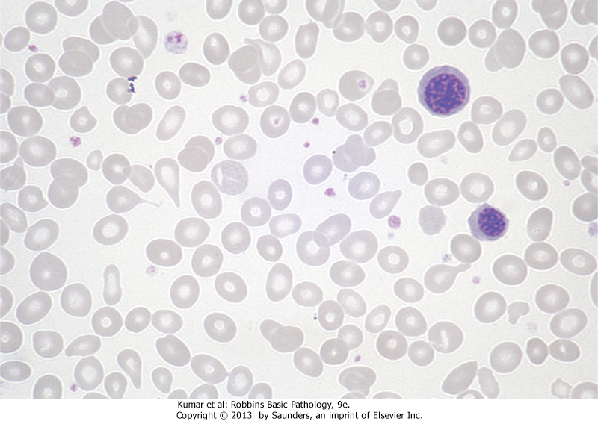
Two nucleated erythroid precursors and several teardrop-shaped red cells are evident

Slide 14
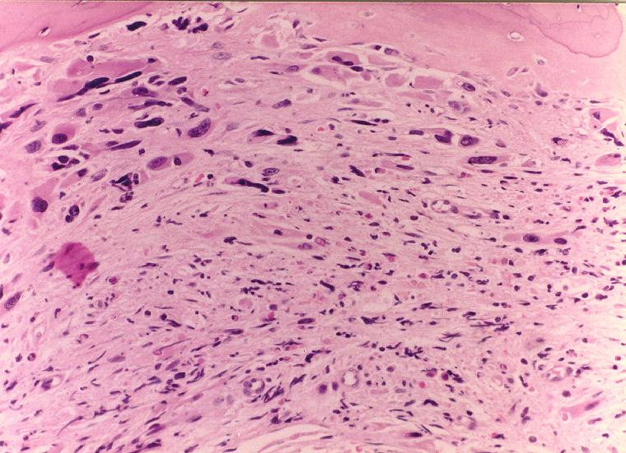
BM biopsy shows hypocellular marrow, spindle shaped stroma and atypia of megakaryocytes

Slide 15
Essential Thrombocythemia
Chronic MPN involves primarily megakaryocytes
Sustained thrombocytosis (>450x10⁹/L)
Increased number of large mature megs
Tendency for thrombosis and hemorrhage
+ Jak2 in 50%
No BM fibrosis
+/- splenomegaly

Slide 16
ET: left: increased number of megakaryocytes. Right: megakaryocytes are large, mature with hyperlobated nuclei

Slide 17
Myelodysplastic syndromes
Group of clonal stem cell disorders characterized by maturation defects that are associated with ineffective hematopoiesis
Hematopoietic cells are morphologically abnormal, stay within the bone marrow and hence the patients have peripheral blood cytopenias
The hallmark of MDS is persistent (refractory) peripheral cytopenia and BM morphologic dysplasia

Slide 18
Pathogenesis
Cytogenetic analysis commonly reveals chromosomal aberrations
Primary (idiopathic): more common, risk factors?
Secondary (therapy related): History of chemotherapy or radiotherapy 2-8 years ago
All forms of MDS can transform to AML, but transformation occurs with highest frequency and most rapidly in t-MDS

Slide 19
Findings
Erythroid: megaloblastoid nuclei, nuclear/cytoplasmic asynchrony, multinucleation, ring sideroblasts
Granulocytes: hyposegmented nuclei, hypogranular cytoplasm
Megakaryocytes: small size, hypolobated nuclei
Dysplasia can occur in a single or multiple lines
With time, blast increases (5-19%), and can progress to acute leukemia

Slide 20
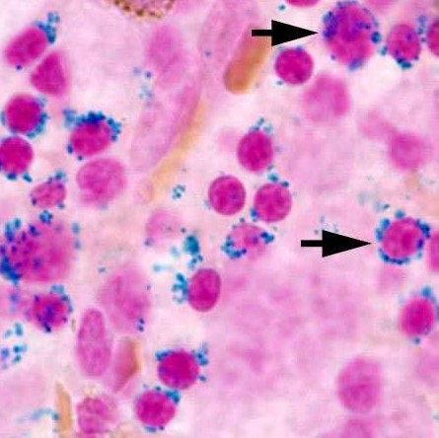
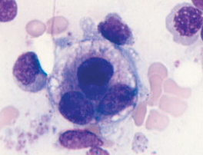
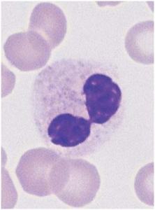
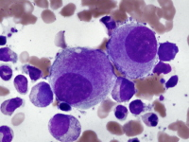
Upper left: ring sideroblasts (iron stain), upper right: dysplastic erythroid precursor (multinucleation), lower right: dysplastic mega (small, hypolobated), middle: dysplastic neutrophil (hypogranulated cytoplasm, hyposegmented nucleus)

